Slide 1
UEENEEG107A : Select wiring systems and cables for low voltage general electrical installations
Topic’s
Performance requirements - design and safety
Final subcircuit arrangements
Factors affecting the suitability of wiring systems
Maximum demand on consumer’s mains/submains
Cable selection based on current carrying capacity requirements
Cable selection based on voltage drop requirements
Cable selection based on fault loop impedance requirements
Selecting protection devices
Selecting devices for isolation and switching
Switchboards

Slide 2
Work Books Required for UEENEEG1O7A and UEENEEG103A
AS/NZS 3000/2007 Amendment 2
AS/NZS 3008/2009 Amendment 1
Service & Installation Rules of New South Wales August 2012, Amendment June 2015

Slide 3
Performance requirements - design and safety encompassing:
harmful effects against which the design of an electrical installation must provide protection.
performance standards of a correctly functioning electrical installation.
supply characteristics that shall be considered when designing an electrical installation.
acceptable methods for determining the maximum demand in consumer's mains and sub-mains.
AS/NZS 3000 requirements limiting voltage drop in an installation.
reason for dividing electrical installations into circuits and the factors that shall determine their number and type.
typical external factors that may damage an electrical installation and that shall be considered in the installation design.
methods for protecting persons and livestock against direct and indirect contact with conductive parts and the typical application of each.

Slide 4
Performance requirements - design and safety encompassing: Continued
acceptable methods of protection against the risks of ignition of flammable materials and injury by burns from the thermal effects of current, in normal service.
likely sources of unwanted voltages and the methods for dealing with this potential hazard.
acceptable methods for protecting persons and livestock against injury and property against damage from the effects of over current.
requirement for protection against fault current.
requirement for protection against the harmful effects of faults between live parts of circuits supplied at different voltages.
need for protection against injury from mechanical movement and how this may be achieved.
features of 'fire rated construction' and how the integrity of the fire rating can be maintained in relation to electrical installation.

Slide 5


AS3000 clause 1.5.1
Read AS 3000 clause 1.5.1
1. What 3 items require protection? | a) PERSONS b) LIVESTOCK c) PROPERTY
2. What are the 3 major risks? | a) SHOCK CURRENT b) EXCESSIVE TEMPERATURE c) EXPLOSIVE ATMOSPHERES
Ac

Slide 6
Design Considerations
Electrical loads
Circuit system design
Environmental aspects
Client requirements
Type of service
Legislation
Local service rules
AS/NZS 3000:2018 Section 1.6

Slide 7
AS/NZS 3000:2018 Section 1.6
Activity 2 – page 9
Designed to protect persons, livestock and property from harmful effects
Function as intended
Be compatible with electricity distribution system
Minimise inconvenience in the event of a fault
Facilitate safe operation, inspection, testing and maintenance

Slide 8
Supply characteristics need to be determined: clause 1.6.2
Activity 3 – page 10
AC or DC
number of conductors – 1Ø, 2Ø, 3Ø
voltage – 230/400 V +10% to - 6%
frequency
maximum demand
prospective short circuit current
earthing system – MEN
limits on use of equipment
harmonics

Slide 9
Activity 4 – supply characteristics
 | Use AS 3000 2007 rule 1.6.2 (C) to complete the following activities:
Calculate the maximum permissible supply voltage for a single phase 230 V installation.
2. Calculate the minimum permissible supply voltage for a single phase 230 V installation.
3. Calculate the maximum permissible supply voltage for a three phase 400 V installation.
4. Calculate the minimum permissible supply voltage for a three phase 400 V installation.
230 + (230 x 10%) = 253 V
230 - (230 x 6%) = 216.2 V
400 + (400 x 10%) = 440 V
400 - (400 x 6%) = 376 V

Slide 10
Activity 5 – Maximum demand of consumers and sub mains
Clause 2.2.2
Calculation
Assessment
Measurement
Limitation
The most commonly used methods of determining maximum demand are, for;
Consumers mains _____(a) and (b)___________
Sub mains _____(a) and (c)___________
Final sub-circuits _____(d) and current rating___

Slide 11
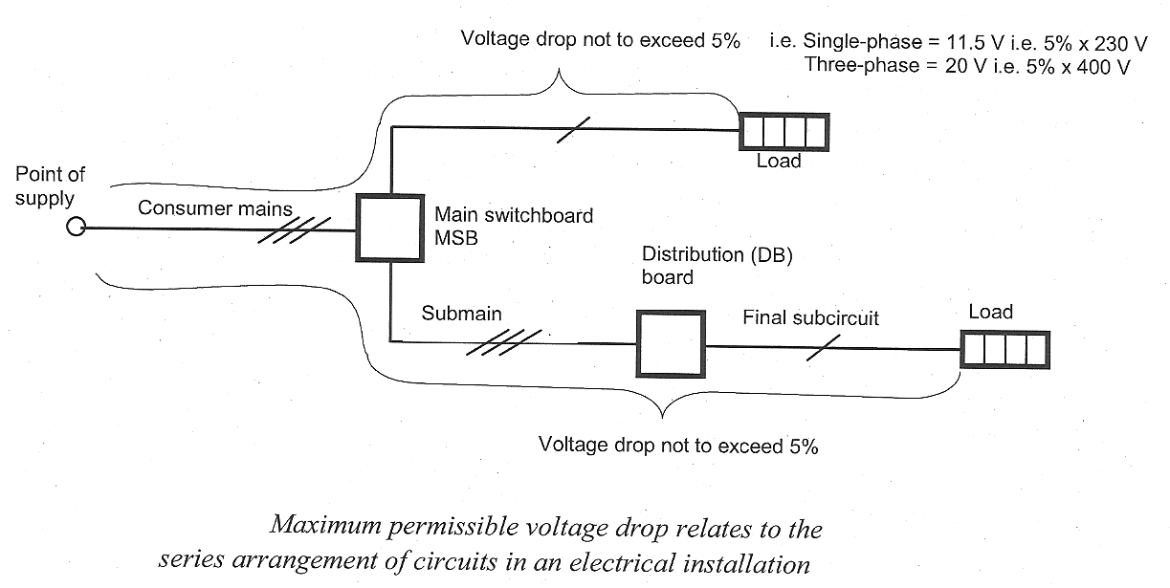

Slide 12
Activity 6 – Limiting voltage drop
Clause 3.6.2
What permissible percentage of the nominal supply voltage is permitted as voltage drop between the point of supply and electrical equipment in a 230 volt installation?
2. What permissible percentage of the nominal supply voltage is permitted as voltage drop between the point of supply and electrical equipment in a 400 volt installation?
3. What is the maximum value of voltage drop permitted for a single phase 230 volt installation?
4. What is the maximum value of voltage drop is permitted for a three phase 400 volt installation?
5%
5%
230 – (230 x 5%) = 218.5V
400 – (400 x 5%) = 380 V

Slide 13

Activity 7 – Permissible Voltage drop
Figure 5 is a 230 V single phase installation. Determine the total conductor voltage drop.
Does the circuit of figure 5 comply with Australian standards (yes/No) why?
8 + 3 = 11 V
Yes – less than 11.5 V
figure 5.

Slide 14
Activity 8 – 22 V, no – must be less than 20 V
Activity 9 – 20 – 15 = 5 V
Activity 10 – Does not comply
Activity 11 – 3 + 3.5 + 4 = 10 .5 V, Yes
Activity 12 – 8 +3 + 6 = 17 V, Yes
Activity 13 – 20 – (4 + 10) = 6 V

Slide 15
Separate circuit arrangements make it possible to:
Activity 14 – clause 1.6.5
limit the effects of a fault – overload/ RCD
simplify fault finding
Carry out maintenance work, testing or circuit extension without interrupting the whole electrical installation

Slide 16
Consumers mains - are used to connect the entire installation to the
street supply at only one point for ease of isolation.
Sub-mains - connect between switchboards, no load is connected
directly to a sub-main.
Final Sub-Circuits - connect the load to the switch board,

Slide 17
The following circuit groups are used:
Activity 15
lighting – indoor, outdoor, communal
socket outlets – 10 A, 15 A, 20 A
cooking – ranges, cooktops, ovens
fixed space heating – air conditioning
water heating – instantaneous, storage, spa, swimming pool
power circuits for fixed plant – lifts, motors, welding machines

Slide 18
The electrical installation must:
safely deliver maximum demand
be protected against
  - over current
  - fault current
  - earth leakage
be controlled by main switch(es)
be certified that it is electrically safe
have documentation of all design aspects

Slide 19
How many circuits?
The number and type of circuits required is determined by the load on the circuit, the location of the loads, any seasonal variations and any special conditions

Slide 20
External influences
Activity 16 – clause 1.5.14
Ambient temperature
Humidity
Altitude
Ultraviolet levels
Presence of water
Presence of foreign bodies
Presence of corrosive substances
Mechanical stress impact
Flora and fauna

Slide 21
Protection for safety
In electrical installations two major types of risk exist
- shock currents from direct or indirect contact
- excessive temperatures likely to cause burns and fires

Slide 22
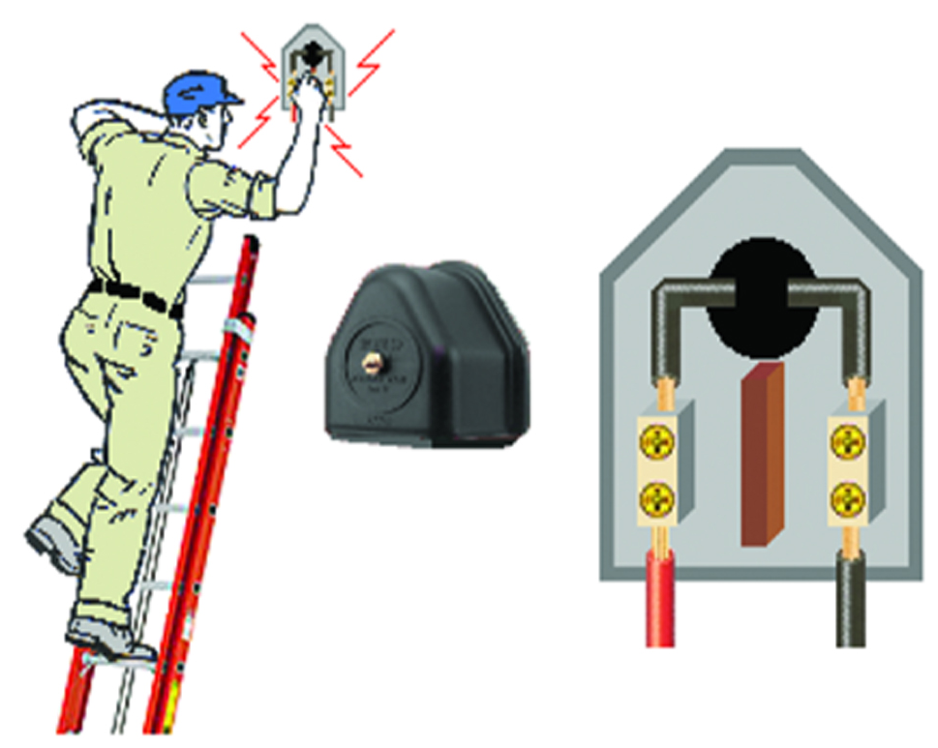
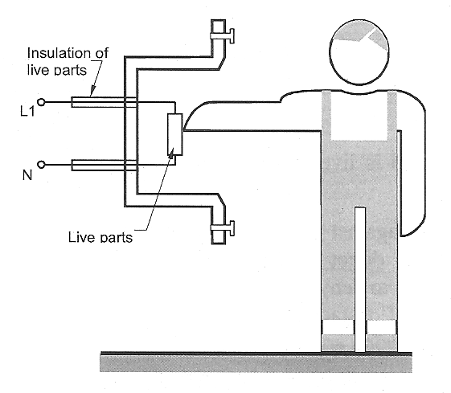
Activity 17 – Direct contact
Clause 1.4.34
Contact with conductors or conductive parts that are supposed to be alive.

Slide 23
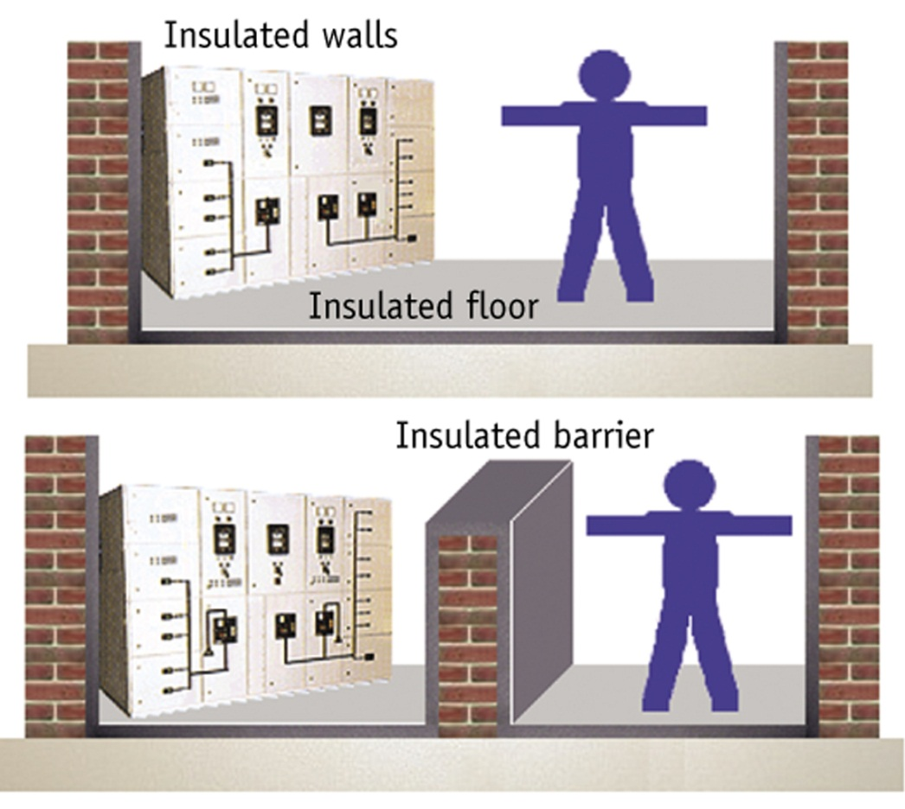
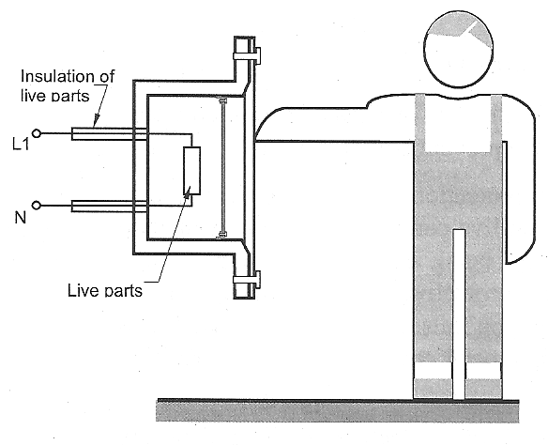
Activity 18 – Protection against direct contact
Clause 1.5.4
Insulation
Barriers
Obstacles
Placing out of reach

Slide 24
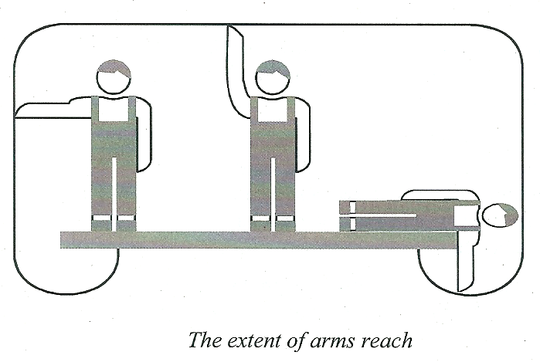
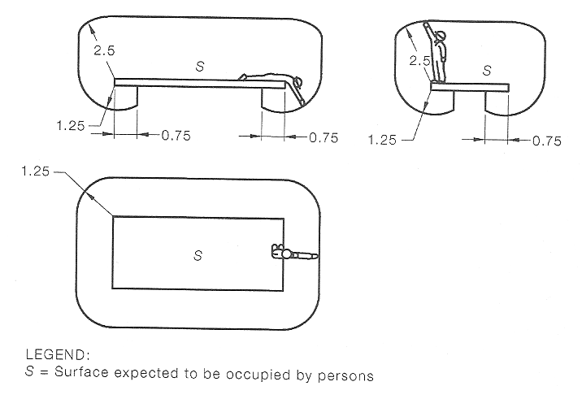
Activity 19 – Arms reach
Clause 1.4.12
2.5 m
1.25 m

Slide 25
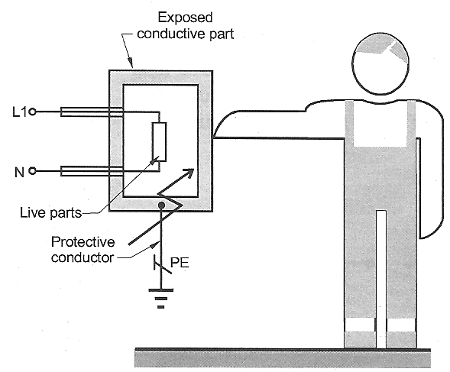
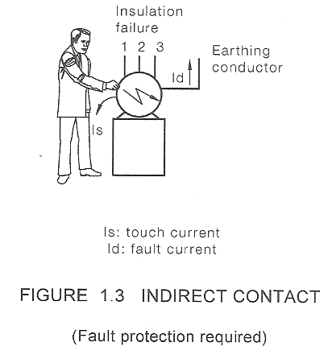
Activity 20 – Indirect contact
Clause 1.4.35
Contact with a conductive part that has become live under fault conditions

Slide 26
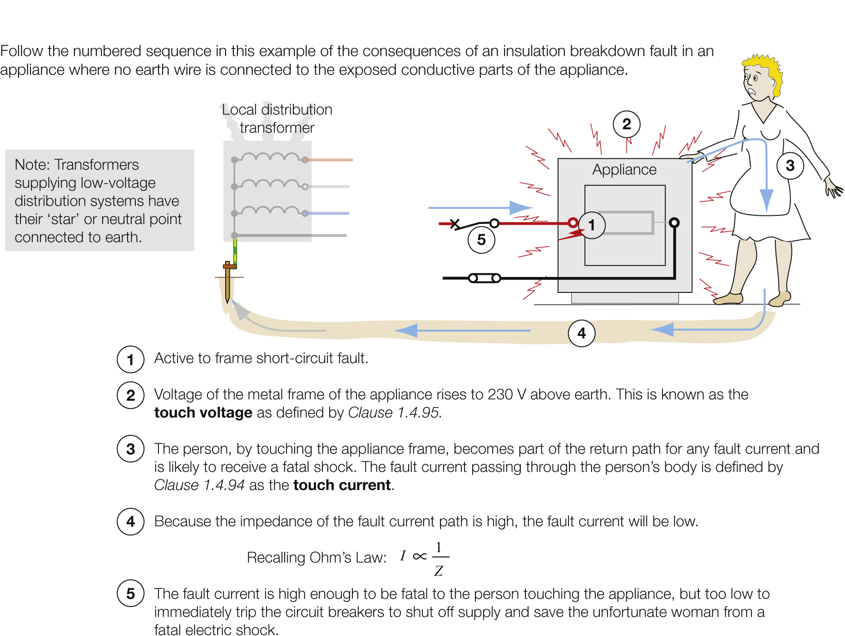

Slide 27
Activity 21 – Protection against indirect contact (fault protection)
Clause 1.5.5.2
Automatic disconnection (circuit breakers)
Class II (double ) insulation
Electrical separation (isolation transformers)
Use extra low voltage systems

Slide 28
Activity 22 – Protection by automatic disconnection of supply
Clause 1.5.5.3
A.C. 50 V D.C. 120 V
0.4 s
5 s
Yes – clause 1.5.6.2

Slide 29
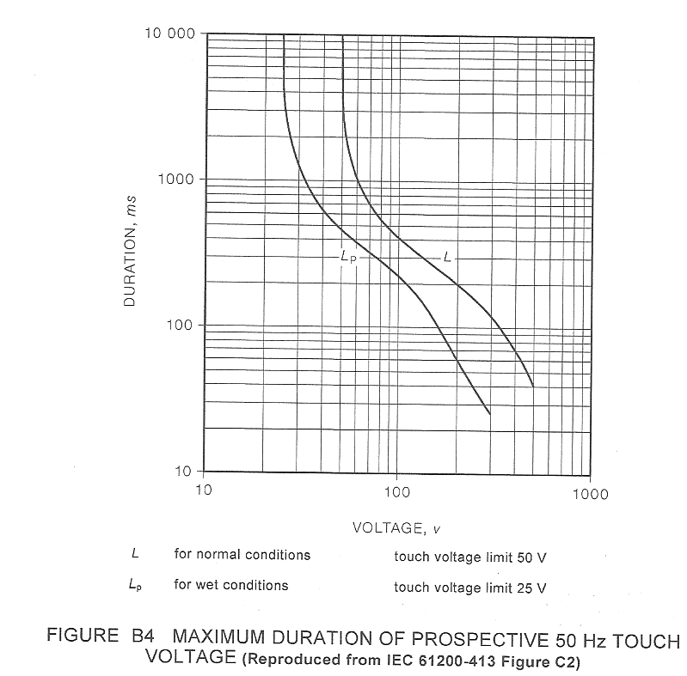
Activity 23 – Disconnection times
Figure B4
400 ms
2.5 s

Slide 30
Activity 24 – Protection against thermal effects
Clause 1.5.8
Equipment is to be installed so that surrounding materials will not get hot enough to ignite.

Slide 31
Activity 25 – Protection against thermal effects
Clause 4.2.2.3
Mount electrical equipment on material that can withstand the heat
Screen electrical equipment by material that can withstand the heat
Mount a sufficient distance from combustible material

Slide 32
Activity 26 – Protection against burns
Clause 4.2.3 Table 4.1
Metallic 55ºC, non-metallic 65ºC
Metallic 70ºC, non-metallic 80ºC
Metallic 80ºC, non-metallic 90ºC

Slide 33
Activity 27 – Protection against over currents
Clause 1.4.37
Fault current – caused by insulation failure
Clause 1.4.38
Overload current – excessive current caused by too high a load
Clause 1.4.39
Short circuit current – active to active, active to neutral or active to earth current

Slide 34
Activity 28 – Protection against the effects of over current
Clause 1.5.9
Automatic disconnection of supply
Limiting the maximum current to a safe value

Slide 35
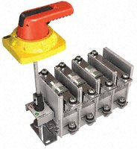
Activity 29 – Devices for protection against the effects of over current
Clause 2.5.2
1. a) circuit breakers with short circuit and over current mechanisms
b) fuse-combination units
c) HRC fuses
d) circuit breakers with HRC fuses
2. Semi-enclosed rewireable fuses
3. No, combination MCB/ RCD yes

Slide 36
Activity 30 – Protection against earth fault current
Clause 1.5.10
Earthing conductors must be capable of carrying earth fault current without overheating.

Slide 37
Activity 31 – Protection against abnormal voltage
Clause 1.5.11
Faults between circuits of different voltages
Induced voltages in unused cables
Harmful influence between different circuits and installations
Lightning
Switching operations
Resonance

Slide 38
Activity 32 – protection against abnormal voltages
Clause 1.5.11.4
Unused cable are to be terminated at each end.

Slide 39
Activity 33 – Protection for circuits operating at different voltages
Clause 1.4.98
Extra low voltage not exceeding 50 V a.c and 120 V d.c.
Low voltage not exceeding 1 000 V a.c and 1 500 V d.c.
Exceeding low voltage.

Slide 40
Activity 34 – Protection of circuits at different voltage levels
Clause 1.5.11.2
Segregation
Installation of overvoltage protection

Slide 41
Activity 35– Protection against injury from mechanical movement
Clause 1.5.13
Mechanical maintenance
Emergency stopping

Slide 42
Activity 36 – Emergency switching
Clause 2.3.5.1
Machinery
Conveyors
Teaching laboratories
Kitchens
ventilation

Slide 43
Activity 37 – Shutting down for mechanical maintenance
Clause 2.3.6.1
Rotating machines
Heating elements
Electomagnetic equipment

Slide 44
Activity 38 – Shutting down for mechanical maintenance
Clause 2.3.6.3
Switches
Circuit breakers
Plugs and sockets

Slide 45
Activity 39 – Fire rated construction and integrity
Clause 1.5.12
Obstruct escape routes
Contribute to, or propagate a fire
Get hot enough to ignite adjacent material
Adversely affect egress

Slide 46
Activity 40 – Fire protection methods
Clause 2.9.7
1. Sealing with a fire retardant sealant.

Slide 47
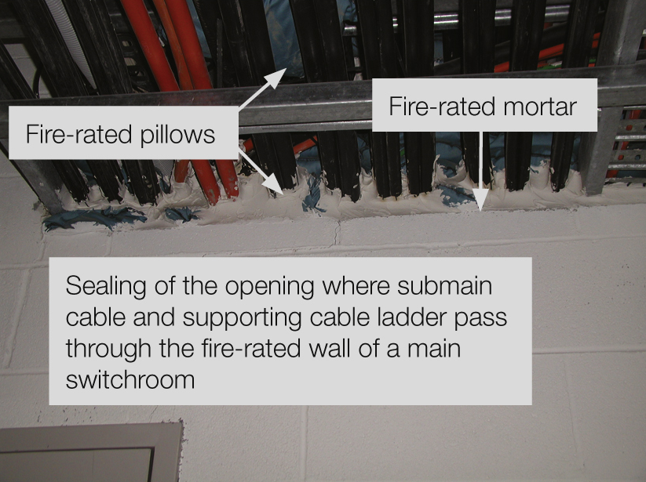
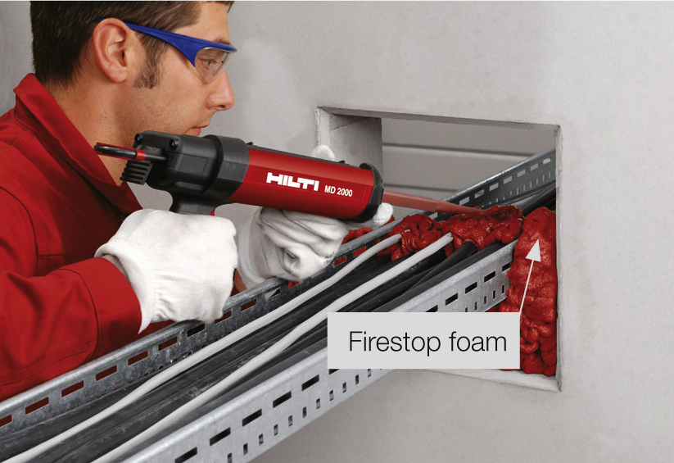
Activity 41 – Penetration of fire barriers
Clause 3.9.9.3
500 mm² or 25 mm in diameter
Internally sealed to the level required

Slide 48
Activity 42 – Building code Australia
Clause E2.1 BCA

