Slide 1
SECTION 10
SELECTING DEVICES FOR
ISOLATION AND SWITCHING

Slide 2
SELECTING DEVICES FOR
ISOLATION AND SWITCHING
Topics
Requirements for provision of isolation
Need for protection against mechanical movement
Selecting isolation and protection devices
L

Slide 3
SELECTING DEVICES FOR
ISOLATION AND SWITCHING
Learning objectives:
Learners should be able to meet the following learning objectives:
Explain the requirements for the provision of the isolation of every circuit in an electrical installation.
Explain the need for protection against mechanical movement of electrically activated equipment.
Apply AS/NZS 3000 requirements for selecting devices for isolation and switching for a range of installations and conditions.
L

Slide 4
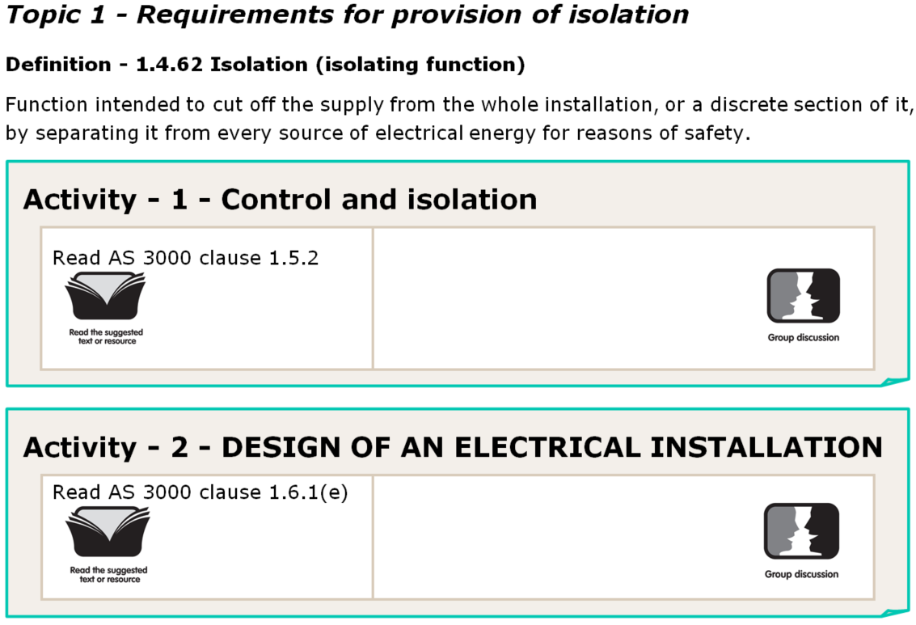
Control and Isolation
Design of an Electrical Installation
L

Slide 5
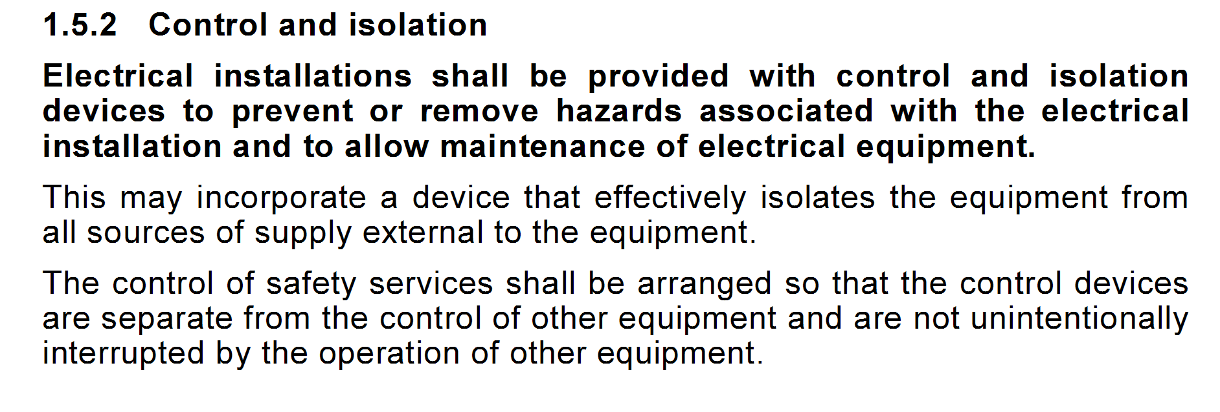
L

Slide 6
L

Slide 7
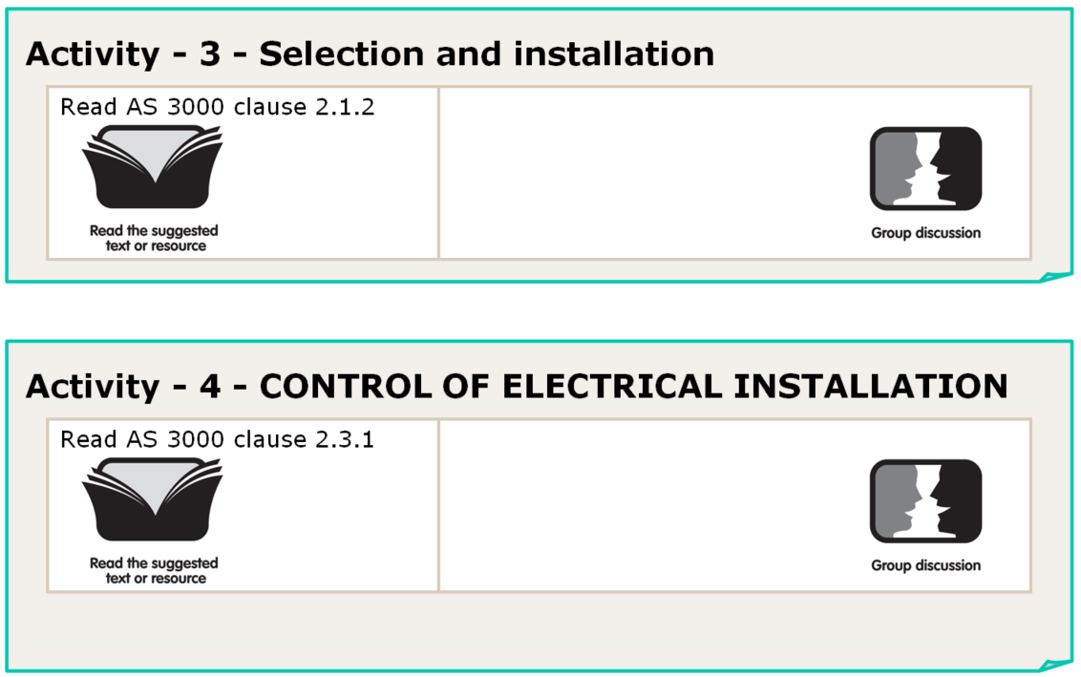
Selection and Installation
Control of an Installation - General
L

Slide 8
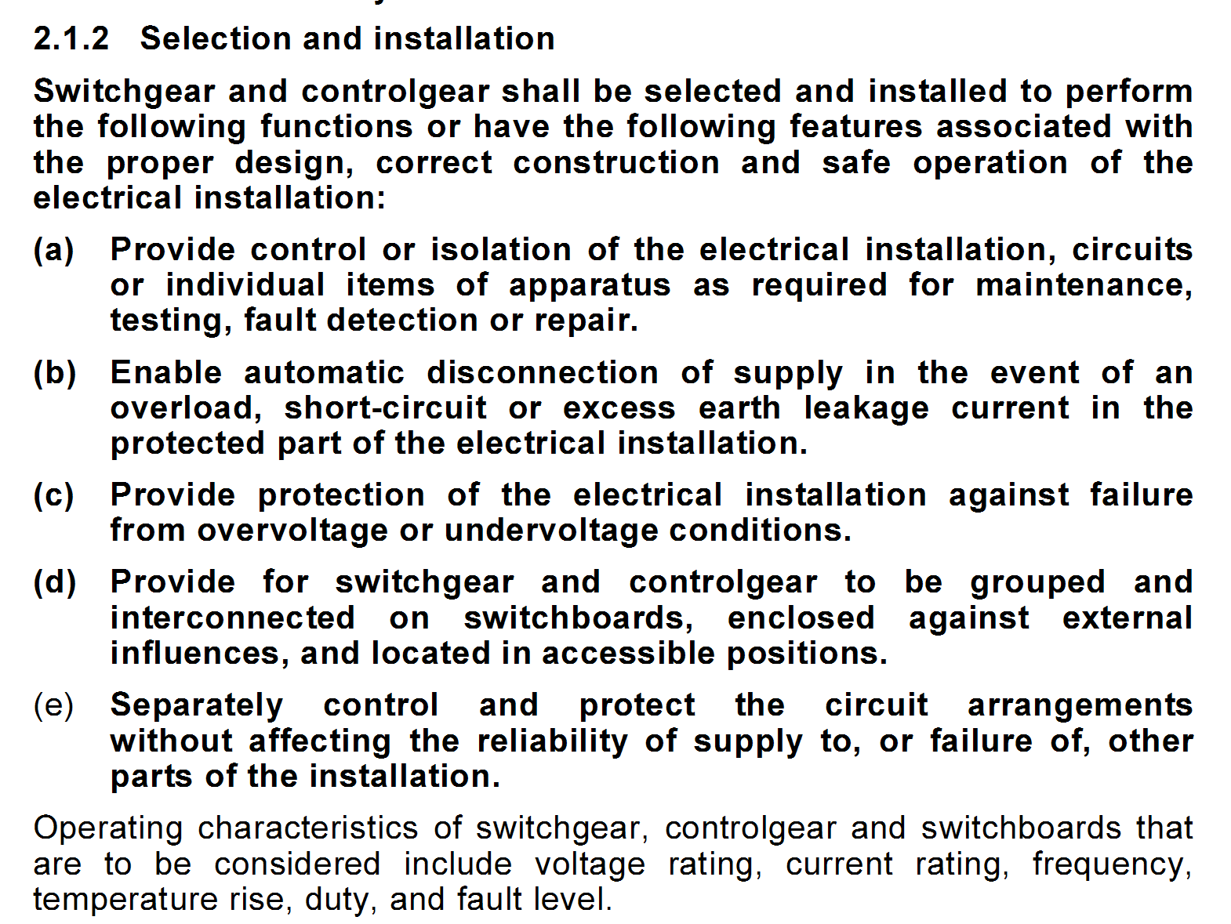
L

Slide 9
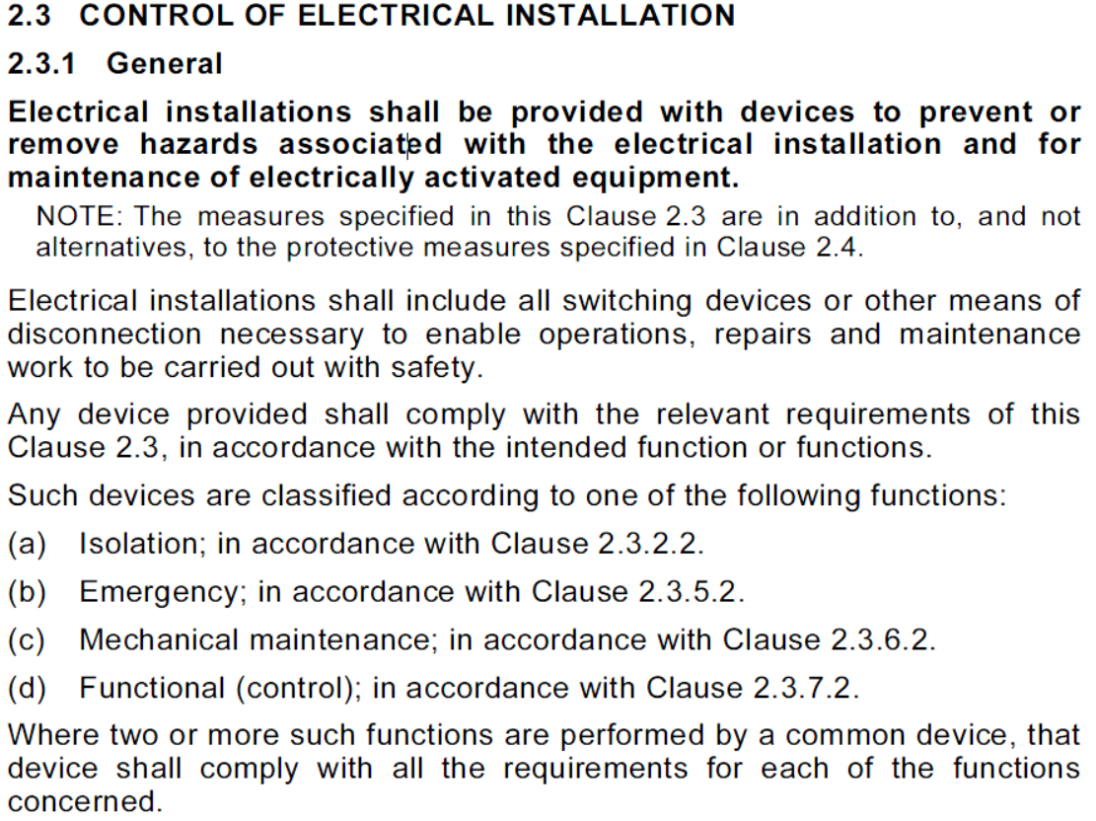
L

Slide 10
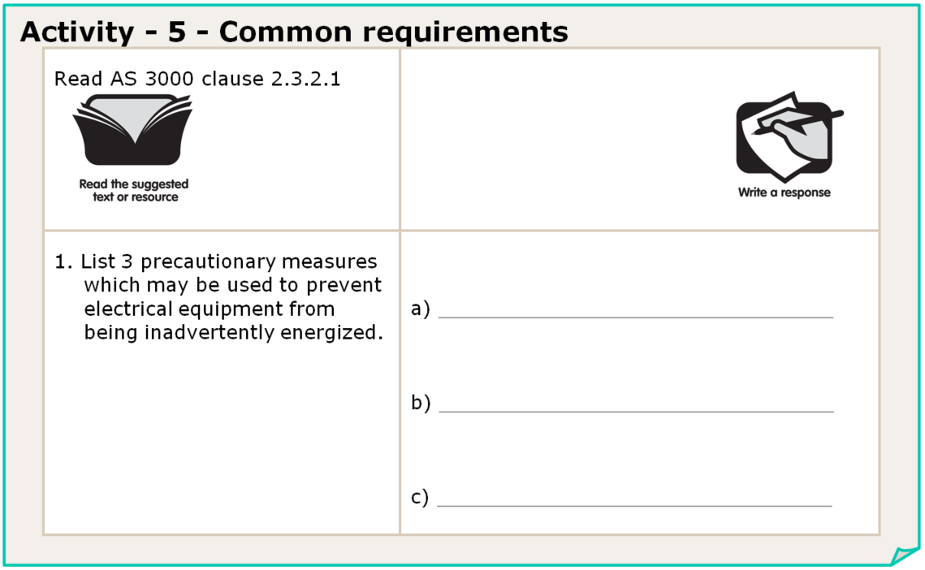
L

Slide 11
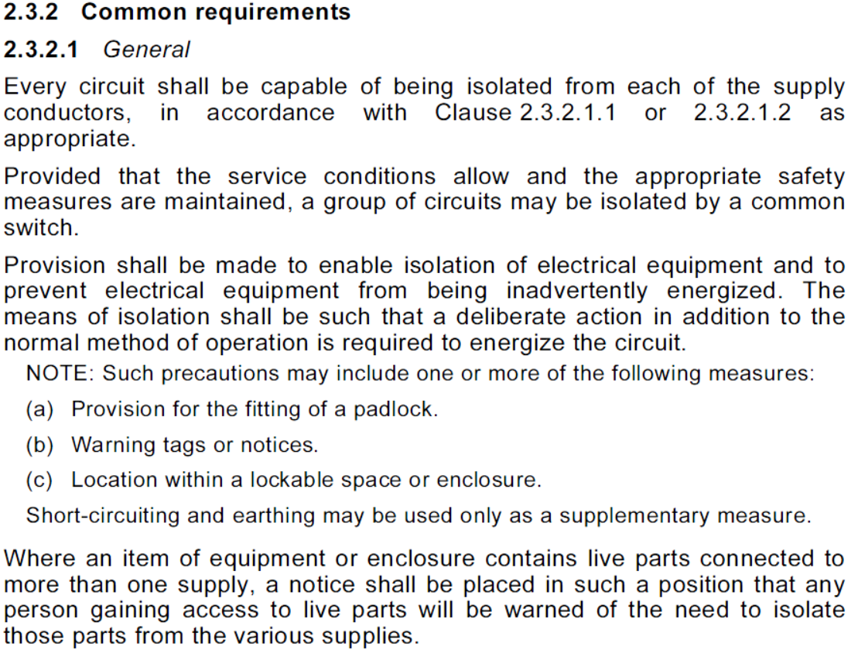
L

Slide 12
Provision for a padlock.
Warning tags or notices.
A lockable space or enclosure.
L

Slide 13
All active conductors (3)
No
Must also switch all actives
at the same time
No
L

Slide 14
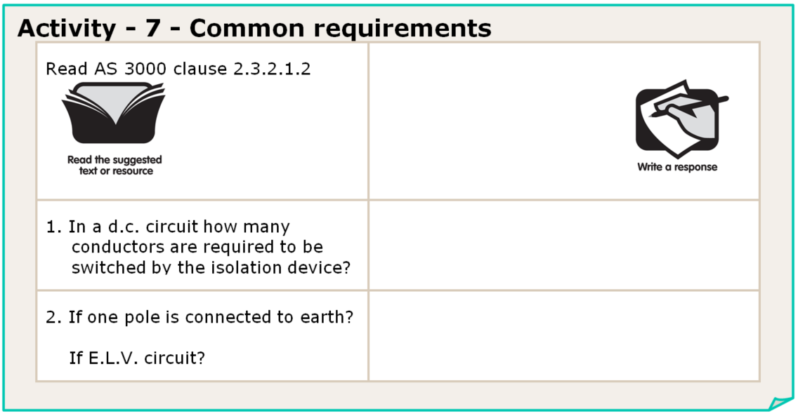
All conductors (2)
just one
just one
L

Slide 15
No
O - off
I - on
the normal load current
L

Slide 16
L

Slide 17
L

Slide 18
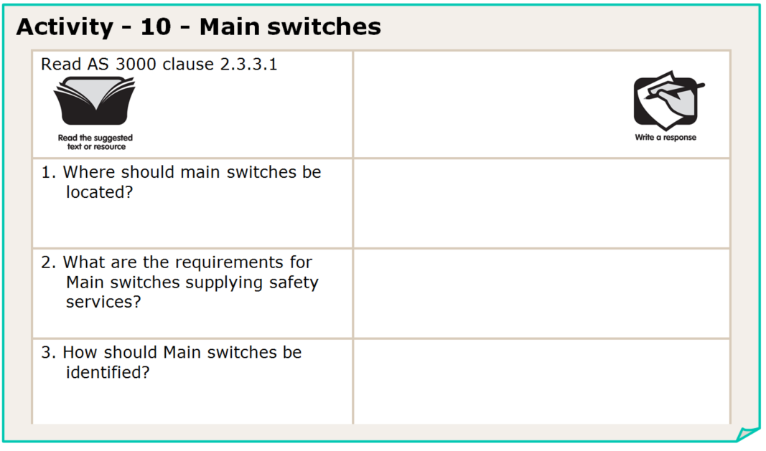
In the Main Switch Board
safety services require
separate main switch
legibly and permanently
L

Slide 19
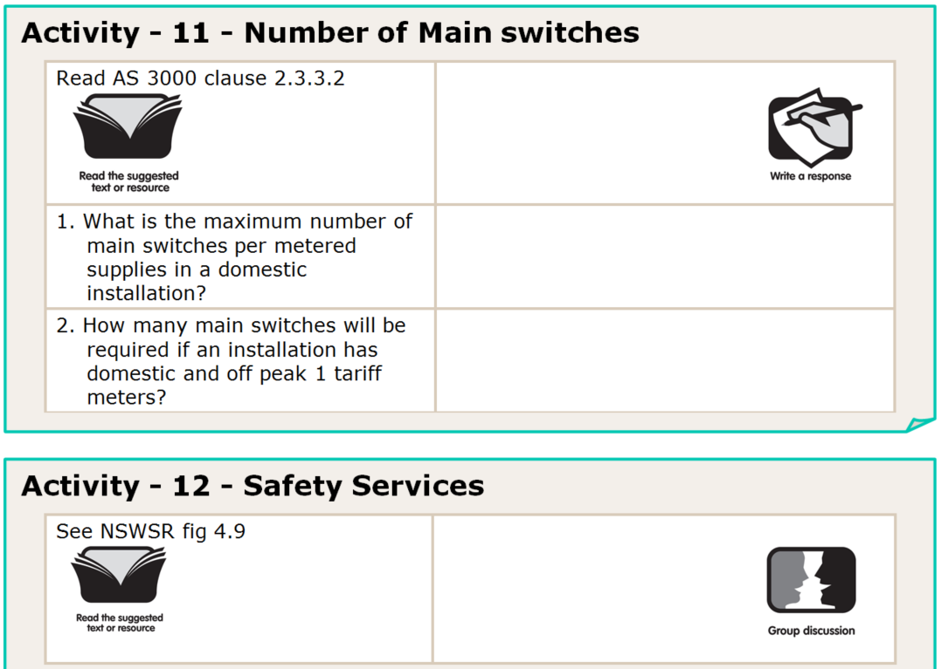
one Main Switch per tariff
2
L

Slide 20
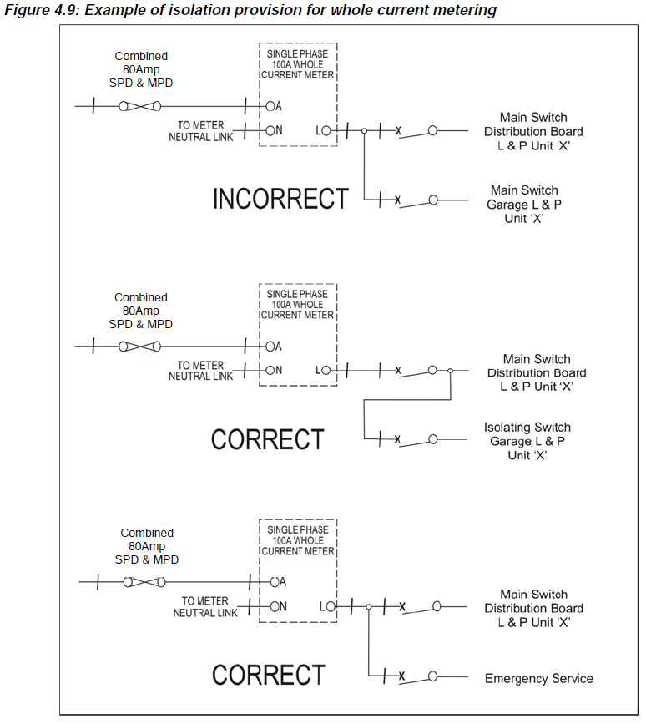
Page 88
Service Rules
Nov 2016
L

Slide 21
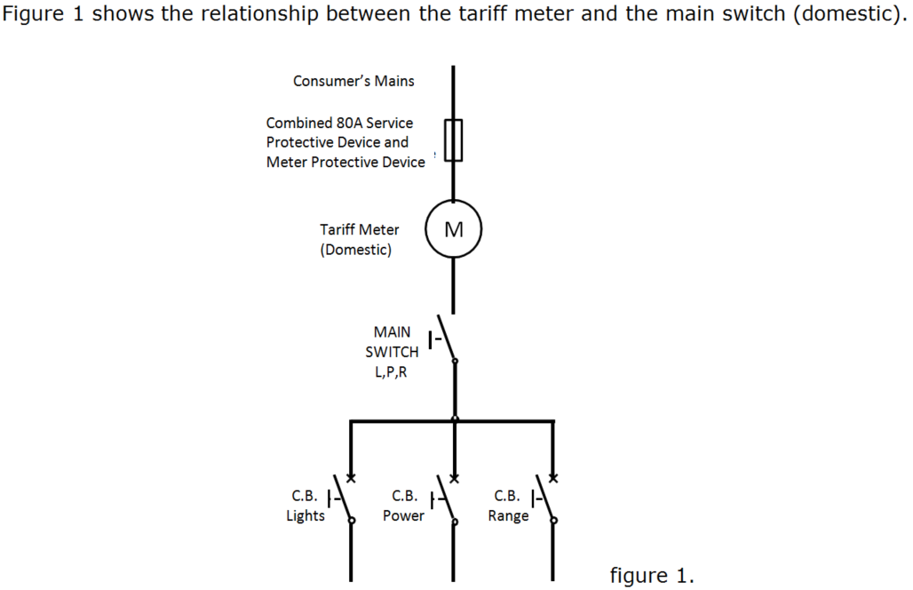
Main Switch for General Installation
L

Slide 22
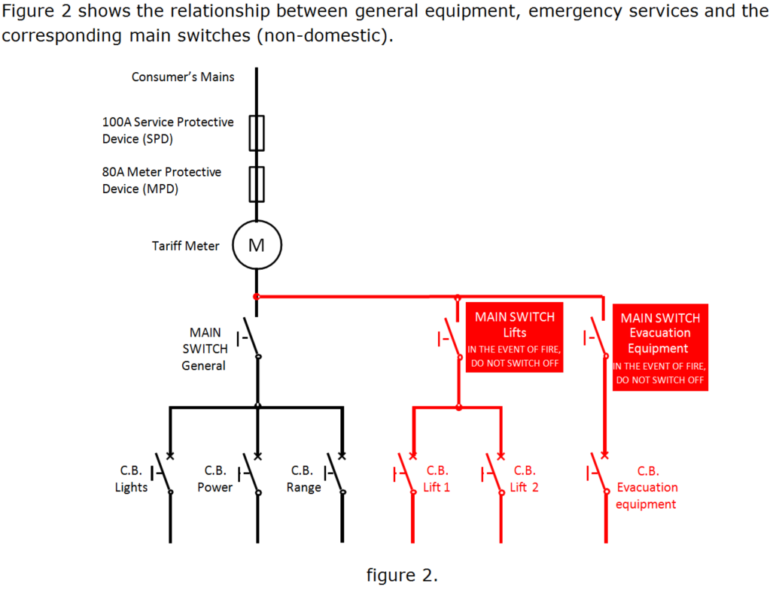
Separate Main Switches for Emergency Service circuits
(connected to the line side of the General Main Switch)
Main Switch for General Installation
L

Slide 23
2m
To prevent unauthorized use
yes – each tenant needs ready
access to isolate their own unit
L

Slide 24
no - should be ‘MAIN SWITCH’
each switch marked to indicate
what it controls.
a notice installed to indicate the
presence of other supplies
L

Slide 25
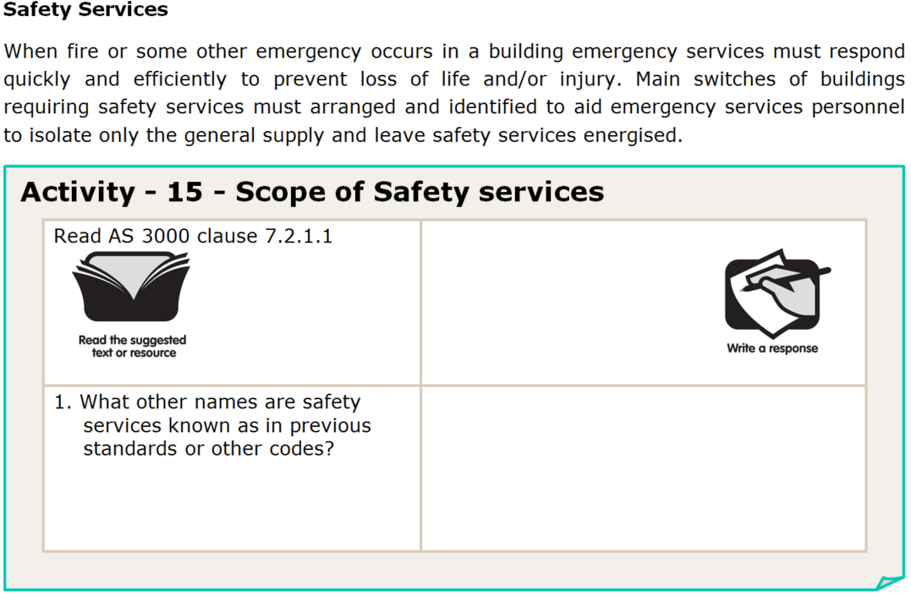
emergency systems - AS3000
(previous editions)
emergency equipment - Aust BC
essential service - NZ BC
L

Slide 26
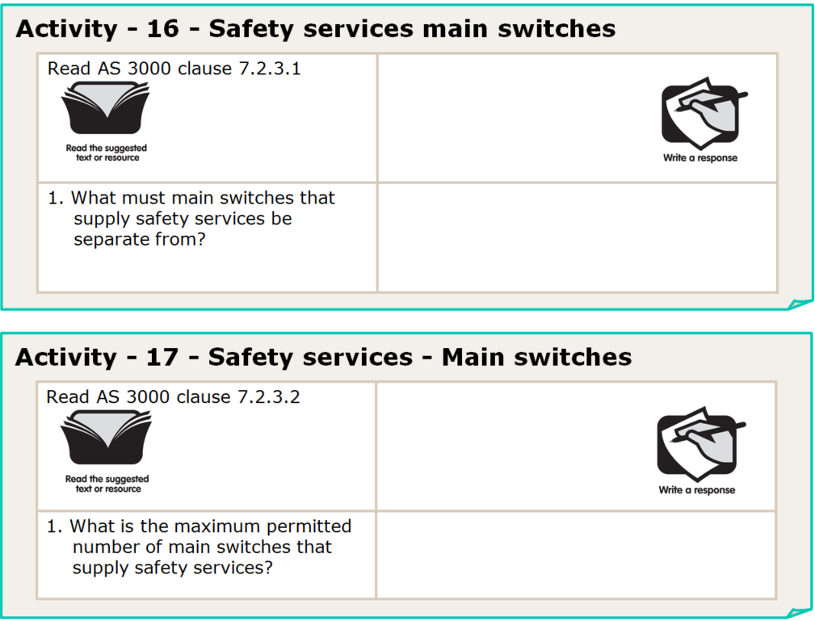
any part of the general electrical
installation; and
other types of safety services
no limit
L

Slide 27
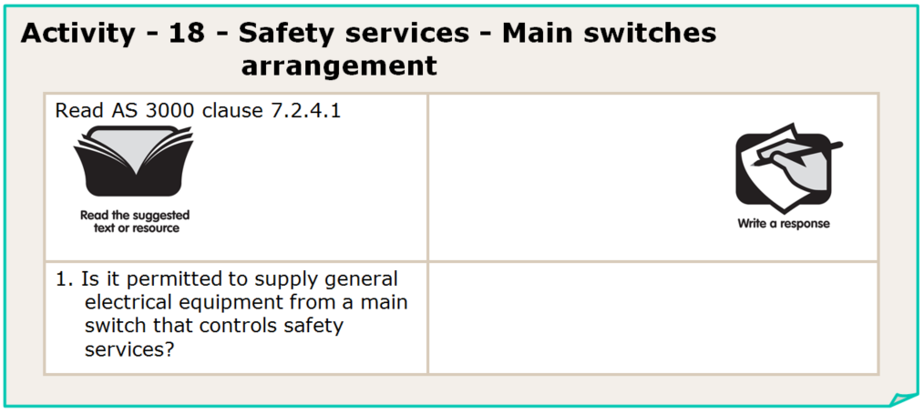
no
L

Slide 28
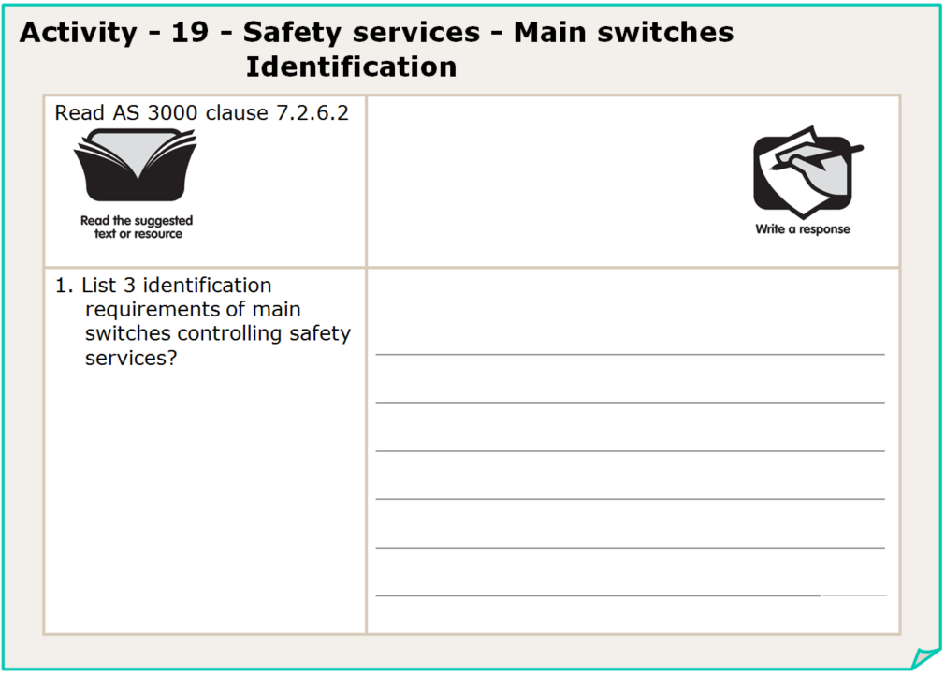
identified to indicate the safety
service equipment that they control
marked ‘IN THE EVENT OF FIRE, DO NOT SWITCH OFF’
identified by contrasting colouring
L

Slide 29
yes
no – but a notice must be placed on
the DB indicating where it is
isolated from.
Note that it is good practice to provide a separate
Isolation switch for each distribution board.
L

Slide 30
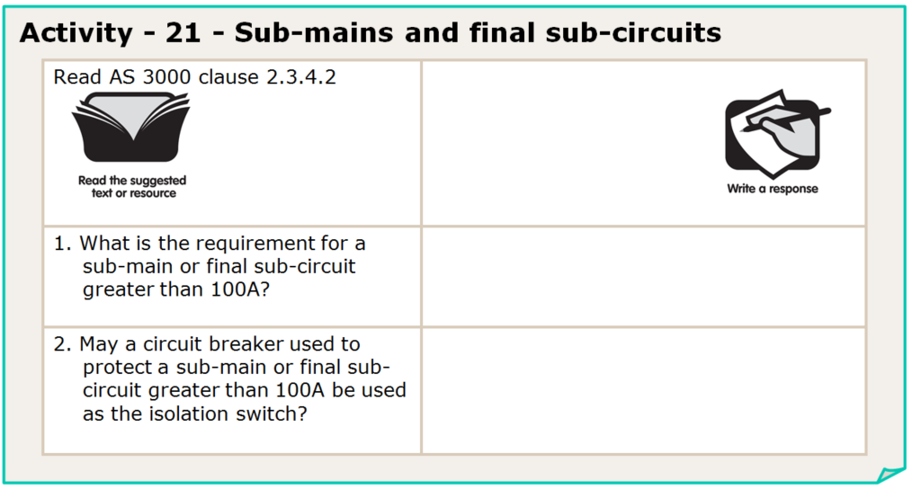
separate isolation switch for
each circuit.
yes
L

Slide 31
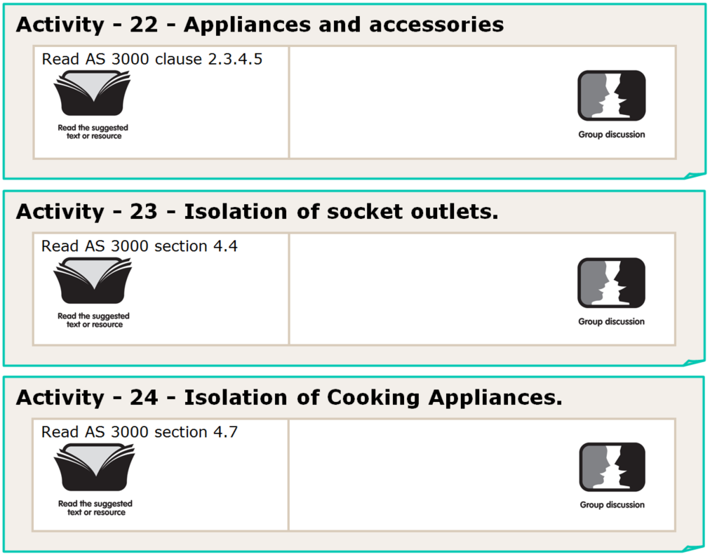
Provides a list of relevant clauses for rules relating to appliances accessories and motors
Rules such as switching requirements, accessibility, location, earthing ,polarity and phase sequence etc.
Rules such what requires isolation, location, marking and accessibility, etc.
L

Slide 32
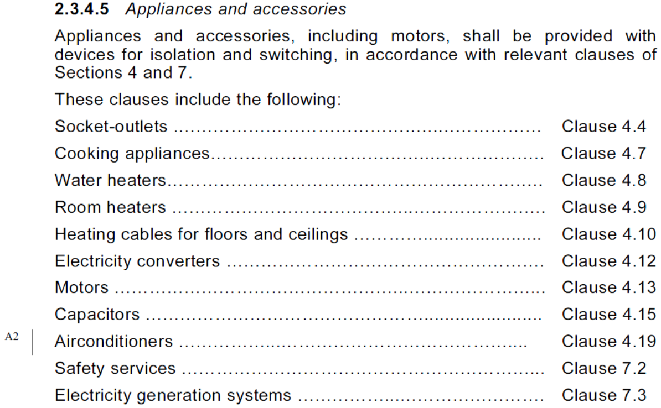
L

Slide 33
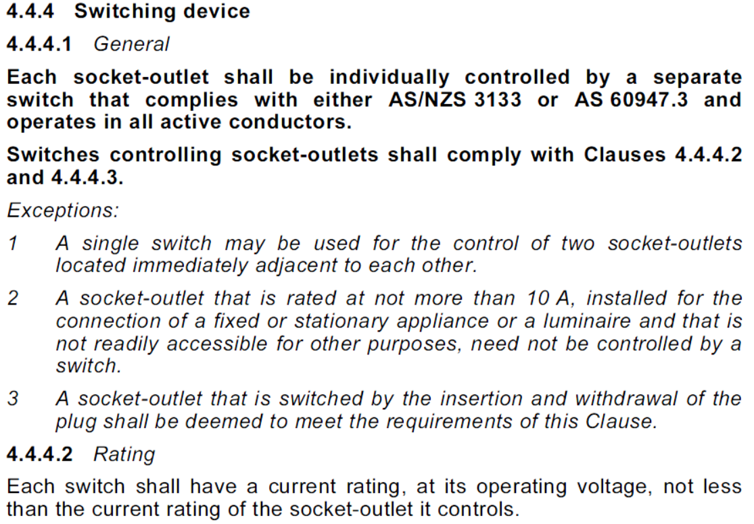
Each relevant clause has specific rules in context
L

Slide 34
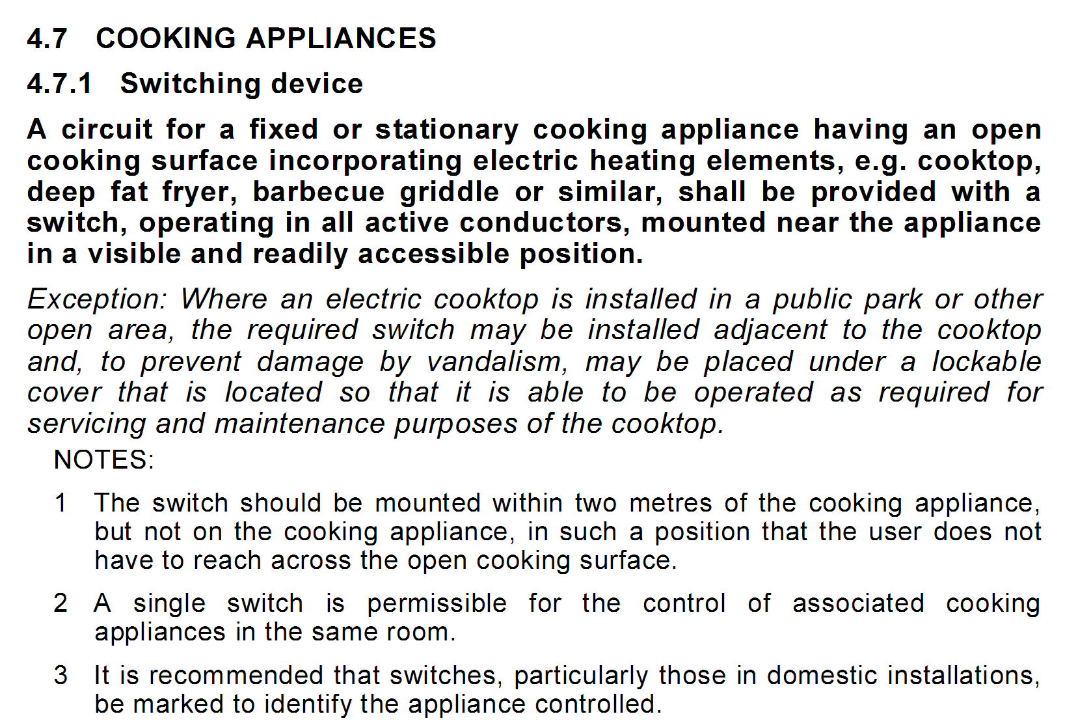
L

Slide 35
on or adjacent to the water
heater or on the switchboards
yes
L

Slide 36
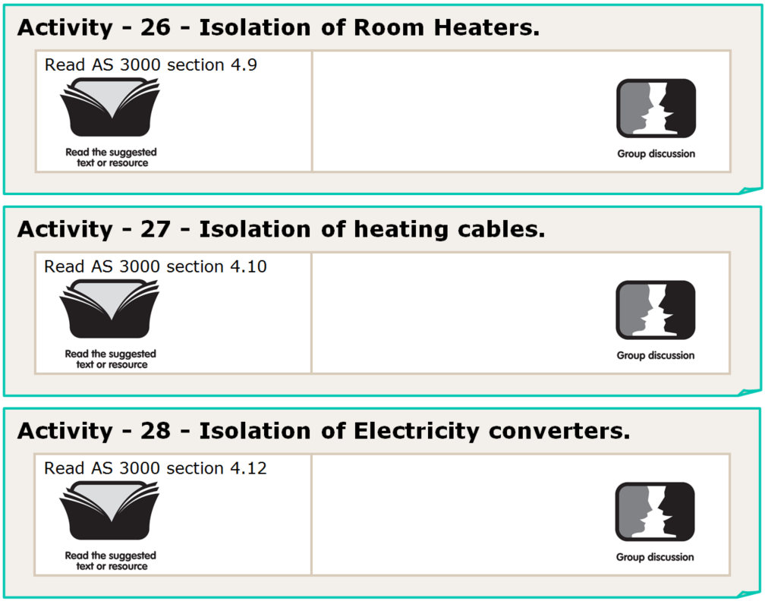
Rules such as location, marking and accessibility, etc. for hard wired room heaters / space heaters
Rules specific to floor / ceiling heating cables including RCD protection requirements and location of cables signage etc.
Rules specific for devices such as UPS systems, inverters, voltage stabilizers, motor-generator sets etc.
L

Slide 37
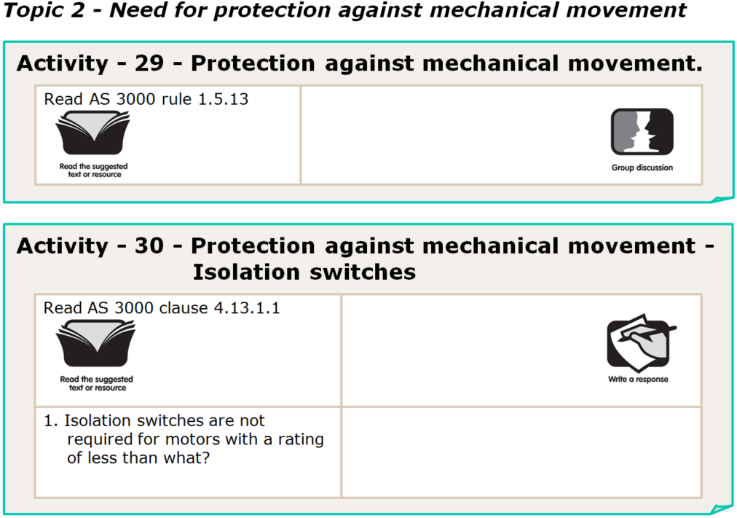
Protection requirements to eliminate physical injury and unexpected danger resulting from moving parts etc.
L

Slide 38
L

Slide 39
Protection requirements to eliminate physical injury and unexpected danger resulting from moving parts etc.
150VA
L

Slide 40
8 x
4 x
M (motor rated)
Note: An M rated isolator may meet the full rated current requirements, without meeting the locked rotor current requirements. An isolator with a higher I rated current may be required to achieve the minimum locked rotor current requirements.
L

Slide 41
facilities for locking in the open position,
a lockable enclosure,
the attachment of a warning
where the means of shutting down is
continuously under the control of the
person performing the maintenance
ie: the isolator is next to the device
L

Slide 42
requires manual operation
the device clearly and reliably
indicates the OFF position
designed or installed so as to prevent
unintentional closure.
L

Slide 43
switches, circuit-breakers or
plugs and sockets.
States that devices shall be placed and marked so as to be readily identifiable and convenient for their intended use
L

Slide 44
functional switching is generally used for operational control and not for safety reasons
L

Slide 45
L

Slide 46
Page 75
L

Slide 47
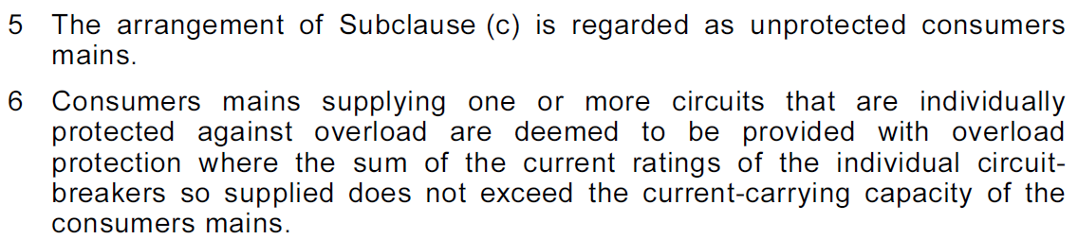
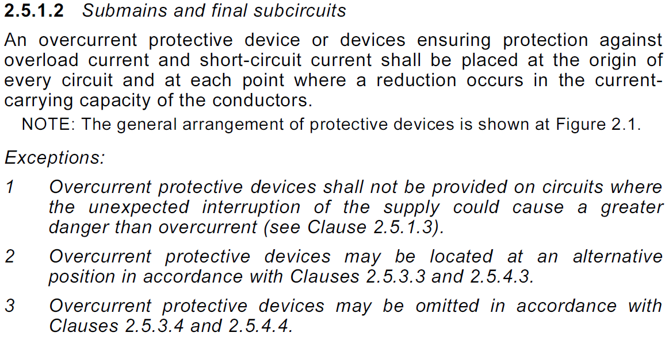
L

Slide 48
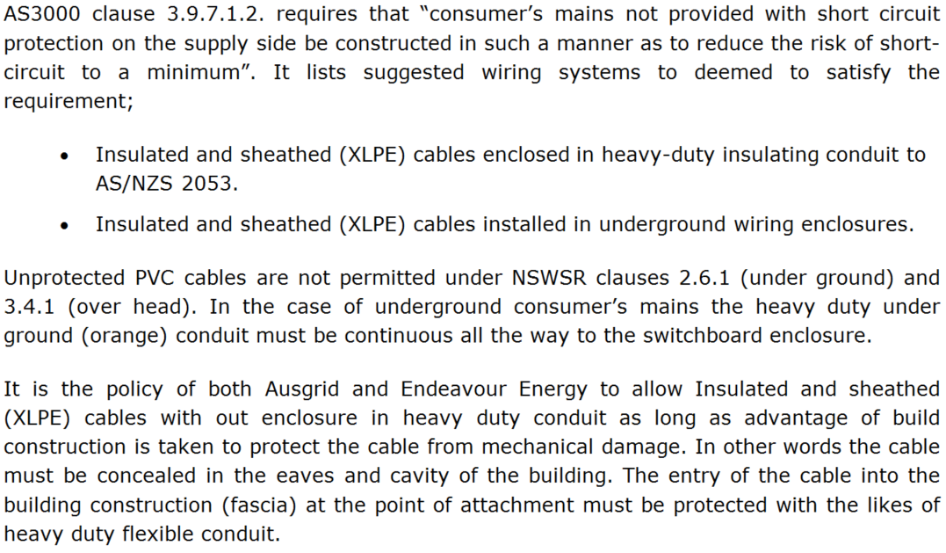
L

Slide 49
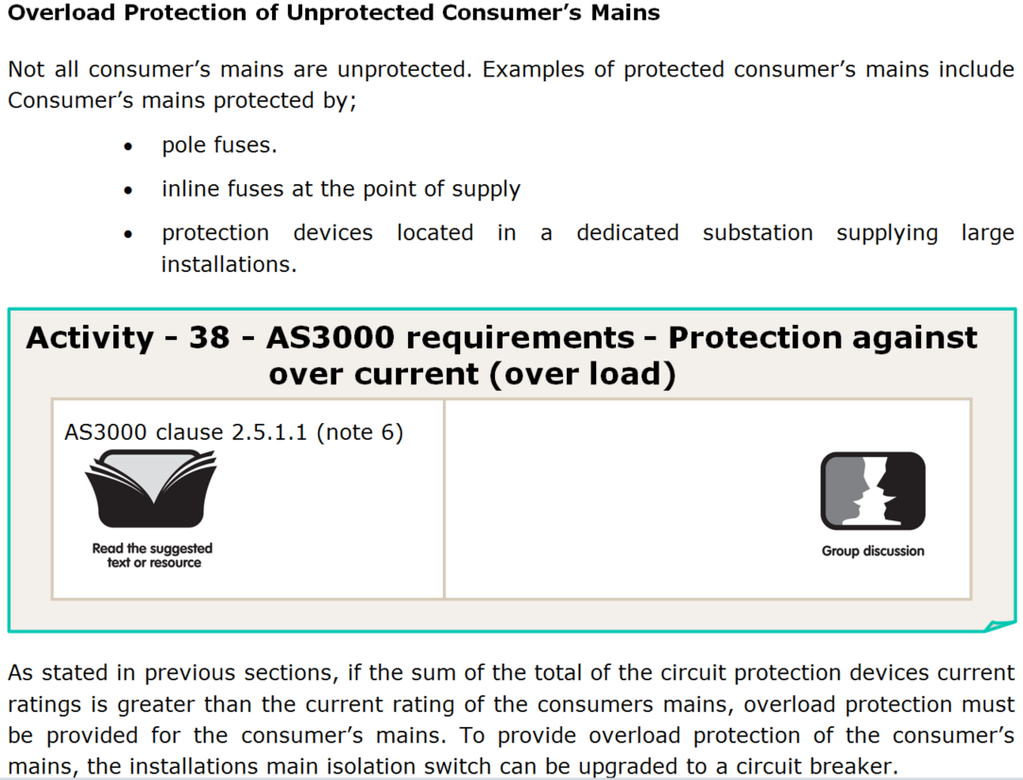
L

Slide 50
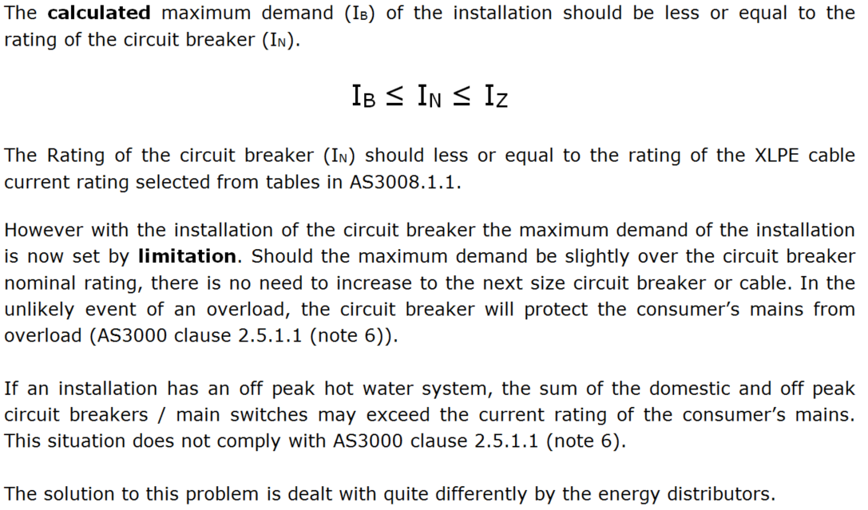
L

Slide 51
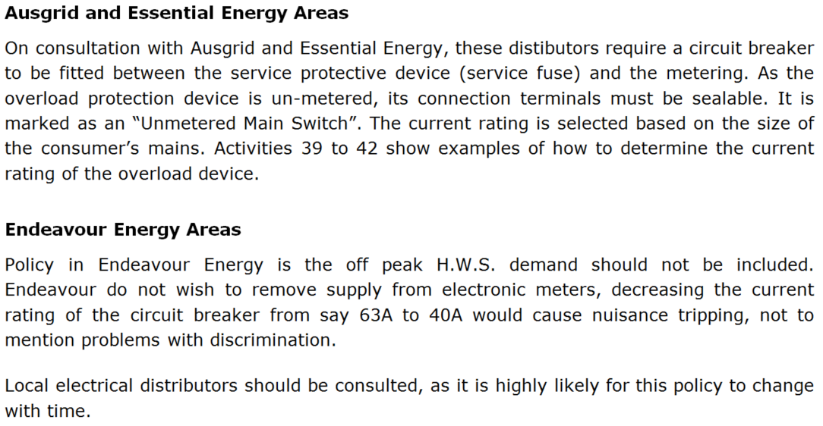
L

Slide 52
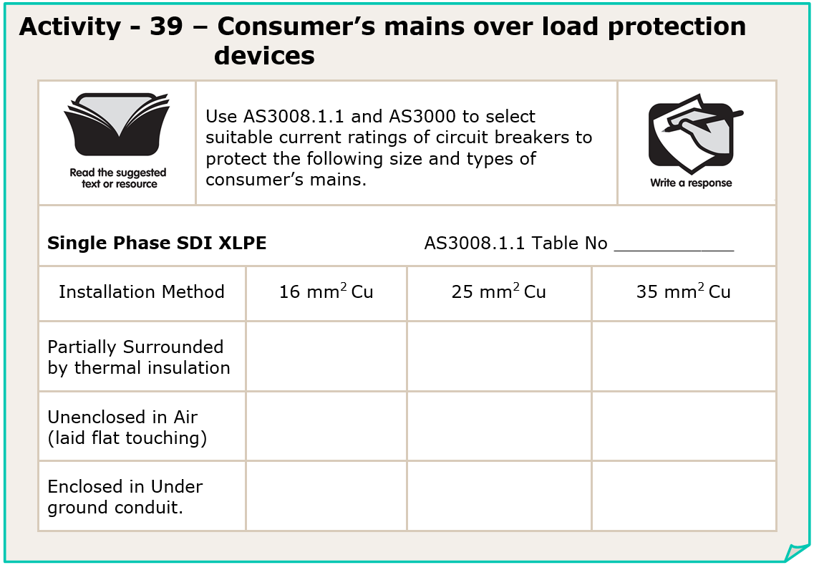
5
63A
(I_{Z}=67A)
80A (I_{Z}=90A)
100A (I_{Z}=108A)
80A (I_{Z}=86A)
100A (I_{Z}=117A)
125A (I_{Z}=144A)
100A (I_{Z}=100A)
125A (I_{Z}=131A)
125A (I_{Z}=157A)
L

Slide 53
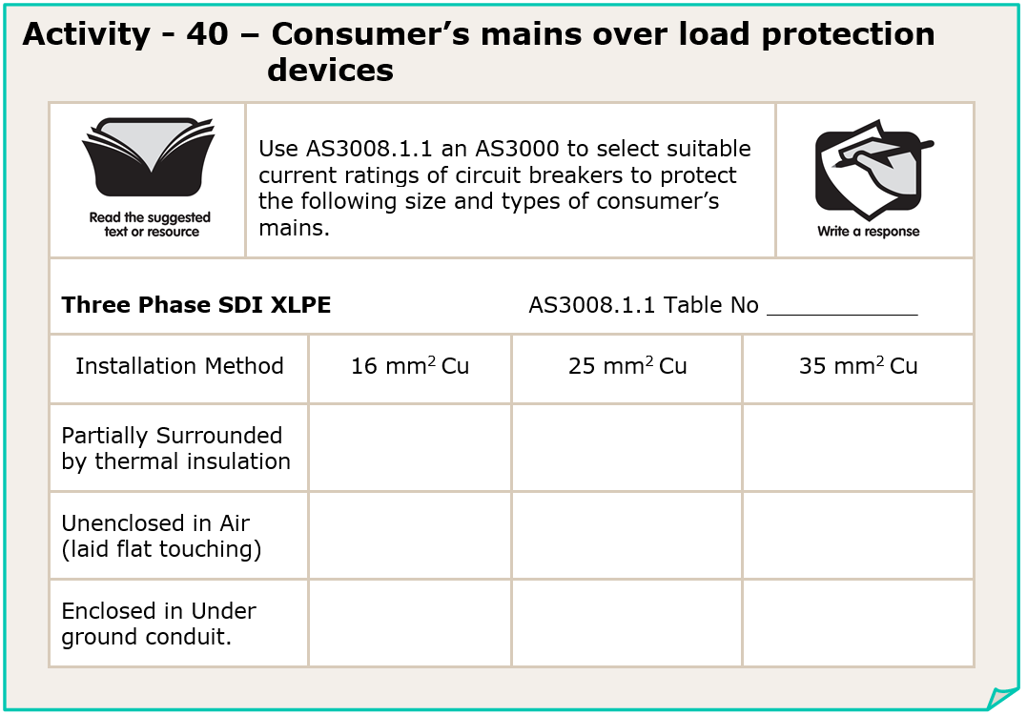
8
50A
(I_{Z}=58A)
63A (I_{Z}=77A)
80A (I_{Z}=96A)
80A (I_{Z}=86A)
100A (I_{Z}=117A)
125A (I_{Z}=144A)
80A (I_{Z}=86A)
100A (I_{Z}=113A)
125A (I_{Z}=137A)
L

Slide 54
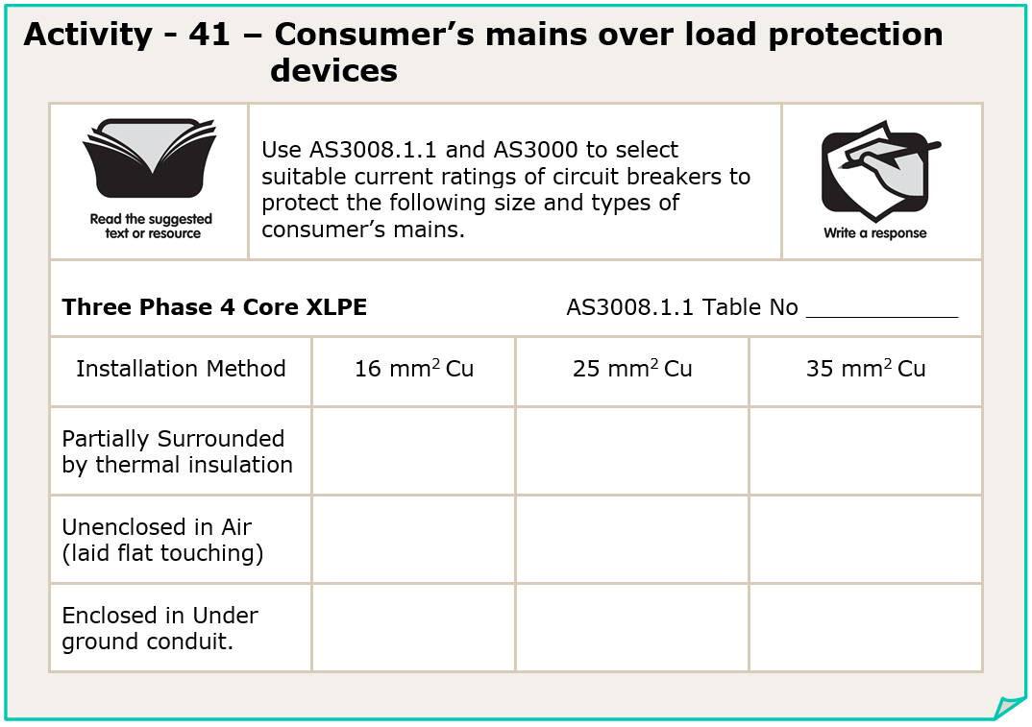
14
63A
(I_{Z}=66A)
80A (I_{Z}=89A)
100A (I_{Z}=110A)
80A (I_{Z}=83A)
100A (I_{Z}=111A)
125A (I_{Z}=137A)
80A (I_{Z}=81A)
100A (I_{Z}=107A)
125A (I_{Z}=130A)
L

Slide 55
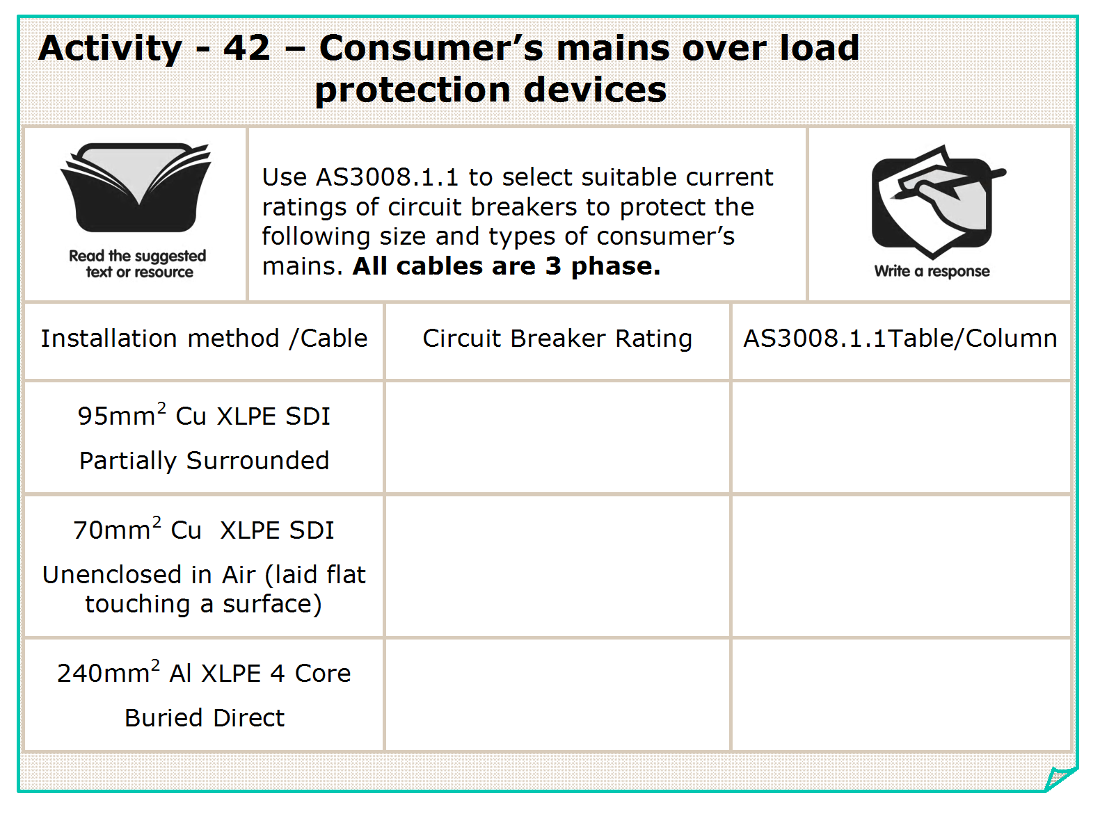
160A
(I_{Z}=176A)
T8C18
200A (I_{Z}=224A)
T8C8
380A (400 x 0.95) (I_{Z}=395A)
T14C24
L

Slide 56
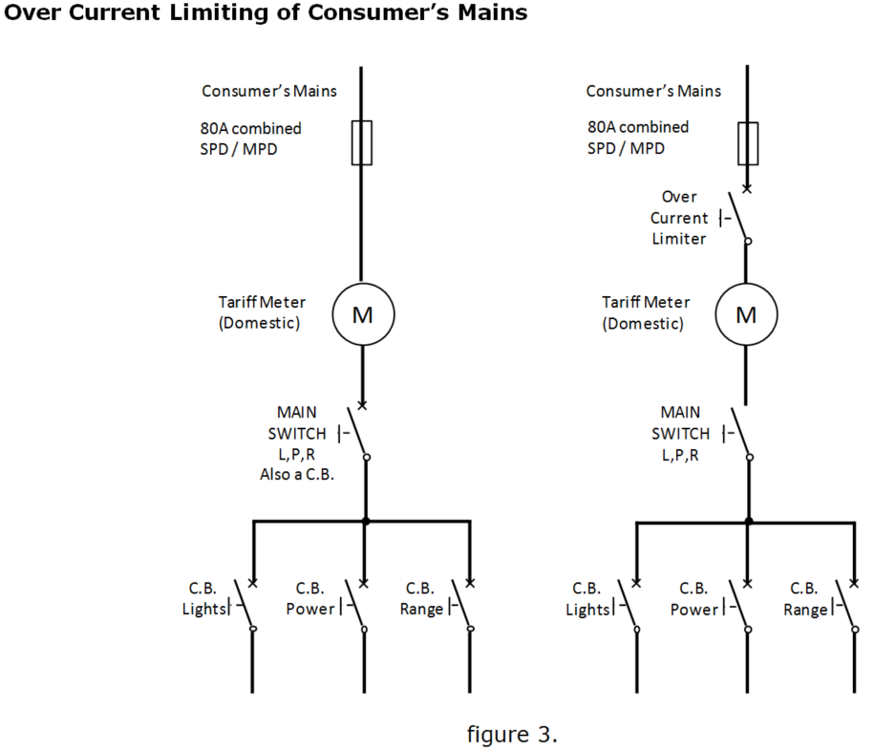
L

Slide 57
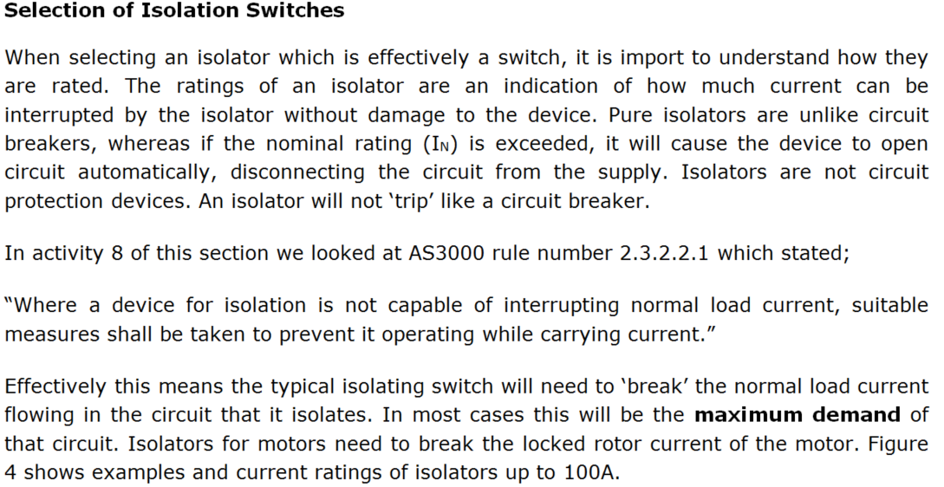
L

Slide 58
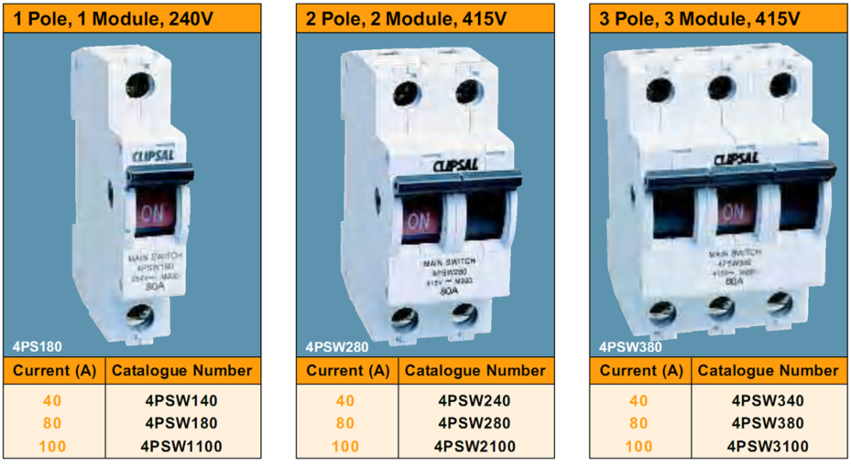
L

Slide 59
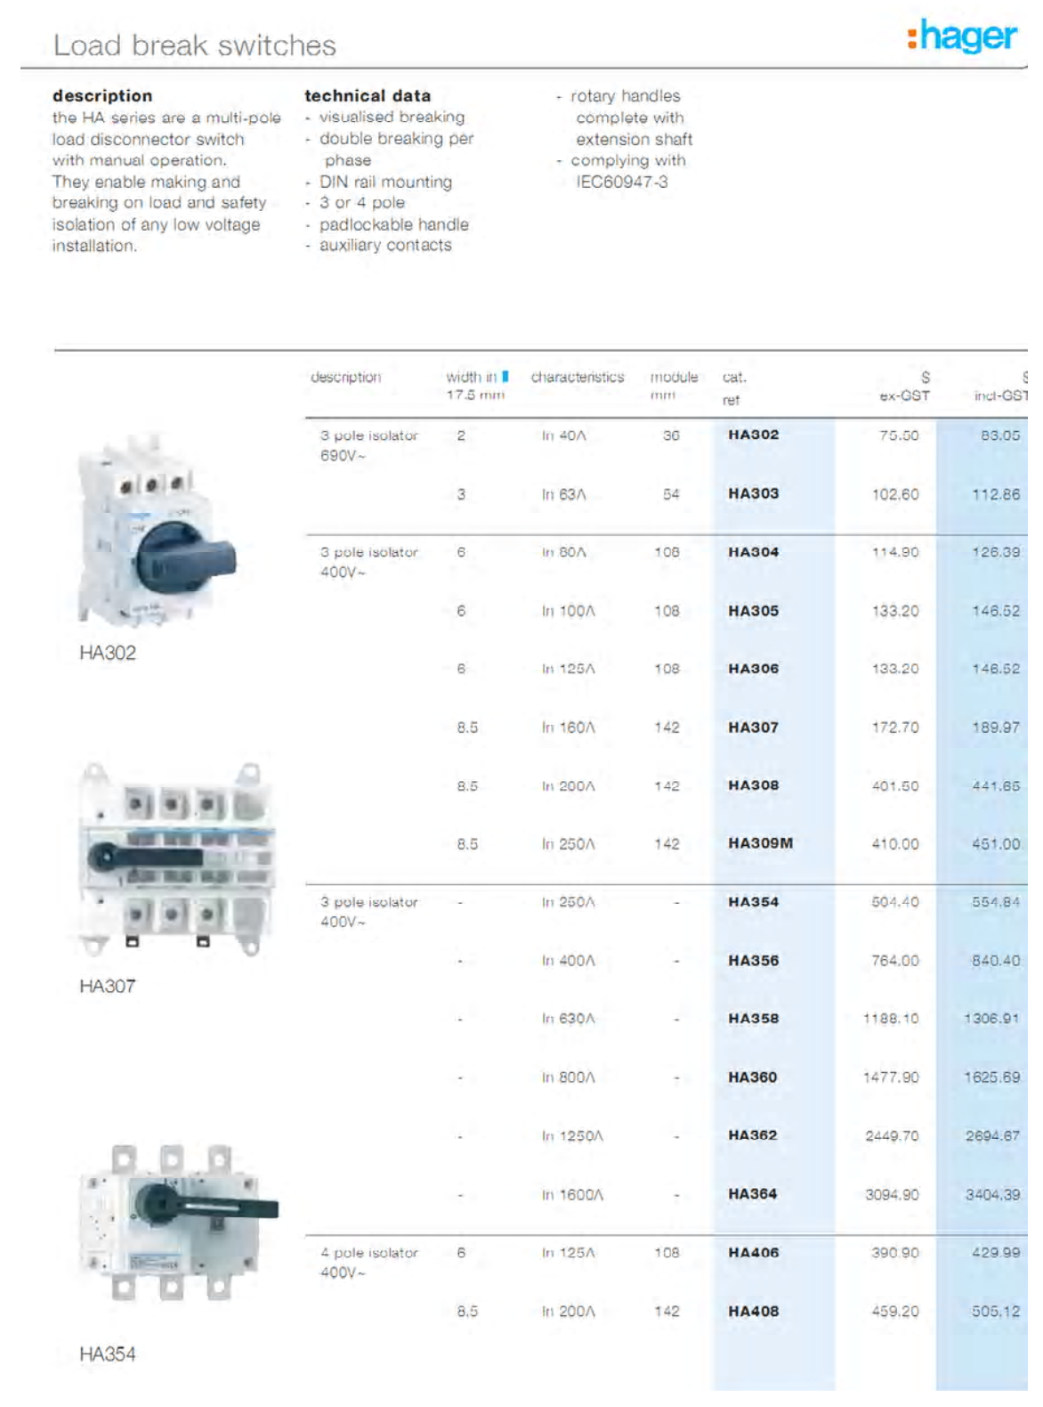
L

Slide 60
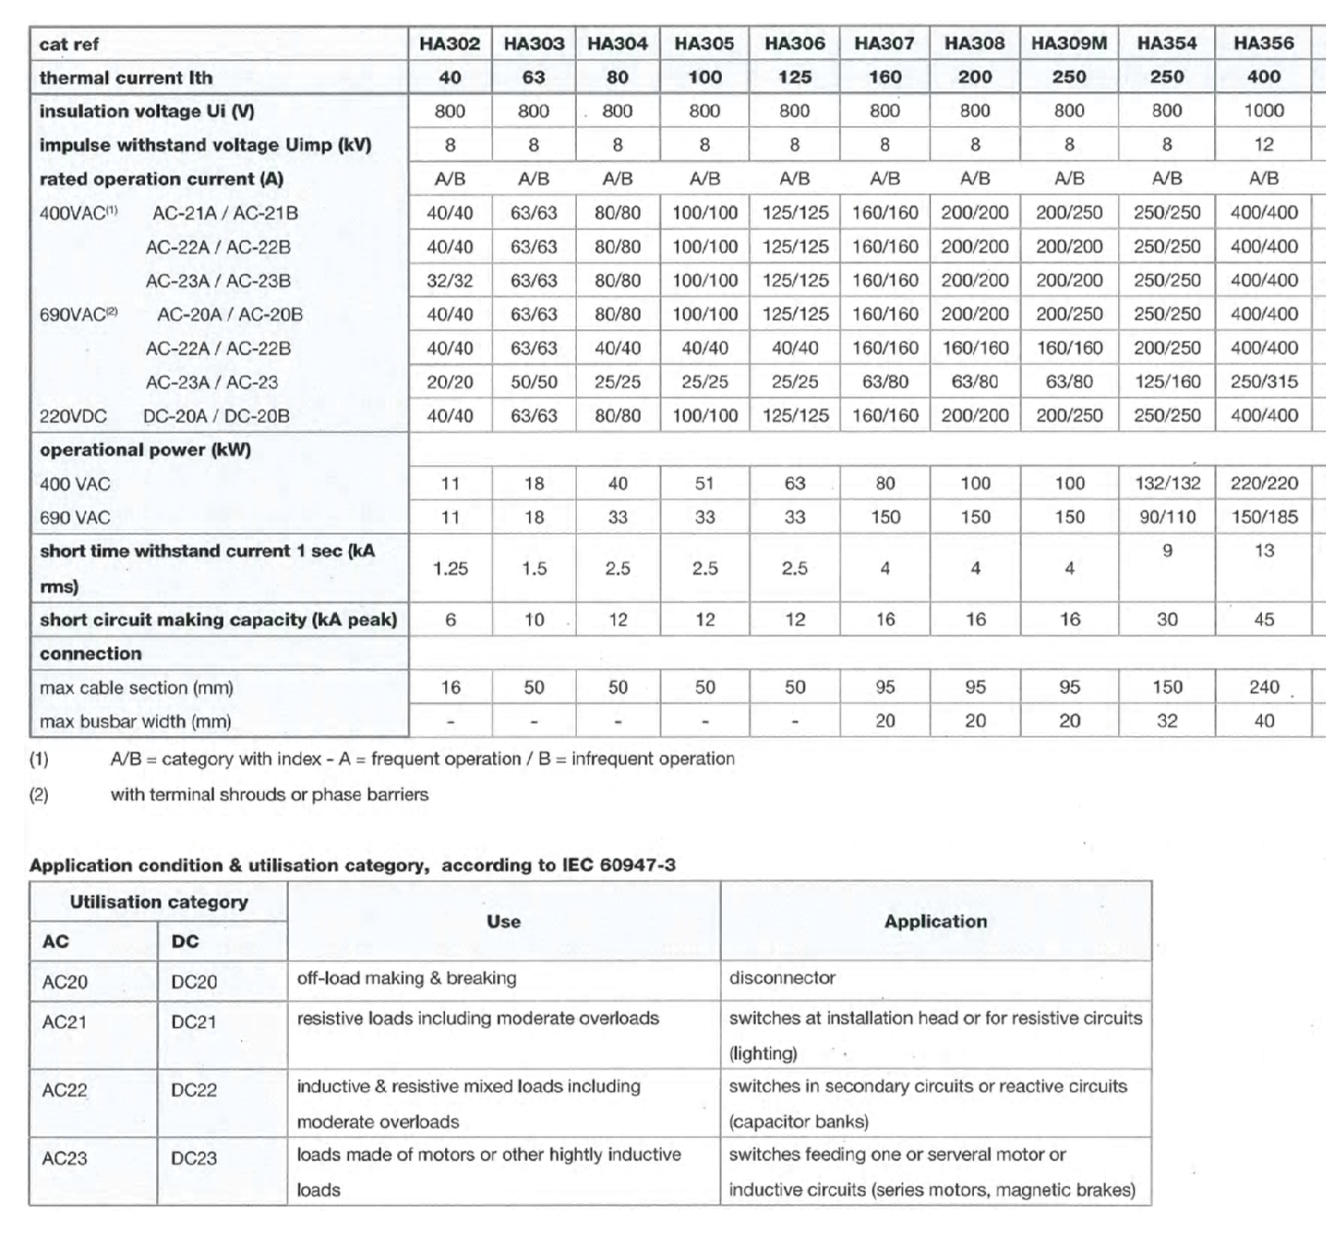
L

Slide 61
1 pole
40A
Iso
AC21A
3 pole
50A
C.B
N/A
L

Slide 62
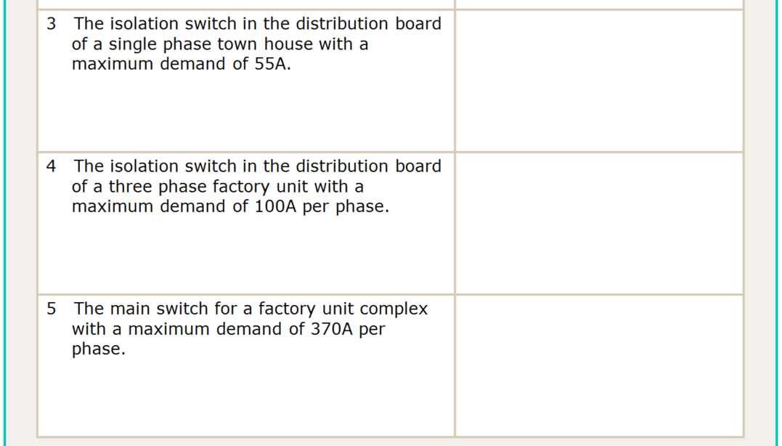
1 pole
80A
Iso
AC21A
3 pole
100A
Iso
AC23B
3 pole
400A
C.B.
N/A
L

Slide 63
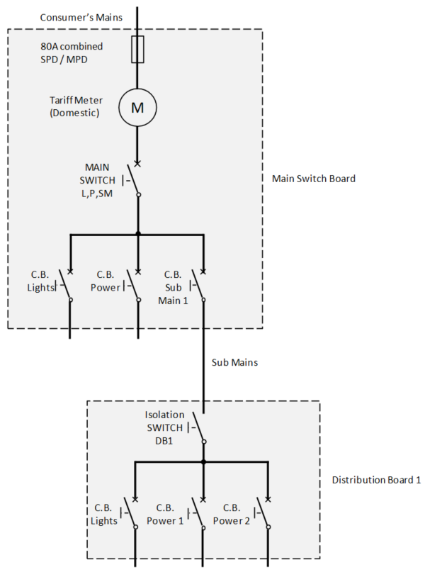
L

Slide 64
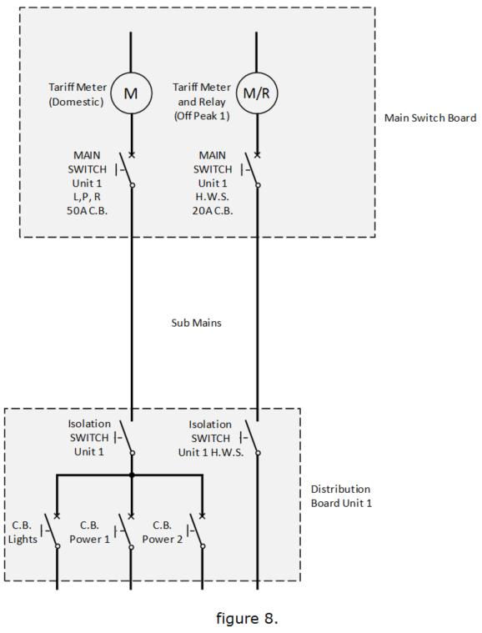
Figure 8 shows 1 unit of a multiple domestic installation. It is assumed the main switch board is locked. Main switches are required for each metered tariff. Circuit breakers are used in the M.S.B. as both circuit protection and isolation devices.
Isolation switches are provided in the distribution board of each unit for both the general and hot water system sub mains. If the units are town houses (outbuildings) they are treated as separate installations.
The general isolation switch is required by Australian standards. The H.W.S. isolation switch is provided so the H.W.S. can be isolated without gaining access to the M.S.B.
L

Slide 65
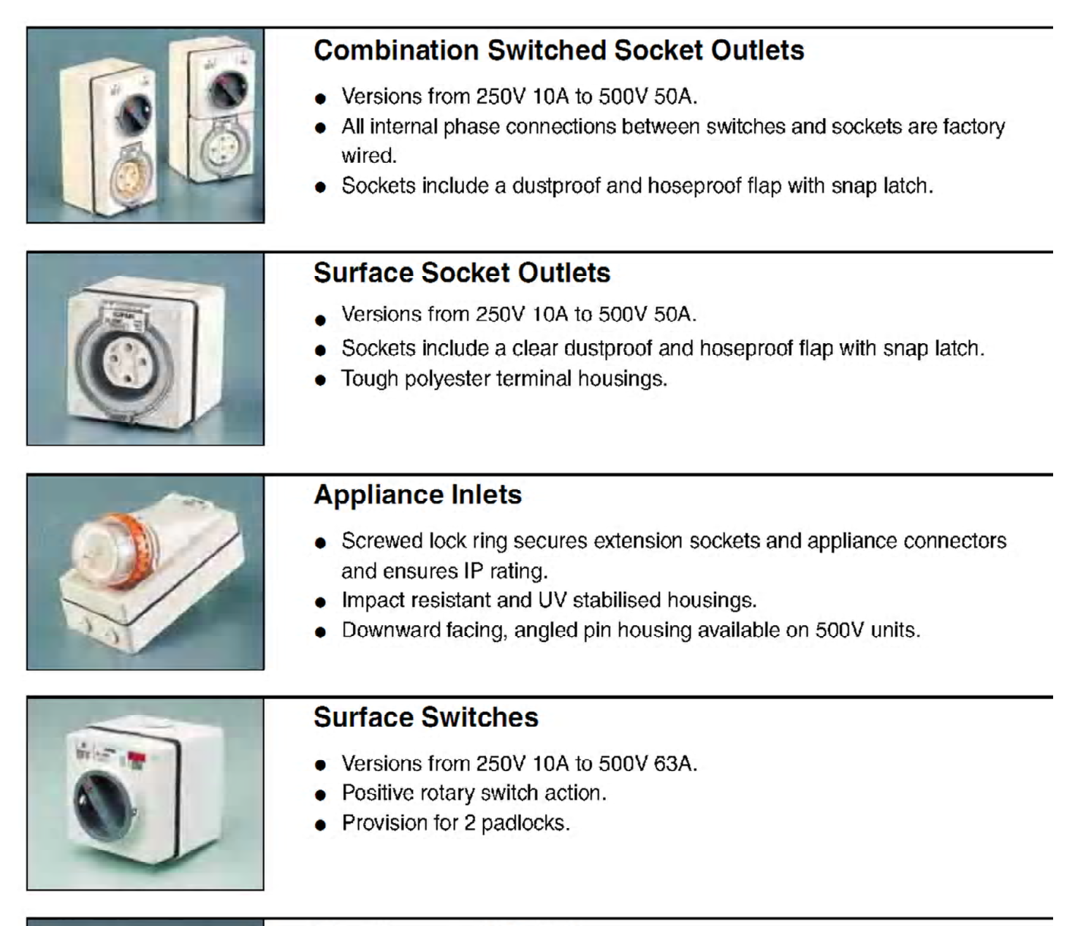
L

Slide 66
L

Slide 67
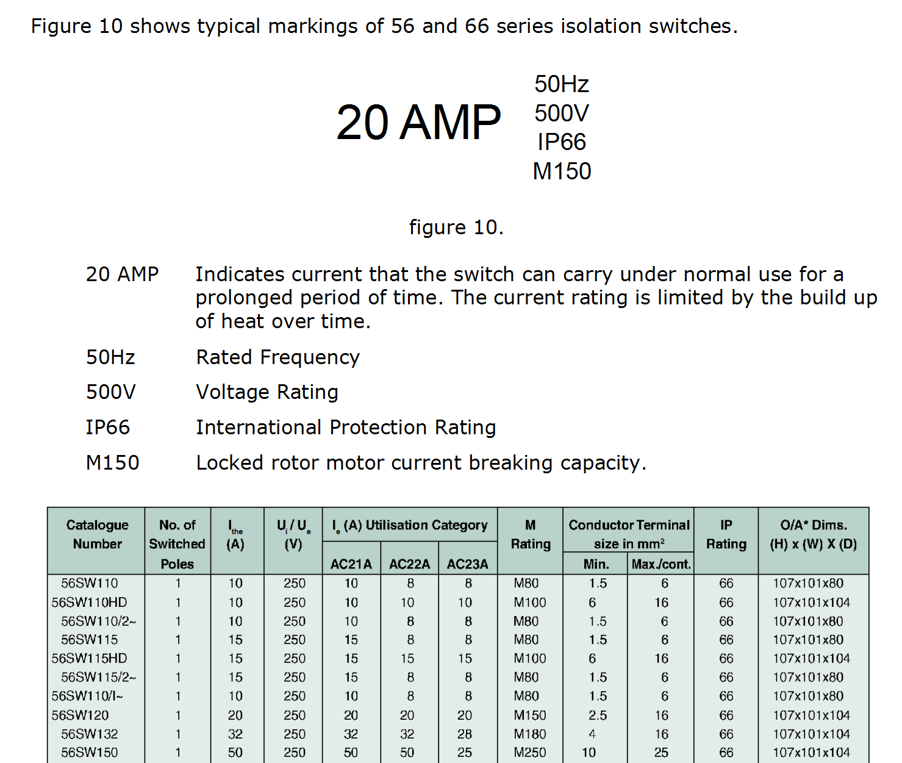
L

Slide 68
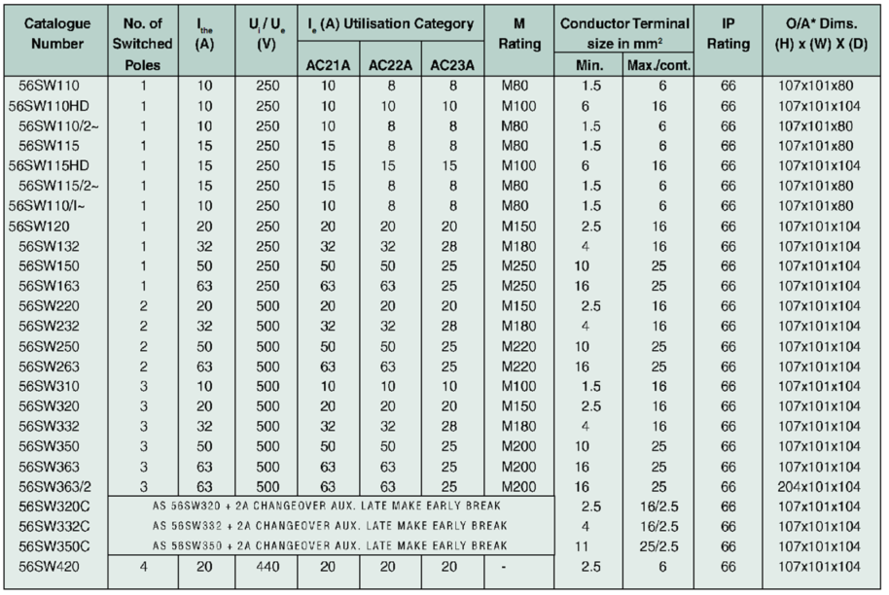
L

Slide 69
L

Slide 70
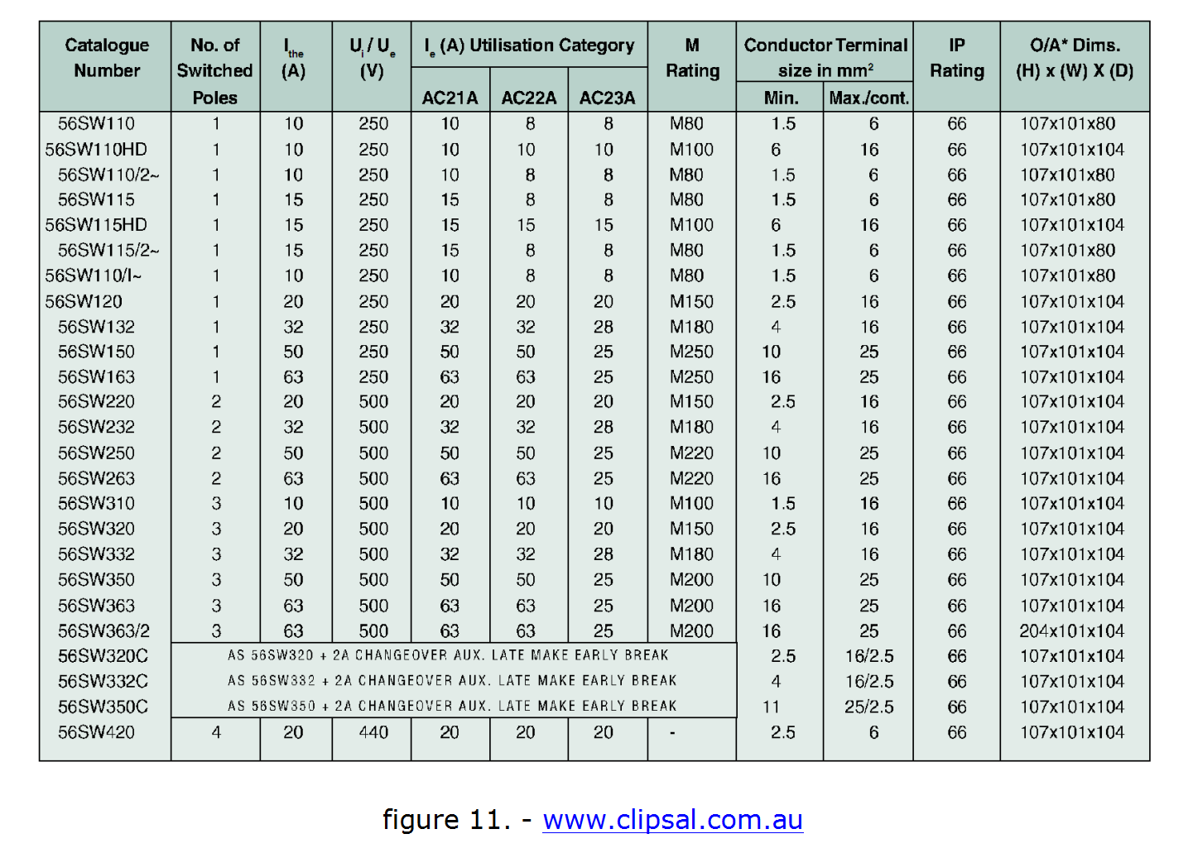
L

Slide 71
1 pole
20A
AC21
1 pole
10A
AC22
L

Slide 72
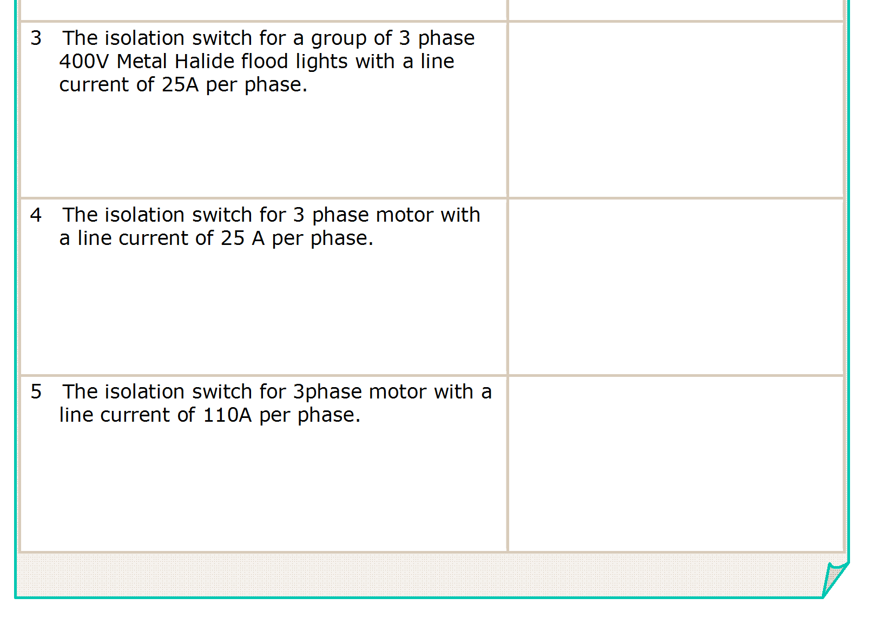
3 pole
32A
AC22
L

Slide 73
L

Slide 74
3 pole
32A
AC22
3 pole
50A
AC23
L

Slide 75
L

Slide 76
3 pole
32A
AC22
3 pole
50A
AC23
3 pole
125 A
AC23
L

Slide 77
END OF LESSON

