Slide 1
Topic 11 - Switchboards
Learners should be able to meet the following learning objectives:
State the AS/NZS 3000 and local supply authority requirements for switchboards.
Explain the tariff structures for the supply of electricity.
List the equipment installed at main switchboards with capacities up to 400 A per phase.
Sketch the layout of a main switchboard for an installation supplied with single phase single tariff whole current metering.
Sketch the layout of a main switchboard for an installation supplied with single phase multiple tariff whole current metering.
Sketch the layout of a main switchboard for an installation supplied with multiphase single tariff whole current metering.
Sketch the layout of a main switchboard for an installation supplied with multiphase multiple tariff whole current metering.
Sketch the layout of a main switchboard for a multiple tenancy installation with whole current metering.
Sketch the layout of a main switchboard, including metering, for an installation supplied with three phase CT metering

Slide 2
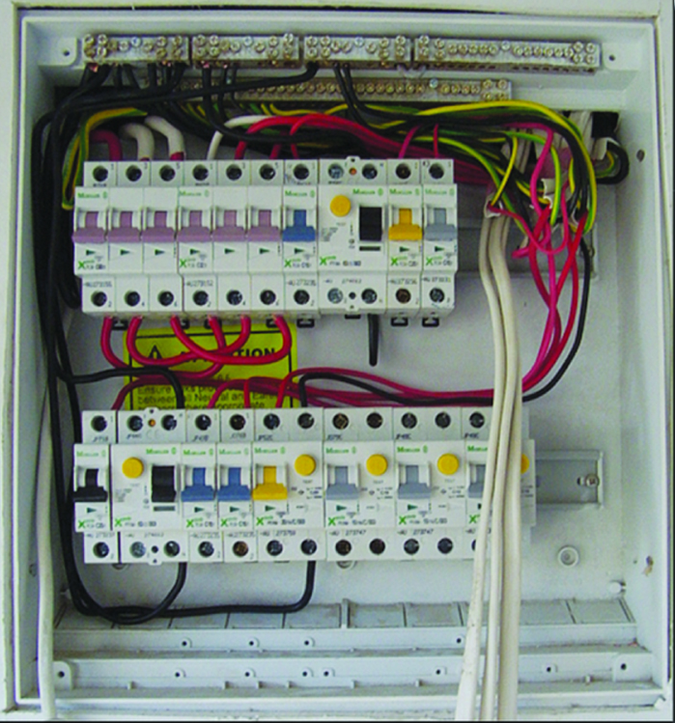

Slide 3
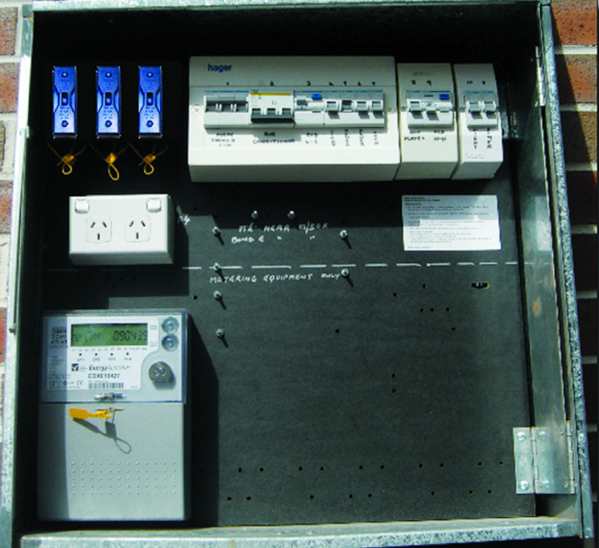

Slide 4
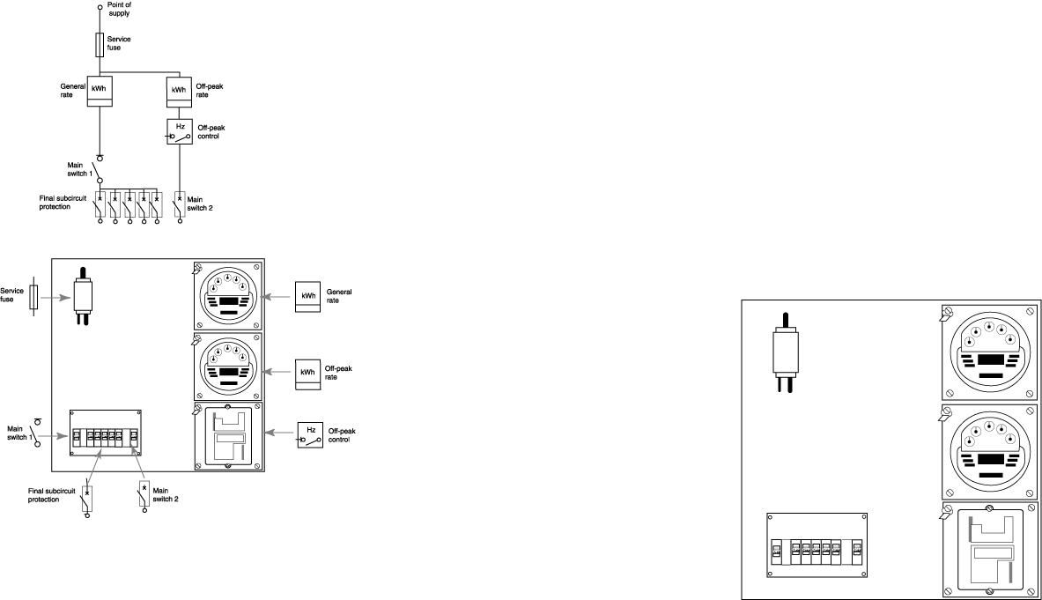
Typical meter box equipped for single-phase supply with meter for domestic tariff, and time switch and meter for off-peak tariff

Slide 5
The type of switchboard used for a particular installation will depend on:-
  load requirements
  number of circuits
  fault level protection requirements
  metering and equipment arrangement
  location
  AS 3000 requirements
  supply authority requirements.

Slide 6
Activity 1 – Location of switchboards
Read AS 3000 clause 2.10.2.1
1. List 3 requirements for the location of switchboards
Well ventilated area
Protected against moisture
Sufficient space for the initial installation and operation, inspection and testing

Slide 7
Activity 2 – Accessibility and emergency exit
Read AS 3000 clause 2.10.2.2
1. What are the minimum dimensions of the door to a room housing a switchboard?
2. What are the dimensions of a standard door? (general knowledge)
3. In relation to the switchboard which way should the door to a room housing a switchboard open?
4. Do the requirements for doors of switch rooms and for emergency exit facilities apply to single domestic electrical installations.?
0.9 m wide by 2.2 m high
0.82 m wide by 2.04 m high
In the direction of egress
(outwards)
No

Slide 8
Activity 3 – Location of main switchboard
Read AS 3000 clause 2.10.2.3
1. What are the general requirements for a main switchboard, or a panel for the remote control of main switches?
2. Can the main switchboard be located within an individual unit of a group of villas?
Readily accessible within easy reach of an entrance
NO

Slide 9
Activity 4 – Identification of main switchboard
Read AS 3000 clause 2.10.2.4
1. What must the main switchboard, of an installation be marked?
2. Is the main switchboard of a single domestic installation required to be marked?
3. List 3 examples of installations in which the main switch board must be identified?
MAIN SWITCHBOARD
NO
Units, factory complex, shopping centre

Slide 10


Activity 5 – Restricted locations
Read AS 3000 clause 2.10.2.5
1. In general what is the minimum height above floor or platform or a switchboard?
2. What are the requirements for switchboards installed in cupboards?
3. Is it permitted to install a switchboard in a fire isolated stairwell?
1.2 m
Activity 5 –
Separate from other sections
At the front of the cupboard
No storage in front
Clear room below cupboard
NO

Slide 11
Activity 6 – Construction
Read AS 3000 clause 2.10.2.5
1. Is it permissible in a non-domestic installation to install a switchboard less than 1.2m above the ground, floor or a platform, if it is lockable?
YES

Slide 12
Activity 7 – Construction
Read AS 3000 clause 2.10.3.4.1
1. What is the requirement for circuit breakers mounted in the same row of a switchboard?
Open in the same direction

Slide 13
Activity 8 – Bars and Links
Read AS 3000 clause 2.10.4.2
Where tunnel type terminals are used in a bar or link, if the screws have an outside diameter of less than 80% of the tunnel diameter, what is the minimum required number of screws for the;
1. Main incoming neutral conductor
2. Main earthing conductor
3. Connection between the main earthing terminal/connection or bar and the neutral bar (MEN connection)
4. Neutral conductor used as a combined protective earthing and neutral (PEN) conductor for protective earthing of any portion of an electrical installation.
Two screws
Two screws
Two screws
Two screws

Slide 14
Activity 9 – Neutral Bars and Links
Read AS3000 clause 2.10.4.3 – NSWSR Clause 4.10
1. What is the minimum current carrying capacity of a service neutral link supplied from a 100A service
2. What is the minimum current carrying capacity of a service neutral link supplied from a 200A service
3. What is the minimum current carrying capacity of a service neutral link supplied from a 400A service
4. What is the minimum current carrying capacity of a consumer’s neutral link for an installation with a maximum demand of 63A?
5. Is it permitted to mount neutral links on the rear of a hinged panel? (Y/N)
6. Is it permitted to have the neutral conductors of two different circuits in the same terminal of a neutral link? (Y/N)
100 A
200 A
400 A
63 A
YES
NO

Slide 15
Activity 10 - Equipment Identification (marking)
AS3000 clause 2.10.5.1
All equipment installed on a switchboard shall be identified in accordance with clause 2.10.5.2 to 2.10.5.6

Slide 16
Activity 11 – Relationship of electrical equipment
Read AS3000 clause 2.10.5.2
1. Does the relationship of switches, circuit-breakers, fuses, RCDs, and similar electrical equipment to the various sections of the electrical installation need to be marked on the switchboard itself?
On or adjacent to the switchboard

Slide 17
Activity 12 – Terminals of switchboard equipment
Read AS 3000 clause 2.10.5.4
1. Which terminals require marking at the consumer’s main neutral bar or link?
To identify corresponding active and neutrals
(MEN at one end and main neutral adjacent)

Slide 18
Activity 13 – Common Neutral
Read AS3000 clause 2.10.5.4
1. What are the requirements when a common neutral is used?
Marked to identify the associated active and neutral

Slide 19
New South Wales Service Rule Requirements
As well as satisfying the requirements of AS3000 switchboards must also be designed and constructed to meet the requirements of the New South Wales Service Rules
The general requirements for the location of switchboards for single
installations up to 100 amperes per phase are covered in Sections 4.1
to 4.13 of the New South Wales Service and Installation Rules.

Slide 20
Activity 14 – NSWSR – General Requirements
Read NSWSR clause 4.2
1. To provide and maintain adequate space in front of the service and metering equipment panel or cabinet, what vertical distance is required?
2. To provide and maintain adequate space in front of the service and metering equipment panel or cabinet, what horizontal distance is required?
3. When a hinged meter panel is extended on its hinge to the 90⁰ open position, what clearance is required between the front face of the panel and any fixed object?
2 m
0.6 m
0.2 m

Slide 21
Activity 15 – NSWSR – General Requirements
Read NSWSR clause 4.2.1
1. If service and metering equipment is to be located on the side of a house, what is the maximum permissible distance from the front corner of the house?
2. Is it recommended that the service and metering equipment be located on a wall adjacent to a bedroom?
1.5 m
Should be avoided

Slide 22
Activity 16 – NSWSR – Metering Locations
Read NSWSR sections 4.2 & 4.3
Answer yes or no if the following locations are suitable for metering and service equipment.
1. In the general area inside a shop in a single premises that is open retail hours.
2. A shops display window in a group of retail outlets.
3. A grouped metering point on the 3rd floor of a multi storey shopping complex.
4. A grouped metering point on the 3rd floor of a block of home units.
5. A grouped metering point within the yard of an individual unit of a group of town houses.
6. Within a factory unit within a group of factory units.
7. Remotely read metering within a factory complex.
8. A driveway
9. In pool or spa areas.
10. A carport
11. A dog run
12. On a pole belonging to the supply authority
Read NSWSR sections 4.2 & 4.3
Answer yes or no if the following locations are suitable for metering and service equipment.
1. In the general area inside a shop in a single premises that is open retail hours.
2. A shops display window in a group of retail outlets.
3. A grouped metering point on the 3rd floor of a multi storey shopping complex.
4. A grouped metering point on the 3rd floor of a block of home units.
5. A grouped metering point within the yard of an individual unit of a group of town houses.
6. Within a factory unit within a group of factory units.
7. Remotely read metering within a factory complex.
8. A driveway
9. In pool or spa areas.
10. A carport
11. A dog run
12. On a pole belonging to the supply authority
YES
Activity 16 – NSWS
NO
YES
YES
NO
NO
YES
NO
NO
NO
NO
NO

Slide 23
Activity 17
Service Protective Devices
NSWSR clause 4.7
Service Protective Devices (S.P.D.) are provided at the end of the consumers mains to provide Prospective short circuit current protection. An isolation point. Overload protection of whole current metering. The current ratings of service protective devices are given in table 4.1 of the NSWSR. Suitable current ratings of service protective devices are selected based on the rating of the service supplying the installation, which is determined by the maximum demand of the installation.

Slide 24
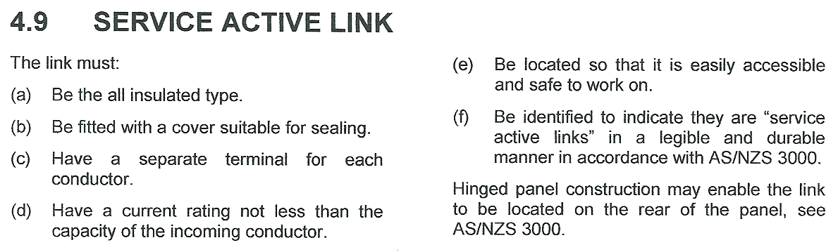
Activity 18 – Service Active Links NSWSR 4.9

Slide 25
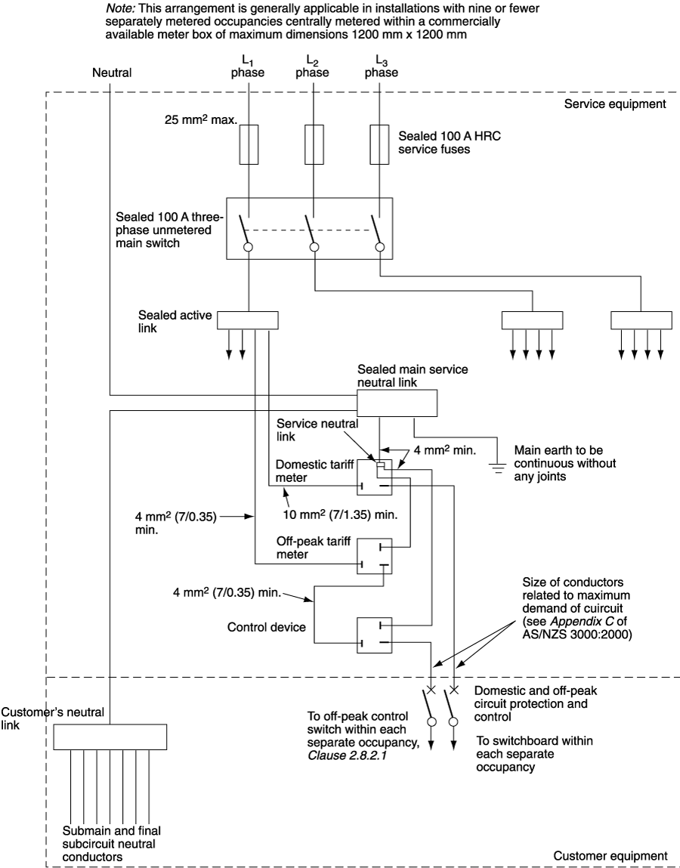

Slide 26
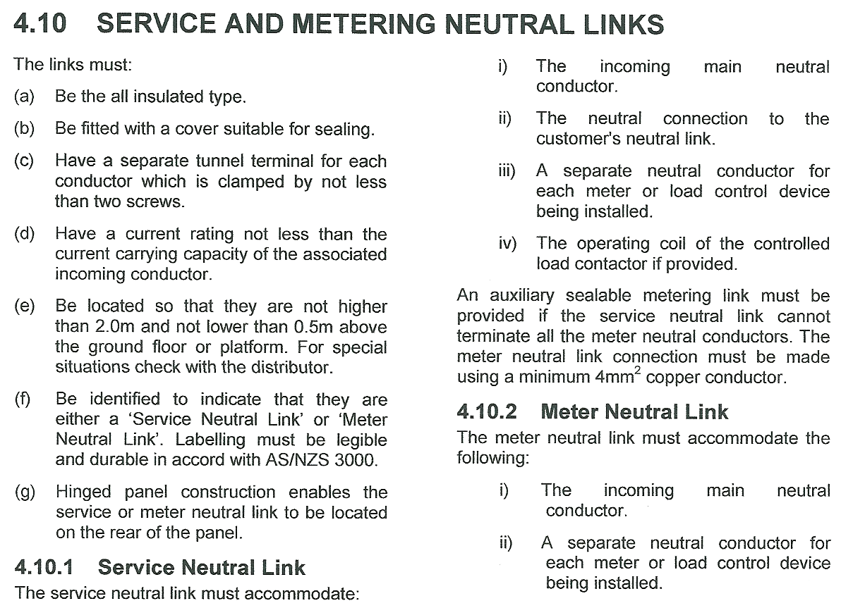
Activity 19 – Service & Metering Neutral Links NSWSR 4.10

Slide 27
Activity 20 – NSWSR – Whole current metering
Read NSWSR clause 4.11
1. What is the maximum permissible current per active conductor when using whole current metering?
2. What is the maximum permissible height for the top edge of a meter above the ground floor or a platform?
3. What is the minimum permissible height for the bottom of a meter above the ground floor or a platform?
100 A
2 m
0.5 m
Amendment 2015

Slide 28
Regulated Retail Tariffs The NSW Government has introduced competition into the retail market. Currently all customers may choose their supplier of electricity. The Tribunal has determined regulated retail tariffs for small retail customers (ie, those customers who use less than 160 MWh per year who do not choose to enter a negotiated contract). In NSW as of July 2010 there is three regulated retail suppliers; Origin (Country Energy) Ausgrid (Energy Australia ) Endeavour (Integral Energy) As well the regulated retailers listed above, it is also possible to purchase electricity under a negotiated contract from interstate suppliers. Regardless of which electricity retailer is used the tariff structures are similar. Clause 2.3.3.2 (a) of AS3000 states each separately metered supply requires a separate main switch.

Slide 29
Domestic / Residential Premises used wholly or principally as private dwellings. A private dwelling is a; house flat home unit town house or similar premises places of worship and includes Residential sections of: Boarding houses Bed and breakfast Nursing homes Hospitals Educational institutions Approved caravan parks whose consumption does not exceed 160MWh per year.

Slide 30
General / Business Rate These prices are generally applicable to; factories warehouses hotels motels shops and offices schools sheds irrigation pumps sporting and social clubs whose consumption does not exceed 160MWh per year.

Slide 31
Off Peak 1 / Controlled Load 1 The supply of electricity is controlled by means of the retailer/distributor’s service equipment, either a ripple control relay or time clock. The supply will not usually be available between 7 am and 10 pm Monday to Friday. Supply is usually available weekends. This tariff is intended for use with; Storage hot water systems with a heating element rated at 4.8kW and a capacity of 250L or more. Thermal Storage Space Heaters (Heat Banks) and Under Floor Heaters rating must be not less than 3 kW. Ice Storage Systems rating must be not less than 3 kW. Heat pump storage H.W.S. are not permitted for use with this tariff.

Slide 32
Off Peak 2 / Controlled Load 2 The supply of electricity is controlled by means of the retailer/distributor’s service equipment so that supply will be available for restricted periods generally not exceeding 17 hours in any period of 24 hours. Generally supply is not available between 5 p.m. to 10 p.m. Loads which are permitted to be supplied by this tariff include: Storage hot water systems with a heating element rated at 4.8kW and a capacity of 100L or more. Heat pump storage H.W.S. swimming pool pumps pool heating equipment dishwashers clothes dryers washing machines and other appliances (other than those described above).

Slide 33
Dual Element “Big Blue” Tariff
Special "Big Blue" hot water systems, equipped with two non-simultaneous heating units, are installed to meet Integral Energy’s minimum tank size requirements as follows:
Number of Bedrooms | Minimum Capacity H.W.S.
1 or 2 | 250 litres
3 | 315 litres
4 or more | 400 litres
In this case, supply is made available to the bottom-heating element outside the period between 7 am and 10 pm. However, the top element can be heated at any other time (at Off-Peak 1) to satisfy customer needs for hot water.

Slide 34
Time of Use Time of Use prices (TOU) are available for business or residential supply. The Time of Use option enables financial benefits for controlled usage at predetermined time, periods as listed in definitions below. PEAK PERIOD is from 7.00 am to 9.00 am and 5.00 pm to 8.00 pm on weekdays. SHOULDER PERIOD is from 9.00 am to 5.00 pm and 8.00 pm to 10.00 pm on weekdays. OFF-PEAK PERIOD is at all other times. All times are Eastern Standard Time and Summer (daylight saving) Time as appropriate.

Slide 35
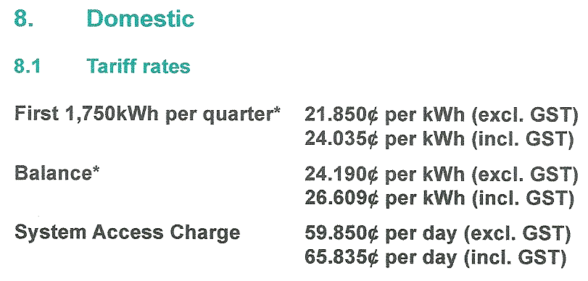
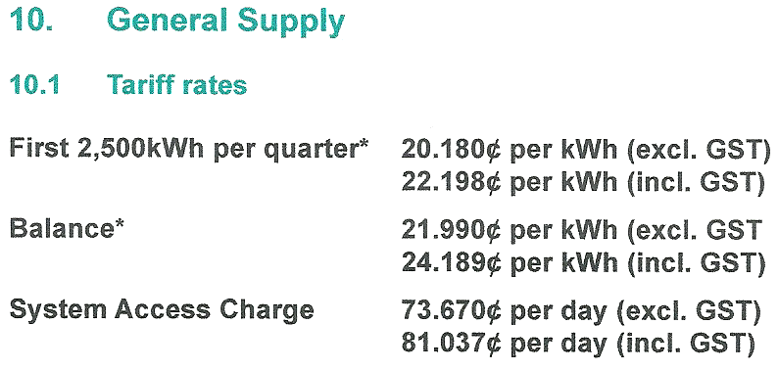
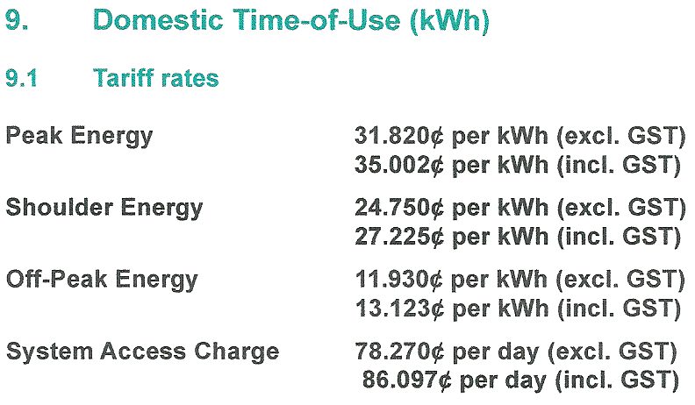
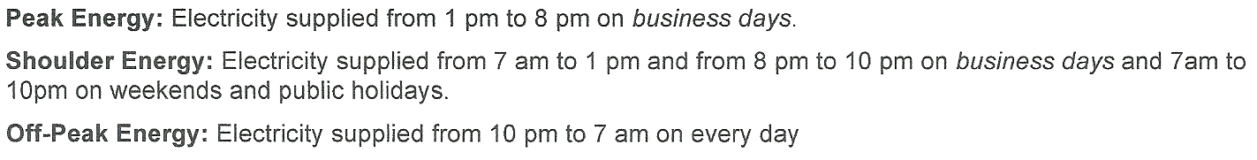

Slide 36
Activity 21 – Tariffs
Refer to Tariffs for your locality
1. What is the Business / General rate?
2. What is the Business / General network access / supply charge?
3. What is the Residential / Domestic rate?
4. What is the Residential / Domestic network access / supply charge?

Slide 37
Topic 3 - Main Switchboard Equipment Equipment installed on main switchboards includes; Service Protective Device – can be a H.R.C. use or circuit breaker. Energy meters - whole current up to 100A per phase Load control relays / time clocks Main Switch/es Active links Circuit protection devices - H.R.C. fuses. - Circuit breakers - Residual Current Devices - over voltage (surge diverters) Service and metering neutral links Consumers neutral links (unprotected and R.C.D. protected) If the installation has a maximum demand greater than 100A per phase, the main switch board will also house; Energy meters - current transformer type required if > 100A per phase. Current transformers Potential fuses Test links

Slide 38
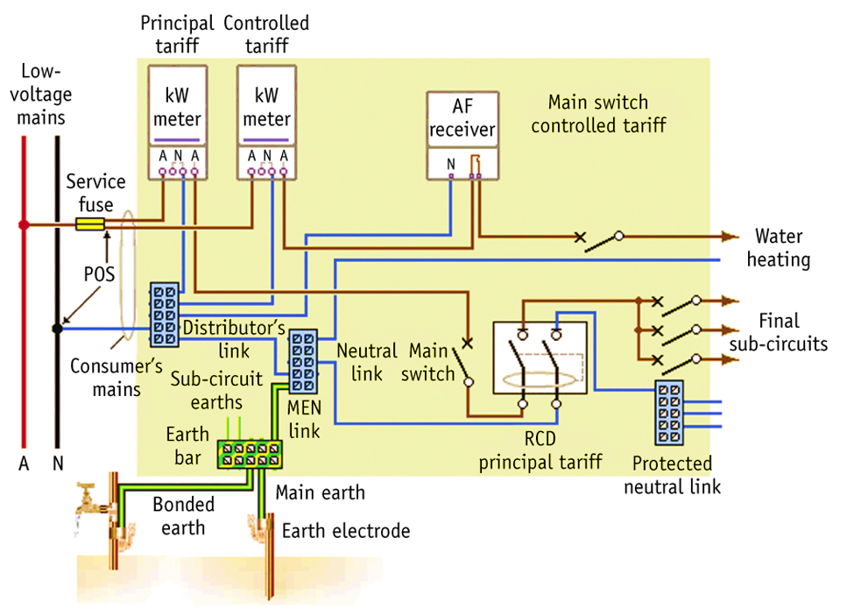

Slide 39
Activity 22 – Conductor sizes
AS3000 clause
A single phase installation has a maximum demand of 60A. It is supplied by a 100 A overhead service. The consumer’s mains are unprotected 16mm² XLPE SDI copper cables. List the CSA of the flowing conductors.
Conductor | CSA | AS 3000 Clause
1. Main Earth
2. M.E.N. link
3. Equipotential bond to switchboard enclosure
4. Equipotential bond to water pipe.
6 mm²
Table 5.1
16 mm²
Cl 5.3.5.2
16 mm²
Cl 5.5.3.5
4 mm²
Cl 5.6.3

Slide 40
Activity 23 – Conductor sizes
AS3000 clause
A three phase installation has a maximum demand of 320A. It is supplied by a 400 A underground service. The consumer’s mains are protected 240 mm² XLPE 4 core aluminium cables. List the CSA of the flowing conductors.
Conductor | CSA | AS 3000 Clause
1. Main Earth
2. M.E.N. link
3. Earth of switchboard enclosure
4. Equipotential bond to water pipe.
50 mm²
Table 5.1
50 mm²
5.5.3.5 EX
50 mm²
Cl 5.6.3.2
4 mm²
Cl 5.6.3

Slide 41
Activity 24 – Whole Current Metering Layouts

Slide 42
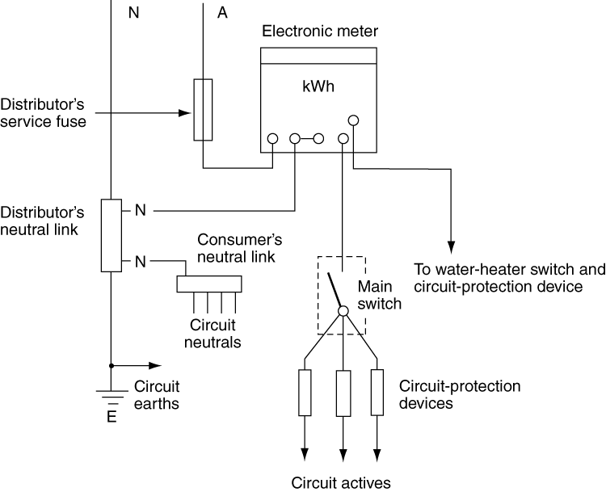
Single tariff whole current metering

Slide 43
Activity 25 – Single Phase Single Tariff

Slide 44
Activity 25 – Single Phase Single Tariff

Slide 45
Single Phase Dual Tariff

Slide 46
Single Phase Dual Tariff “E2” Meter

Slide 47
Activity 26 – Single Phase Dual Tariff

Slide 48
Activity 26 – Single Phase Dual Tariff

Slide 50
Three Phase Single Tariff

Slide 51
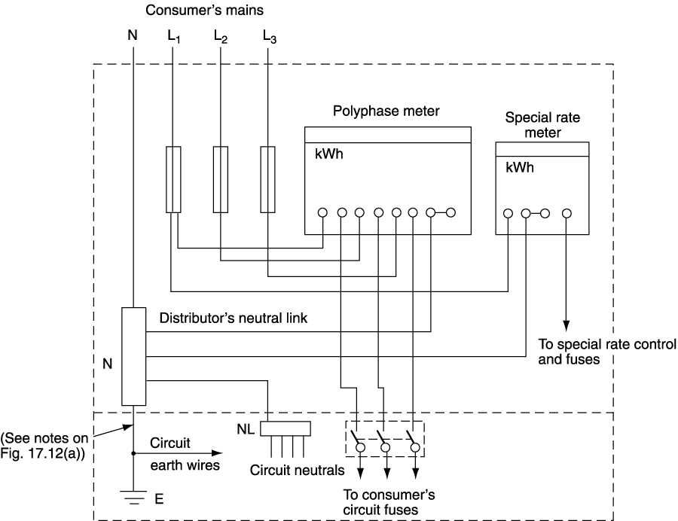
Three phase dual tariff metering

Slide 52
Three Phase Single Tariff (Polyphase meter)

Slide 53
Activity 27 – Three Phase Single Tariff E1 Meters

Slide 54
Activity 27 – Three Phase Single Tariff E1 Meters

Slide 55
Activity 28 – Three Phase Dual Tariff E2 Meters

Slide 56
Activity 28 – Three Phase Dual Tariff E2 Meters

Slide 57
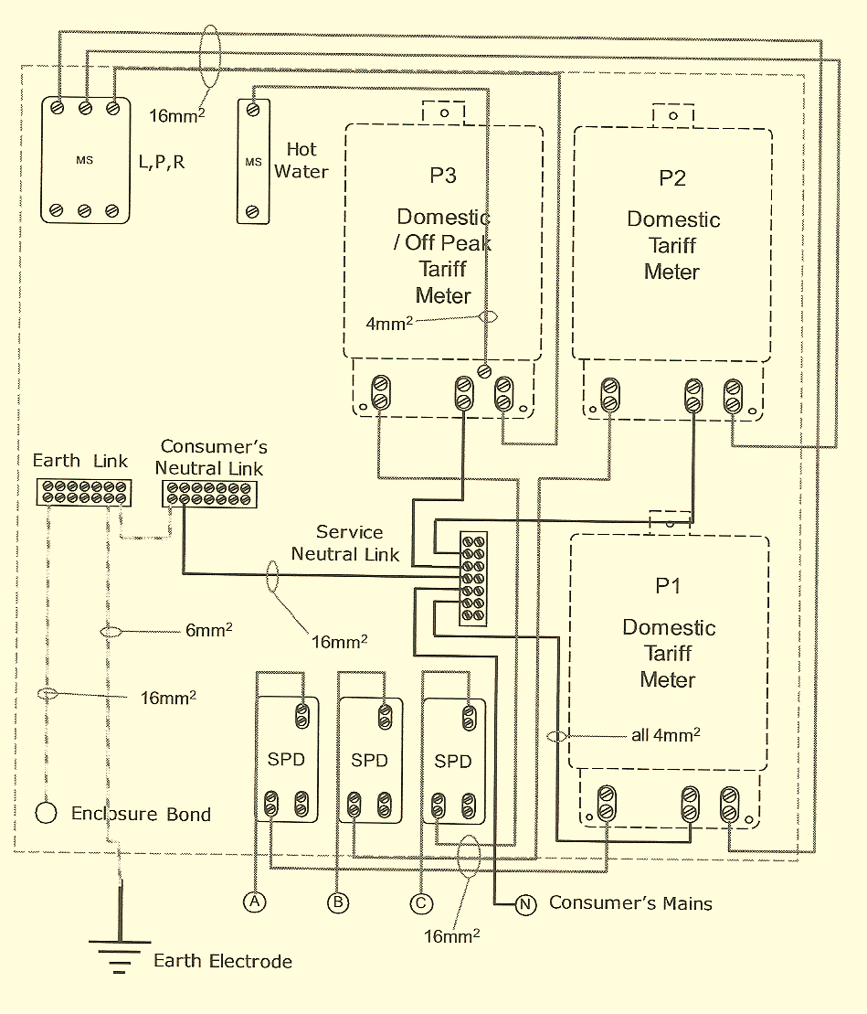

Slide 58
Multiple tenancy installation

Slide 59
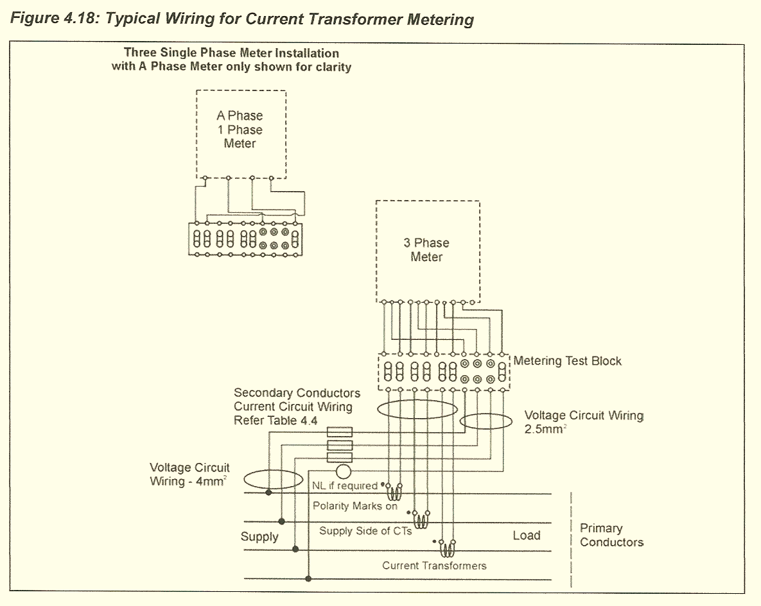

Slide 60
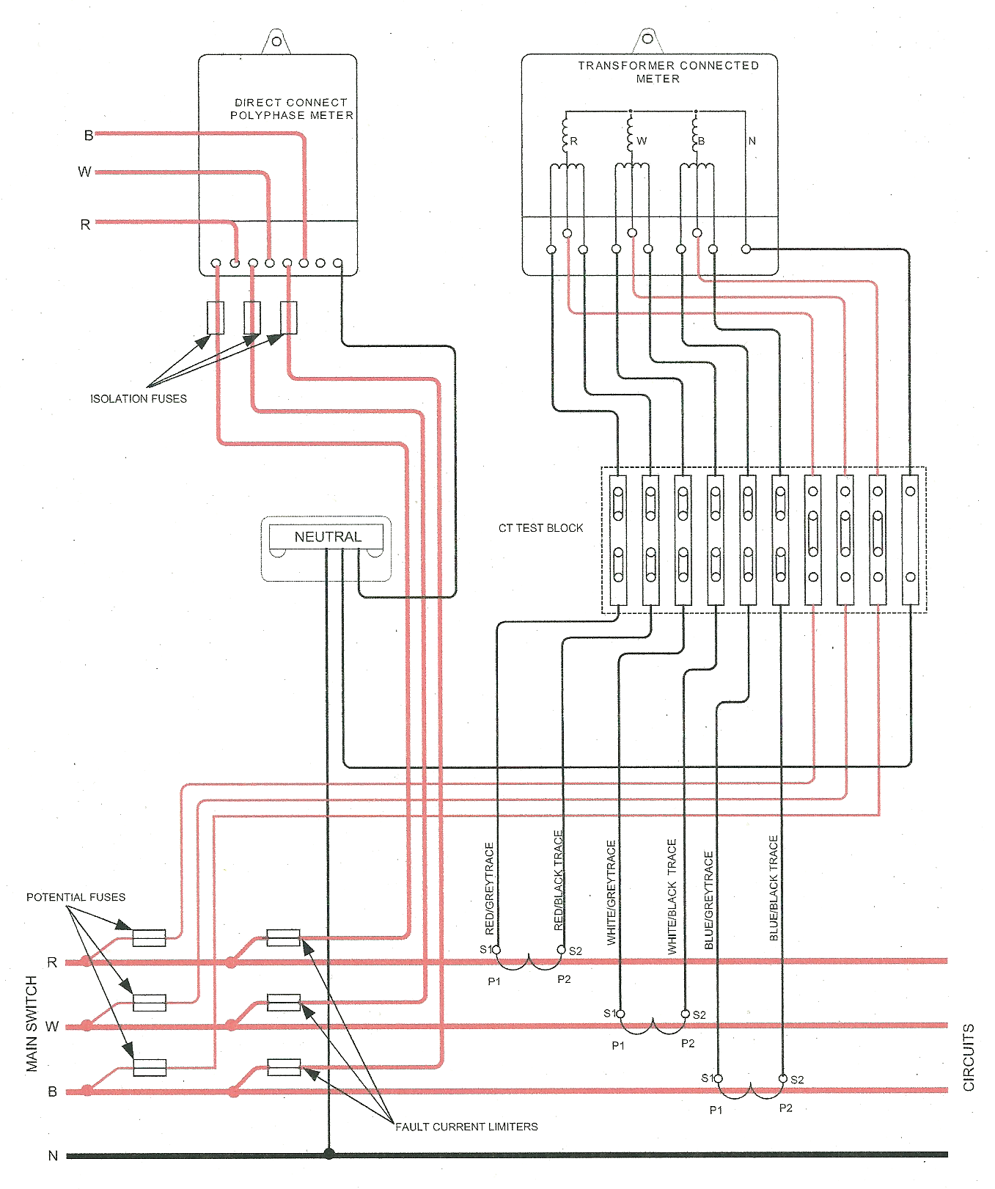

Slide 61
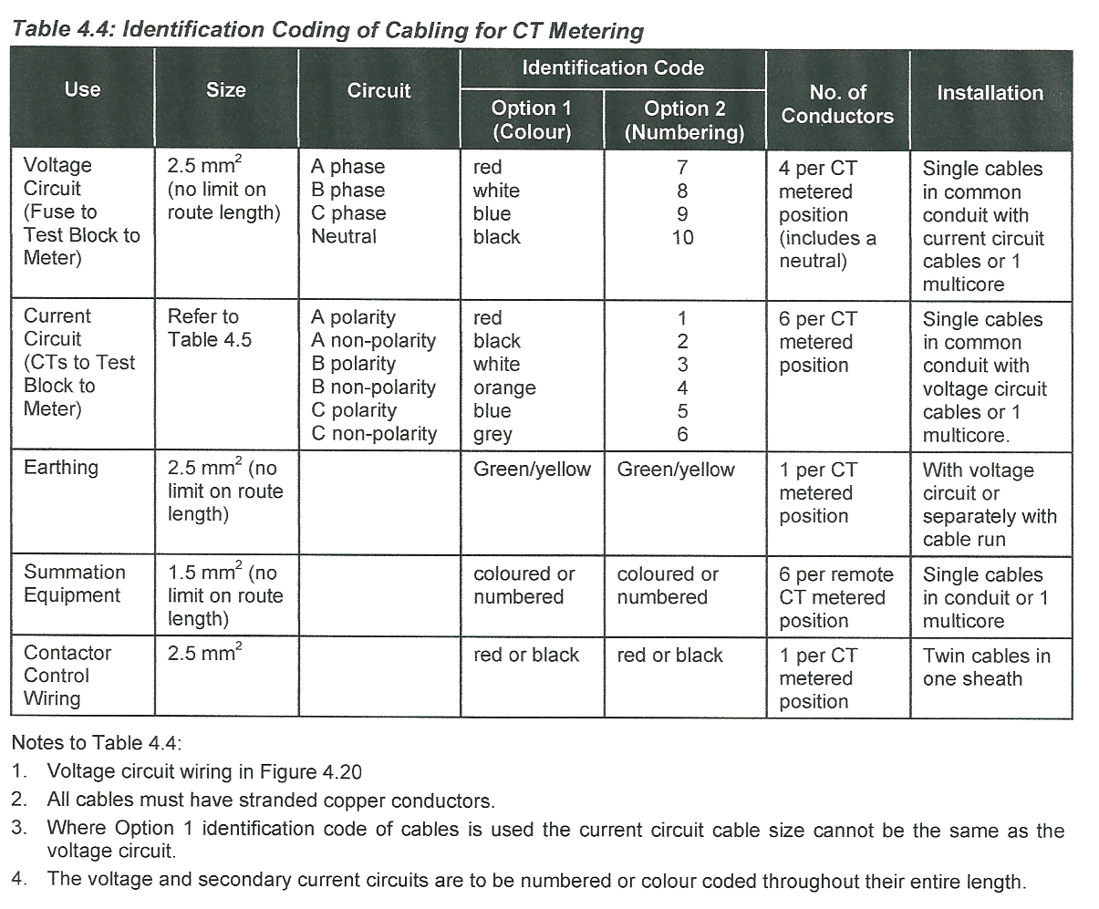

Slide 62
Activity - 27 – C.T. Metering Layouts NSWSR 4.17

Slide 63
Activity - 27 – C.T. Metering Layouts NSWSR 4.17

Slide 65
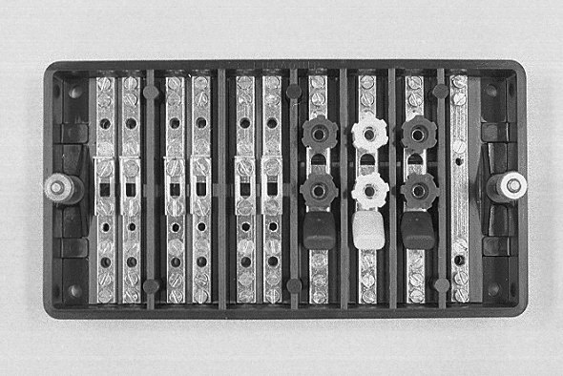
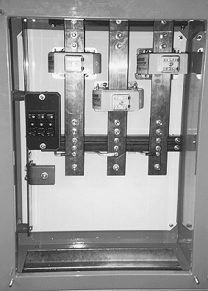
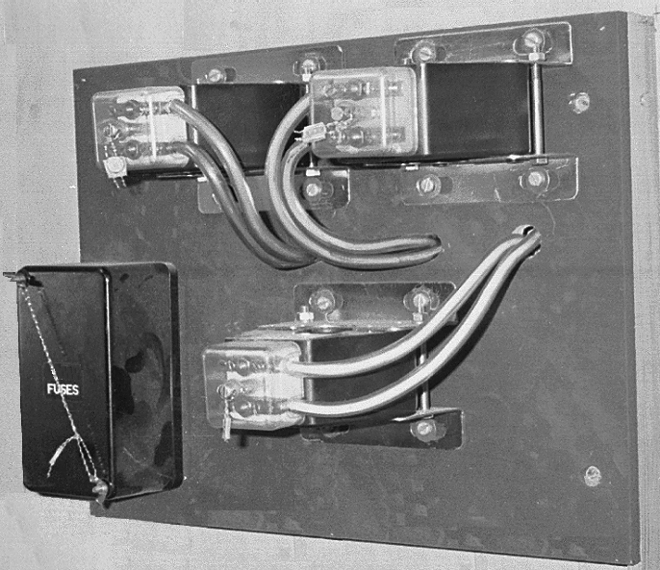

Slide 67
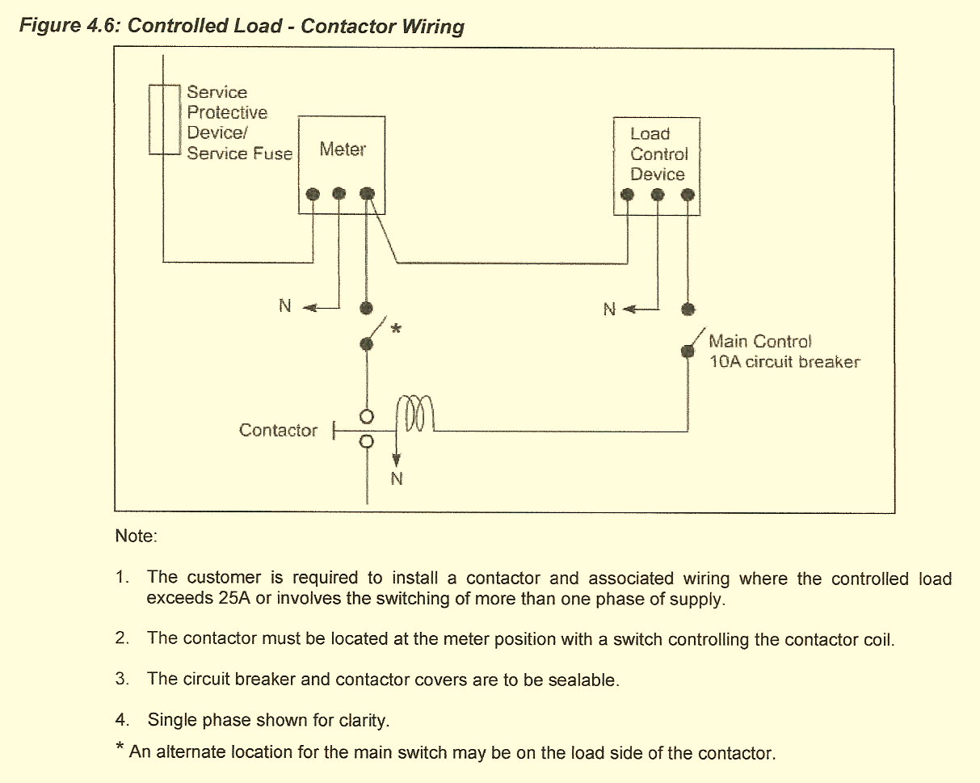

Slide 68
The following switchboard wiring contains seven faults. List each fault
and state the relevant associated clause.
Consumer’s mains are run buried in the ground and all final sub-circuits
are run partially surrounded.

Slide 70
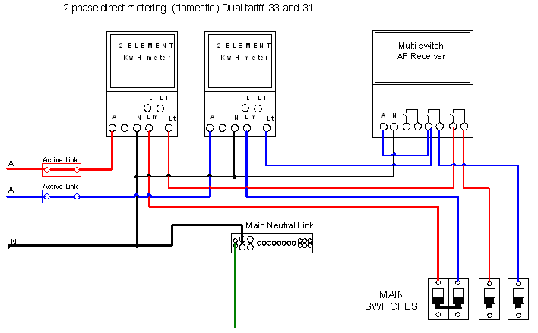

Slide 73
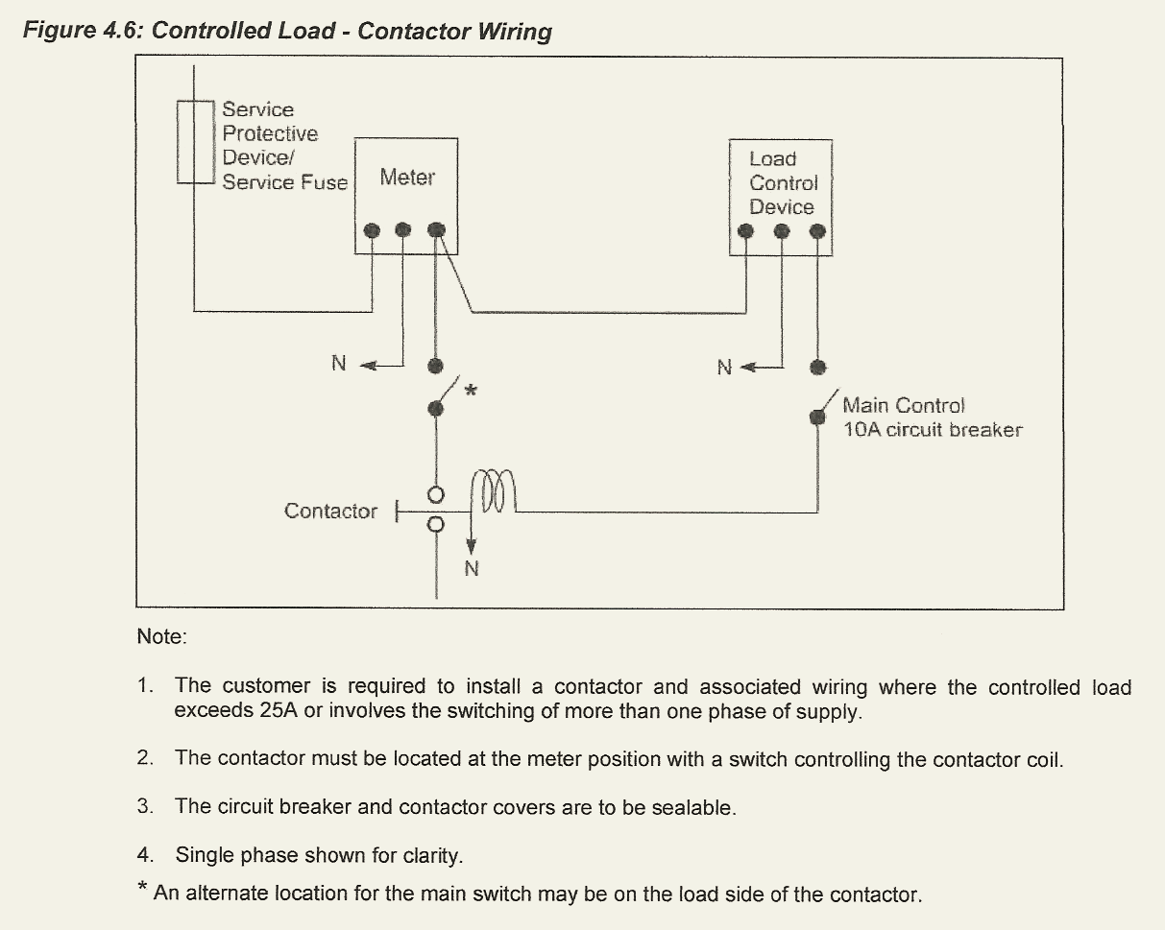

Slide 74
AUSGRID ES3 Part A metering Installation
E1  single phase, single element meter (Refer ES3, Part B for details)
E2  single phase, dual element meter, with pre-programmed controlled load facility
(ripple frequency relay or time switch). (Refer ES3, Part B for details)
E3  3-phase, single element. (Note: This 3-phase meter must only be used to meter a
single tariff). (Refer ES3, Part B for details).
L – Load Control Device - a ripple receiver or time switch for up to 25A switching of
resistive load. See clause 2.1.6 for more information on the requirements for controlled
load. (Refer ES3, Part B for details).
Table 1 following shows the standard whole current metering configurations for new
and upgraded sites (i.e. increase in the number of supply phases).

Slide 75
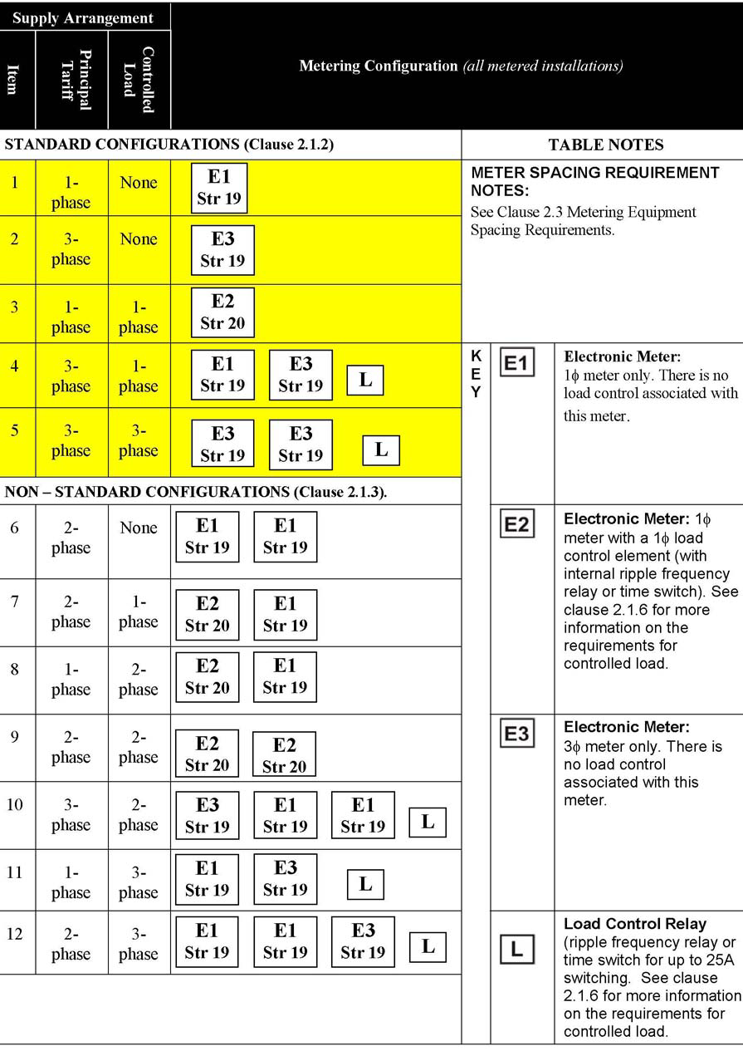

Slide 76
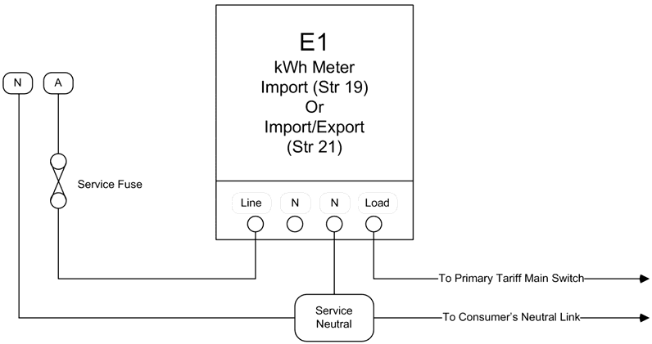

Slide 77
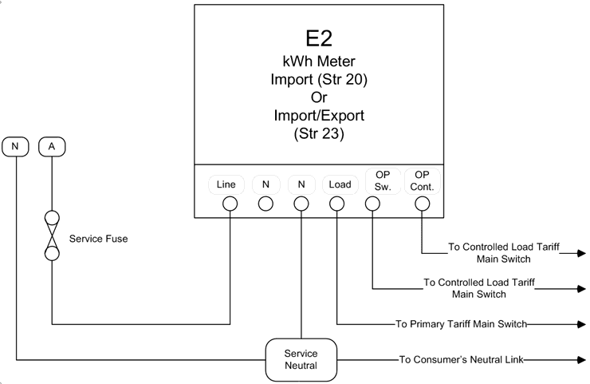

Slide 78
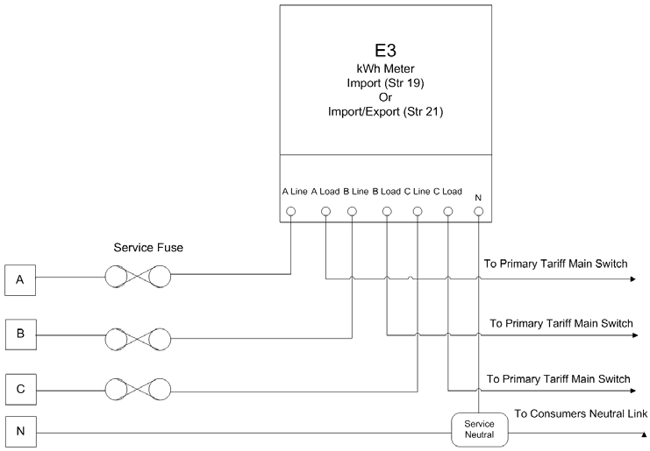

Slide 79
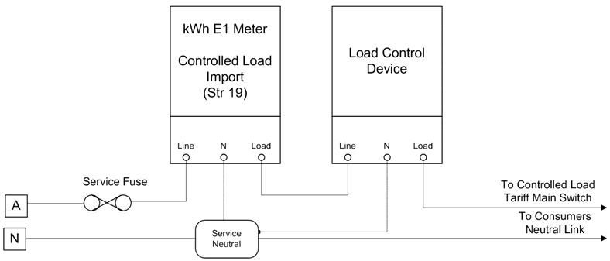

Slide 80
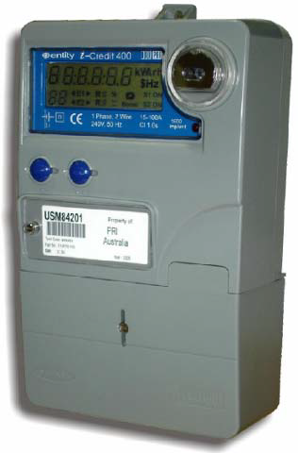
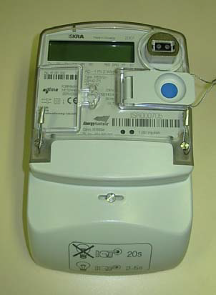
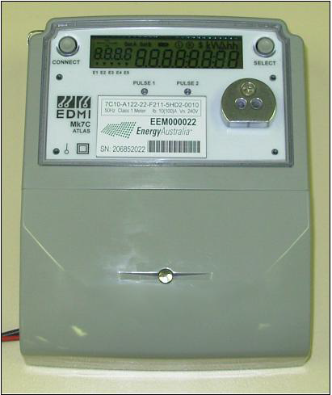

Slide 81
