Slide 2
SECTION 2
FINAL SUBCIRCUITS ARRANGEMENTS

Slide 3
FINAL SUBCIRCUIT ARRANGEMENTS
Topics
Arrangement into circuits
Maximum demand
Factors determining number and type of circuits
Current requirements for final sub-circuits
Circuit layouts/schedules
SELV and PELV circuits
Isolated supply circuits
Aim
Learners will plan the cable arrangements for final sub-circuits in a variety of installations.
L

Slide 4
FINAL SUBCIRCUIT ARRANGEMENTS
Learning objectives:
Learners should be able to meet the following learning objectives:
Determine the daily and seasonal demand for lighting, power, heating and other loads in a given installation.
Determine the number and types of circuits required for a particular installation.
Determine the current requirements for given final sub-circuits.
Prepare a layout/schedule of circuits for given installations.
Determine an application and arrangement of a SELV and PELV circuit
Determine an application and arrangement of an isolated supply
L

Slide 5
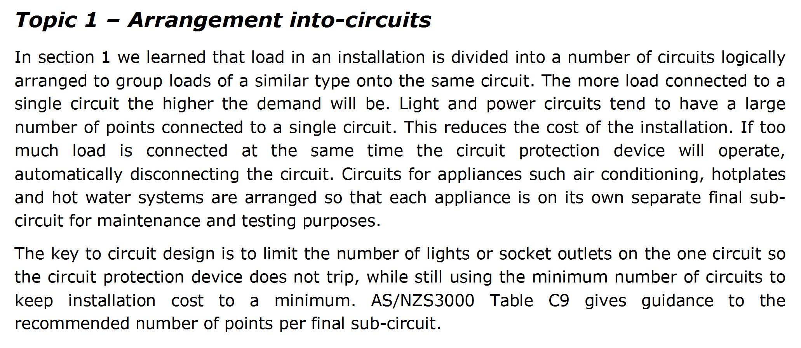
L

Slide 6
L

Slide 7
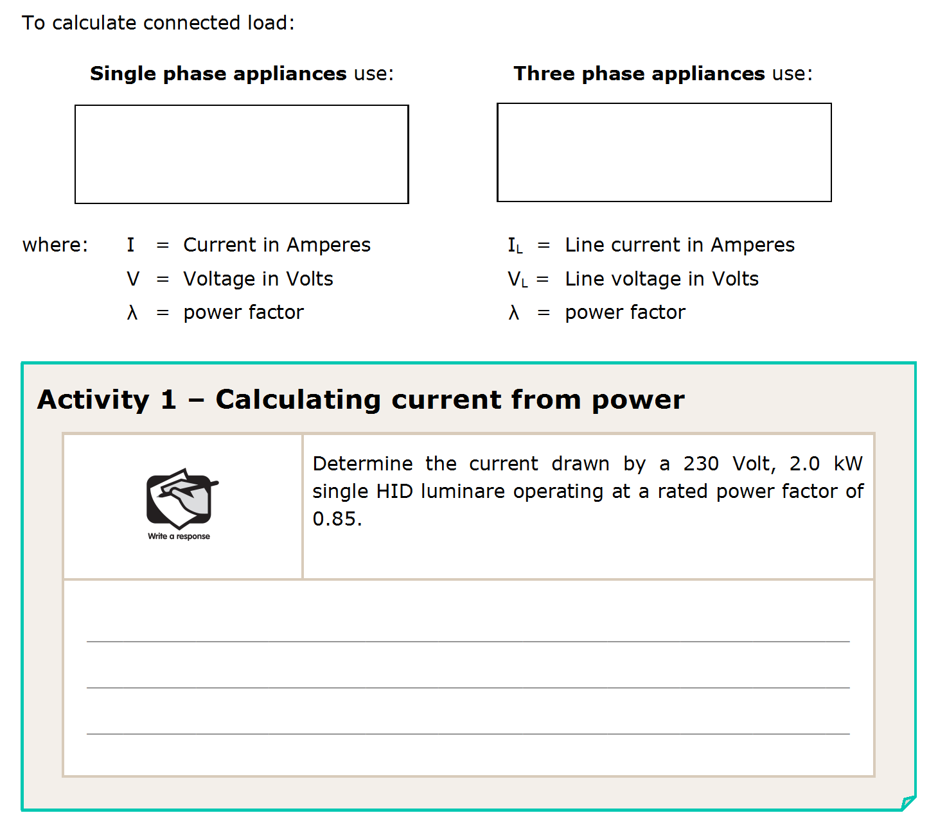
I = P
I_{L} = P
(V x λ)
(√3 x V_{L} x λ)
I = P
= 2000
(V x λ)
= 10.23A
(230 x 0.85)
L

Slide 8
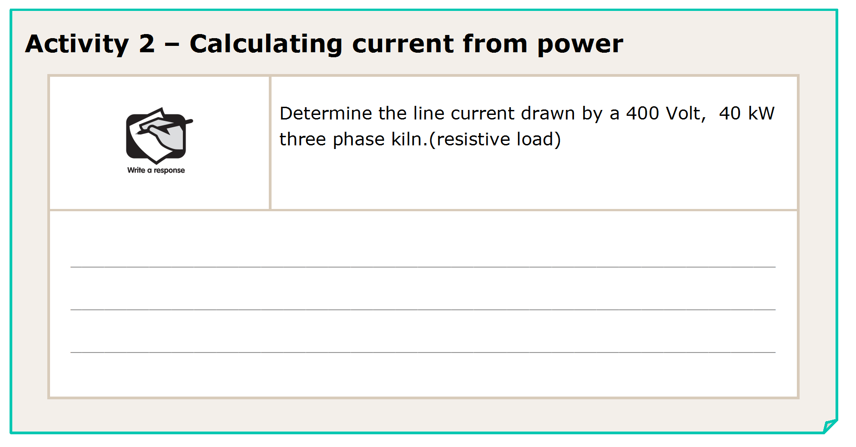
I_{L} = P
= 40000
= 57.7A
(√3 x V_{L} x λ)
(√3 x 400 x 1)
L

Slide 9
L

Slide 10
L

Slide 11
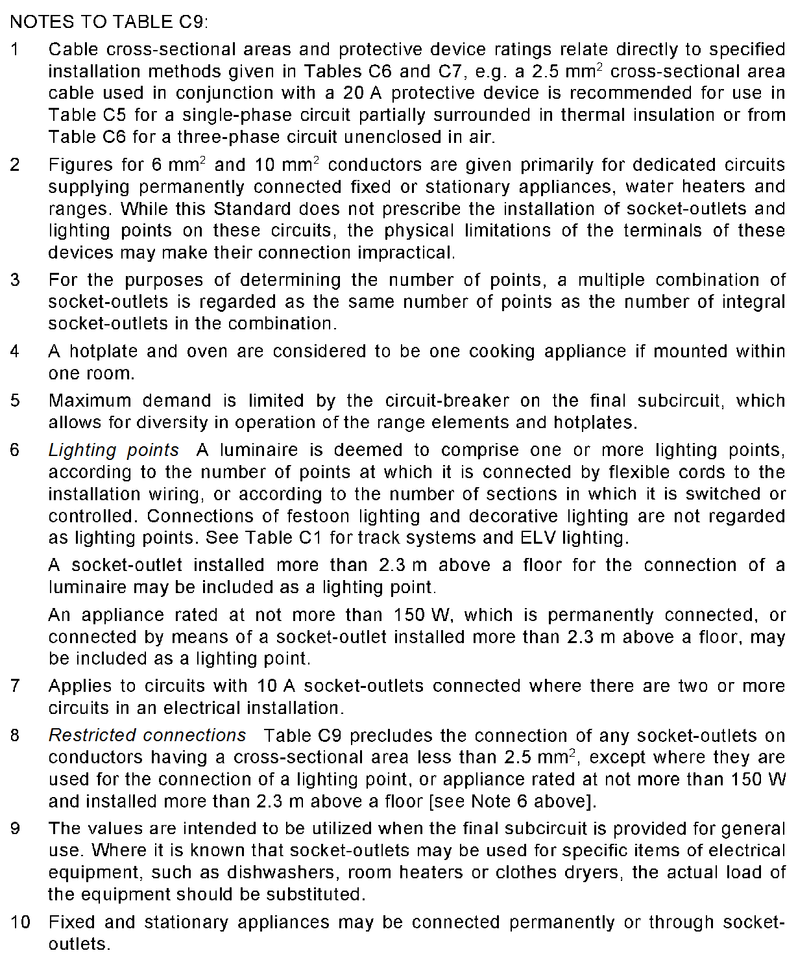
L

Slide 12
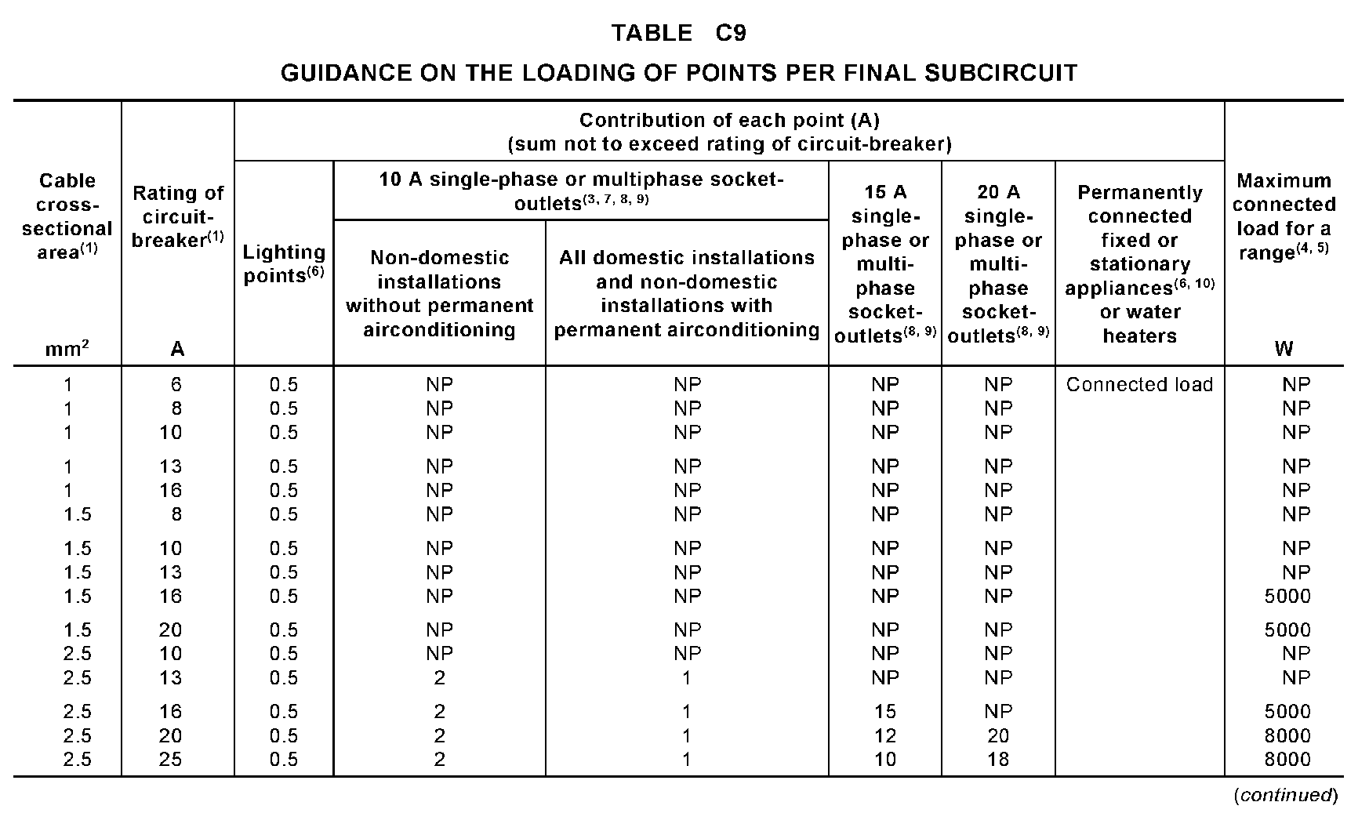
32 lights (10A CB)
32 x 0.5 = 16A.
can’t put on 1 x 10A C.B.
16 x 0.5 = 8A
2 circuits x 10A C.B.’s
L

Slide 13
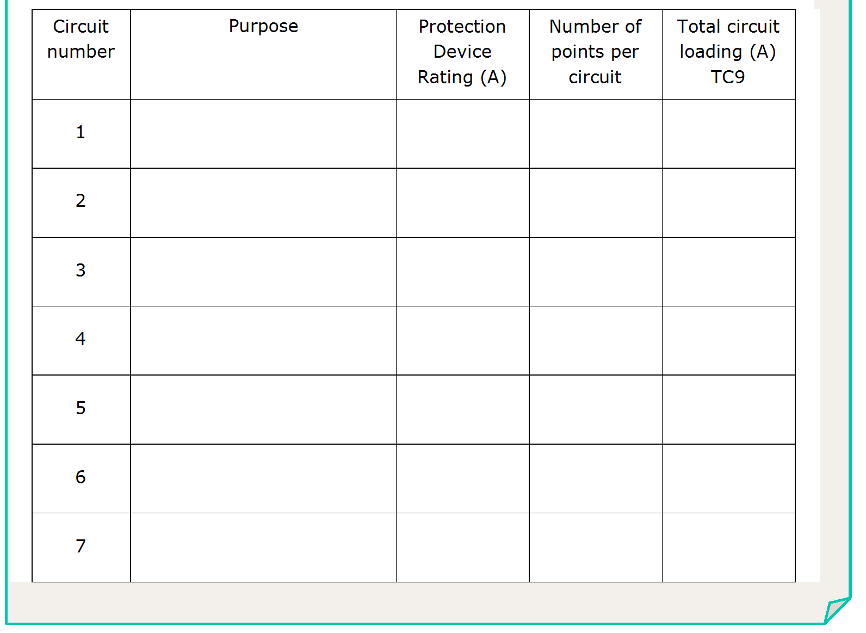
Light 1
10A
16
8A
Light 2
10A
16
8A
L

Slide 14
L

Slide 15
L

Slide 16
1 double = 2 points.
24 x 2 = 48 points.
48 x 1 = 48A.
can’t put on 1 x 20A C.B.
can’t put on 2 x 20A C.B.
16 x 1 = 16A
3 circuits x 20A C.B.’s
L

Slide 17
Light 1
10A
16
8A
Light 2
10A
16
8A
Power 1
20A
8Doubles
(16points)
16A
Power 2
20A
8Doubles
(16points)
16A
Power 3
20A
8Doubles
(16points)
16A
L

Slide 18
L

Slide 19
L

Slide 20
Connected load = 25A
1 point per final sub-circuit
L

Slide 21
Light 1
10A
16
8A
Light 2
10A
16
8A
Power 1
20A
8Doubles
(16points)
16A
Power 2
20A
8Doubles
(16points)
16A
Power 3
20A
8Doubles
(16points)
16A
A/C
25A
1
25A
L

Slide 22
L

Slide 23
Connected load = P/V
= 4400/230
= 19.1A
1 point per final sub-circuit
L

Slide 24
Light 1
10A
16
8A
Light 2
10A
16
8A
Power 1
20A
8Doubles
(16points)
16A
Power 2
20A
8Doubles
(16points)
16A
Power 3
20A
8Doubles
(16points)
16A
A/C
25A
1
25A
H.W.S.
20A
1
19.1A
L

Slide 25
L

Slide 26
10 x 1.85 = 18.5A
can’t put on 1 x 16A C.B.
So 2 circuits needed
10 / 2 = 5 points per circuit
L

Slide 27
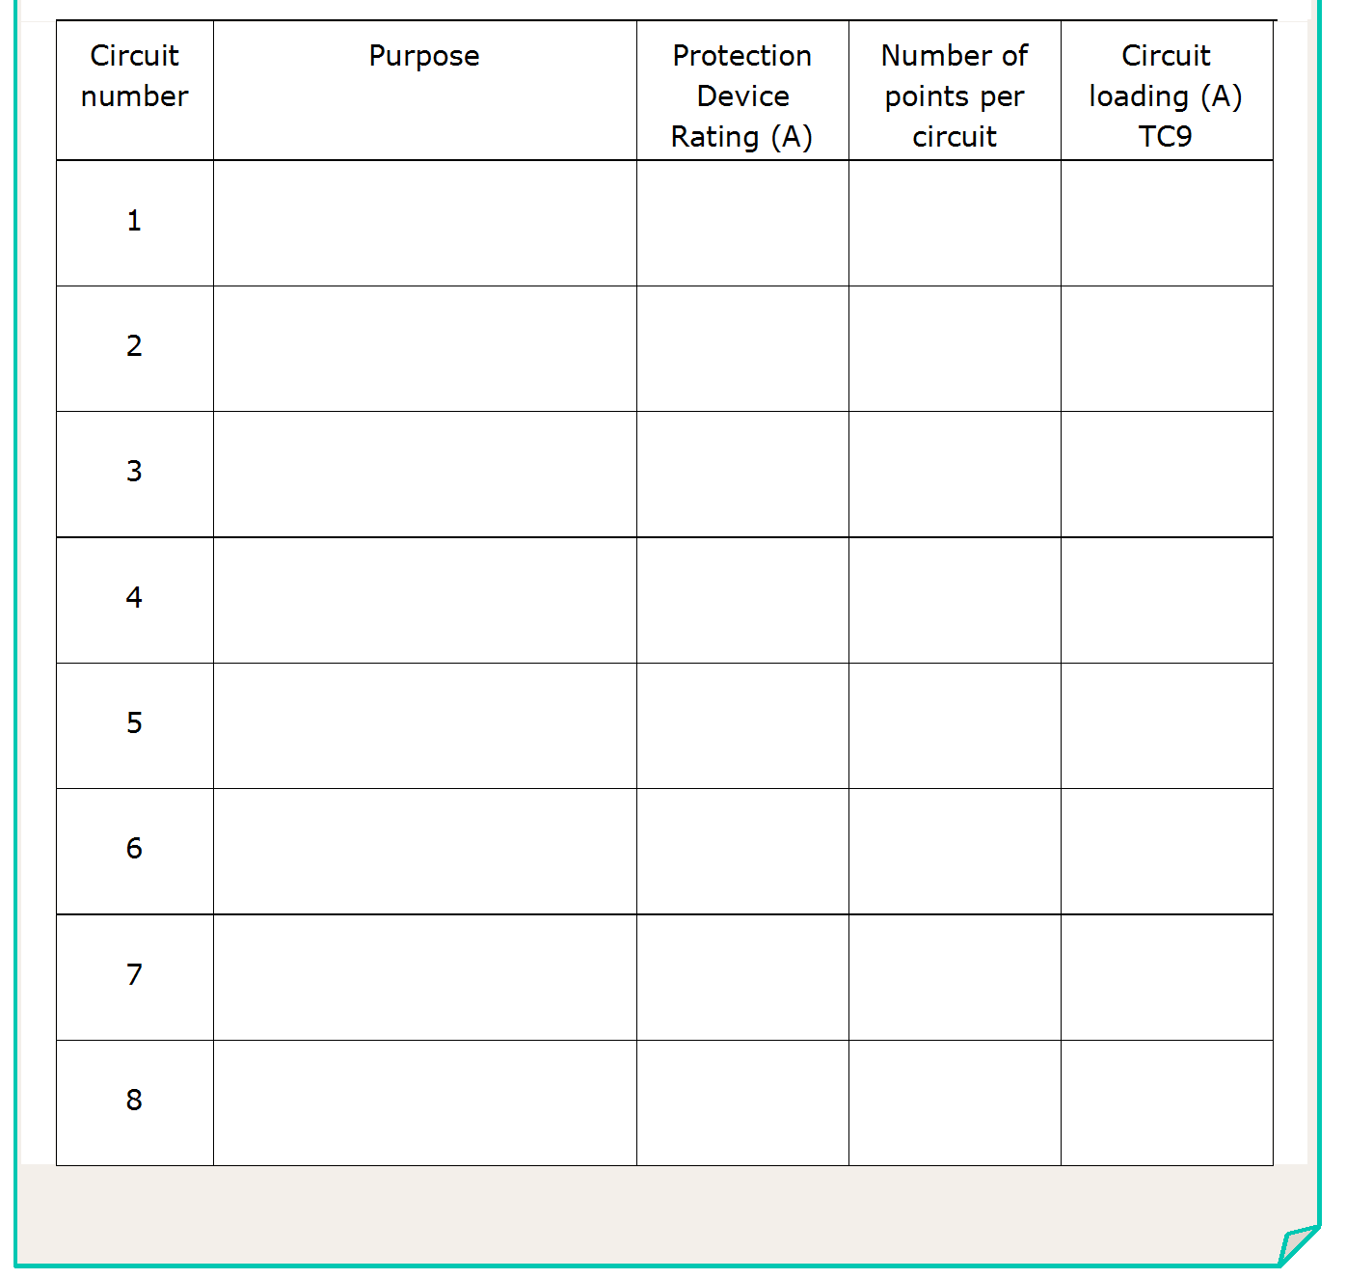
H/Bay Light 1
16A
5
9.25A
H/Bay Light 2
16A
5
9.25A
L

Slide 28
L

Slide 29
22 x 0.5 = 11A.
can put on 1 x 20A C.B.
L

Slide 30
H/Bay Light 1
16A
5
9.25A
H/Bay Light 2
16A
5
9.25A
Light 3
20A
22
11A
L

Slide 31
L

Slide 32
12 x 10A Socket Outlets
How many circuits?
L

Slide 33
H/Bay Light 1
16A
5
9.25A
H/Bay Light 2
16A
5
9.25A
Light 3
20A
22
11A
Power 1
20A
6
12A
Power 2
20A
6
12A
L

Slide 34
L

Slide 35
L

Slide 36
H/Bay Light 1
16A
5
9.25A
H/Bay Light 2
16A
5
9.25A
Light 3
20A
22
11A
Power 1
20A
6
12A
Power 2
20A
6
12A
32A Outlet 1
32A
1
32A
32A Outlet 2
32A
1
32A
32A Outlet 3
32A
1
32A
L

Slide 37
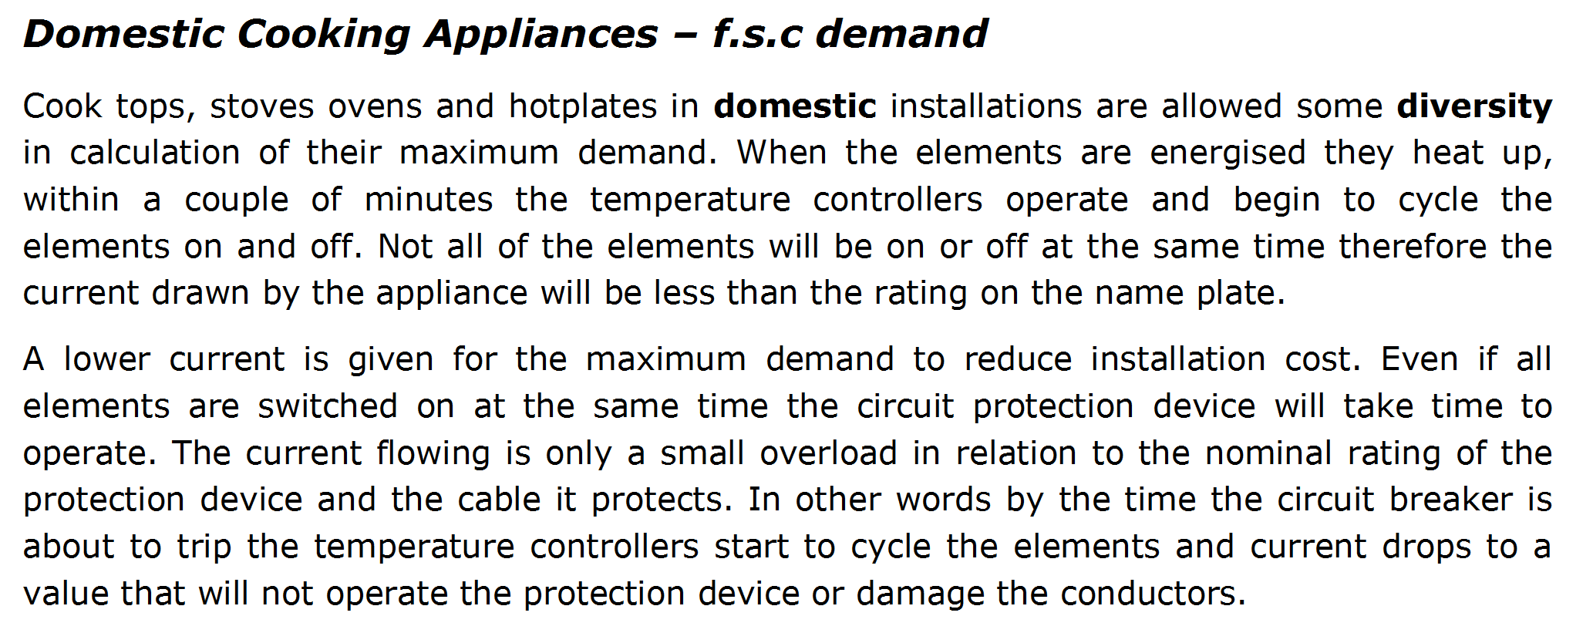
L

Slide 38
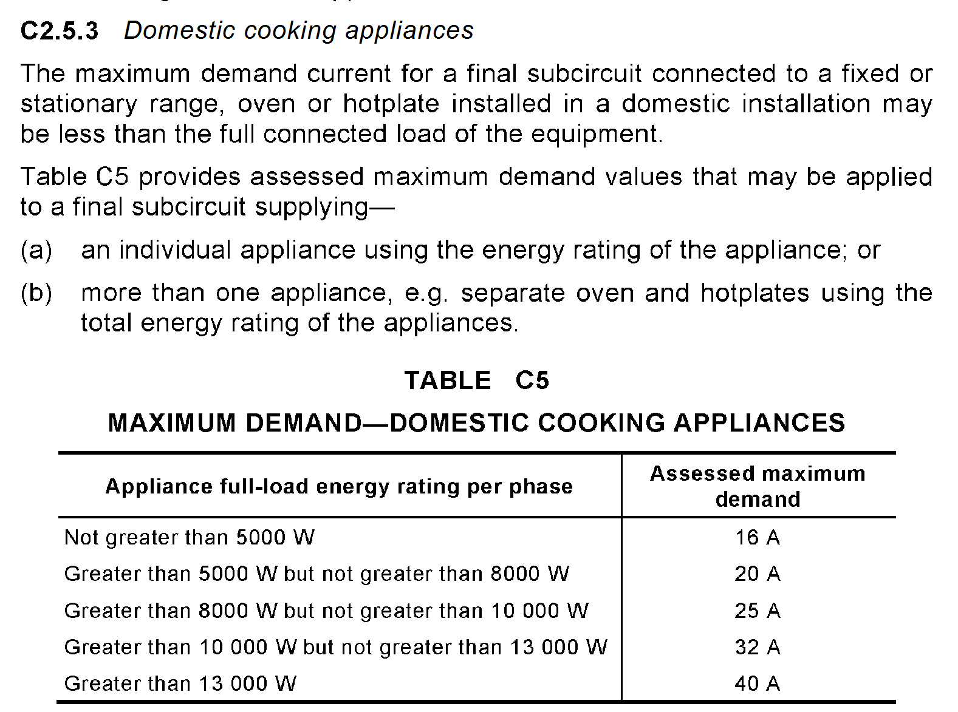
L

Slide 39
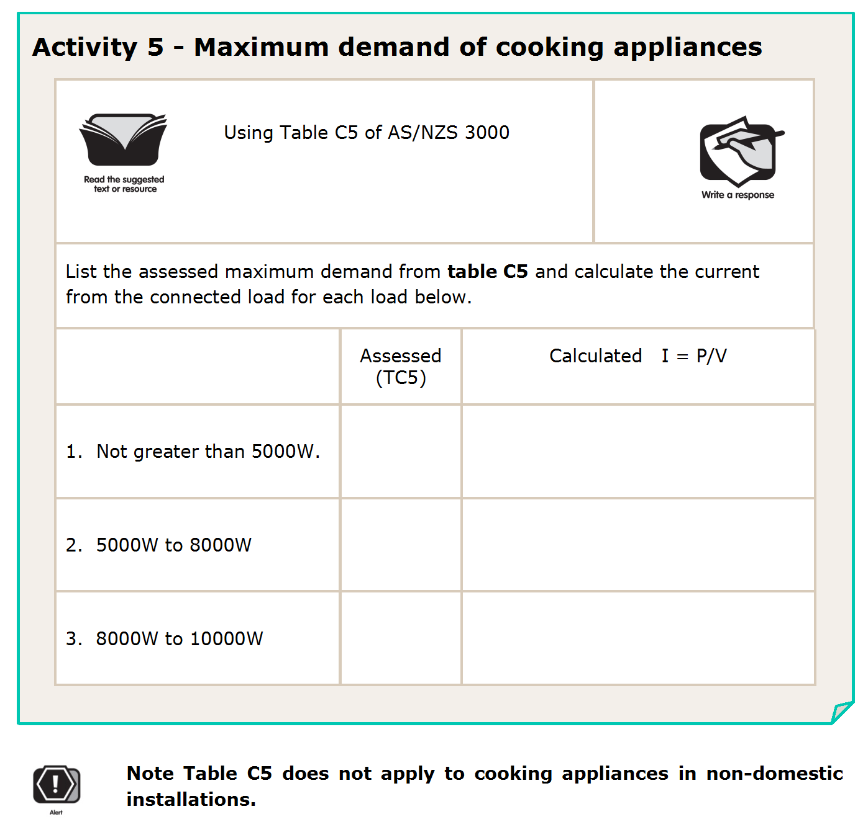
I = P
V
= 5000
= 21.7A
16A
230
20A
= 8000
= 34.8A
230
25A
= 10000
= 43.5A
230
L

Slide 40
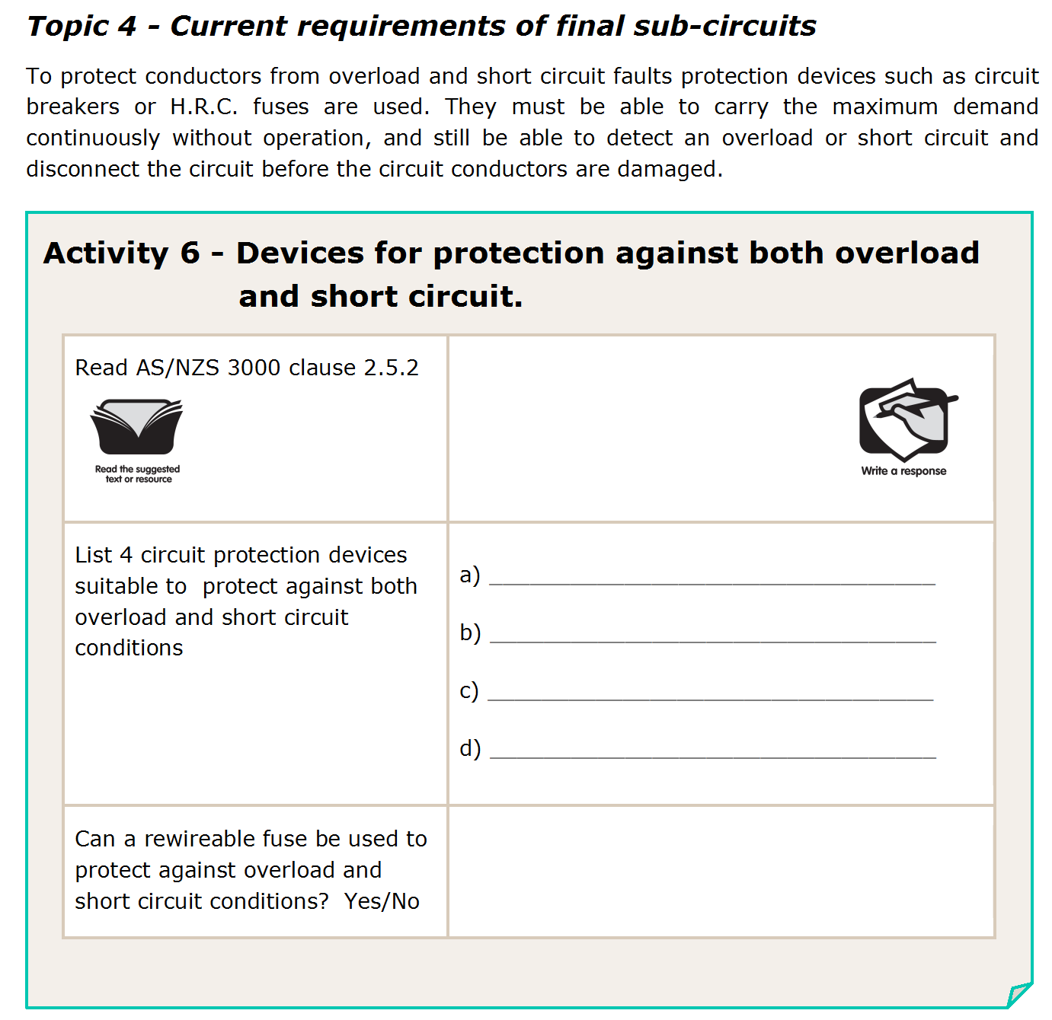
L

Slide 41
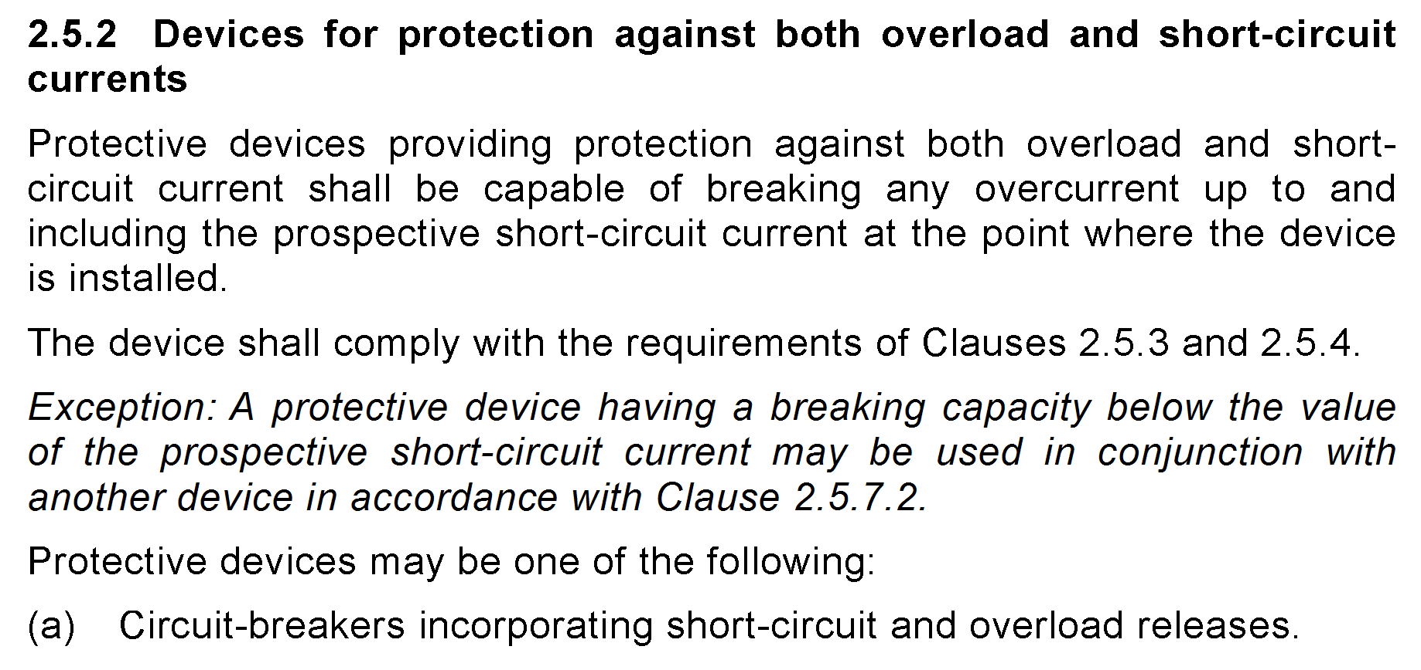
L

Slide 42
Circuit breakers
C.F.S. Units
H.R.C. fuses
Circuit breakers and fuses
no
L

Slide 43
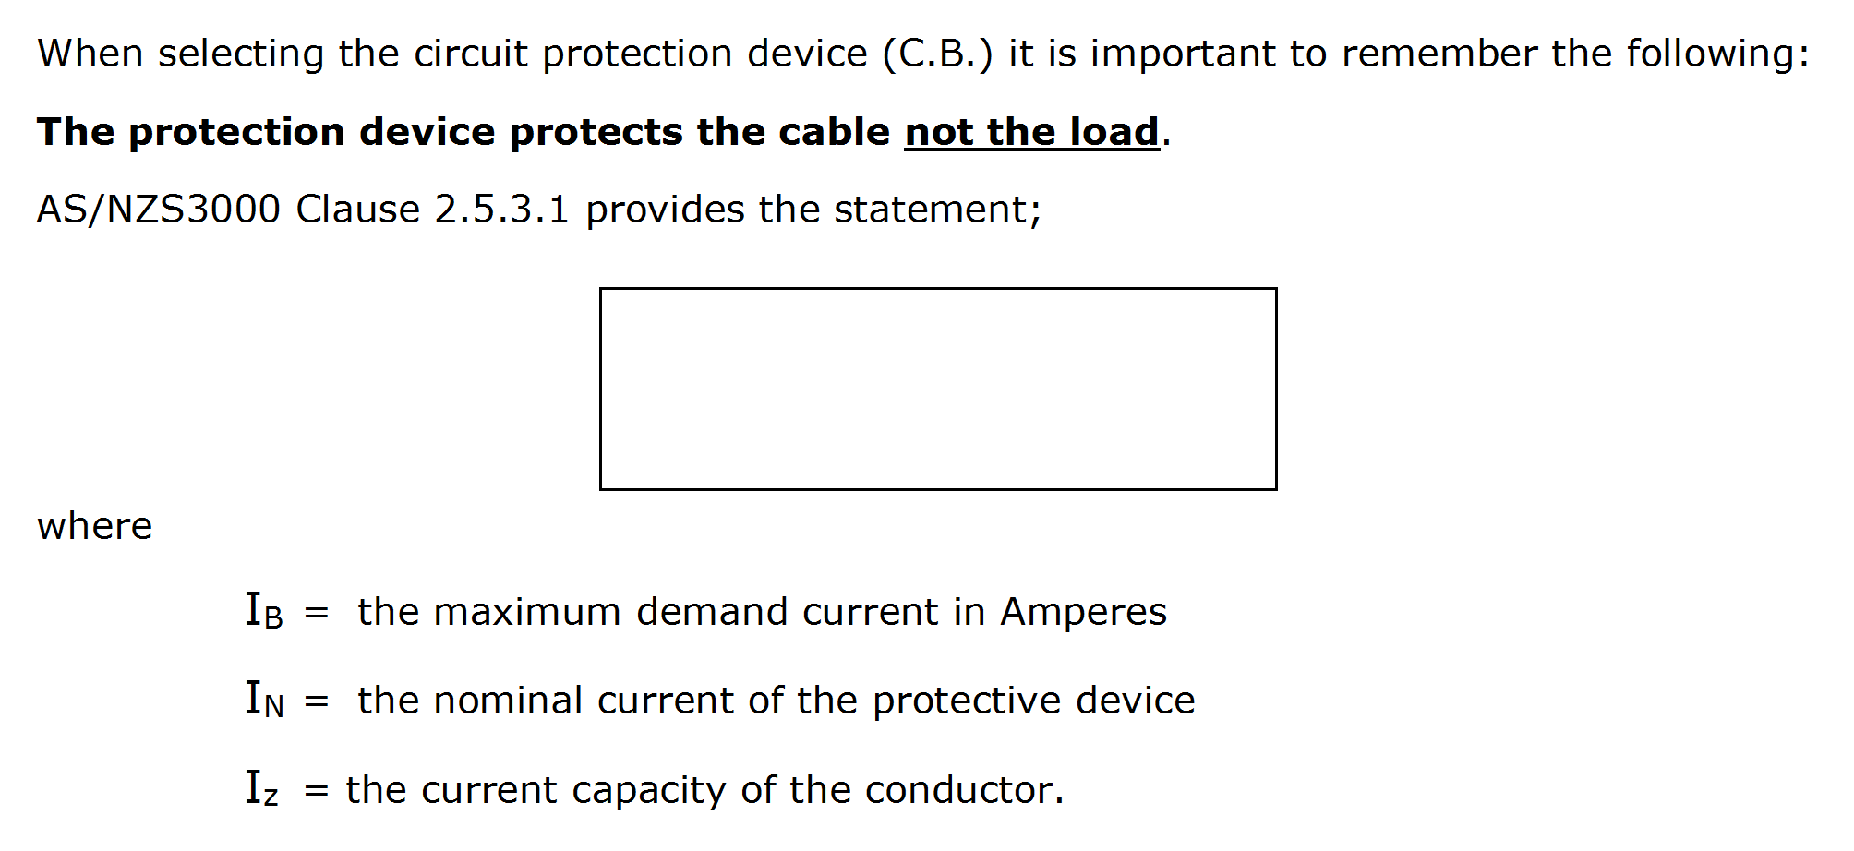
I_{B} ≤ I_{N} ≤ I_{Z}
L

Slide 44
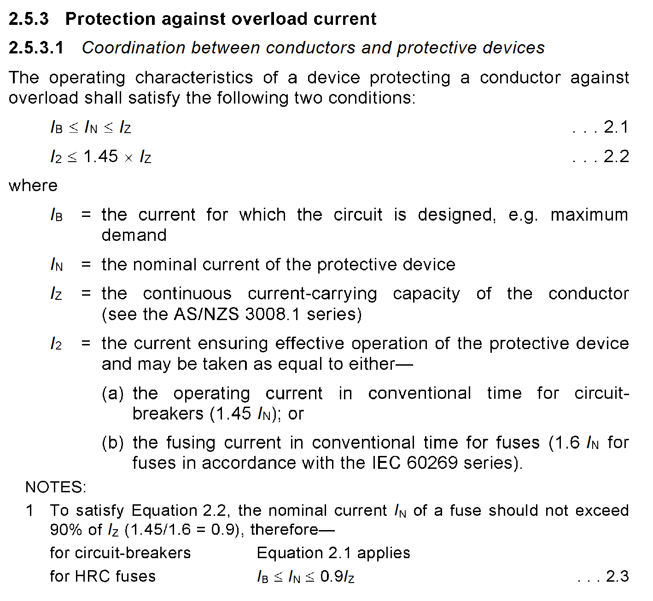
L

Slide 45
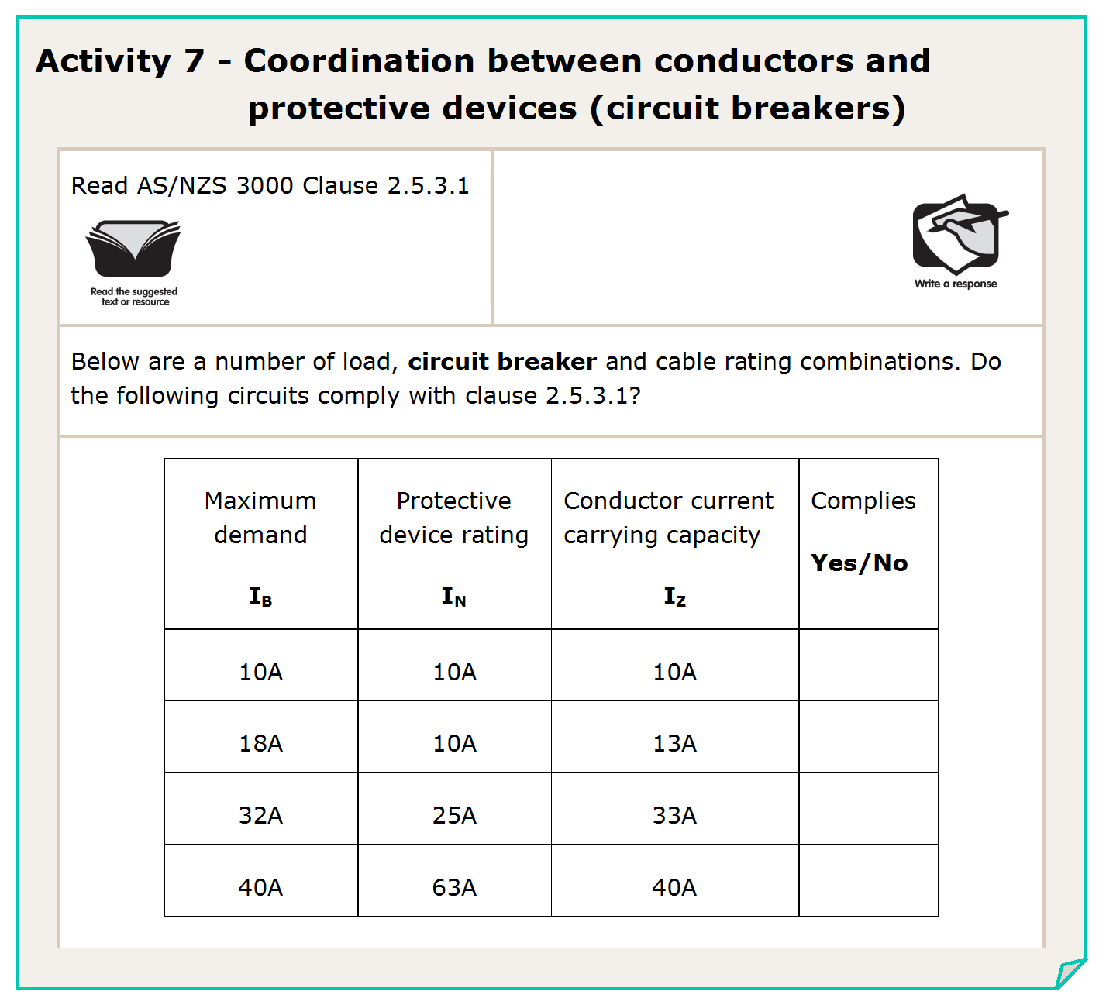
≤
≤
yes
no
no
no
L

Slide 46
I₂ ≤ 1.45 x I_{Z}
L

Slide 47
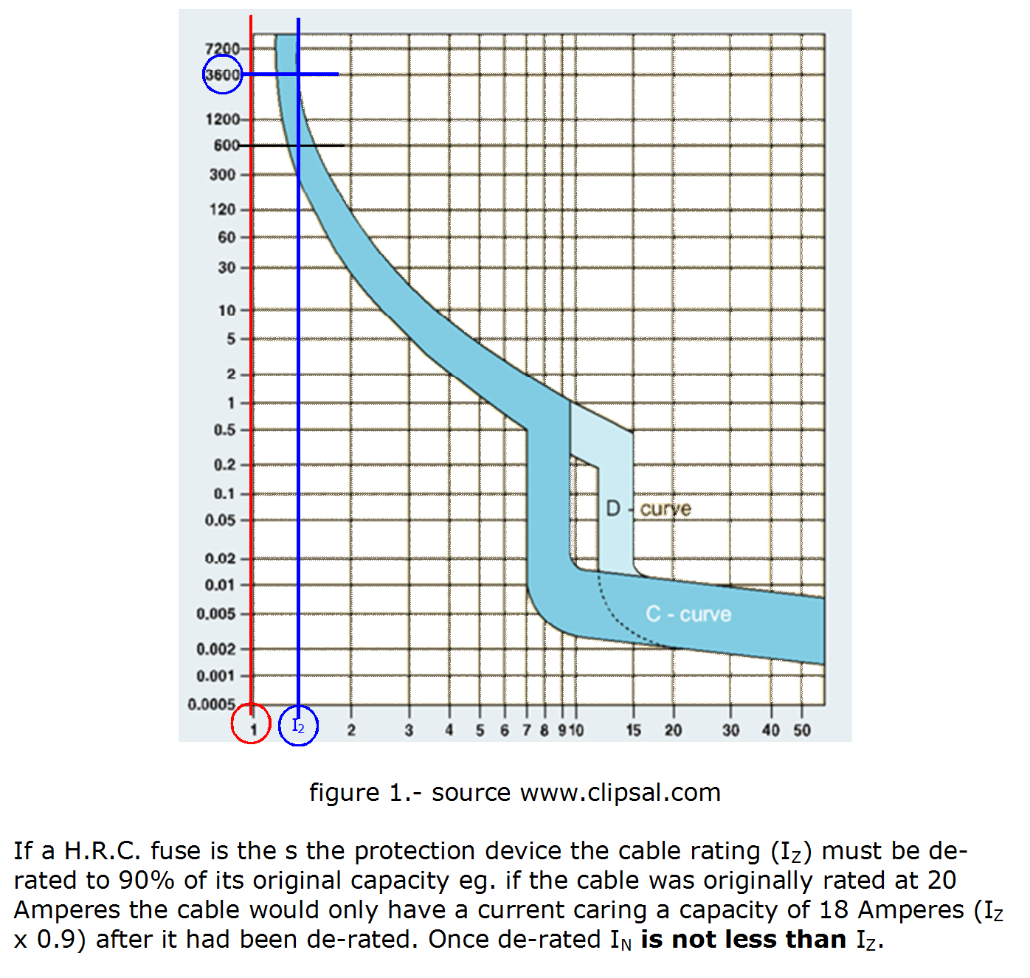
Fuse Curve
I₂=1.6 x I_{N}
I₂=1.45 x I_{N}
L

Slide 48
I_{B} ≤ I_{N} ≤ (I_{Z} x 0.9)
L

Slide 49
≤
≤
x 0.9
X 9A
no
X 18.9A
no
X 32.4A
yes
X 14.4A
no
L

Slide 50
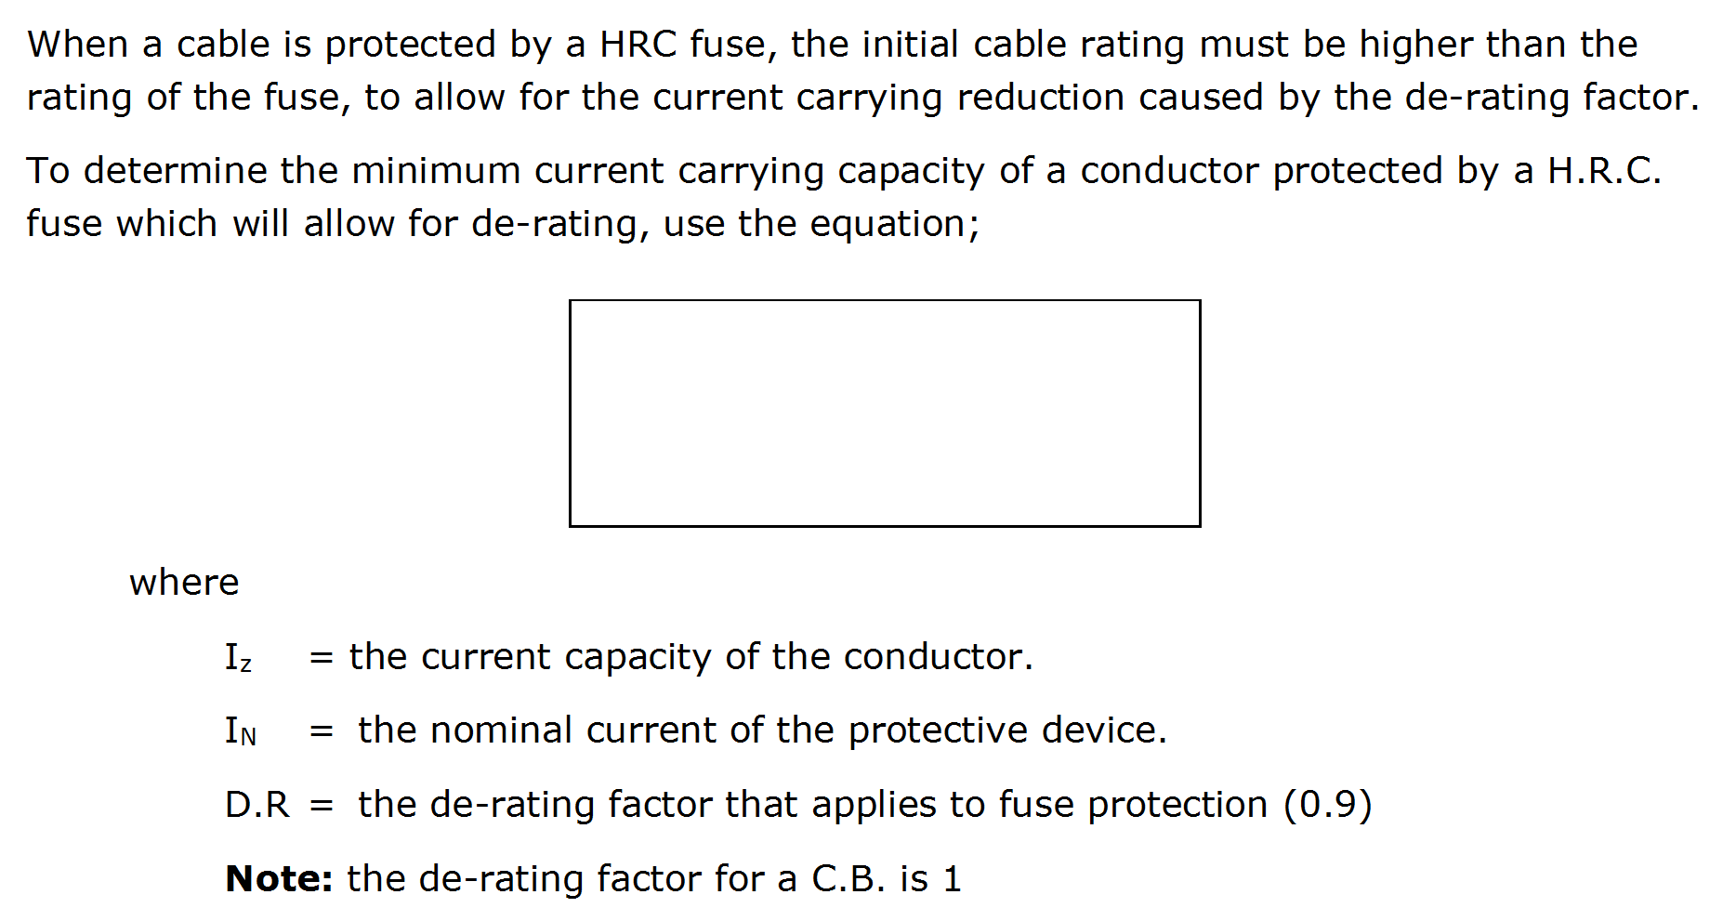
I_{Z} = I_{N}
D.R.
L

Slide 51
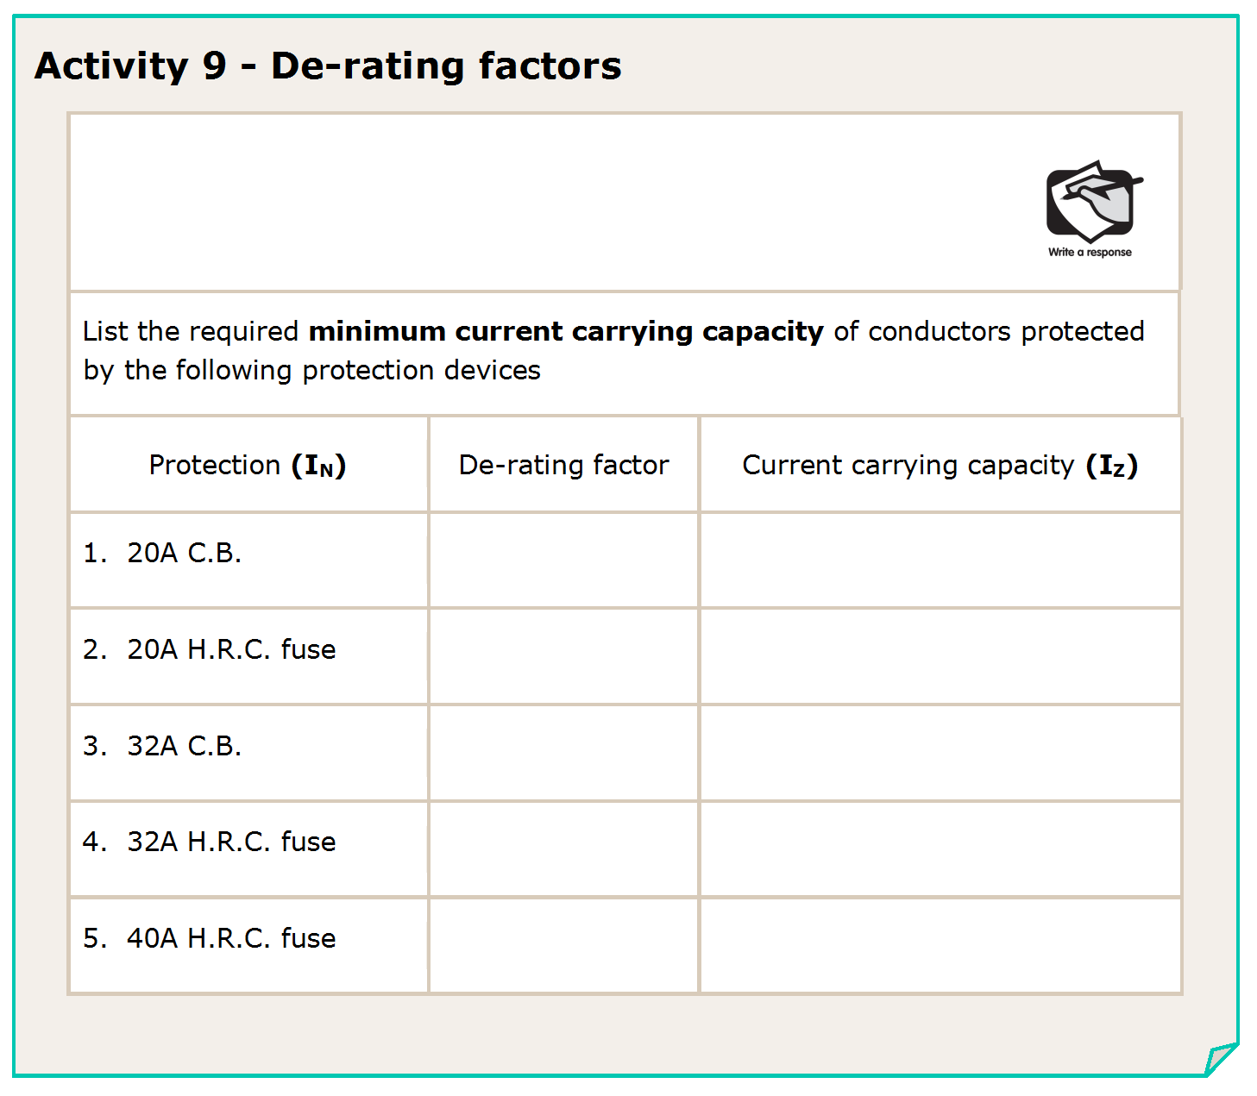
I_{Z} = I_{N}
D.R.
1
= 20
= 20A
1
= 20
= 22.2A
0.9
0.9
= 32
= 32A
1
1
0.9
= 32
= 35.6A
0.9
0.9
= 40
= 44.4A
0.9
L

Slide 52
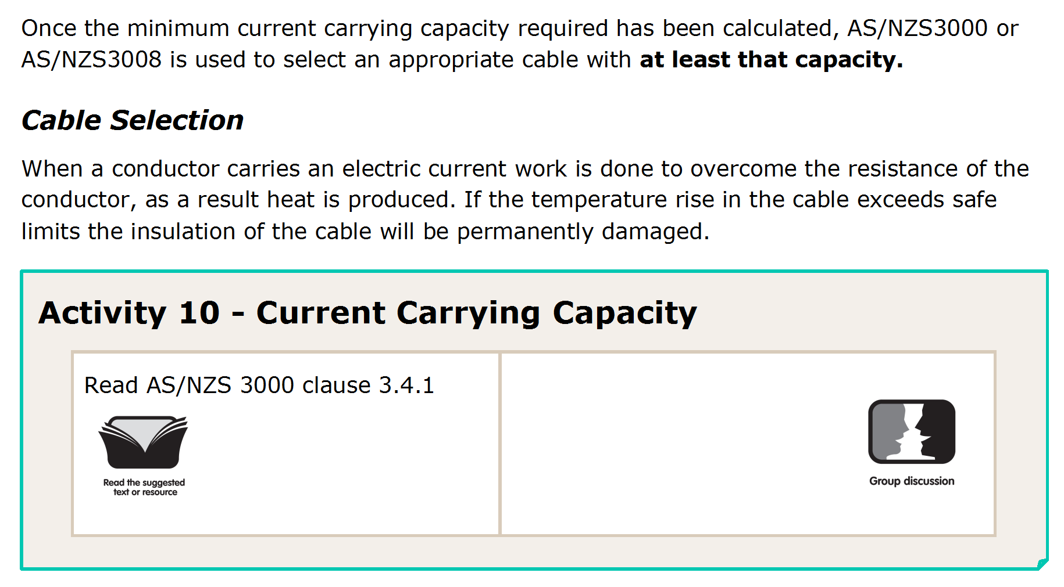
L

Slide 53
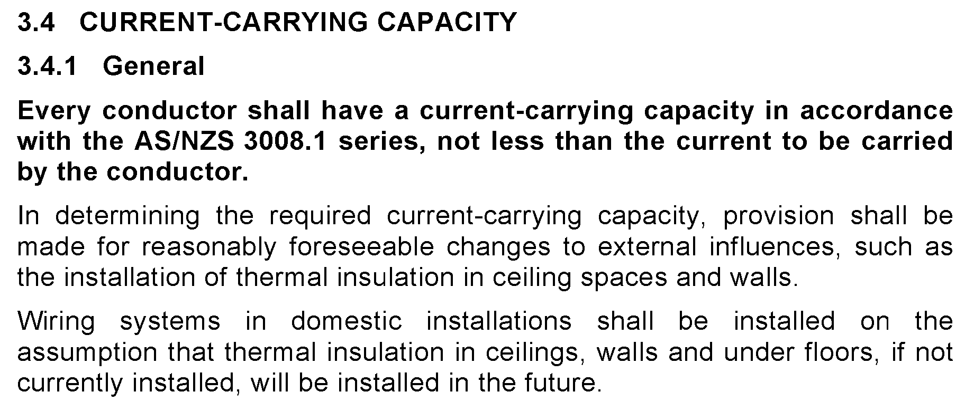
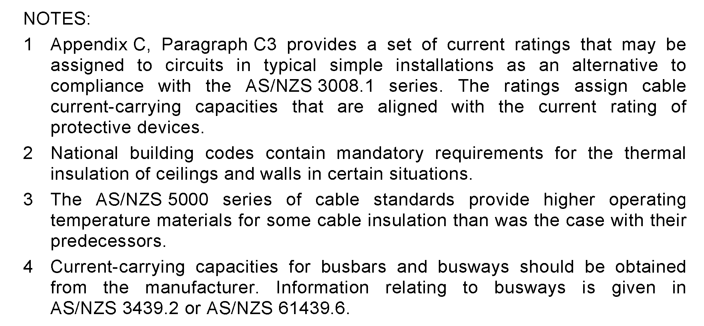
L

Slide 54
L

Slide 55
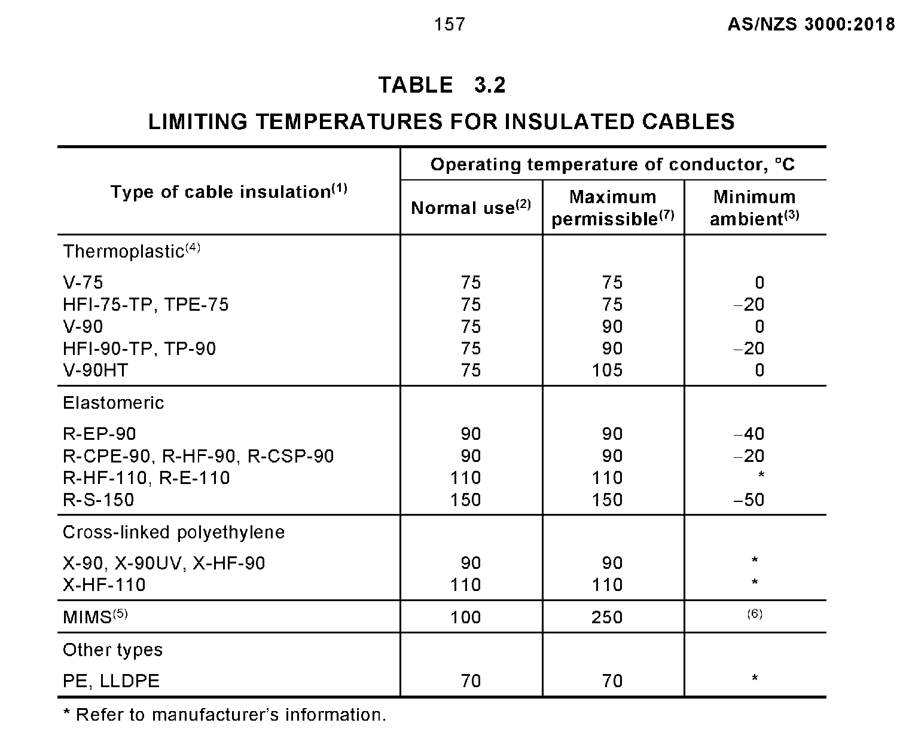
L

Slide 56
75°
75°
75°
90°
90°
90°
L

Slide 57
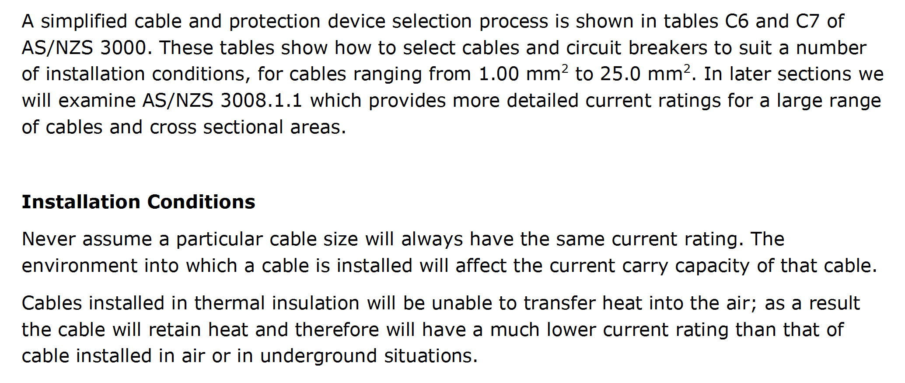
L

Slide 58
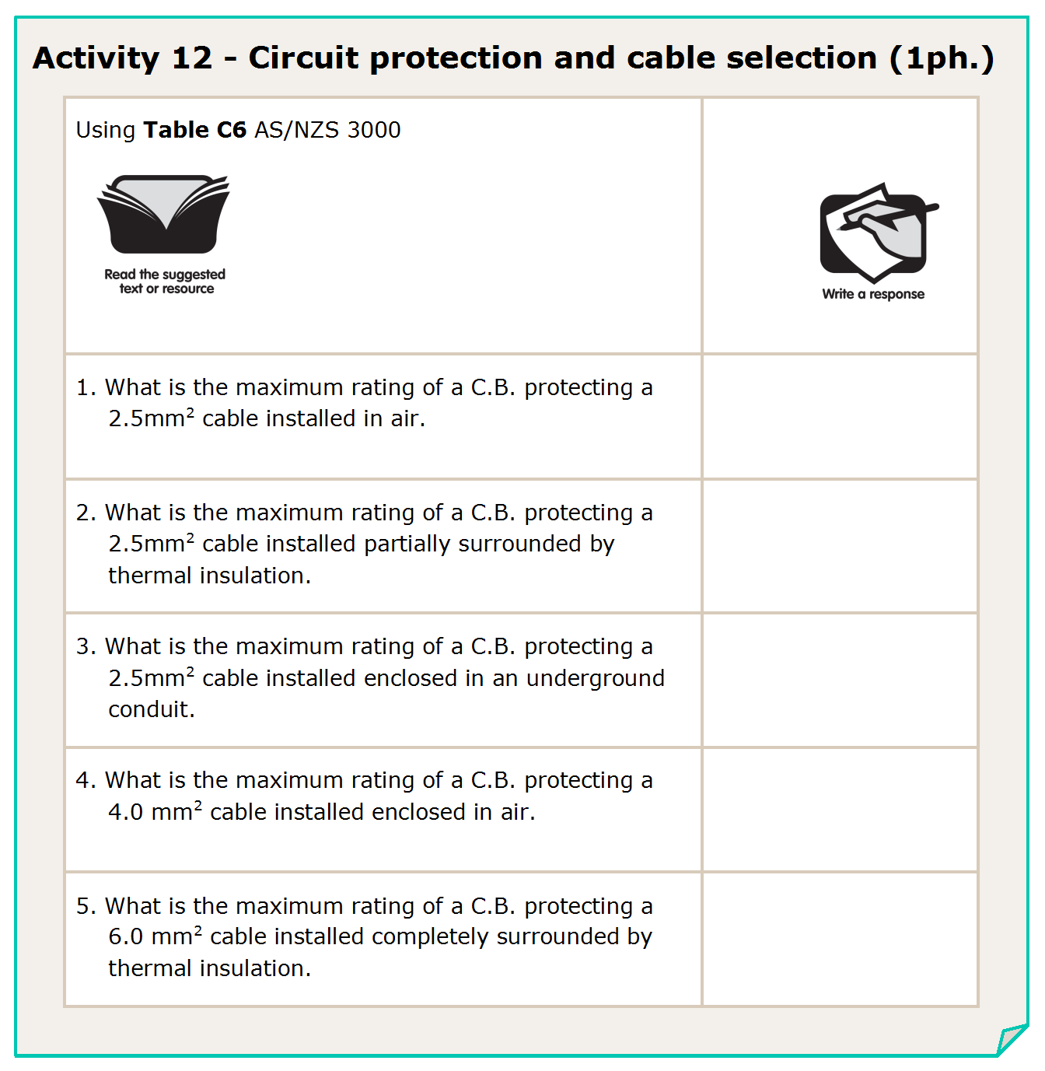
L

Slide 59
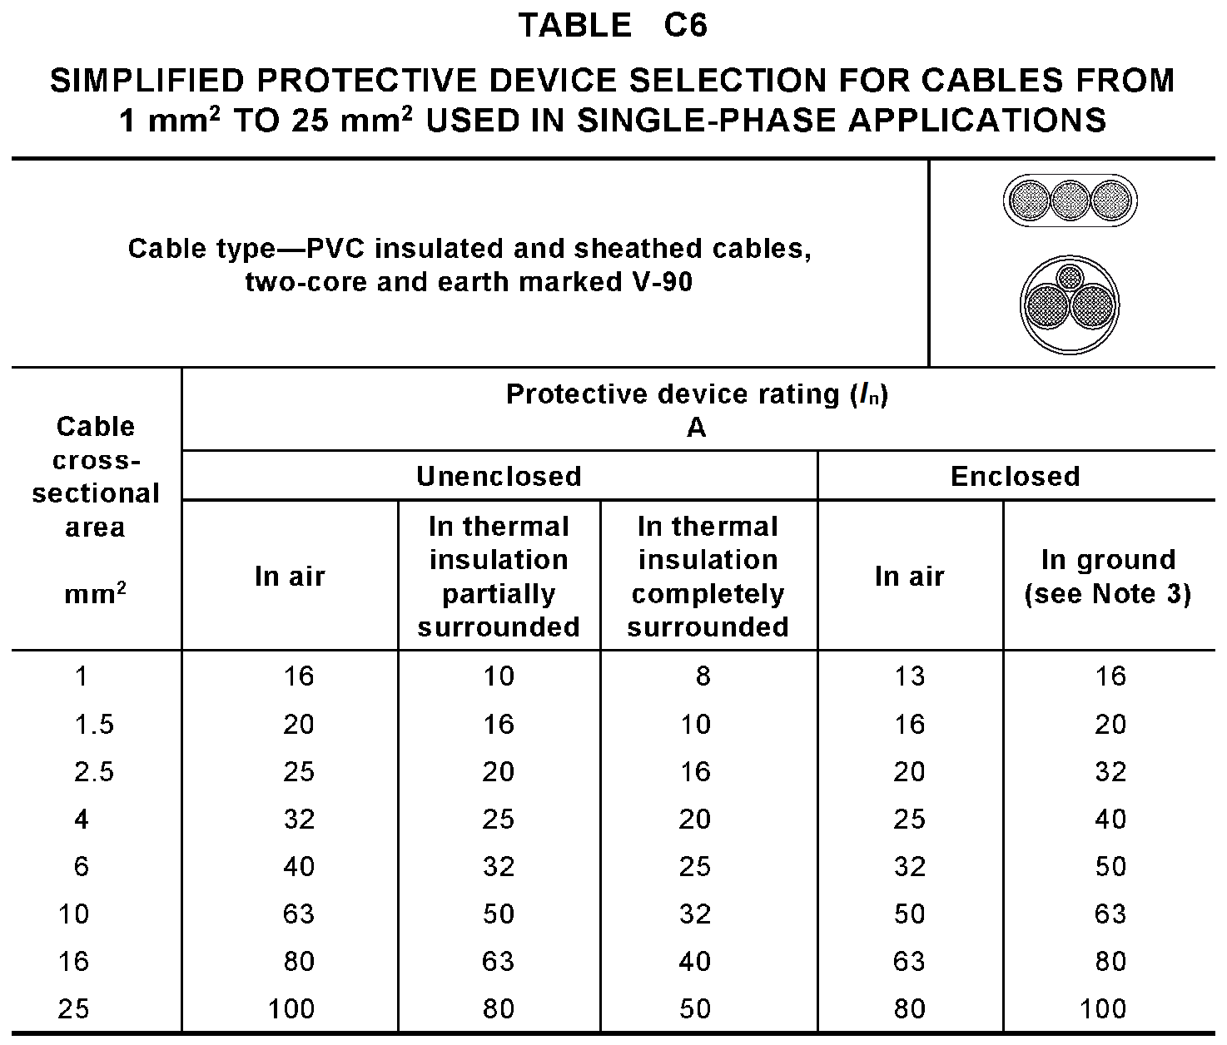
L

Slide 60
25A
L

Slide 61
L

Slide 62
25A
20A
L

Slide 63
L

Slide 64
25A
20A
32A
L

Slide 65
L

Slide 66
25A
20A
32A
25A
L

Slide 67
L

Slide 68
25A
20A
32A
25A
25A
L

Slide 69
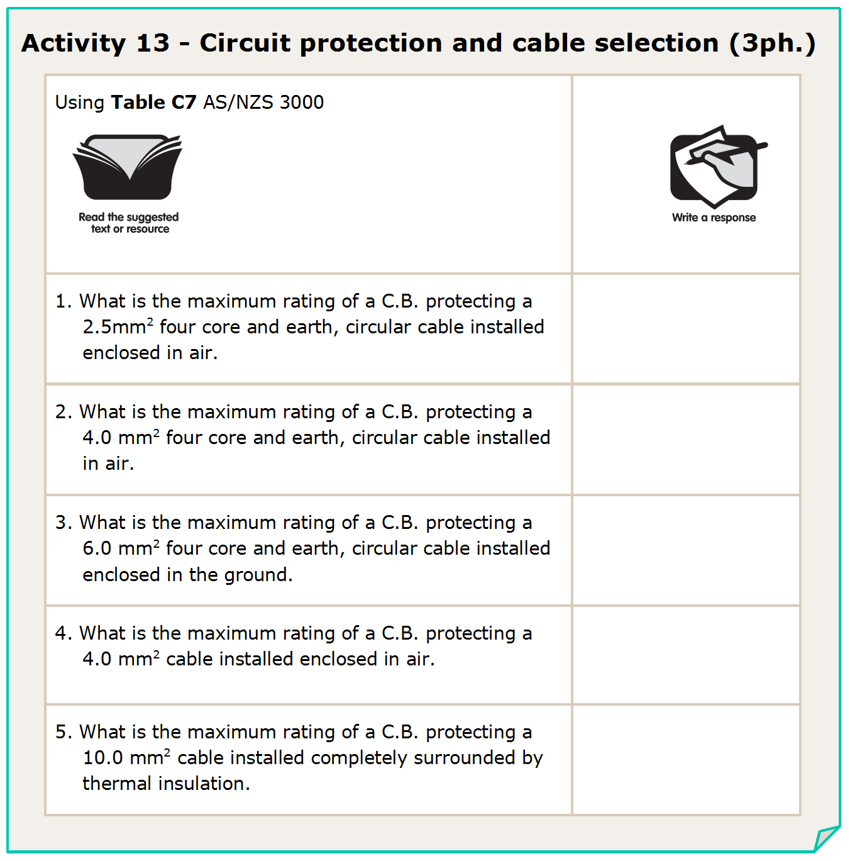
L

Slide 70
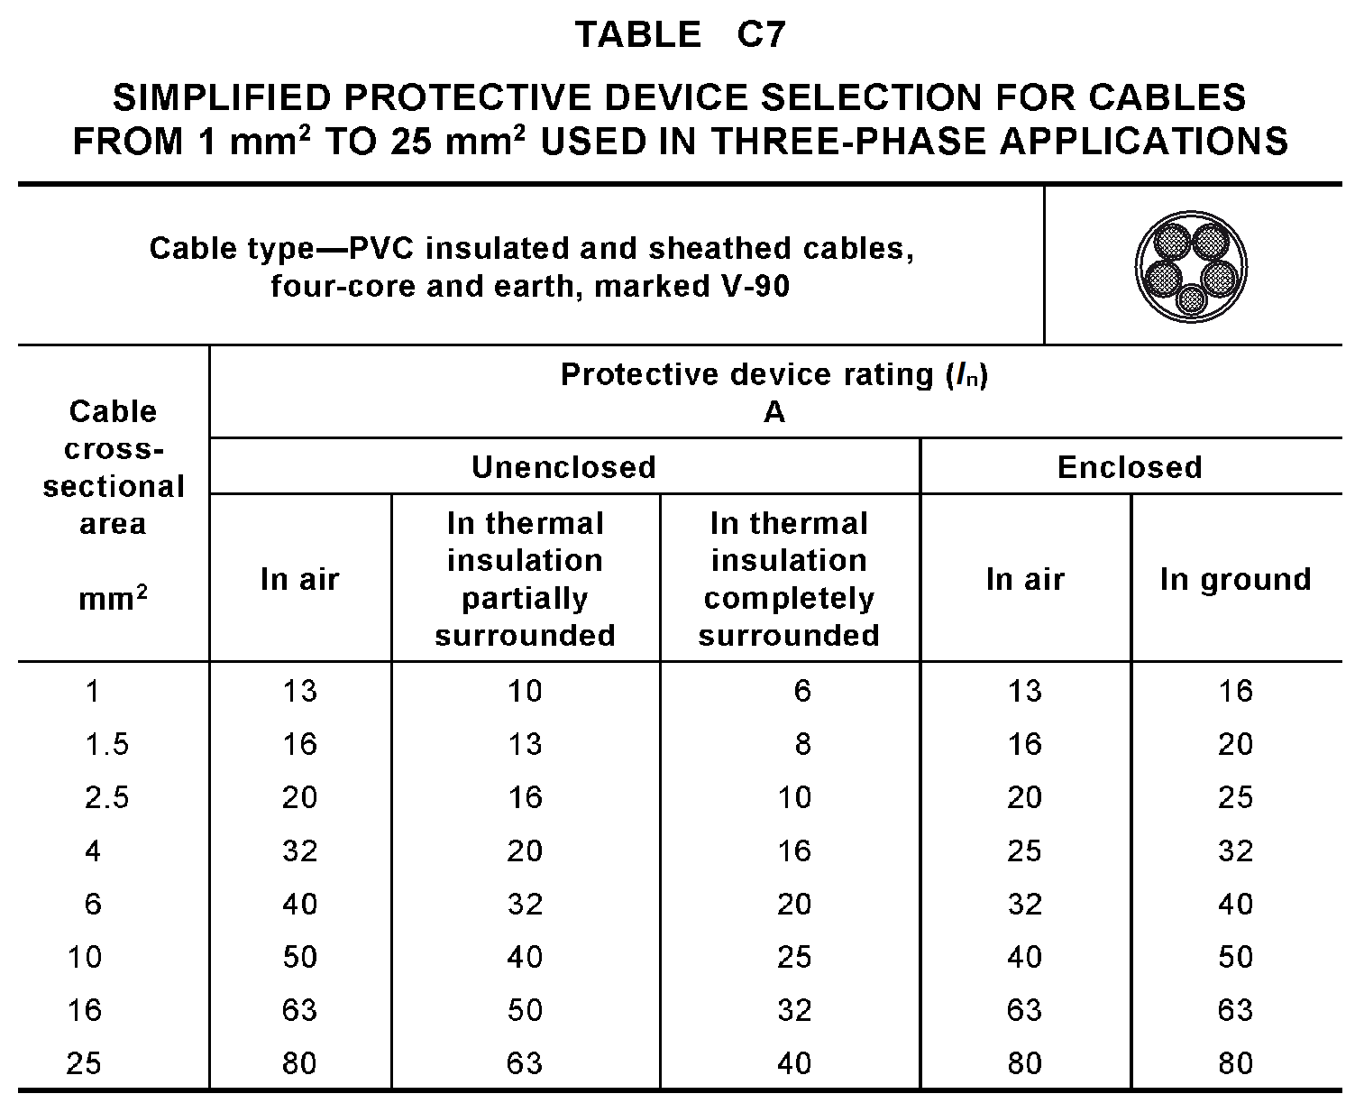
L

Slide 71
20A
32A
40A
25A
25A
L

Slide 72
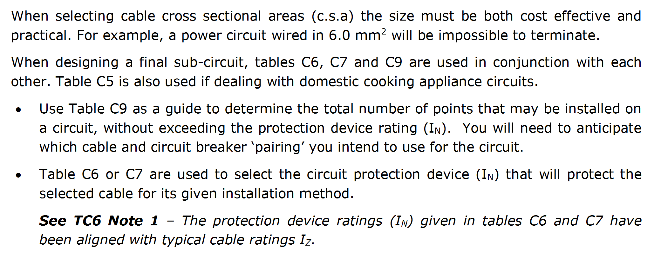
L

Slide 73
L

Slide 74
L
Notes:
74

Slide 75
L
Notes:
75

Slide 76
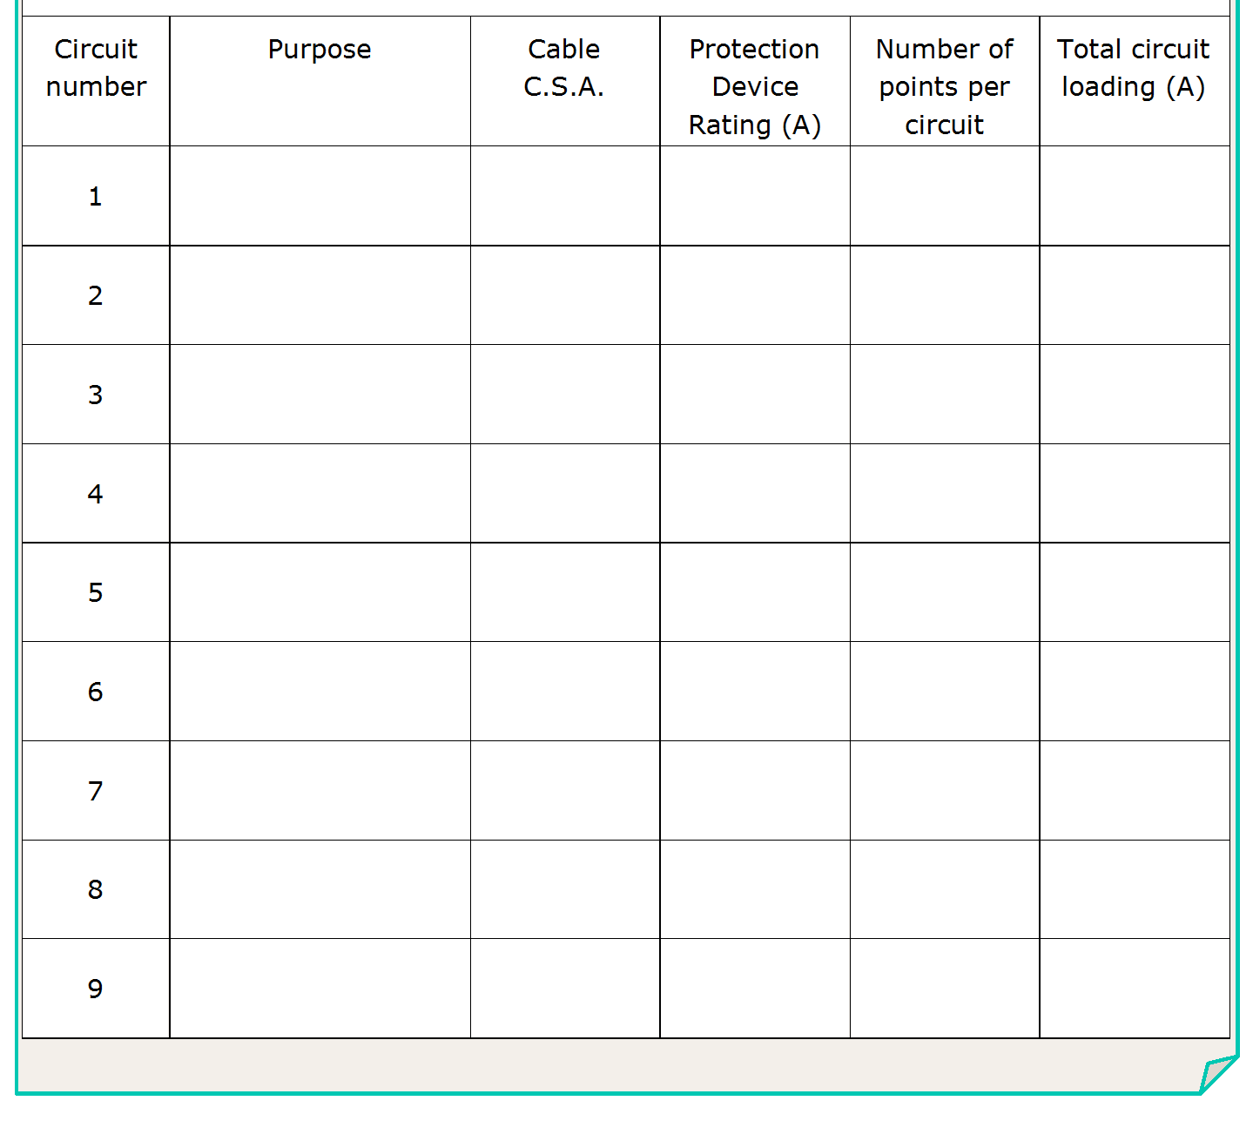
Light 1
1.5 mm²
16A
22
11A
L

Slide 77
L

Slide 78
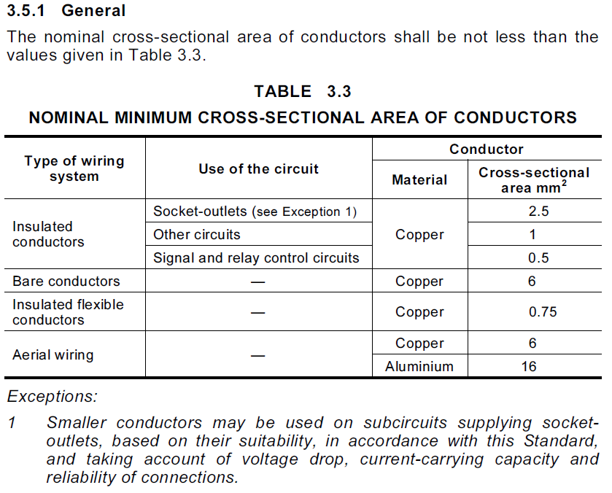
L

Slide 79
L
Notes:
79

Slide 80
L
Notes:
80

Slide 81
Light 1
1.5 mm²
16A
22
11.5A
Power 1
2.5mm²
20A
16
(8Doubles)
16A
Power 2
2.5mm²
20A
16 (8Doubles)
16A
16 (8Doubles)
16A
Power 3
2.5mm²
20A
L

Slide 82
L

Slide 83
L
Notes:
83

Slide 84
L
Notes:
84

Slide 85
Light 1
1.5 mm²
16A
22
11.5A
Power 1
2.5mm²
20A
16
(8Doubles)
16A
Power 2
2.5mm²
20A
16 (8Doubles)
16A
Power 3
2.5mm²
20A
16 (8Doubles)
16A
A/C
2.5mm²
16/20A
1
15A
L

Slide 86
L

Slide 87
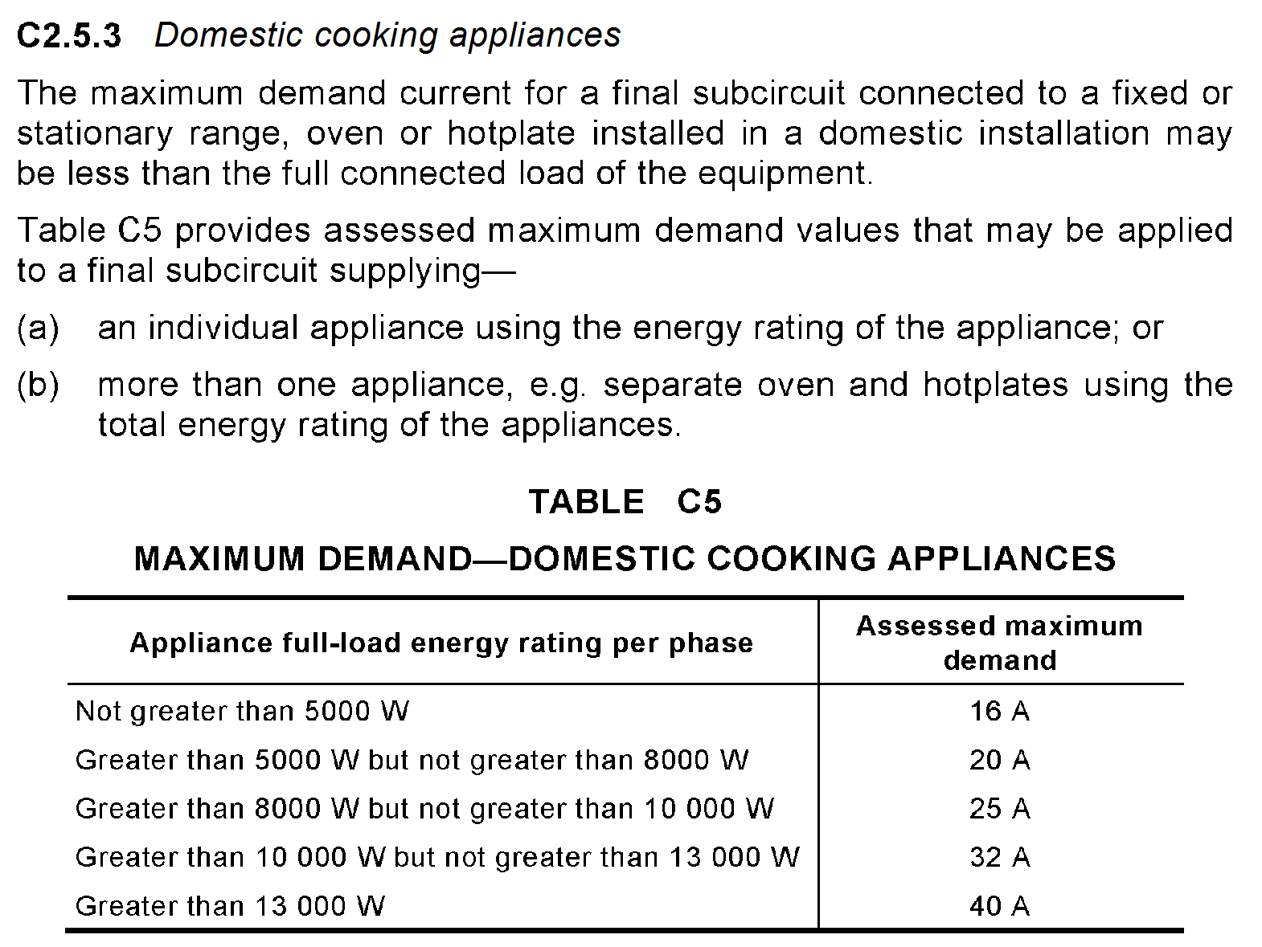
L
Notes:
87

Slide 88
L
Notes:
88

Slide 89
L
Notes:
89

Slide 90
Light 1
1.5 mm²
16A
22
11.5A
Power 1
2.5mm²
20A
16
(8Doubles)
16A
Power 2
2.5mm²
20A
16 (8Doubles)
16A
Power 3
2.5mm²
20A
16 (8Doubles)
16A
A/C
2.5mm²
16/20A
1
15A
Cook Top
2.5mm²
20A
1
20A
L

Slide 91
L

Slide 92
L
Notes:
92

Slide 93
L
Notes:
93

Slide 94
Light 1
1.5 mm²
16A
22
11.5A
Power 1
2.5mm²
20A
16
(8Doubles)
16A
Power 2
2.5mm²
20A
16 (8Doubles)
16A
Power 3
2.5mm²
20A
16 (8Doubles)
16A
A/C
2.5mm²
16/20A
1
15A
Cook Top
2.5mm²
20A
1
20A
Oven
1.5mm²
16A
1
16A
L

Slide 95
OR do them together DEMO ONLY
L

Slide 96
L
Notes:
96

Slide 97
L
Notes:
97

Slide 98
Go to next page of the table
L
Notes:
98

Slide 99
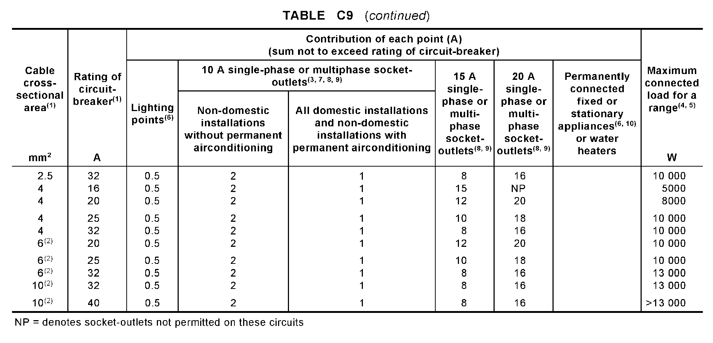
L
Notes:
99

Slide 100
L

Slide 101
L
Notes:
101

Slide 102
L
Notes:
102

Slide 103
Light 1
1.5 mm²
16A
22
11.5A
Power 1
2.5mm²
20A
16
(8Doubles)
16A
Power 2
2.5mm²
20A
16 (8Doubles)
16A
Power 3
2.5mm²
20A
16 (8Doubles)
16A
A/C
2.5mm²
16/20A
1
15A
Cook Top
2.5mm²
20A
1
20A
Oven
1.5mm²
16A
1
16A
H.W.S.
2.5mm²
20A
1
20A
L

Slide 104
L

Slide 105
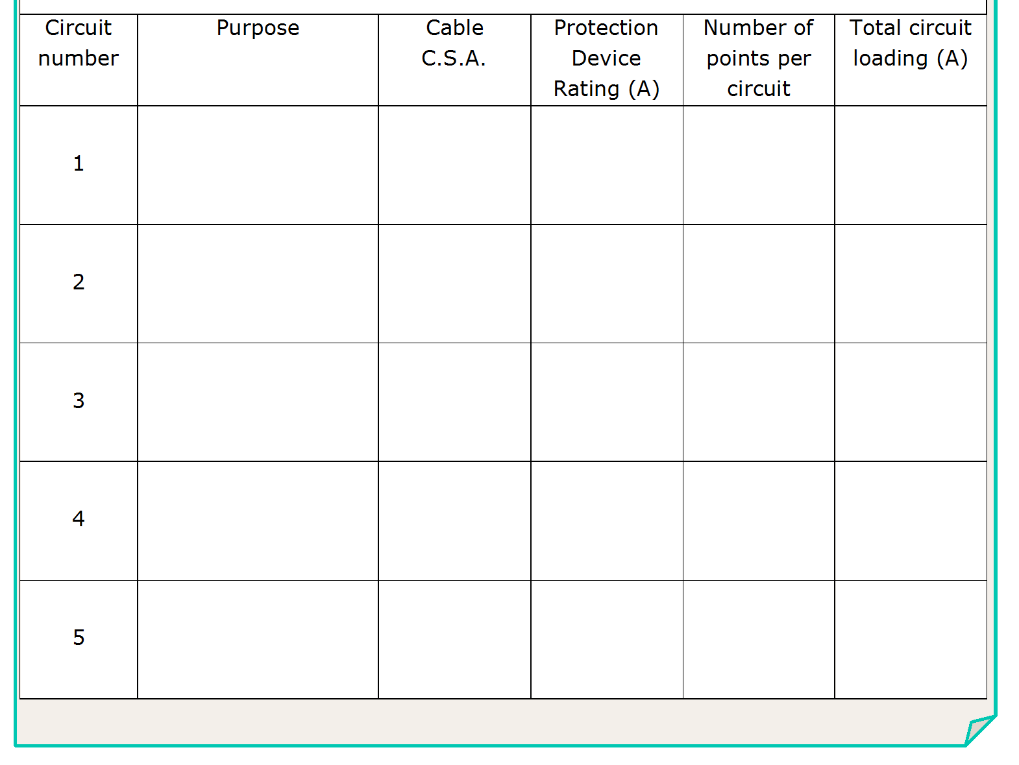
Light 1
1.5 mm²
16 A
24
12A
Light 2
1.5 mm²
16 A
24
12A
Power 1
2.5 mm²
20A
20
(10doubles)
20A
Power 2
2.5 mm²
20A
20
(10doubles)
20A
Power 3
2.5 mm²
20A
20
(10doubles)
20A
L

Slide 106
Fan /Heaters =
4 x 275W for heat lamps =
1100W
1 x 60W for Light =
60W
1 x 150W for fan =
150W
Total
1310W
I = P
= 1310
= 5.7A each x 2
= 11.4A Total
(V x λ)
(230 x 1)
L

Slide 107
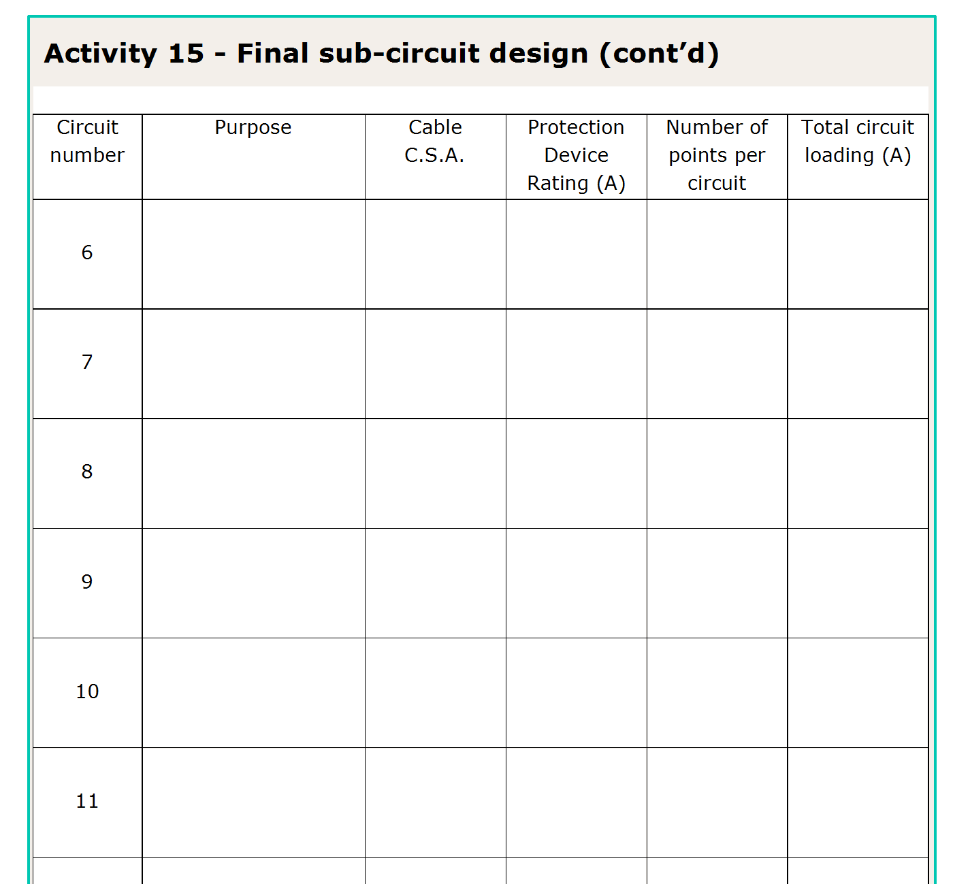
Fan /Heaters
1.5mm²
16A
2
11.4A
A/C
2.5mm²
20A
1
18A
2.5mm²
1
(34A) TC5=20A
Range
20A
Spa
6.0mm²
32A
1
32A
Sauna
1.5mm²
16A
1
15.7A
H.W.S.
2.5mm²
20A
1
19.2A
L

Slide 108
Convention in non domestic is to use 2.5mm² conductors for lighting
L

Slide 109
L
Notes:
109

Slide 110
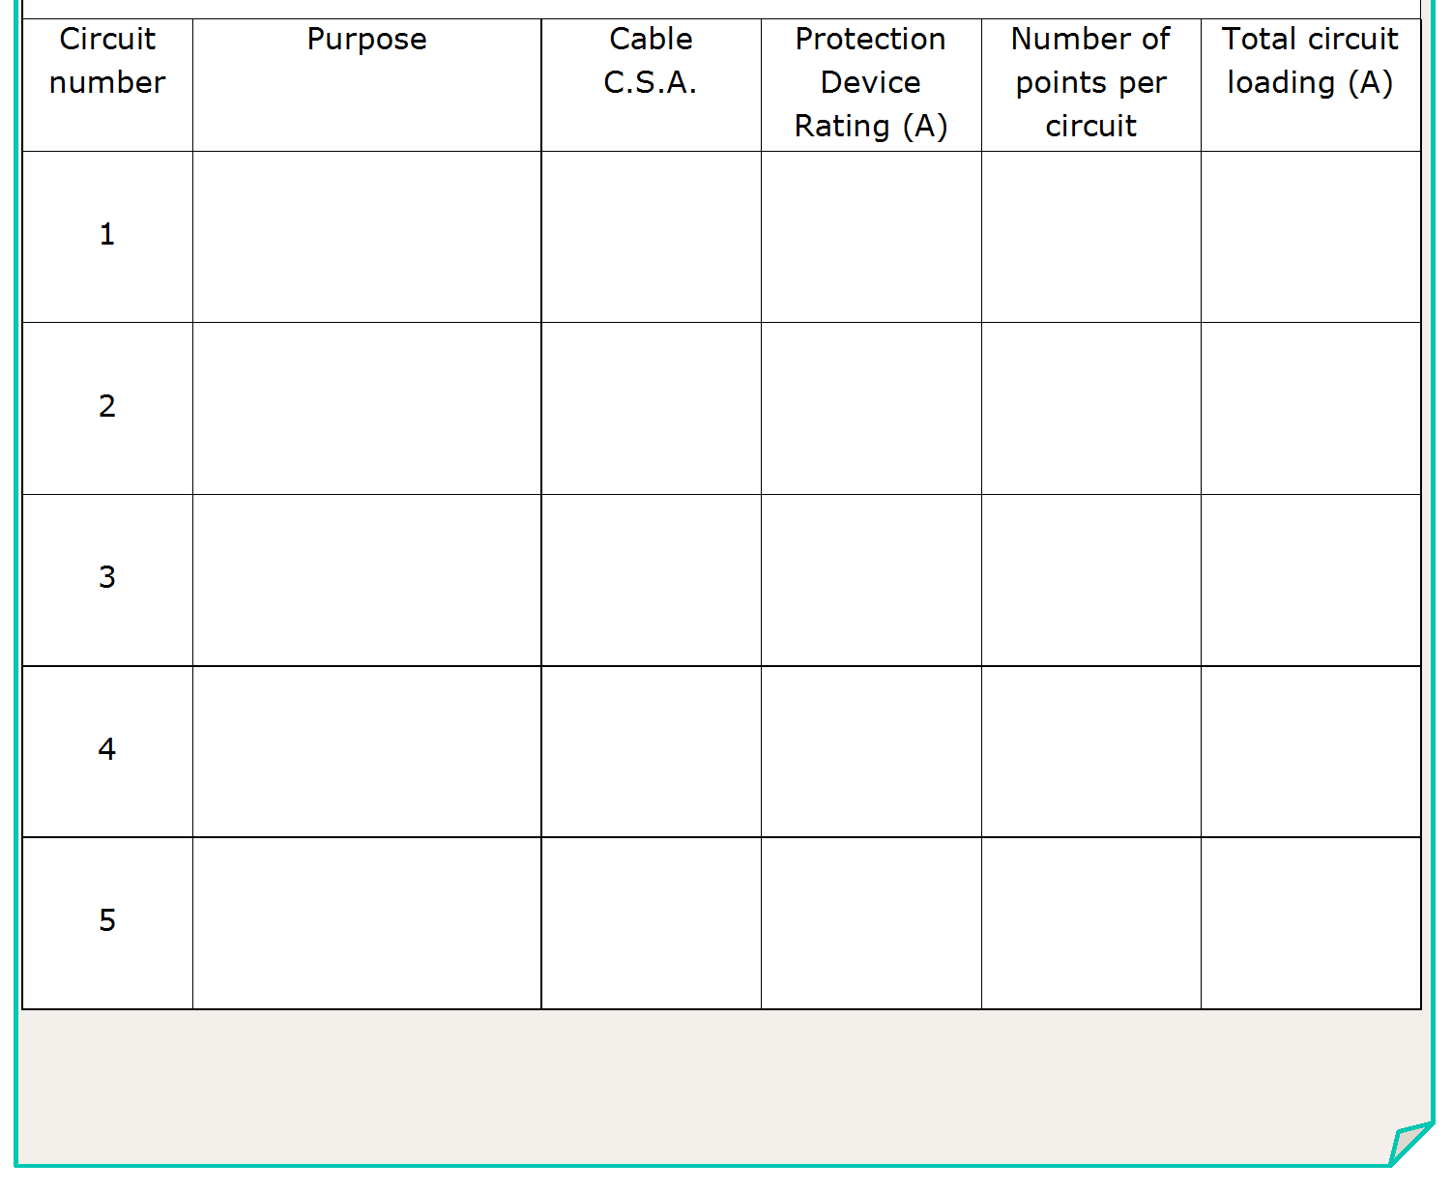
Light 1 - HB
2.5 mm²
25A
8
10A
Light 2 - HB
2.5 mm²
25A
8
10A
Light 3 - Fl
2.5 mm²
25A
24
8A
L

Slide 111
L

Slide 112
L
Notes:
112

Slide 113
L
Notes:
113

Slide 114
Light 1 - HB
2.5 mm²
20A
8
10A
Light 2 - HB
2.5 mm²
20A
8
10A
Light 3 - Fl
2.5 mm²
20A
24
8A
Power 1
2.5 mm²
20A
10
(5doubles)
20A
Power 2
2.5 mm²
20A
10
(5doubles)
20A
L

Slide 115
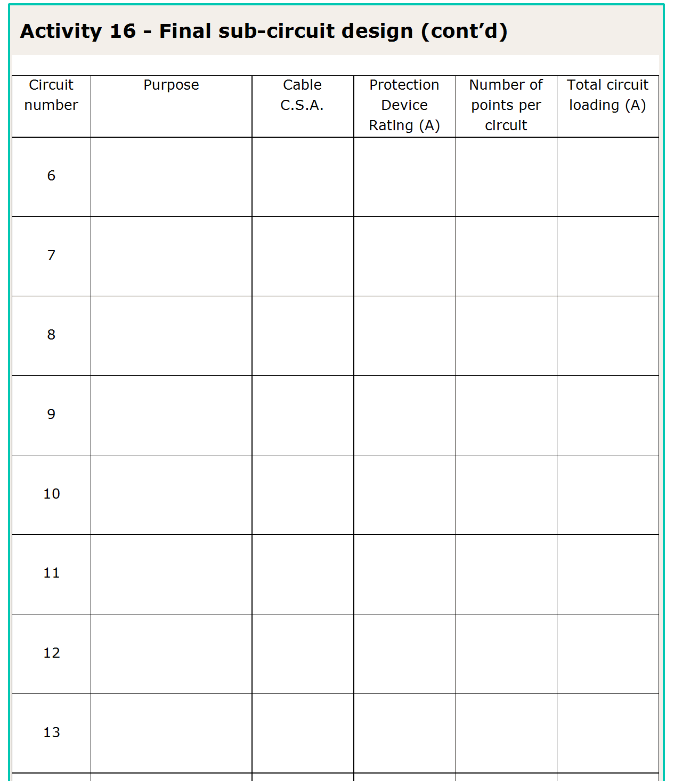
Power 3
2.5mm²
20A
10
(5doubles)
20A
L

Slide 116
L

Slide 117
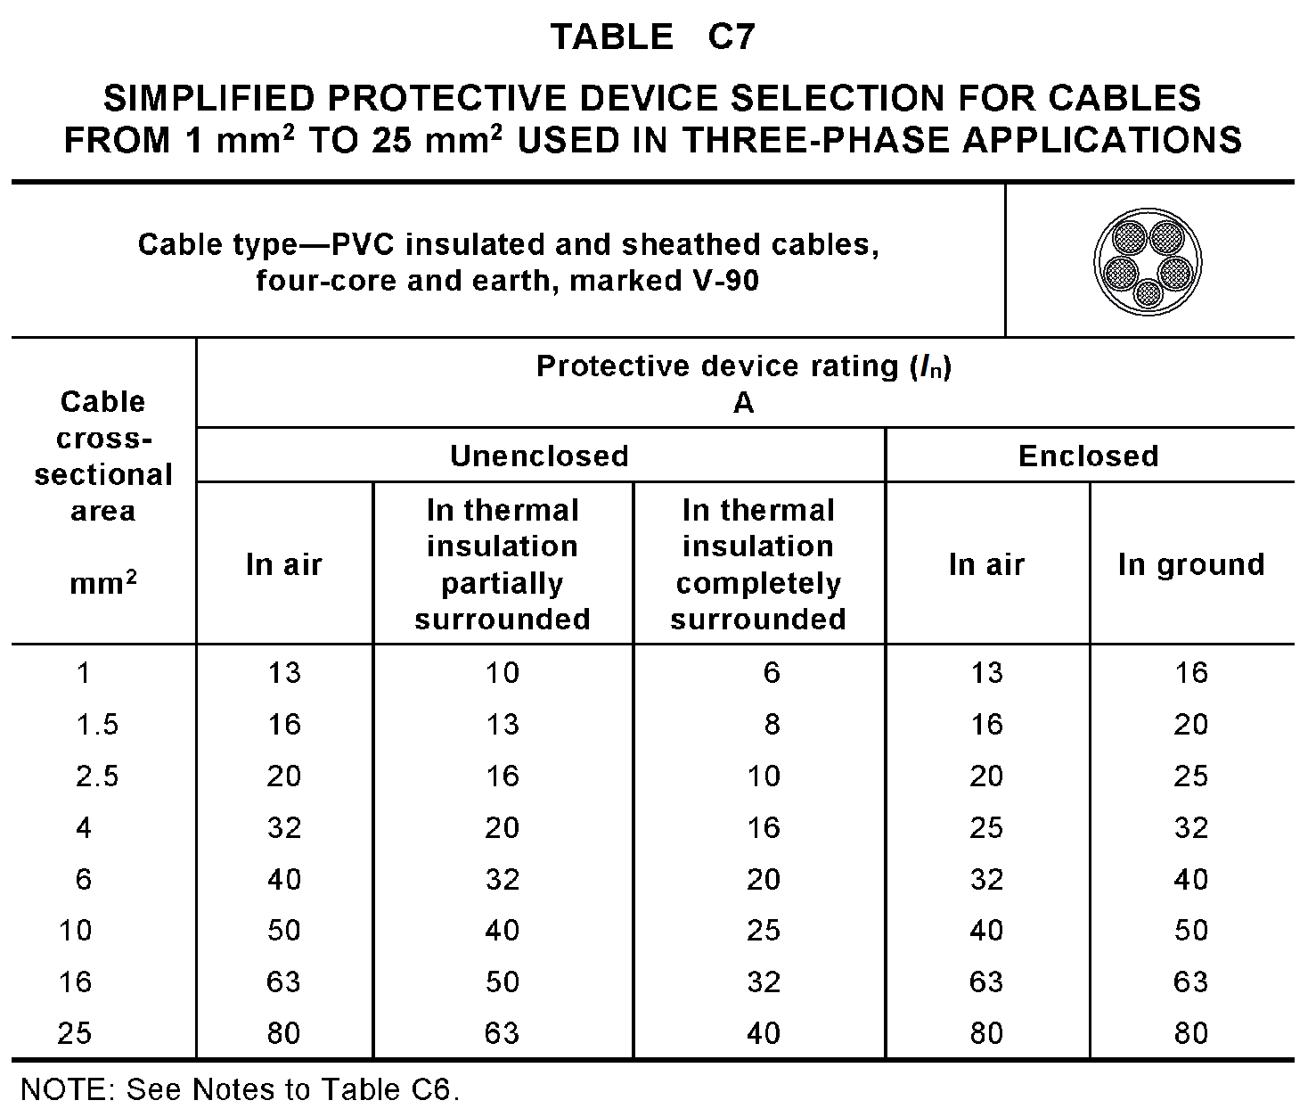
L
Notes:
117

Slide 118
Power 3
2.5mm²
20A
10
(5doubles)
20A
3ph SO 1
6mm²
32A
1
32A
3ph SO 2
6mm²
32A
1
32A
3ph SO 3
6mm²
32A
1
32A
L

Slide 119
L

Slide 120
L
Notes:
120

Slide 121
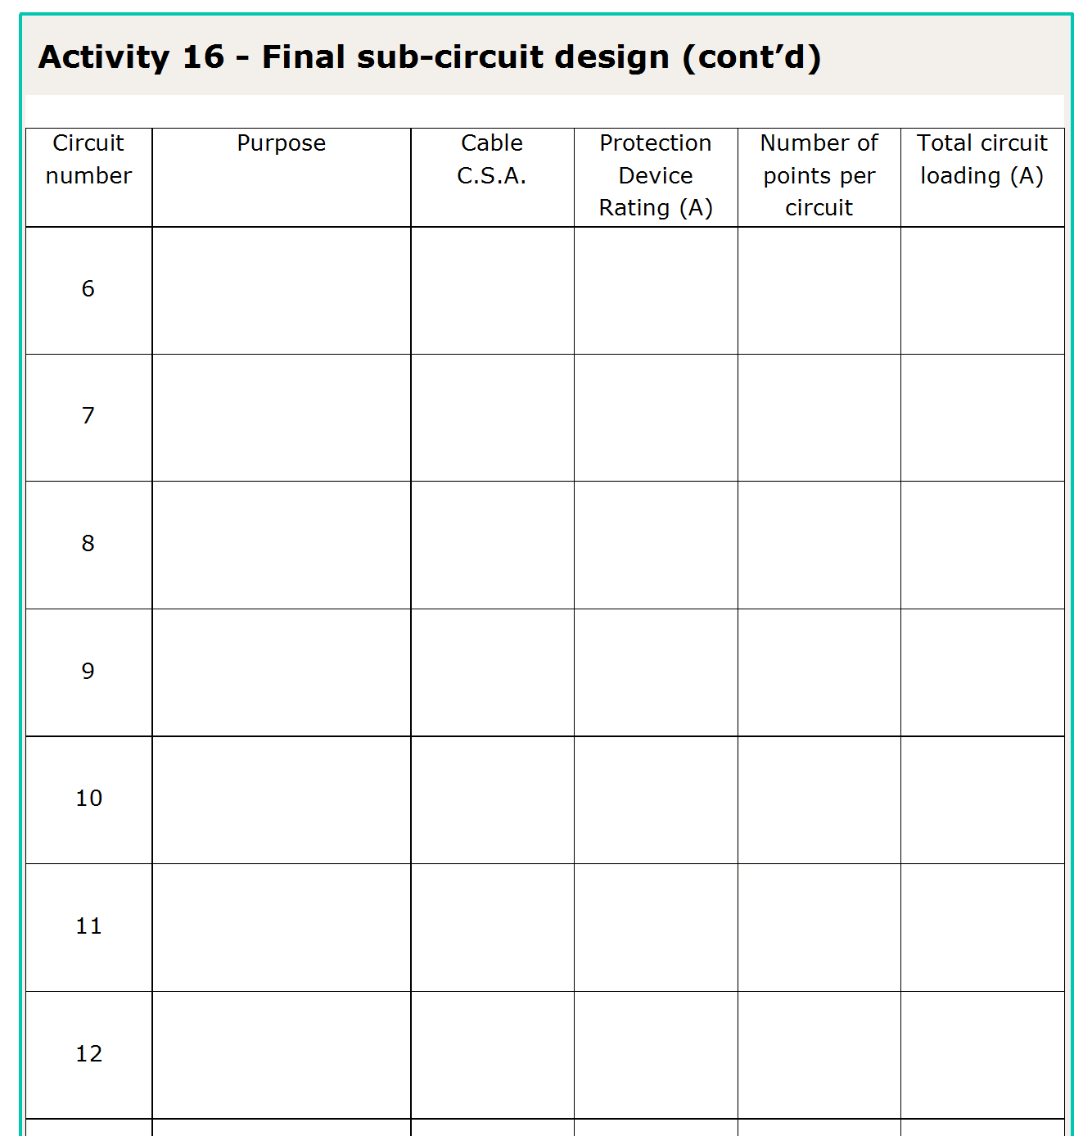
Power 3
2.5mm²
20A
10
(5doubles)
20A
3ph SO 1
6mm²
32A
1
32A
3ph SO 2
6mm²
32A
1
32A
3ph SO 3
6mm²
32A
1
32A
Mach 1
16mm²
63A
1
54A
Mach 2
10mm²
40A
1
34A
Mach 3
10mm²
40A
1
34A
L

Slide 122
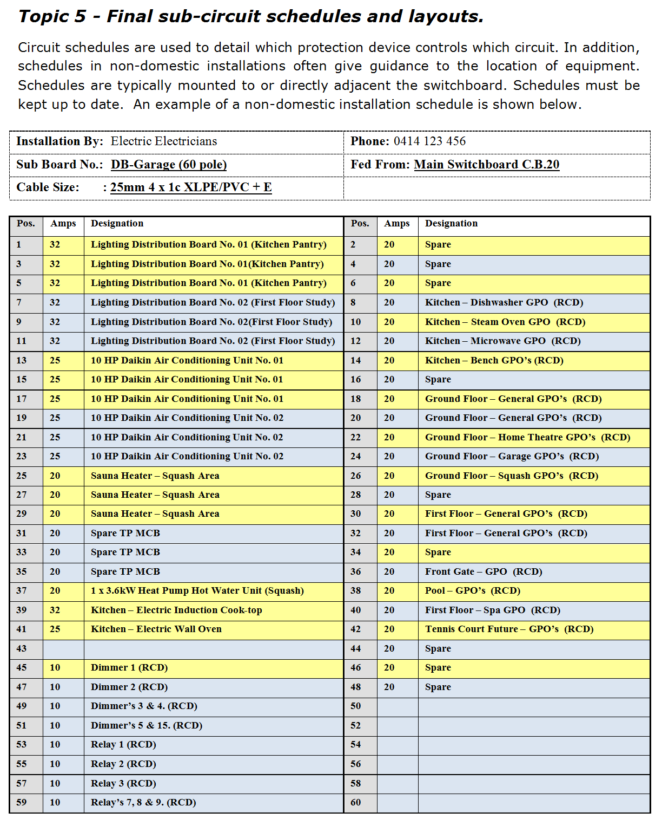
L

Slide 123
L

Slide 124
L

Slide 125
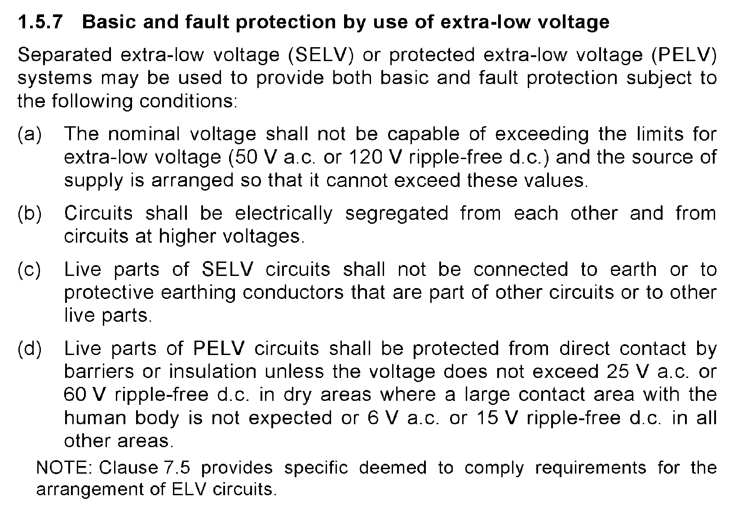
L
Notes:
125

Slide 126
Separated Extra-Low Voltage
Protected Extra-Low Voltage
Not exceeding 50V a.c. or 120V ripple free d.c.
L

Slide 127
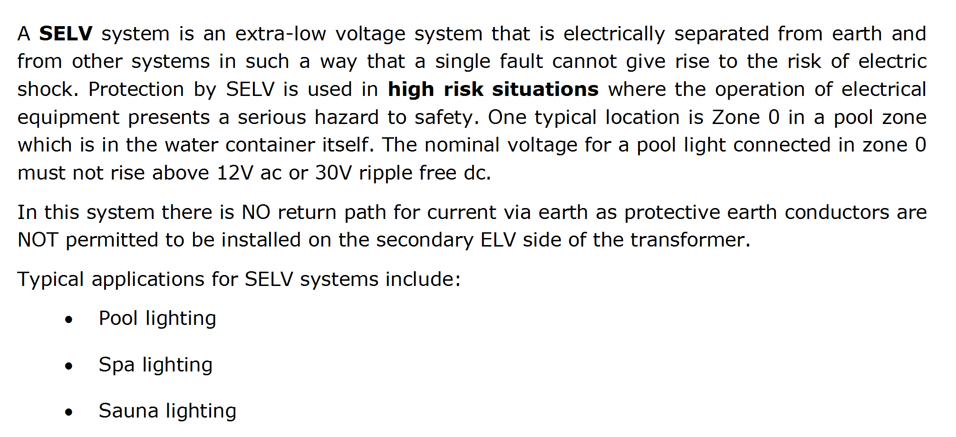
L

Slide 128
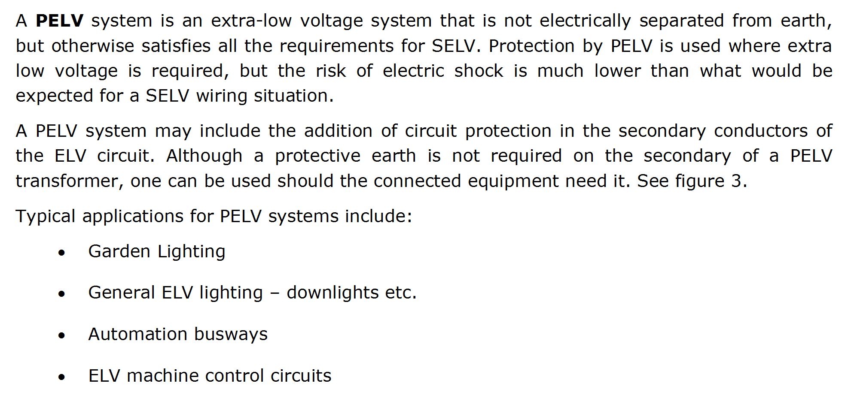
L

Slide 129
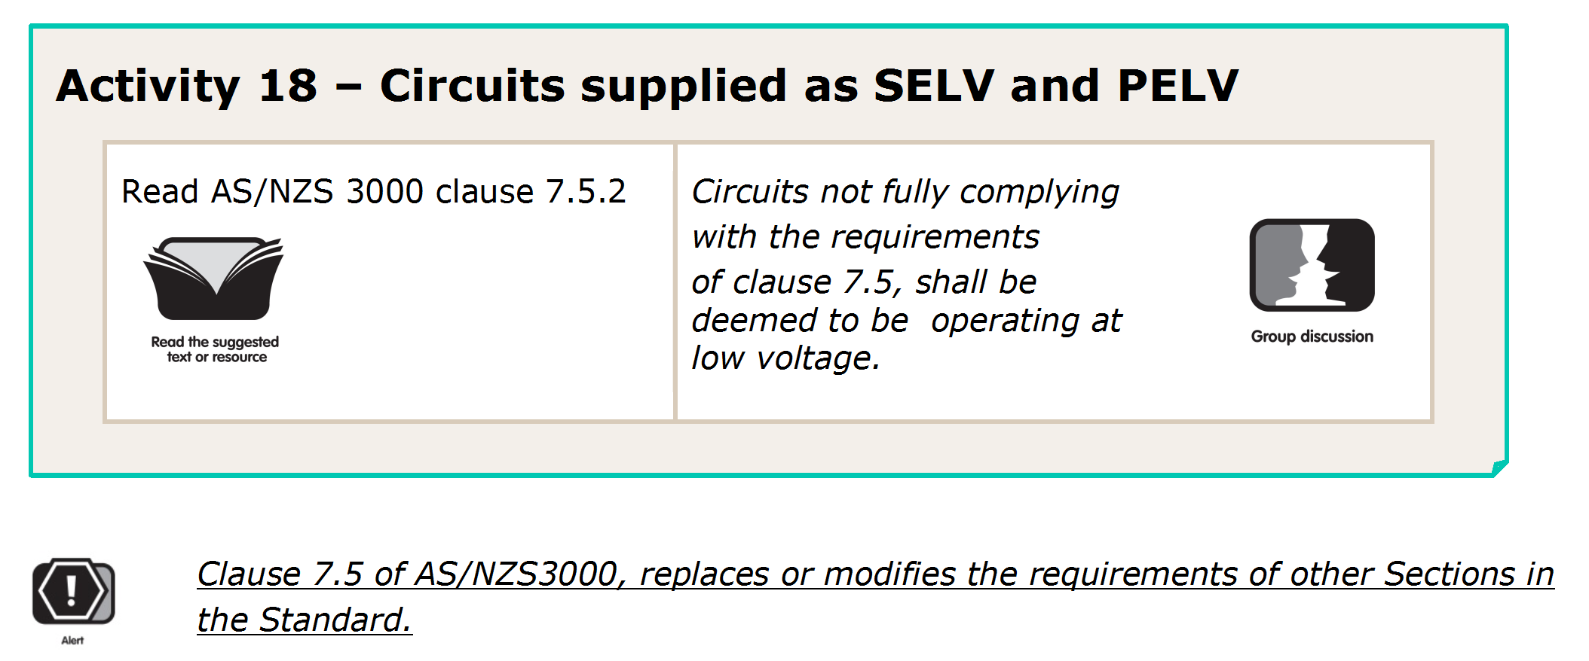
L

Slide 130
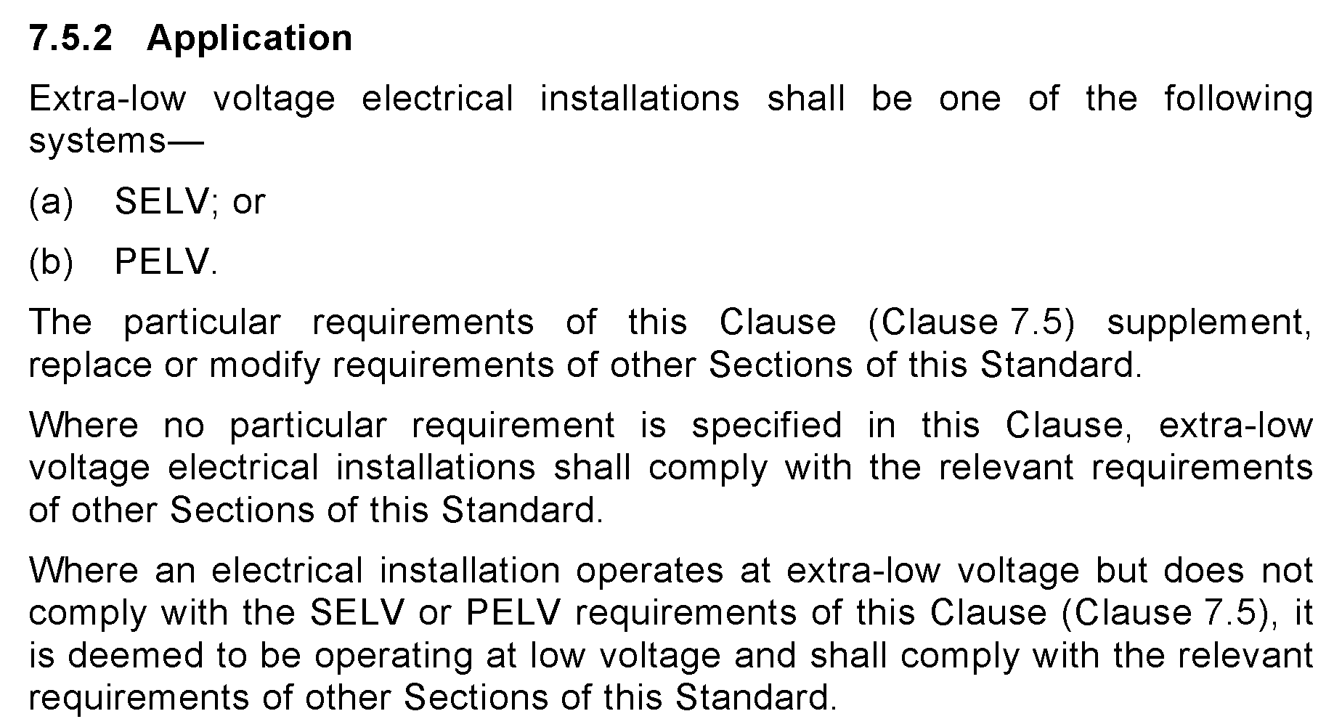
L

Slide 131
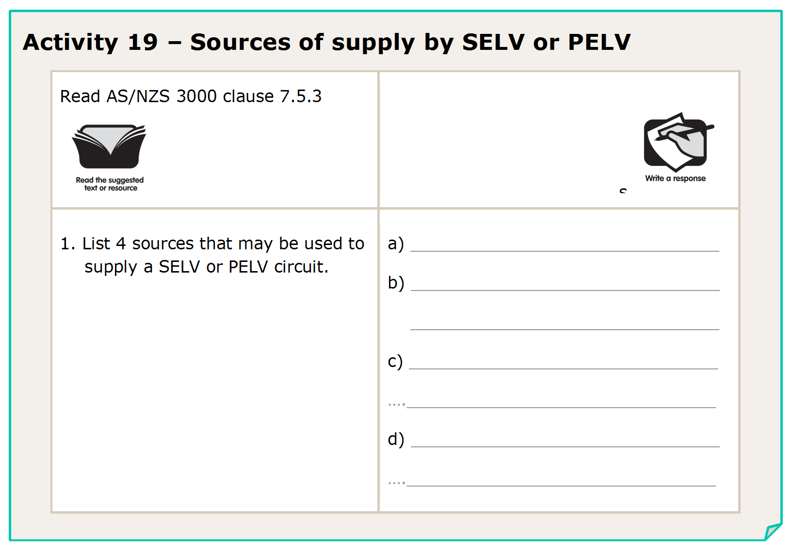
L

Slide 132
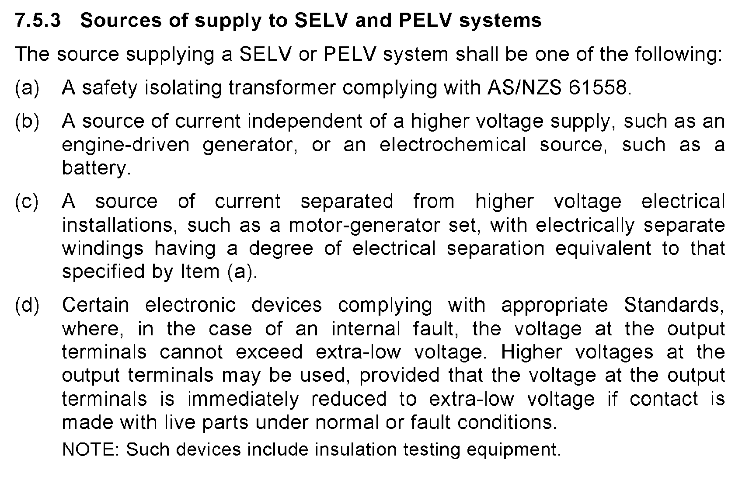
L

Slide 133
Isolation Tx
Battery
Motor / Generator set
Electronic device
L

Slide 134
L

Slide 135
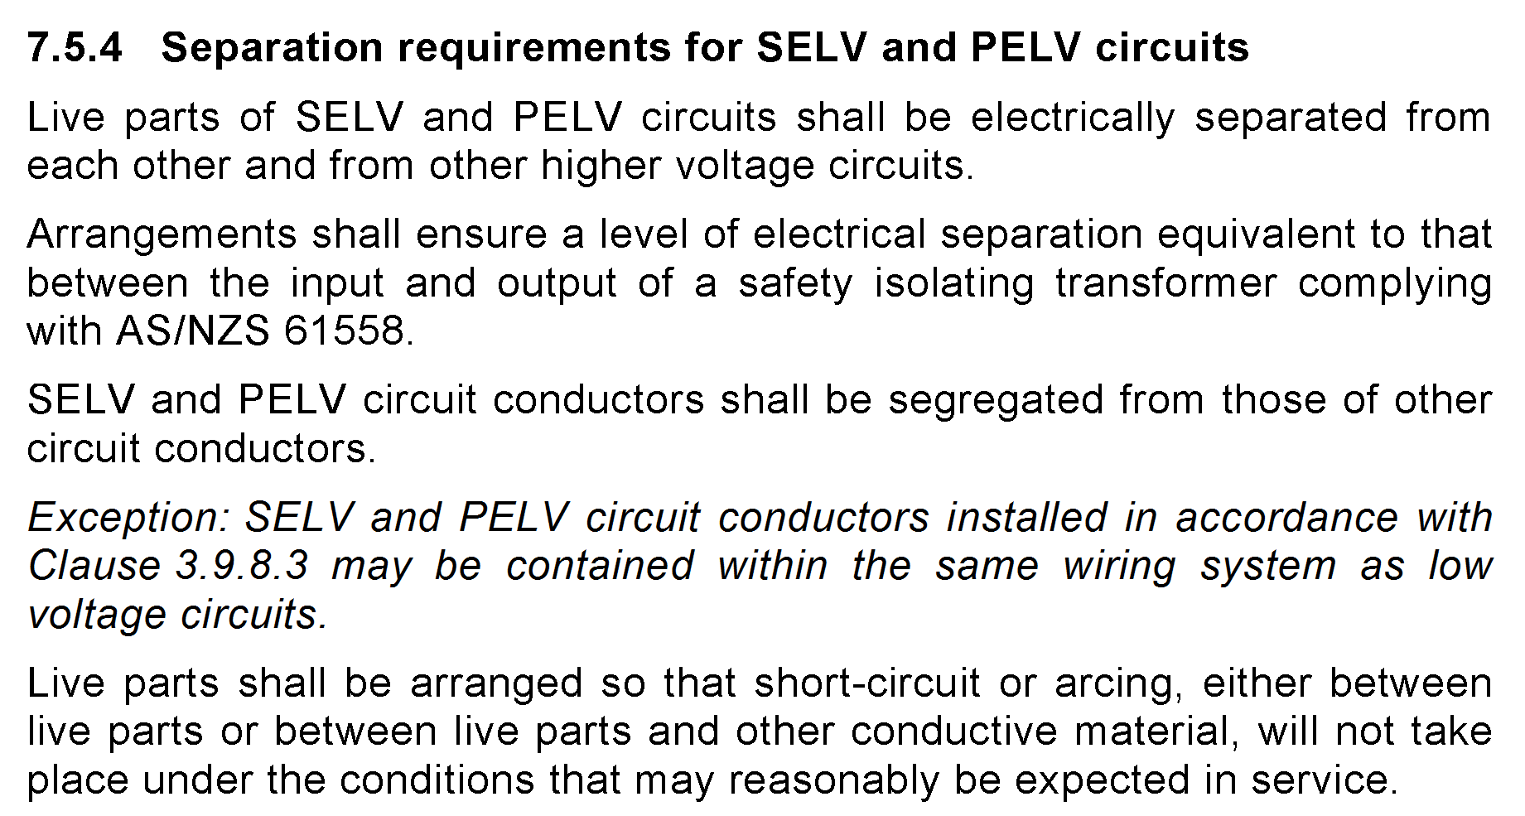

Slide 136
Each other and higher voltages
No.
Exception if installed under clause 3.9.8.3
L

Slide 137
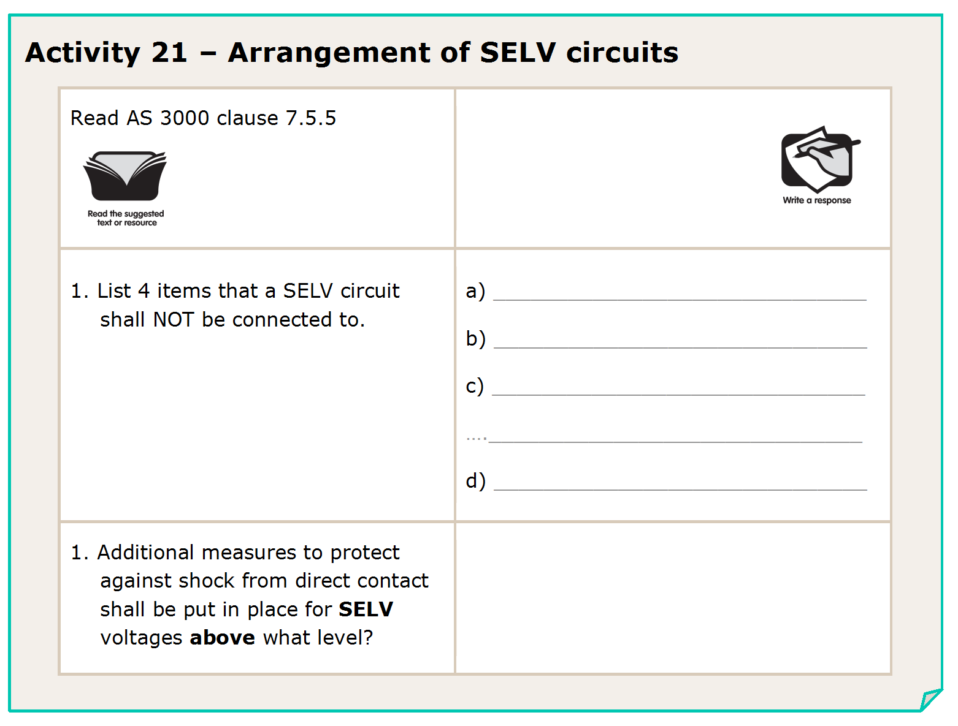
L

Slide 138
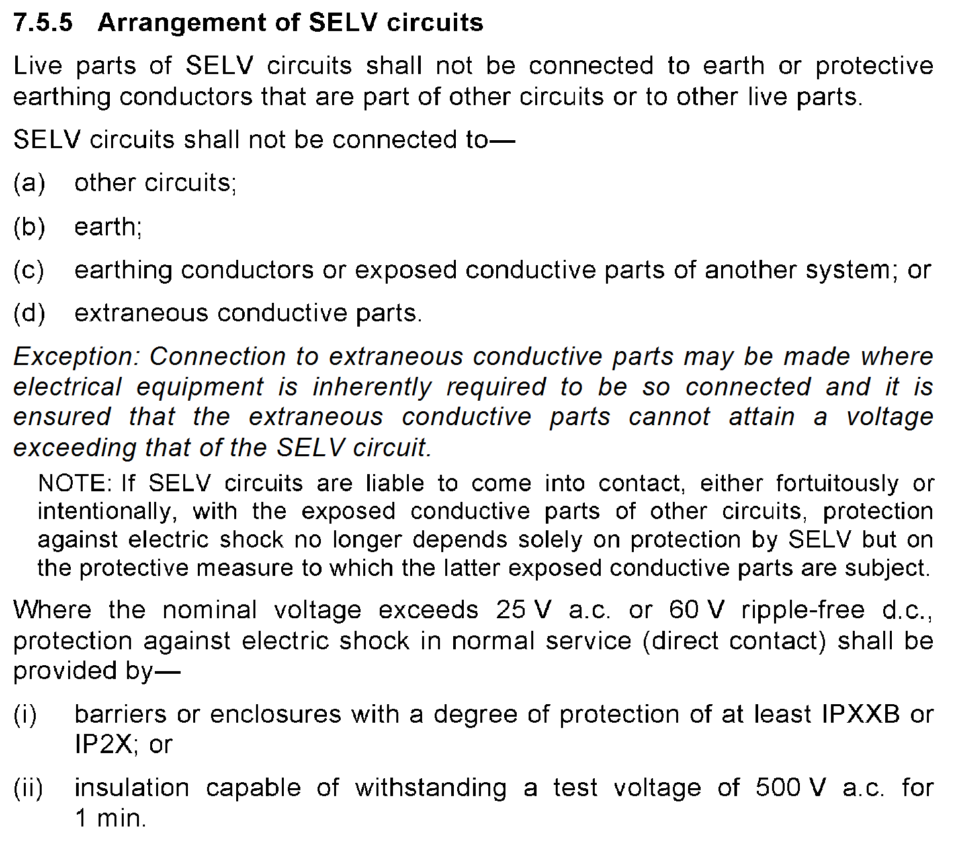

Slide 139
other circuits; or
earth; or
earthing conductors or exposed conductive parts
extraneous conductive parts.
25Va.c. or 60Vd.c.
L

Slide 140
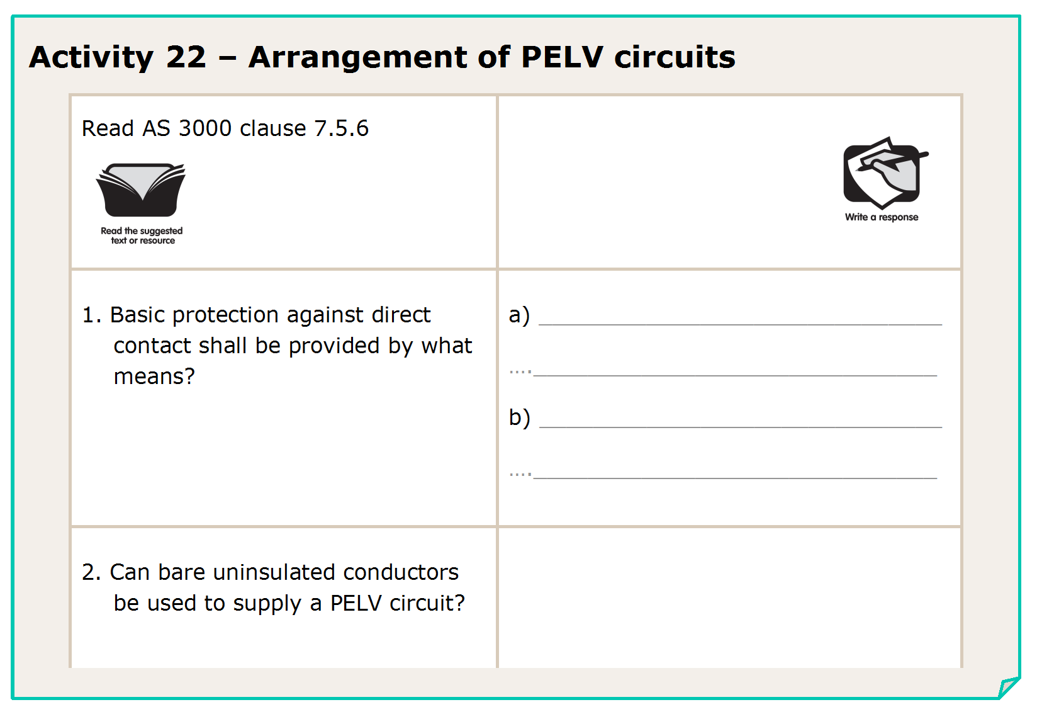
L

Slide 142
Barriers or enclosures to IPXXB or IP2X
Insulation capable of withstanding 500V a.c. for 1 minute
No.
(some exceptions apply)
L

Slide 143
L

Slide 144
L

Slide 145
L

Slide 146
L

Slide 147
Yes
7.4.2(a)
500V
7.4.3(a)
Earth
7.4.3(b)
No
7.4.3(c)
Connected to the equipotential bonding conductor
7.4.6(b)
L

Slide 148
END OF LESSON

