Slide 2
SECTION 3 FACTORS AFFECTING THE
SUITABILITY OF WIRING SYSTEMS

Slide 3
FACTORS AFFECTING THE SUITABILITY OF WIRING SYSTEMS
Topics
Construction methods
Installation conditions
External Influences
Selecting wiring systems
Aim
Learners will plan the cable arrangements for final sub-circuits in a variety of installations.
L

Slide 4
FACTORS AFFECTING THE SUITABILITY OF WIRING SYSTEMS
Learning objectives:
Learners should be able to meet the following learning objectives:
Identify wiring systems typically used with various construction methods and particular environments.
Describe the installation conditions that may affect the current-carrying capacity of cables.
Explain the external influences that may affect the current-carrying capacity and/or may cause damage to the wiring system.
Apply the AS/NZS 3000 requirements for selecting wiring systems for a range of circuits, installation conditions and construction methods into which the wiring system is to be installed.
Note: Wiring systems include cable enclosures, underground wiring, aerial wiring, catenary support, safety services, busbar, trunking and earth sheath return.
L

Slide 5
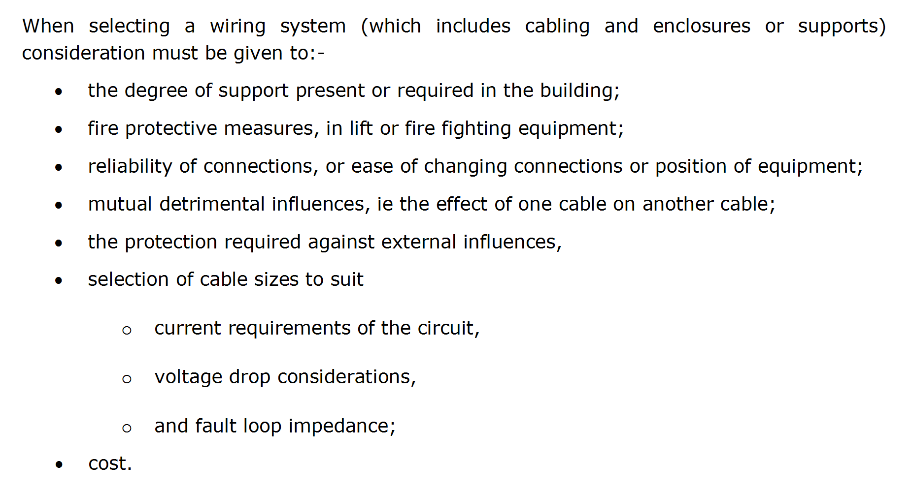
L

Slide 6
L

Slide 7
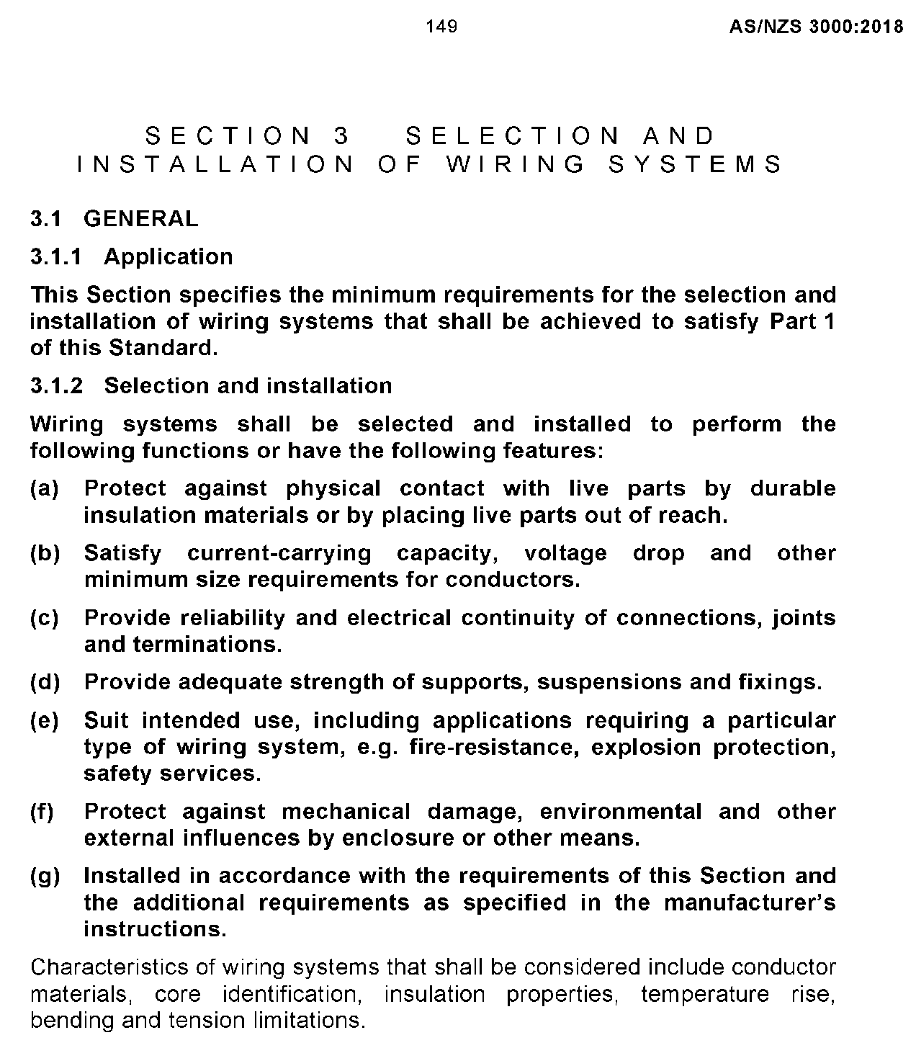
L

Slide 8
L

Slide 9
L

Slide 10
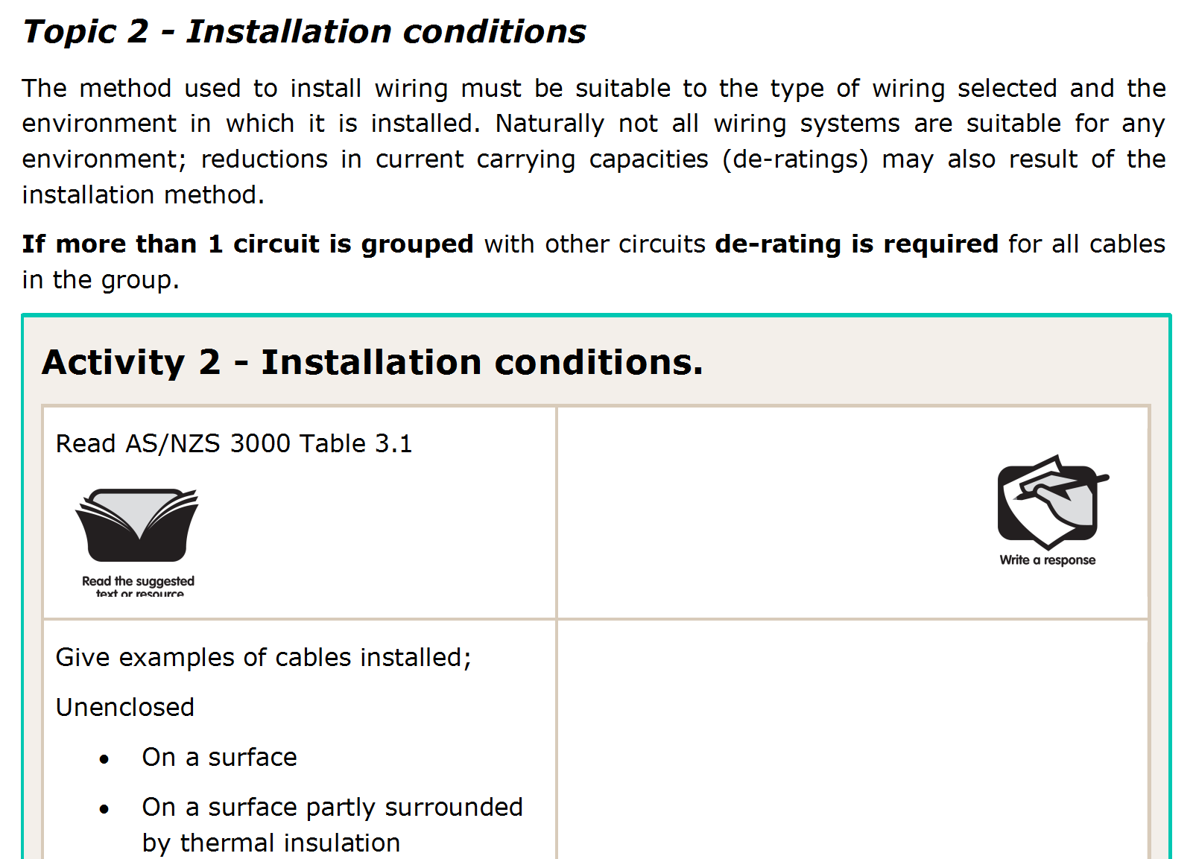
L

Slide 11
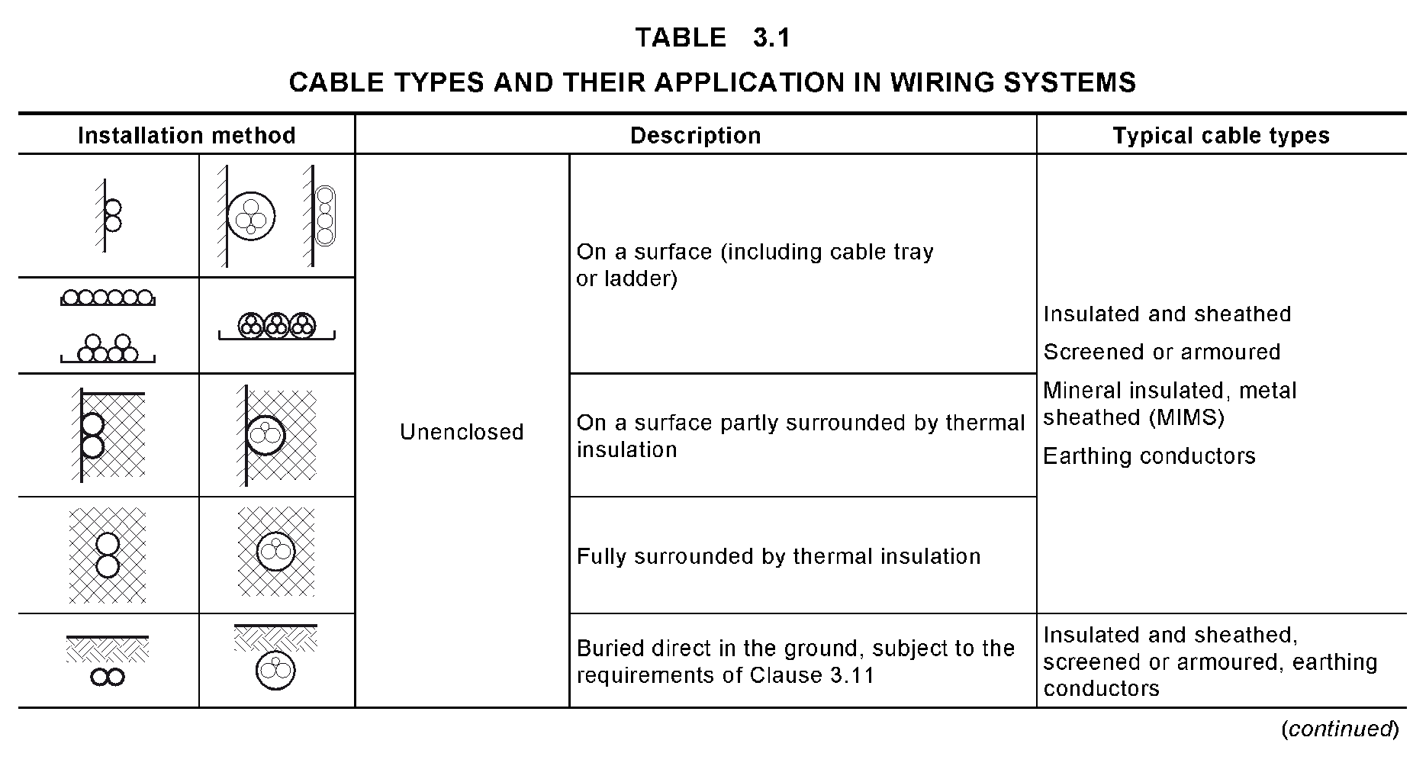
L

Slide 12
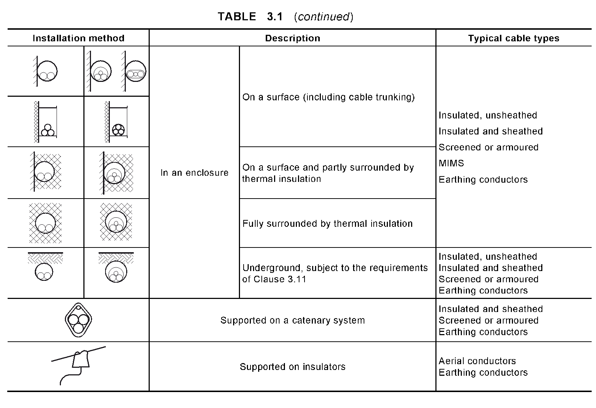
L

Slide 13
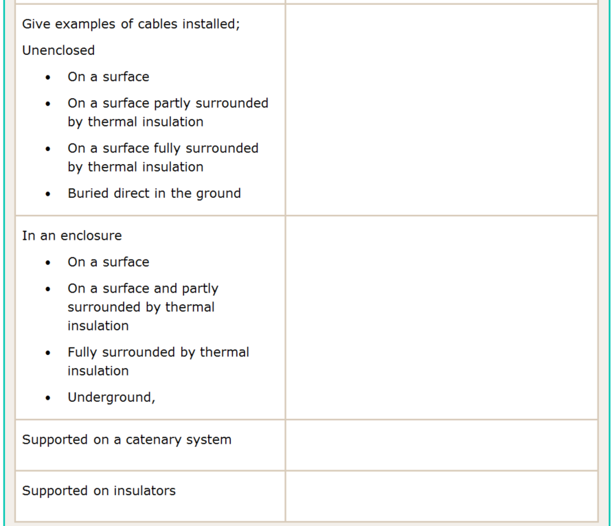
Power cct clipped to timber under floor
Light cct clipped to timber in roof space
A wall cavity filled with foam insulation
U/G distribution (street) mains
Inside a conduit saddled to a wall
Consumers mains in conduit in a roof space
Consumers mains down a brick cavity wall filled with foam
U/G consumer’s mains
Temporary builders supplies
O/H distribution (street) mains
L

Slide 14
L

Slide 15
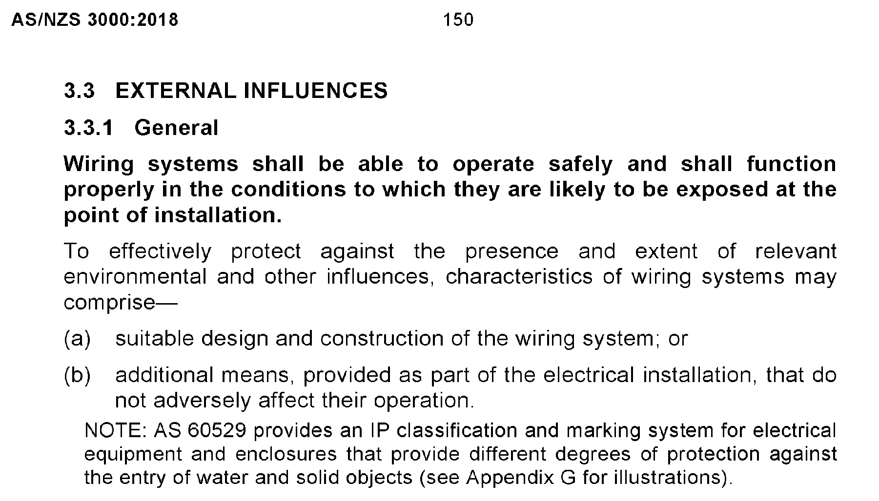
L

Slide 16
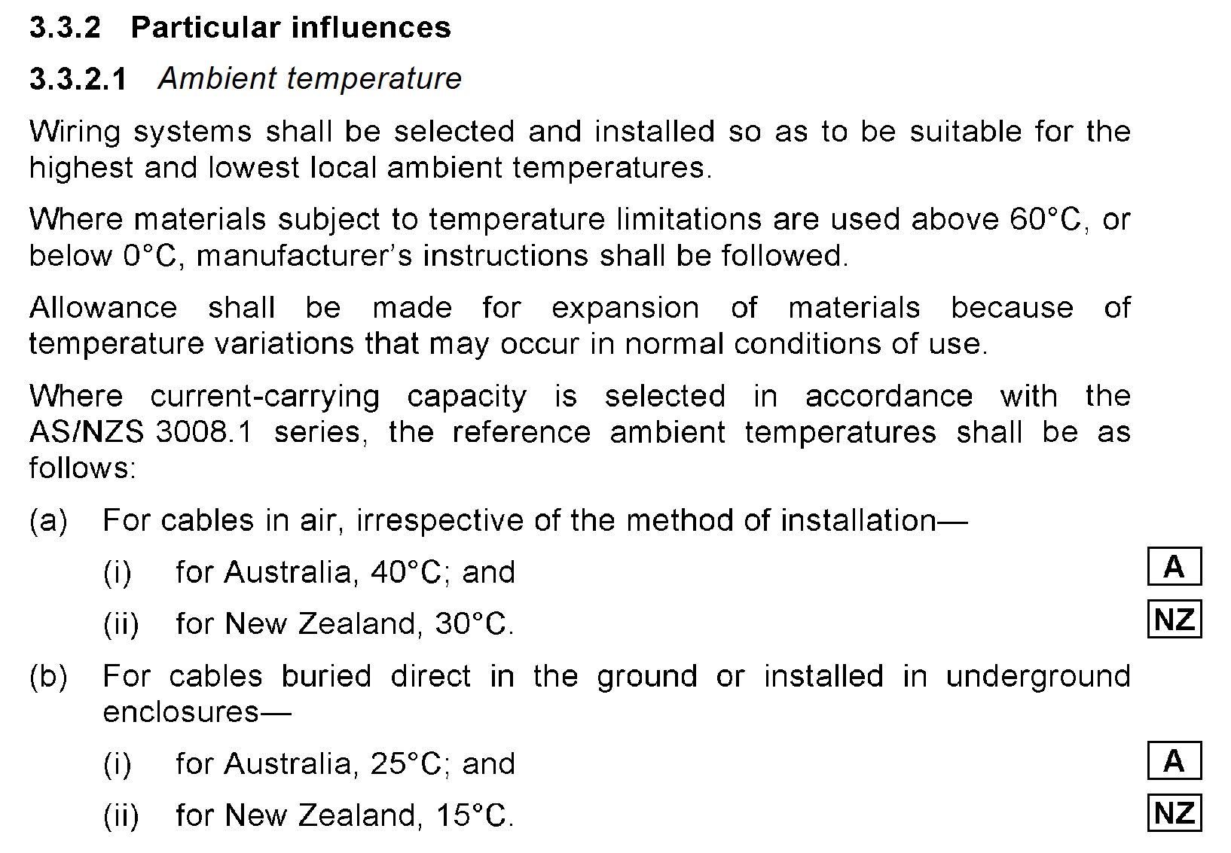
L

Slide 17
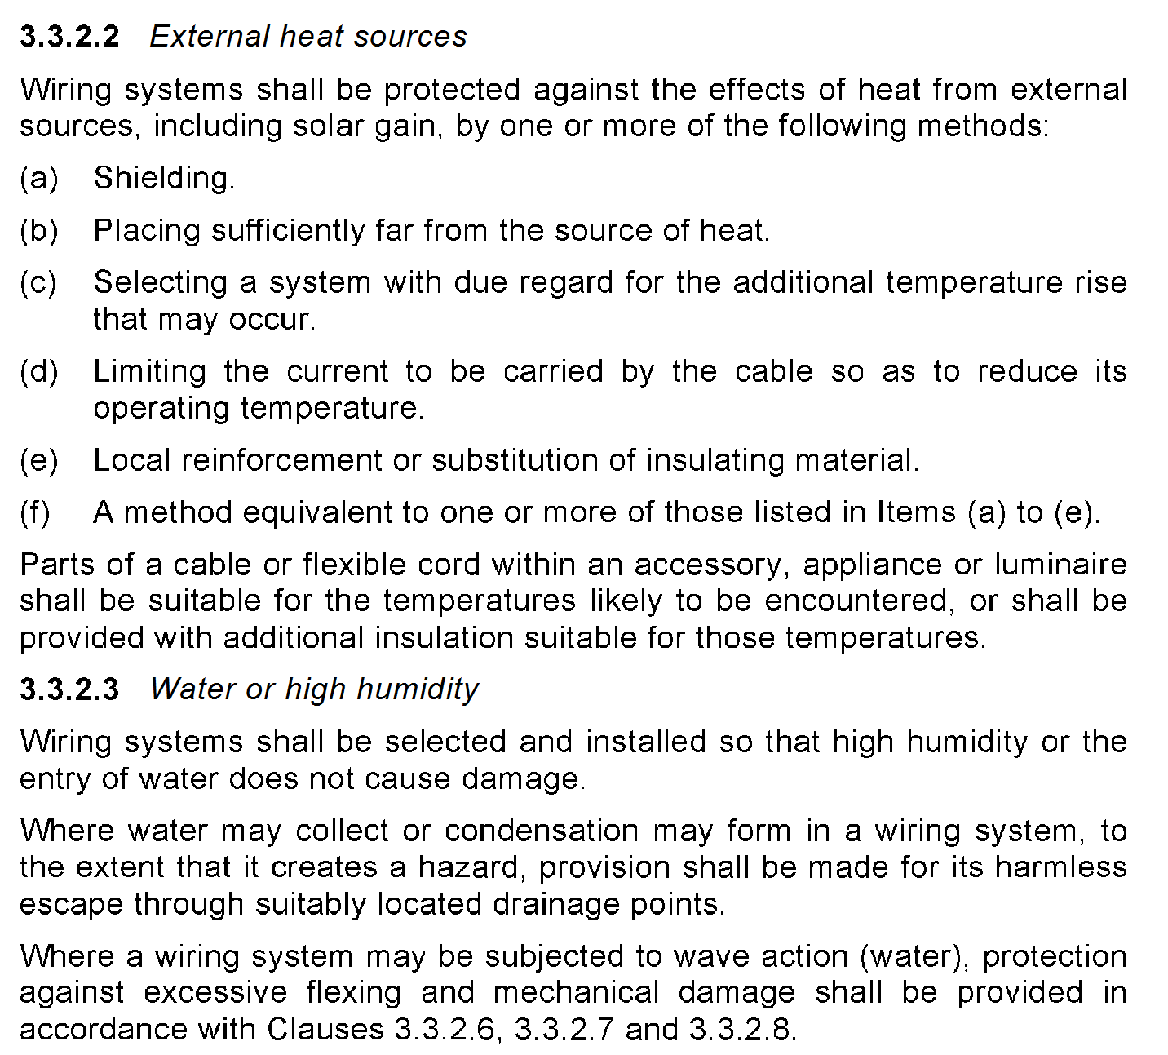
L

Slide 18
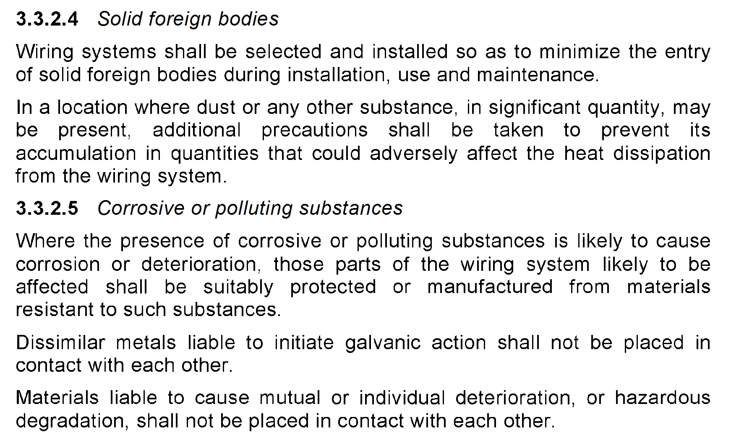
L

Slide 19
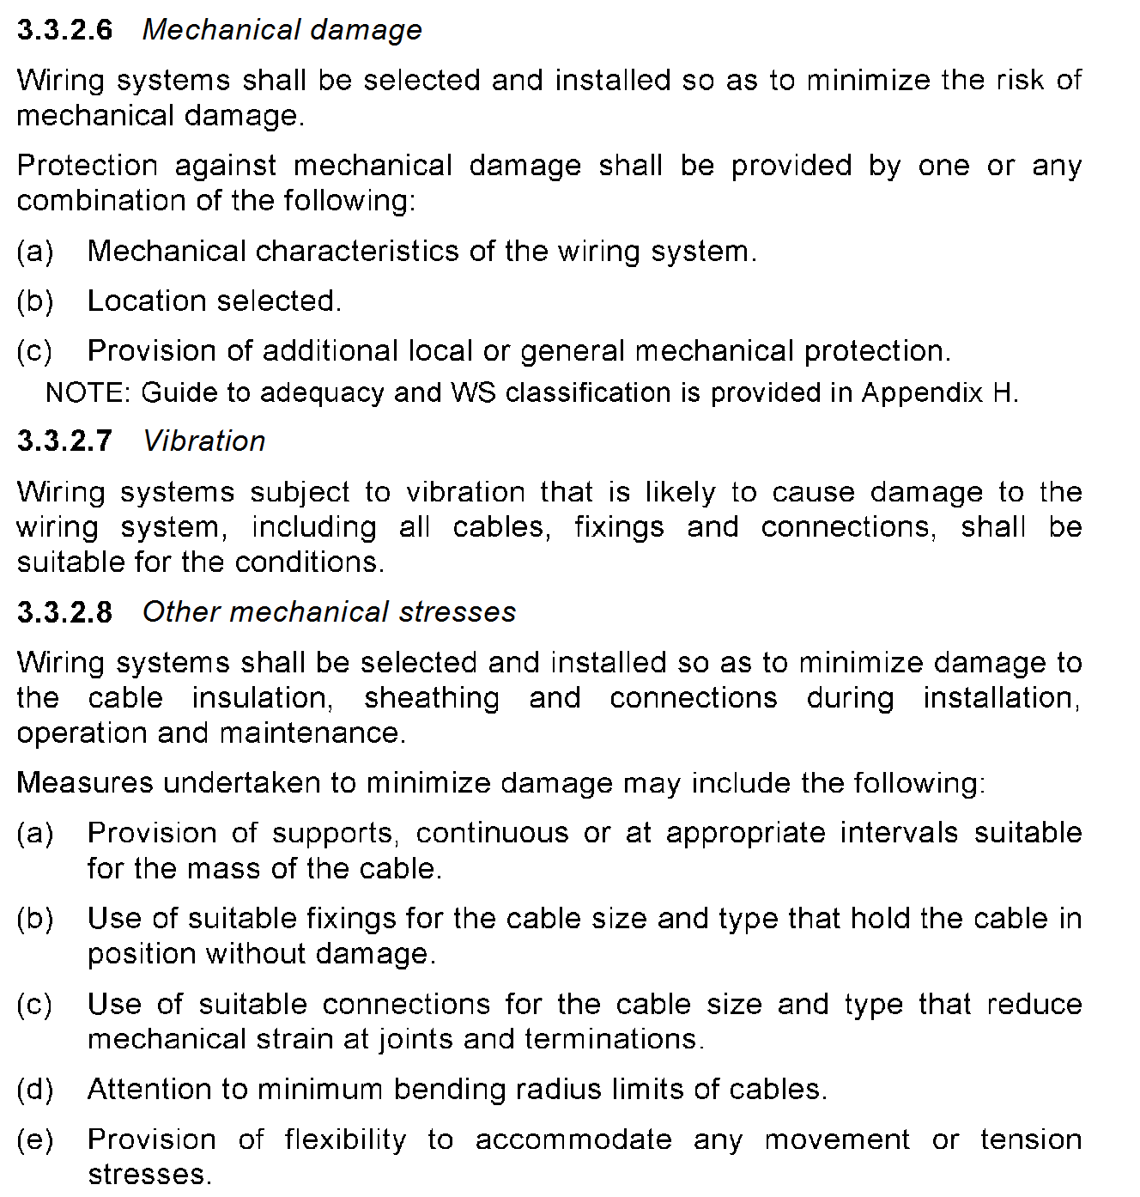
L

Slide 20
L

Slide 21
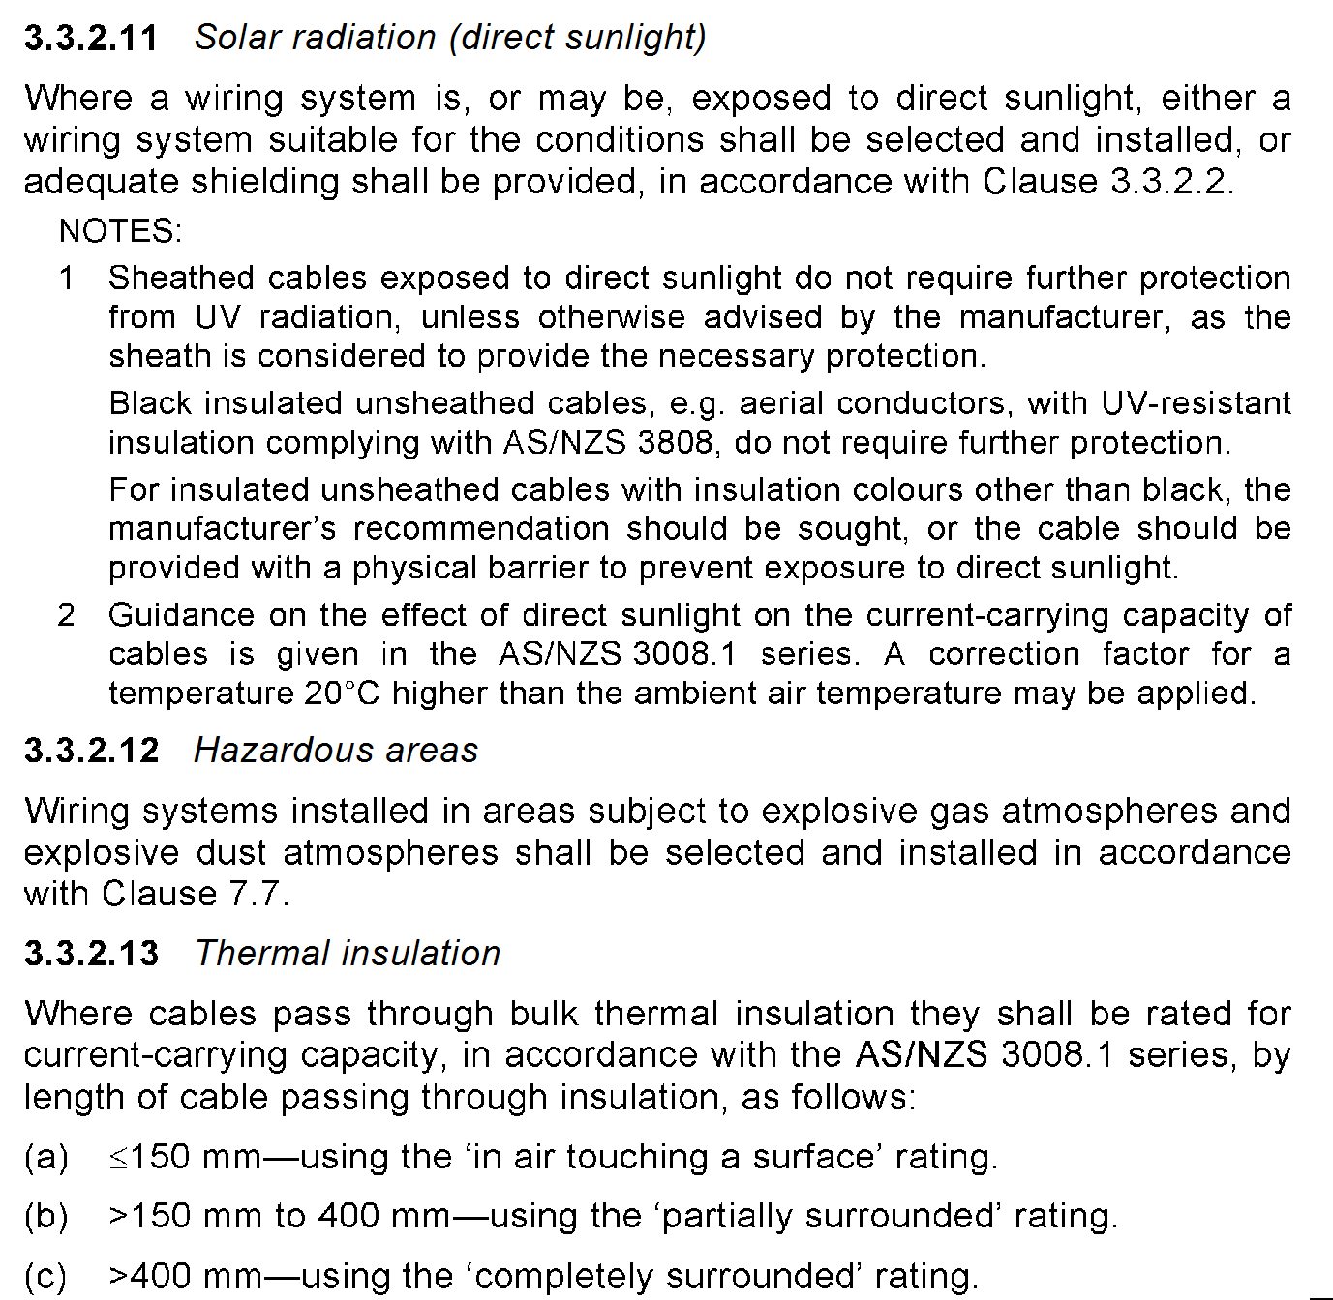
L

Slide 22
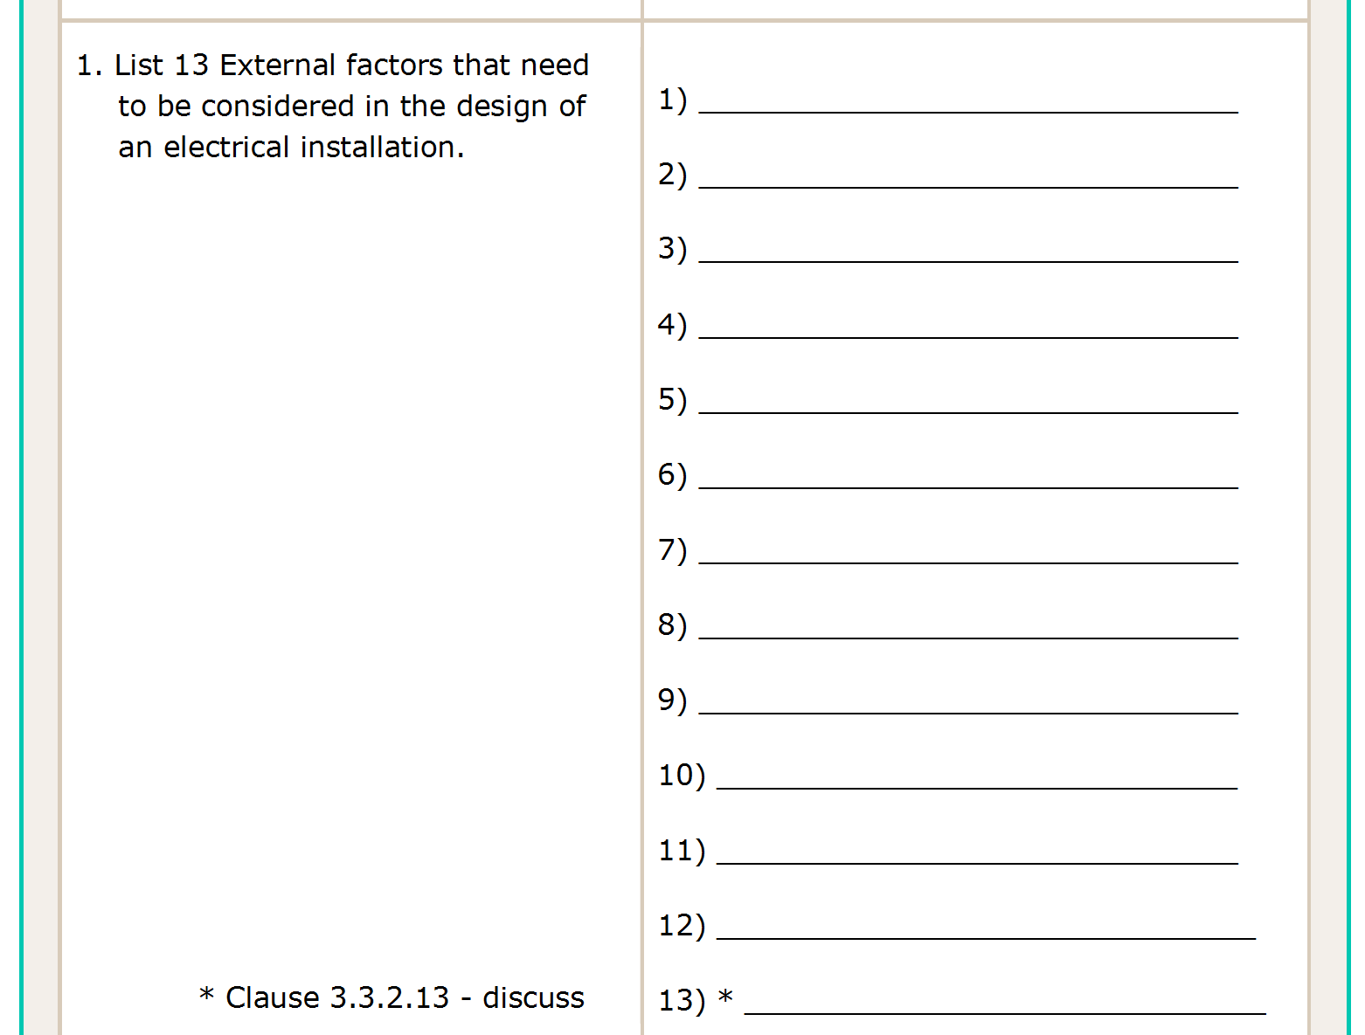
Ambient temperature
External heat sources
Water or high humidity
Solid foreign bodies
Corrosive or polluting substances
Impact
Vibration
Other mechanical stresses
Flora
Fauna
Solar radiation (direct sunlight)
Hazardous areas
Thermal insulation
L

Slide 23
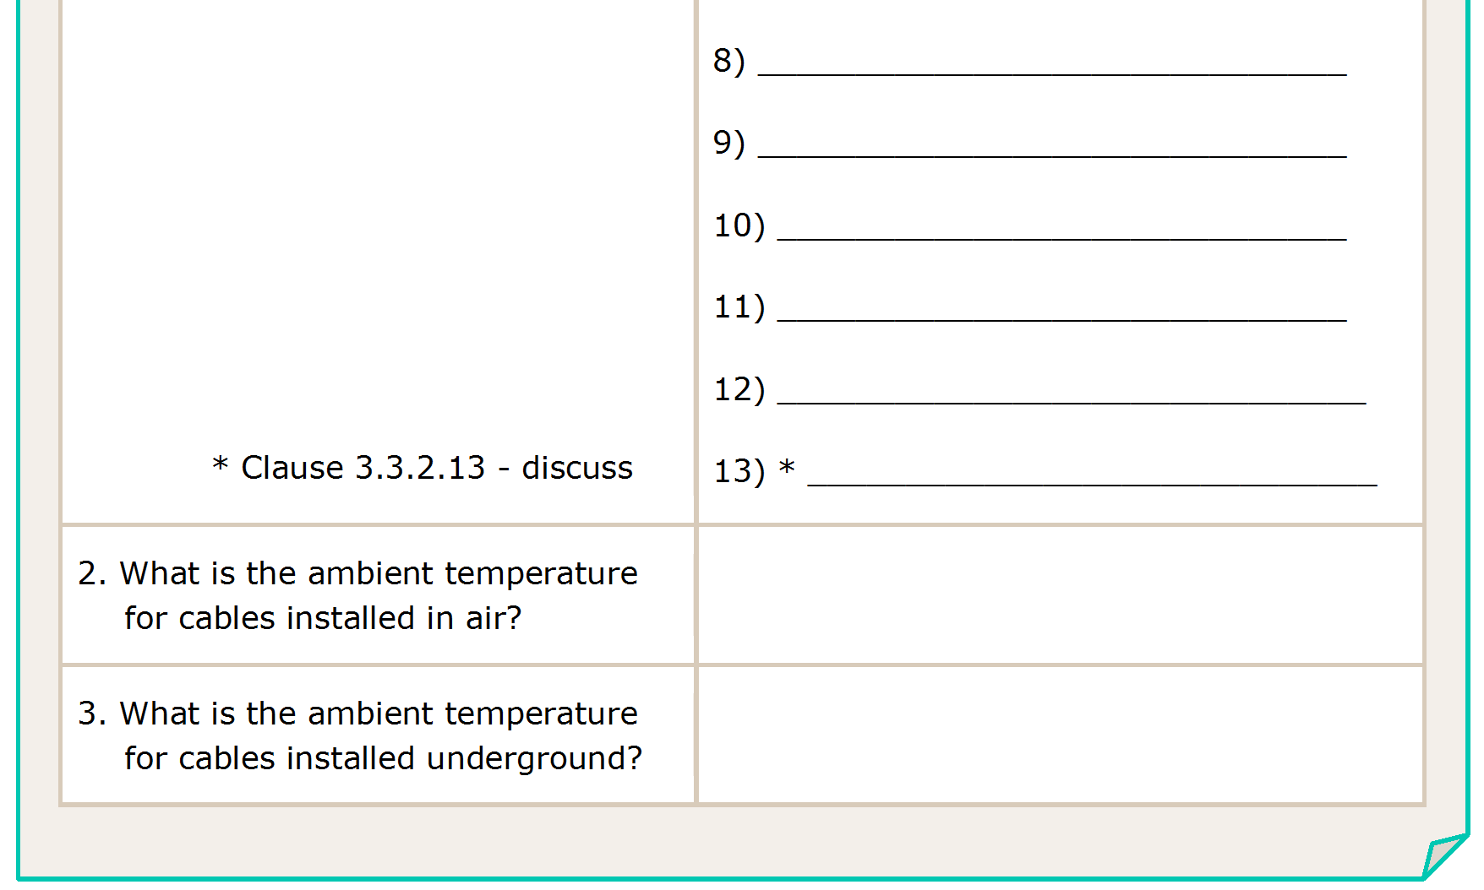
Other mechanical stresses
Flora
Fauna
Solar radiation (direct sunlight)
Hazardous areas
Thermal insulation
40○ C
25○ C
L

Slide 24
L

Slide 25
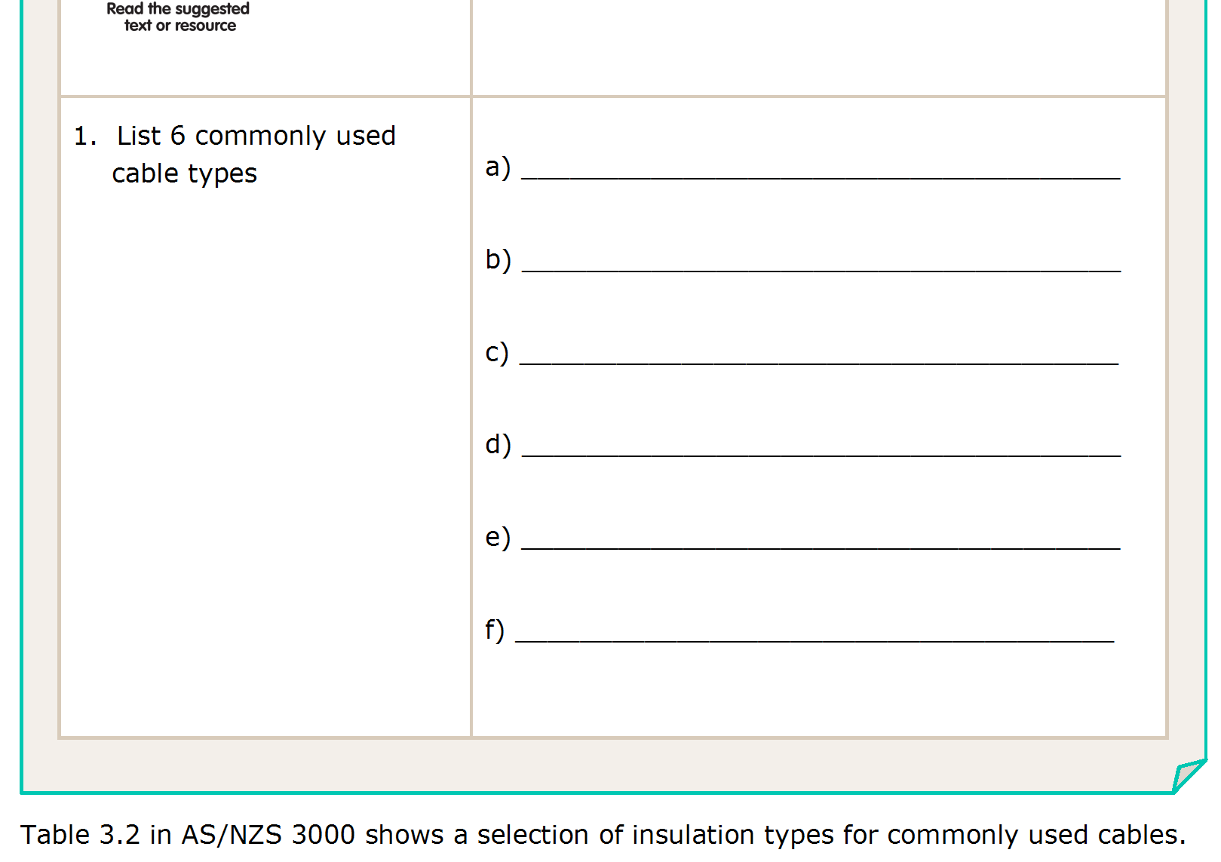
Insulated and unsheathed (T.P.I.)
Insulated and sheathed (T.P.S.)
Screened or armoured
MIMS
Earthing conductors
Aerial conductors
L

Slide 26
L

Slide 27
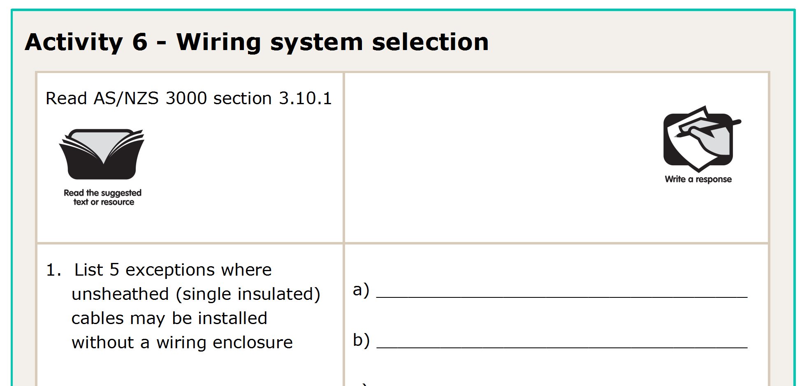
L

Slide 28
L

Slide 29
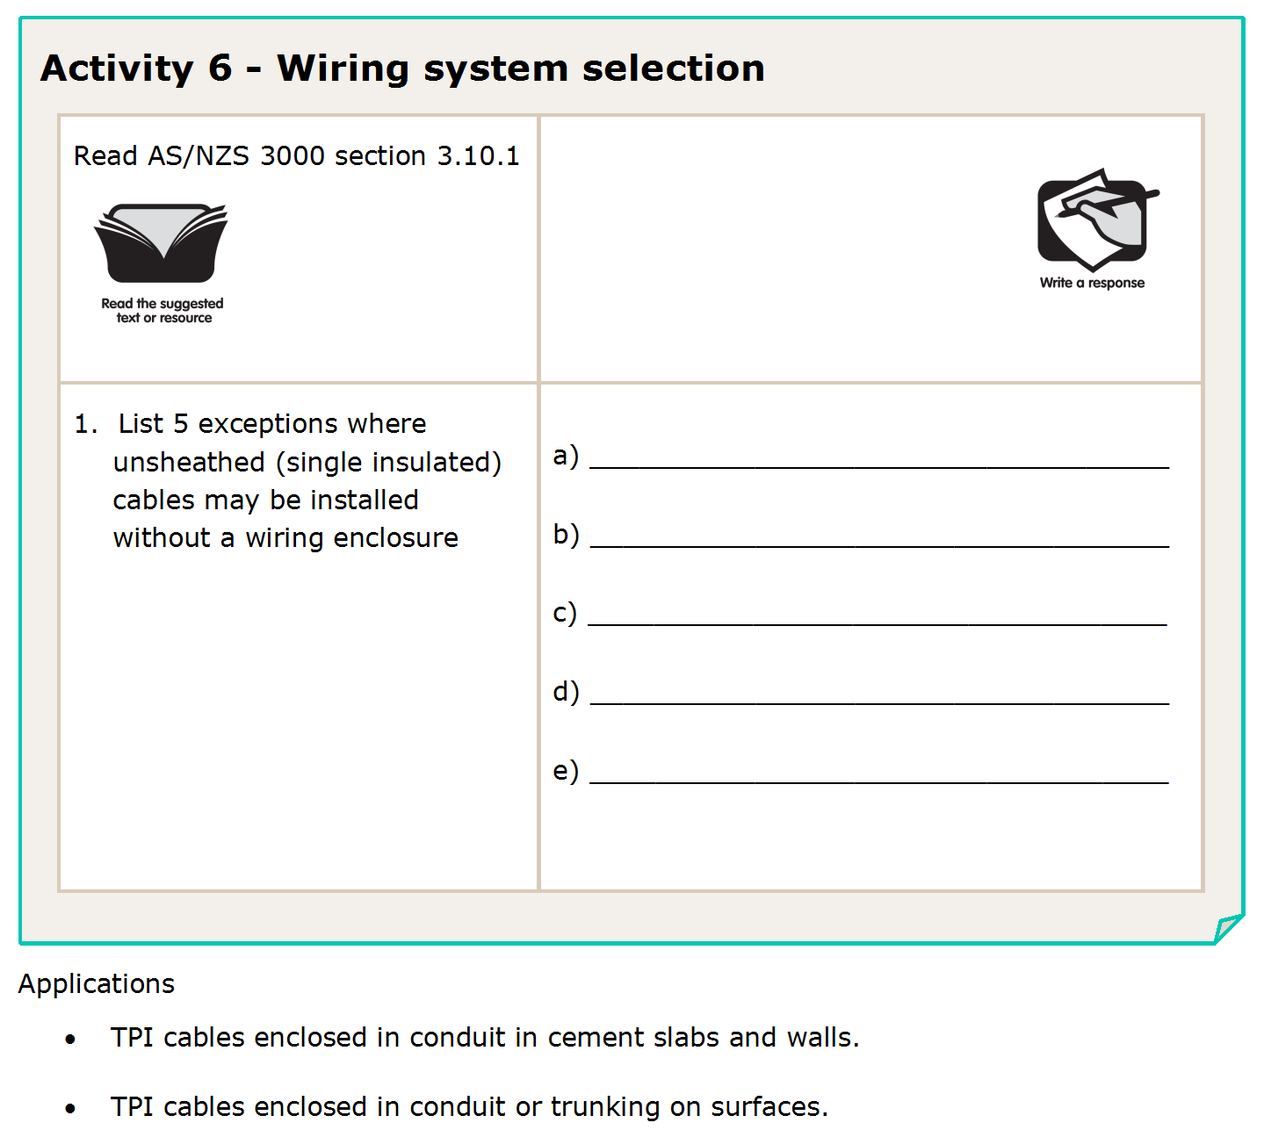
Aerial conductors
In a wall within 100mm of an accessory
In switch boards or similar enclosures
Earthing conductors
Extra low voltage (ELV)
-for single insulated cables
L

Slide 30
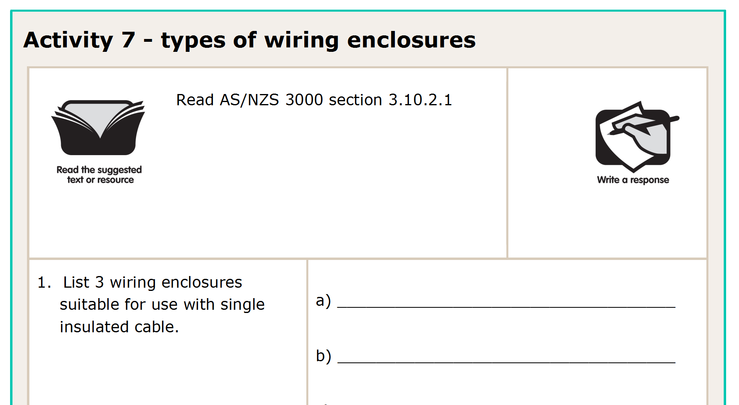
L

Slide 31
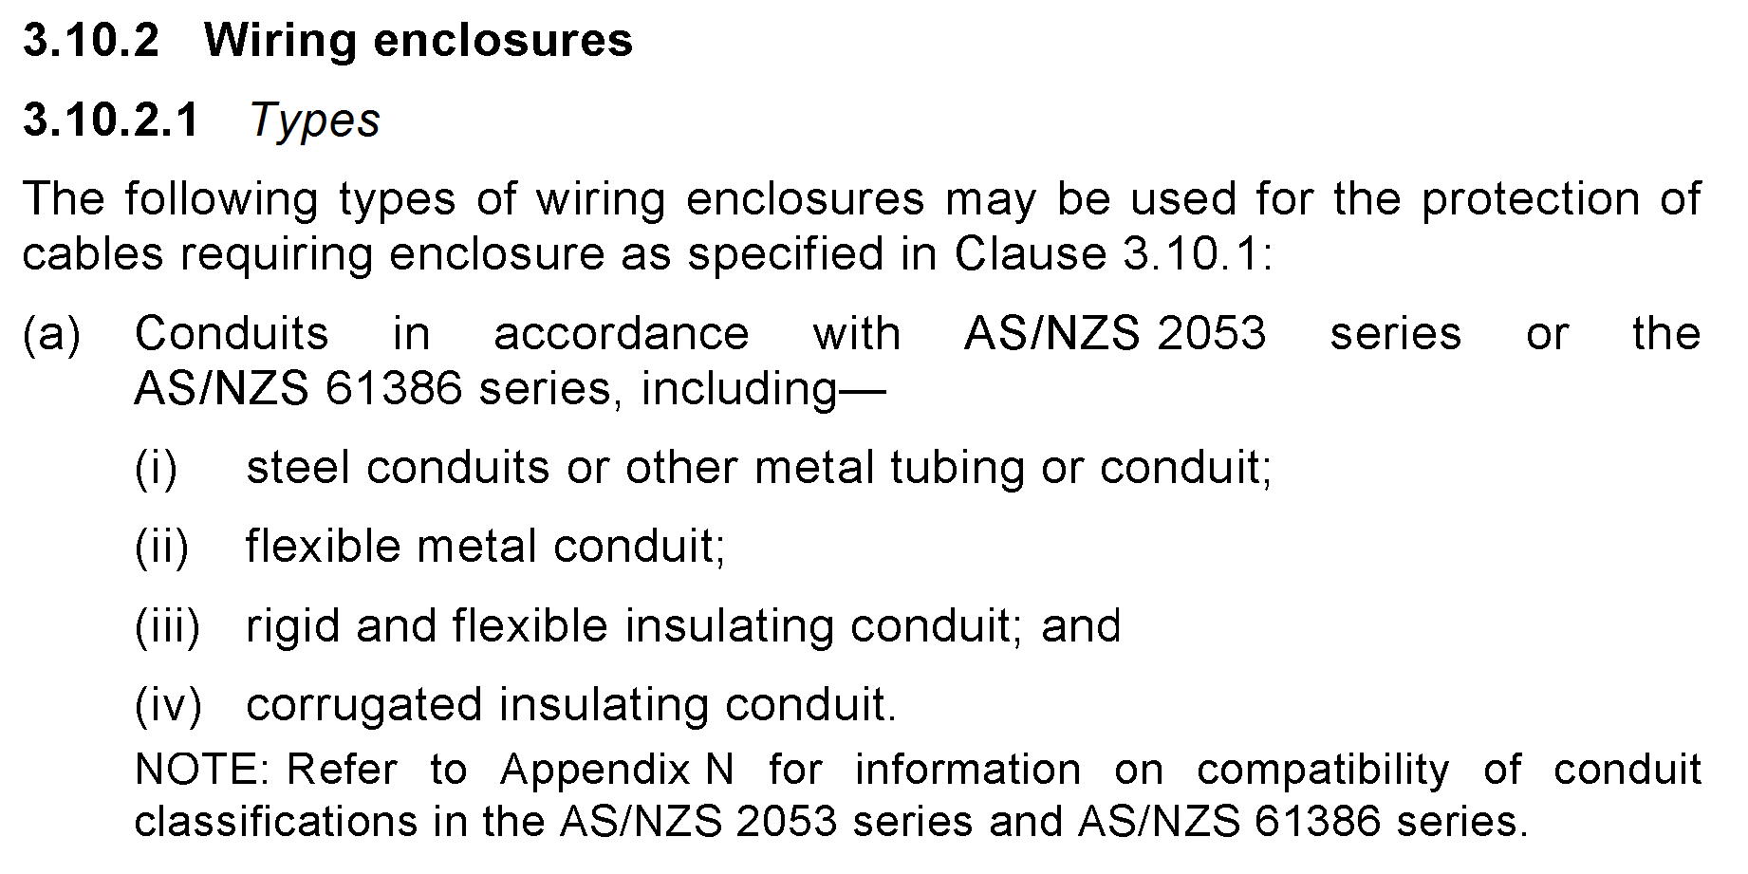
L

Slide 32
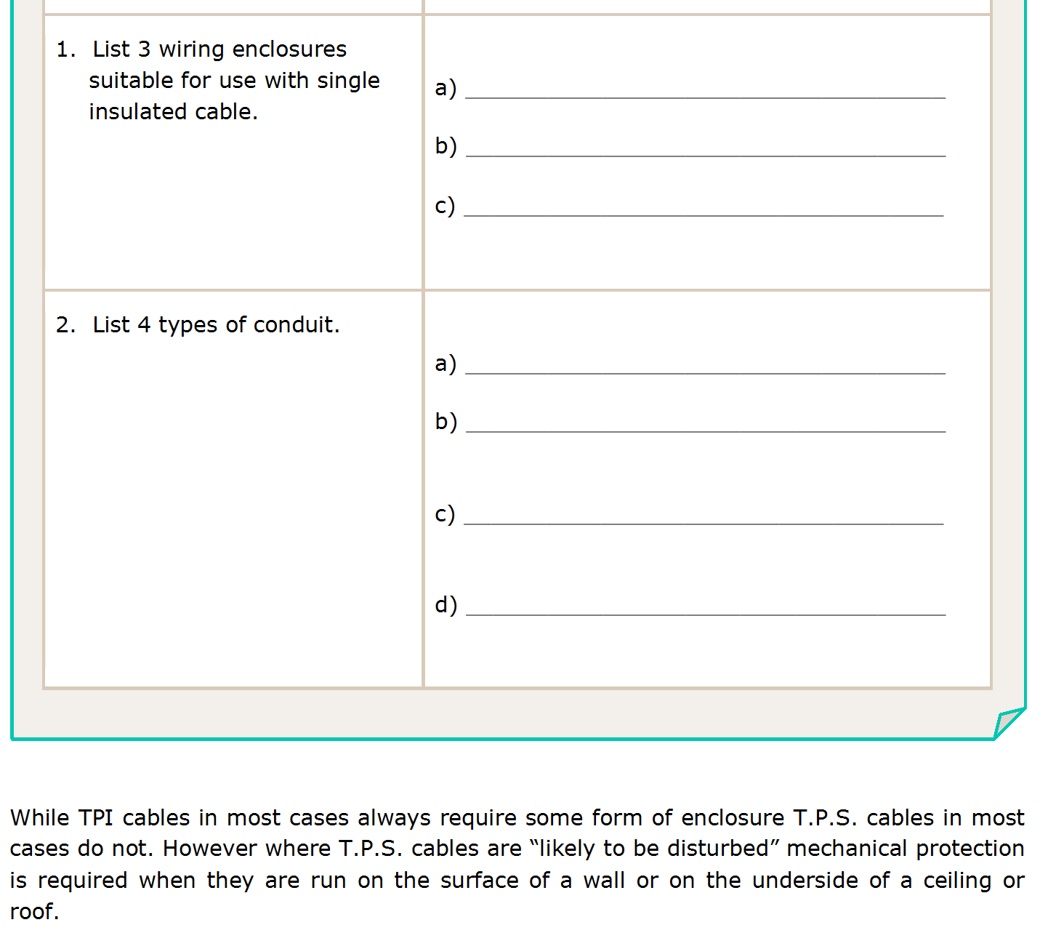
Conduits
Trunking
Other similar to a and b
Steel / or tubing
Flexible metal
Rigid and flexible insulated
Corrugated insulated
L

Slide 33
L

Slide 34
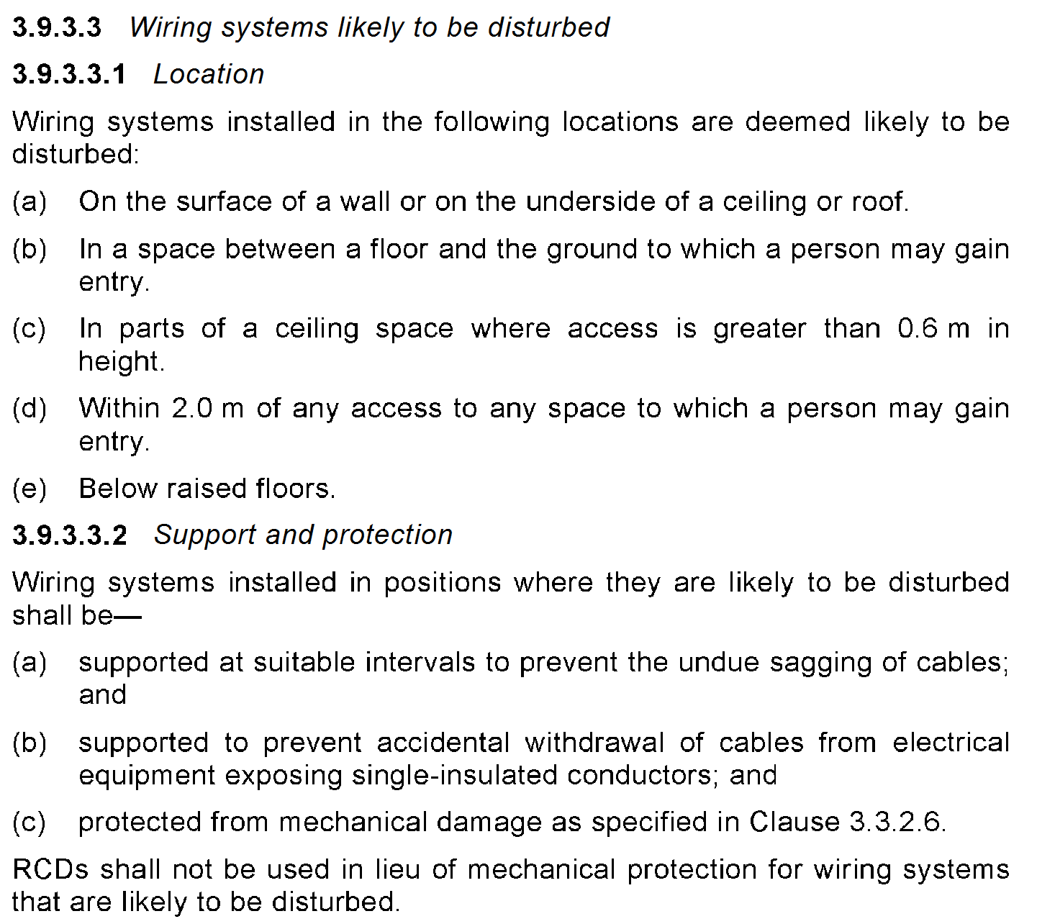
L

Slide 35
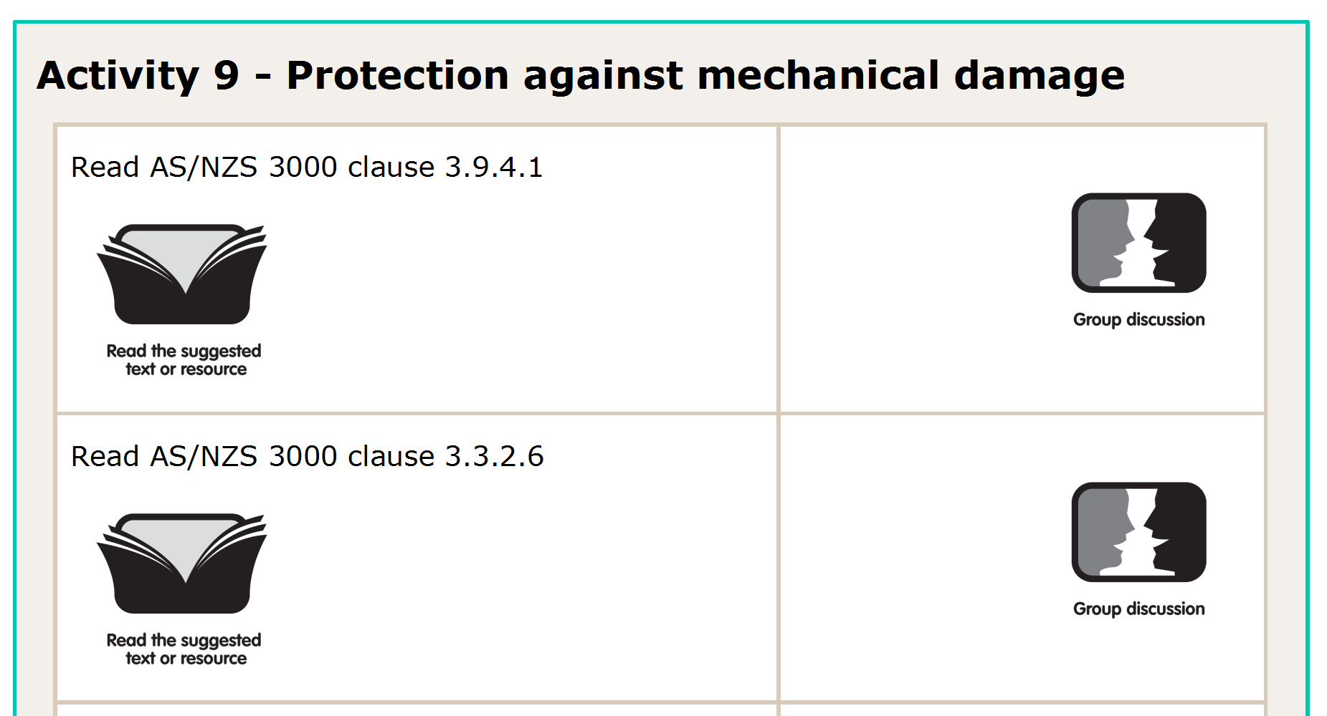
L

Slide 36
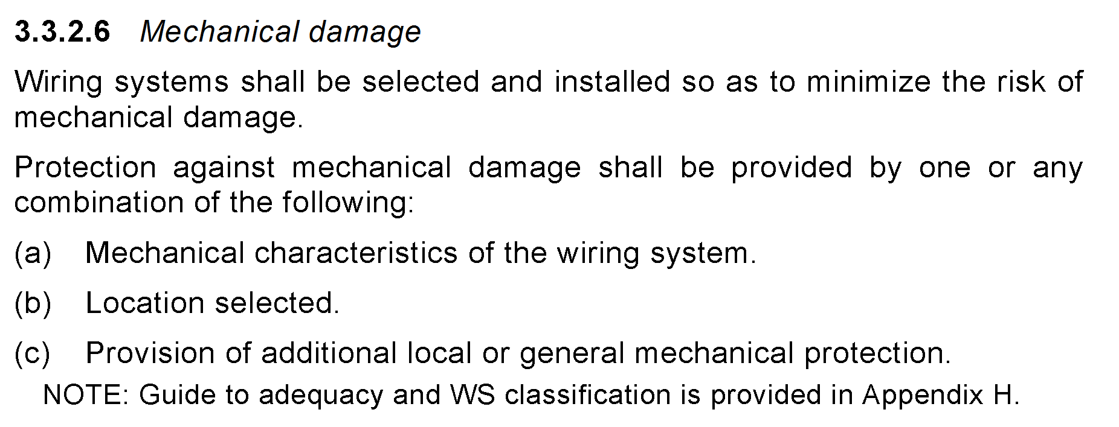
L

Slide 37
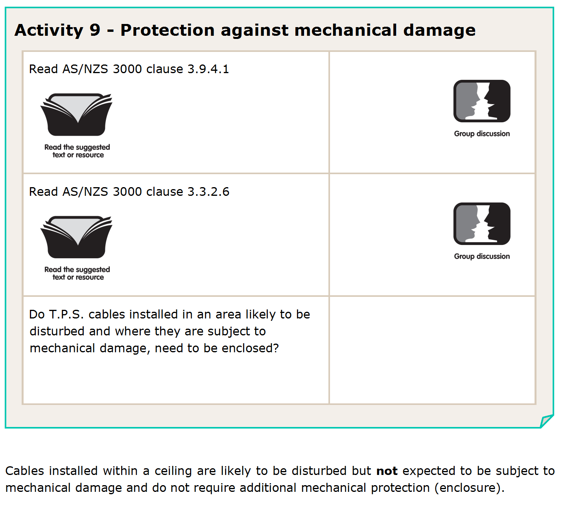
yes
L

Slide 38
L

Slide 39
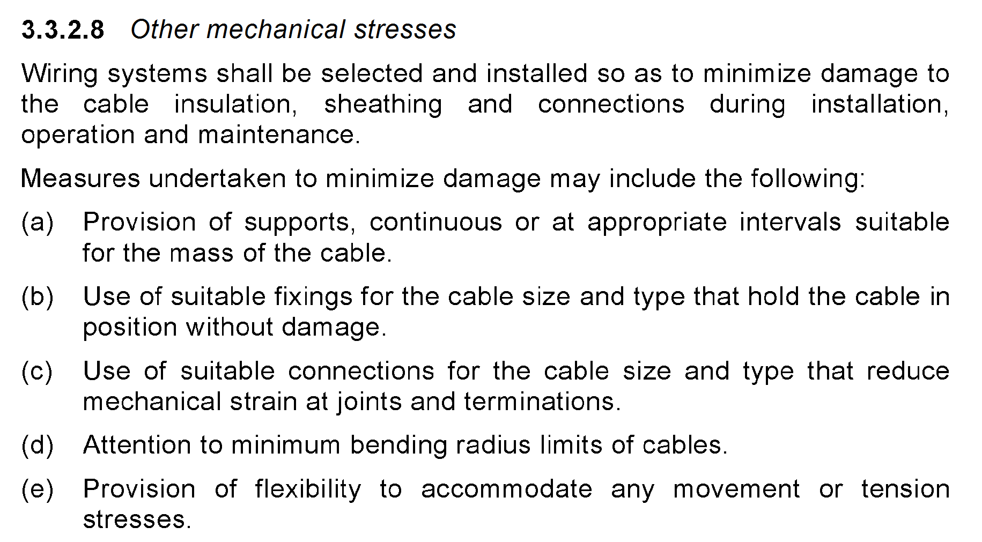
L

Slide 40
L

Slide 41
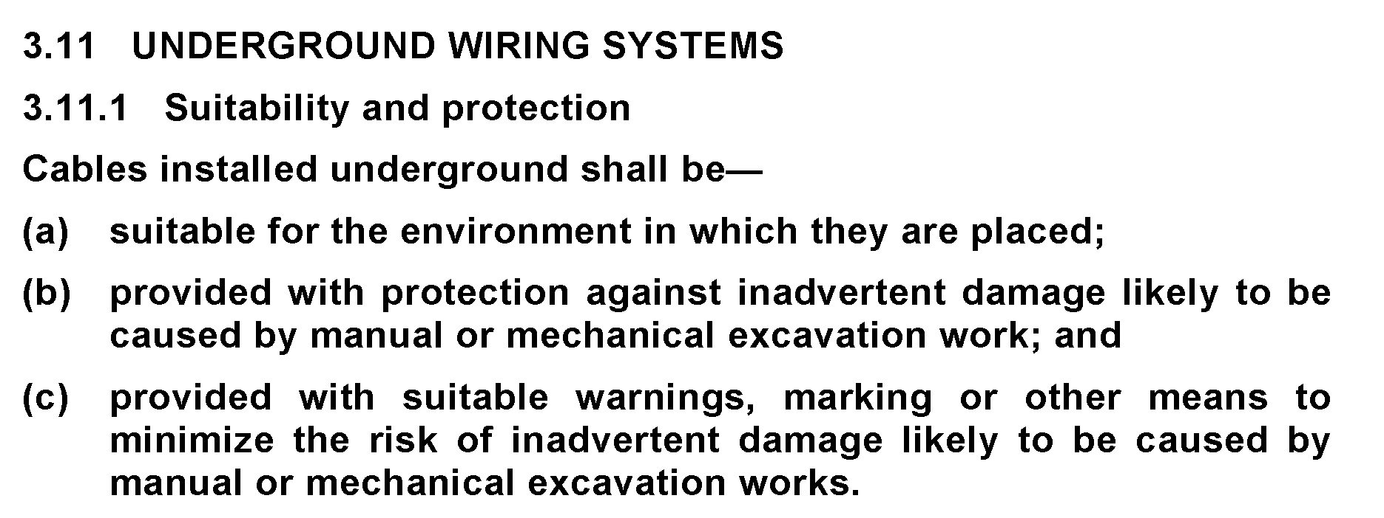
L

Slide 42
L

Slide 43
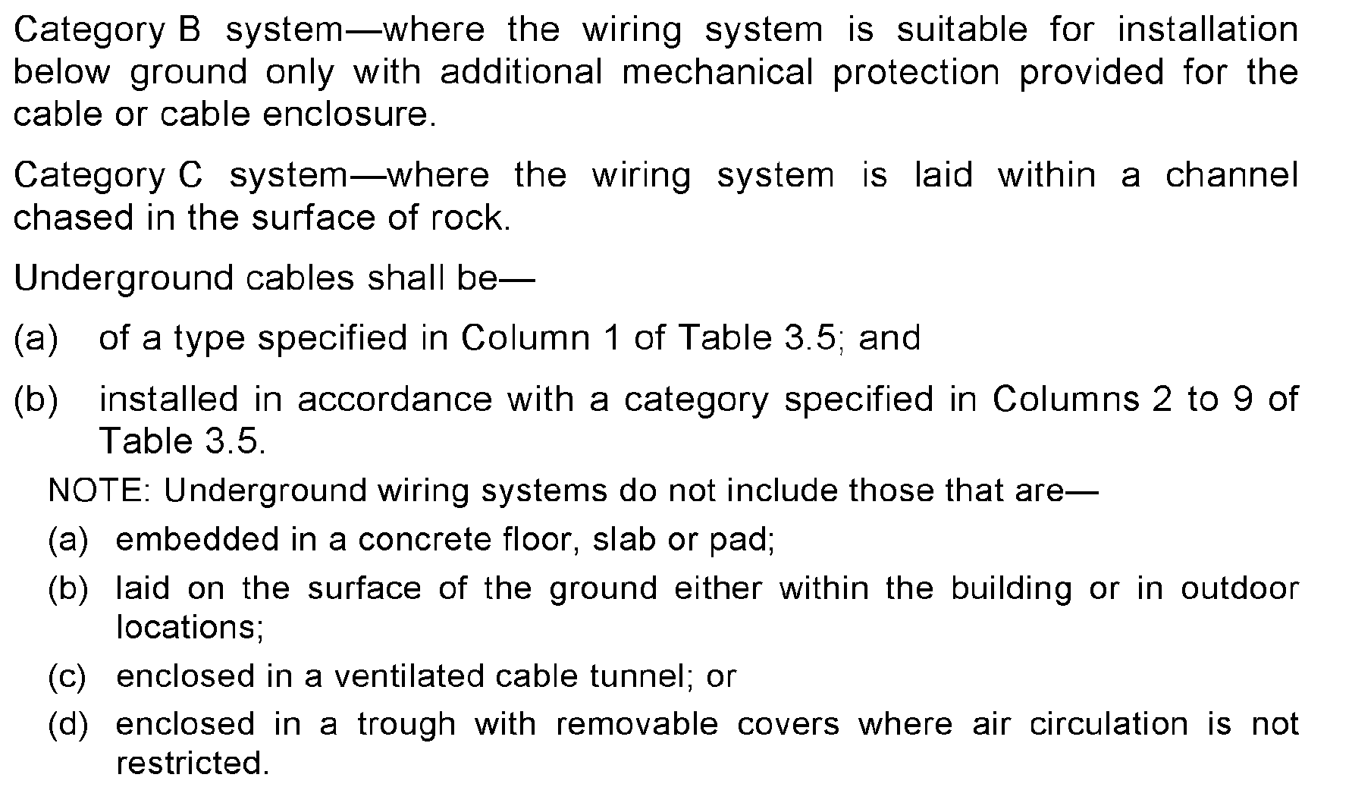
L

Slide 44
Cat A
Cat B
Cat C
L

Slide 45
L

Slide 46
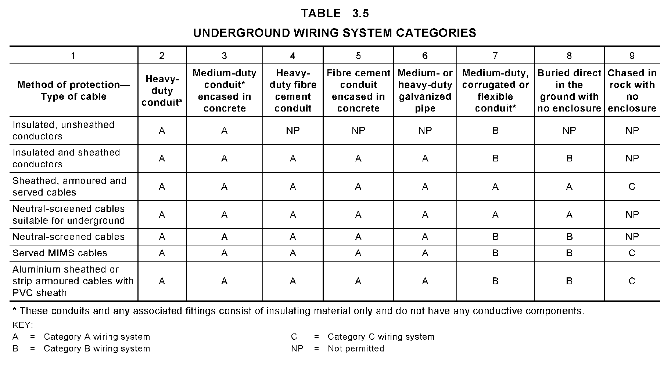
L

Slide 47
L

Slide 48
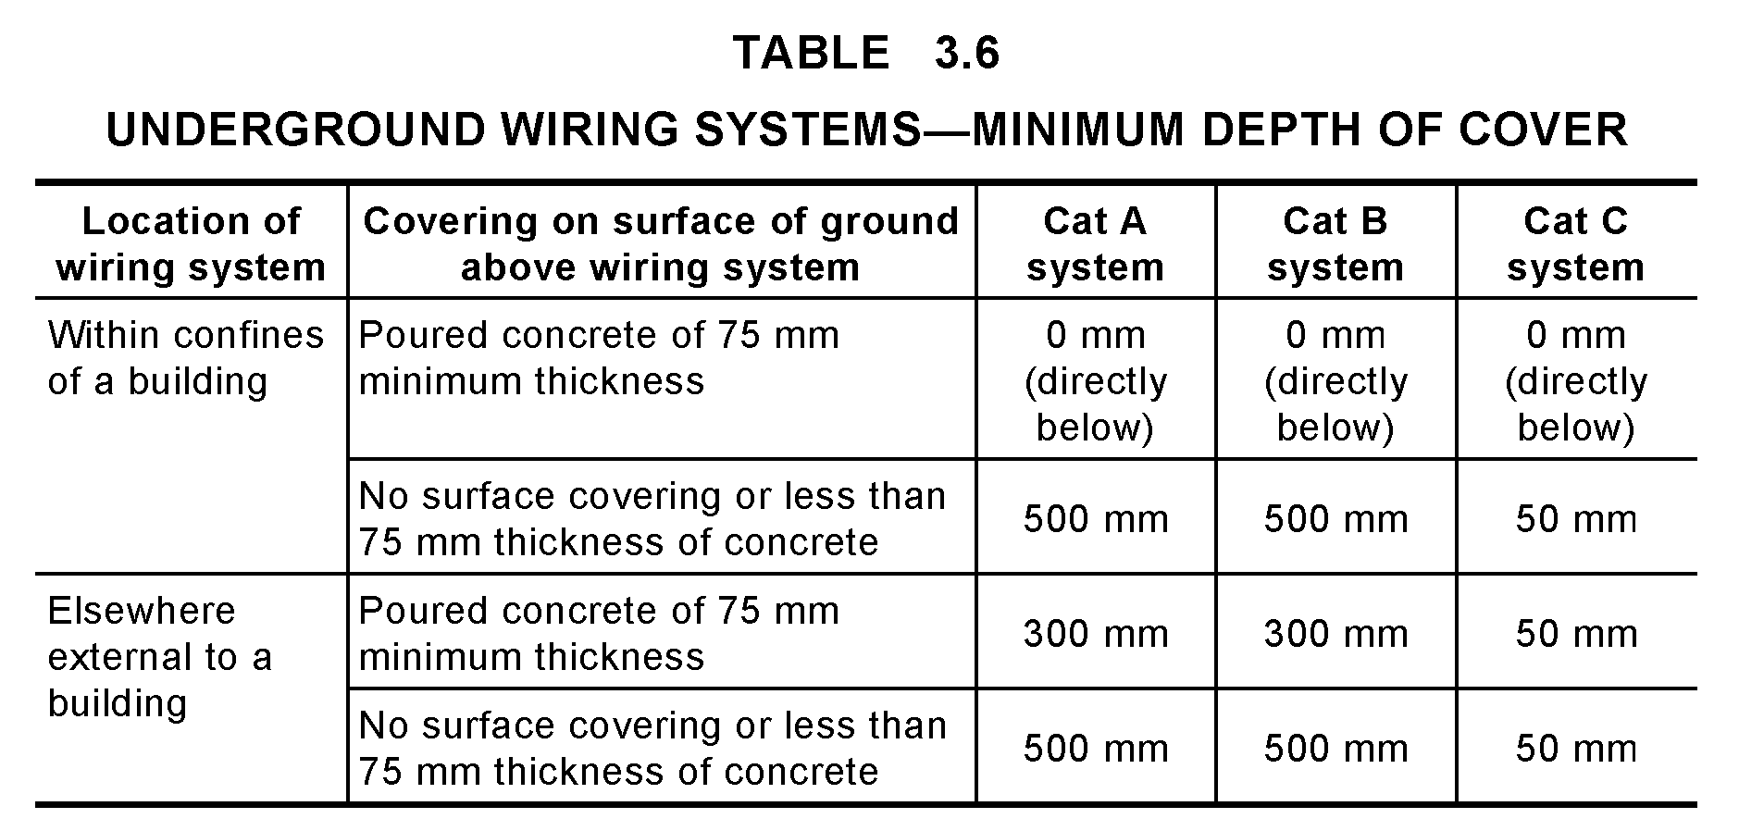
L

Slide 49
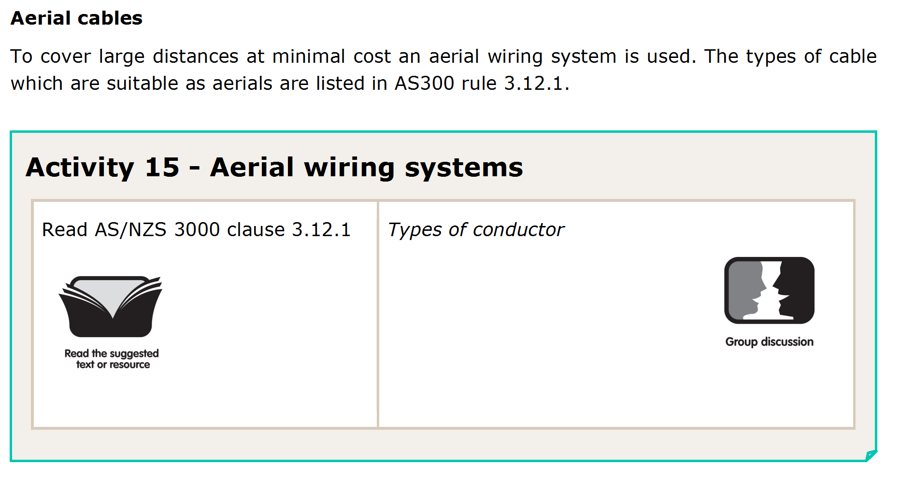
L

Slide 50
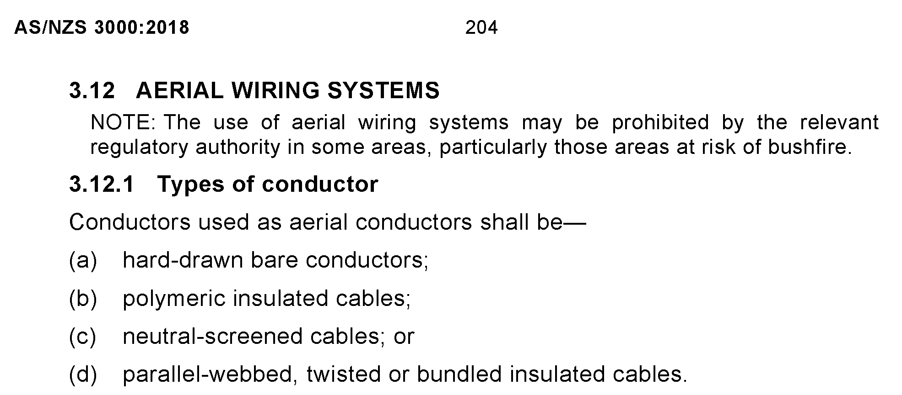
L

Slide 51
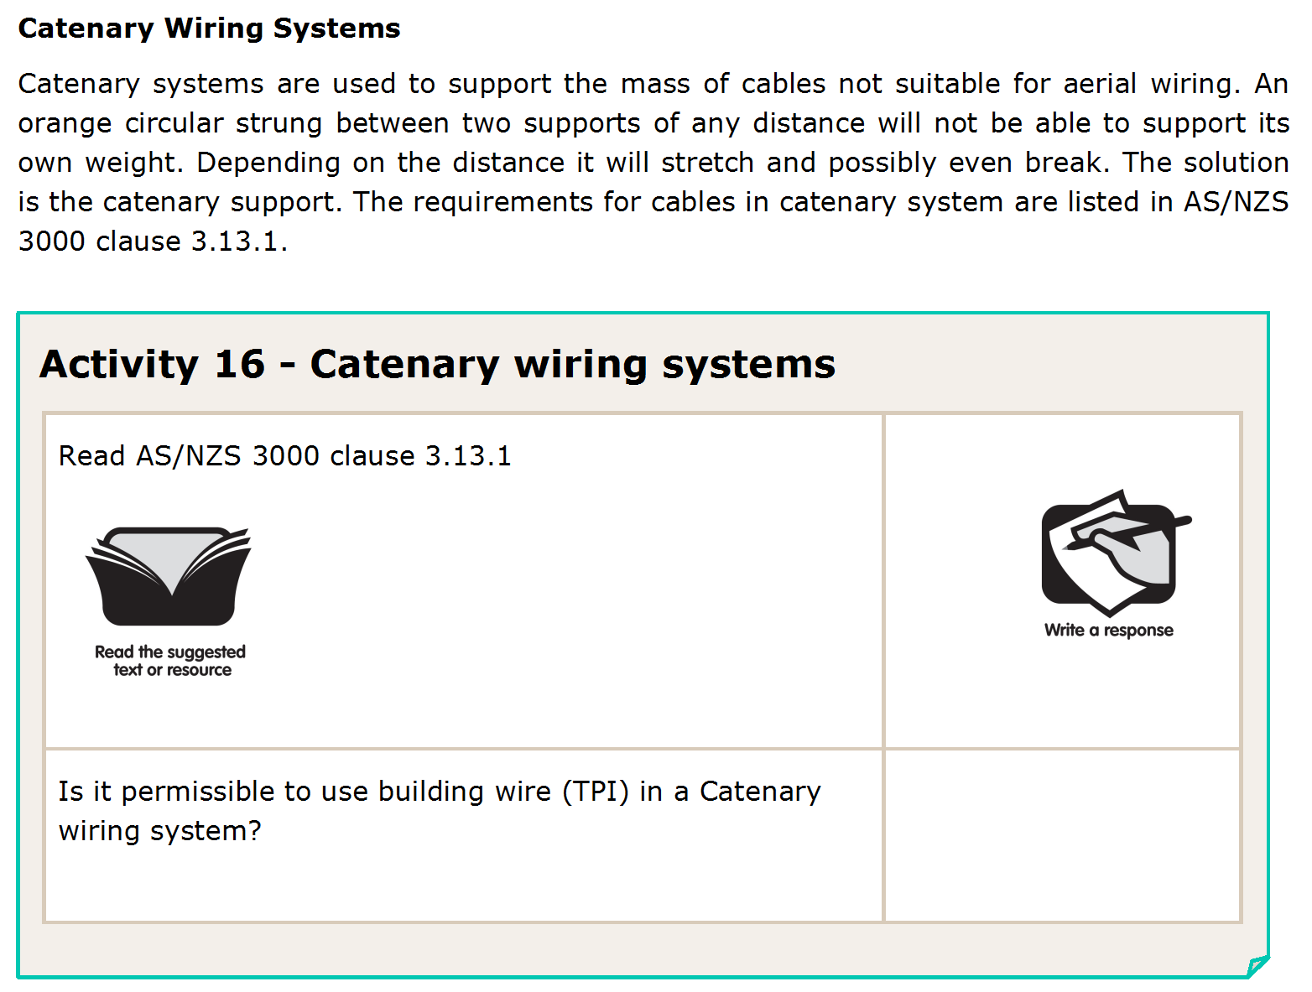
L

Slide 52
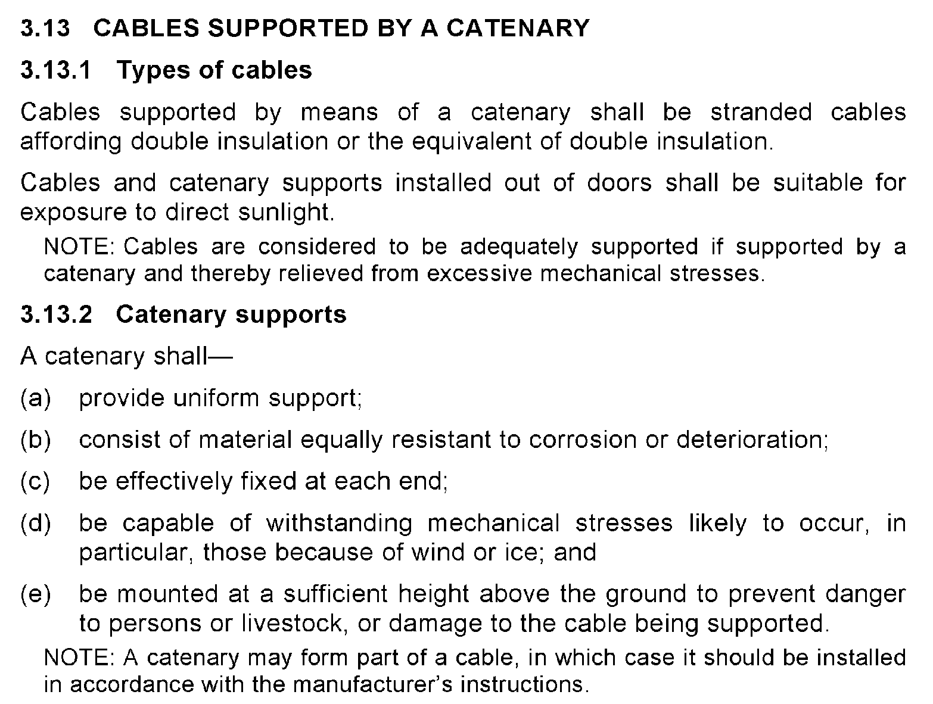
L

Slide 53
No
L

Slide 54
L

Slide 55
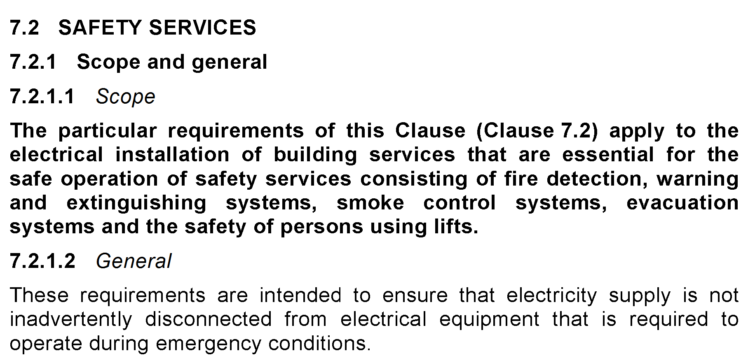
L

Slide 56
L

Slide 57
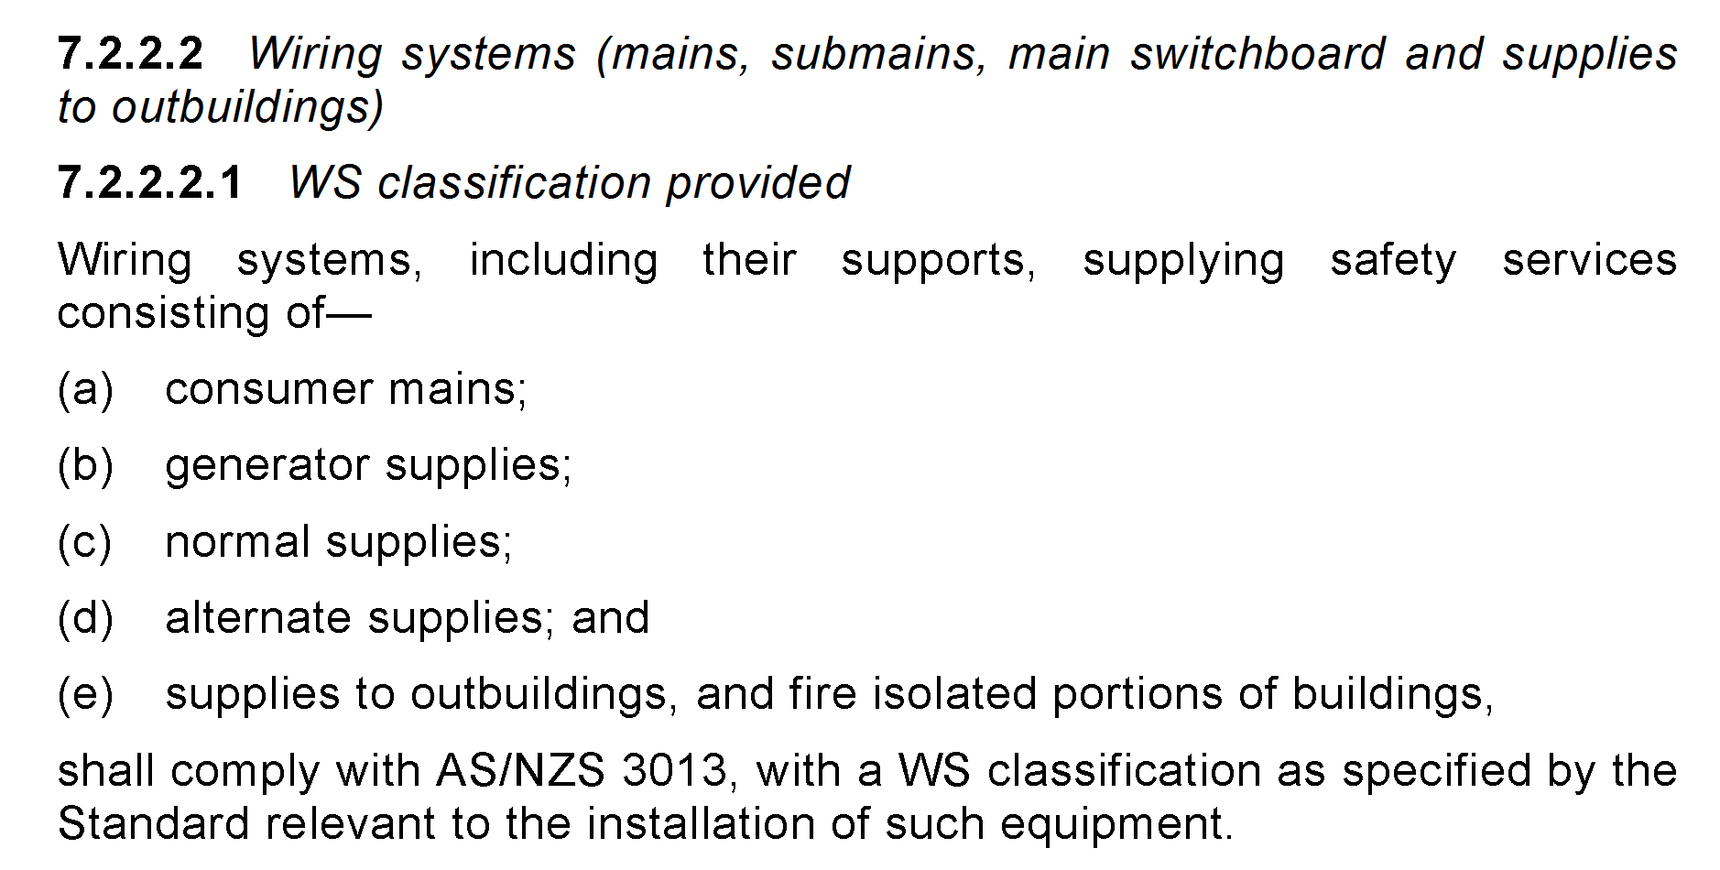
L

Slide 58
yes
L

Slide 59
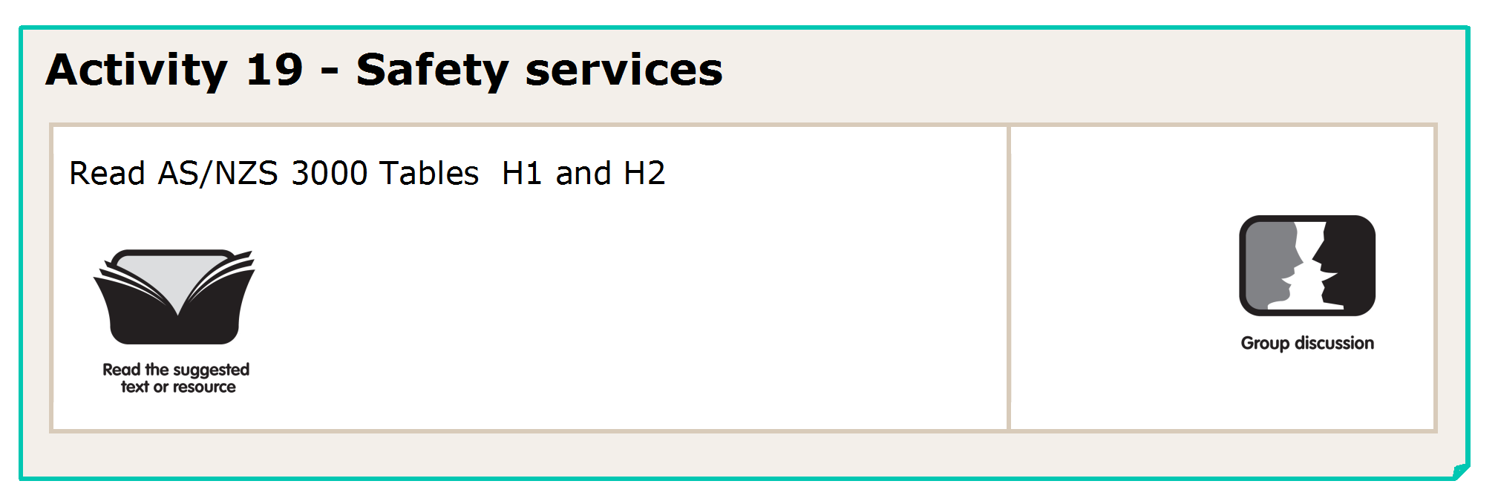
L

Slide 60
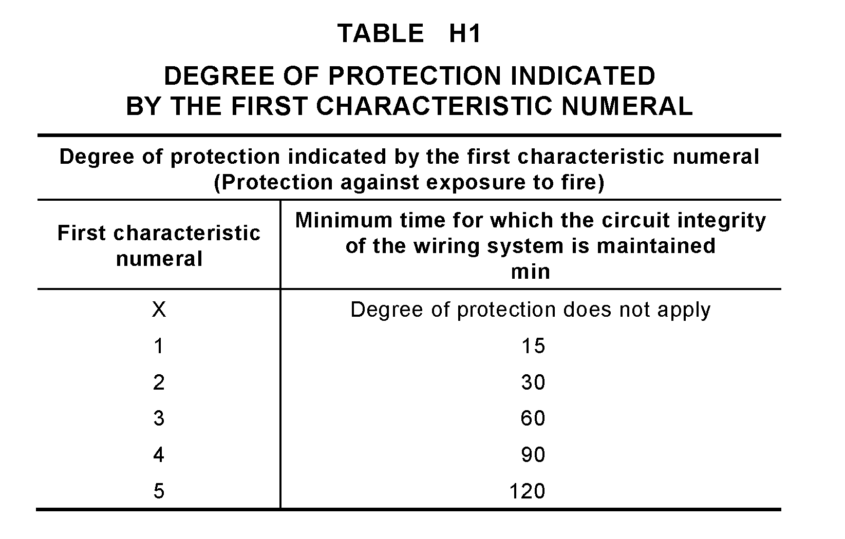
L

Slide 61
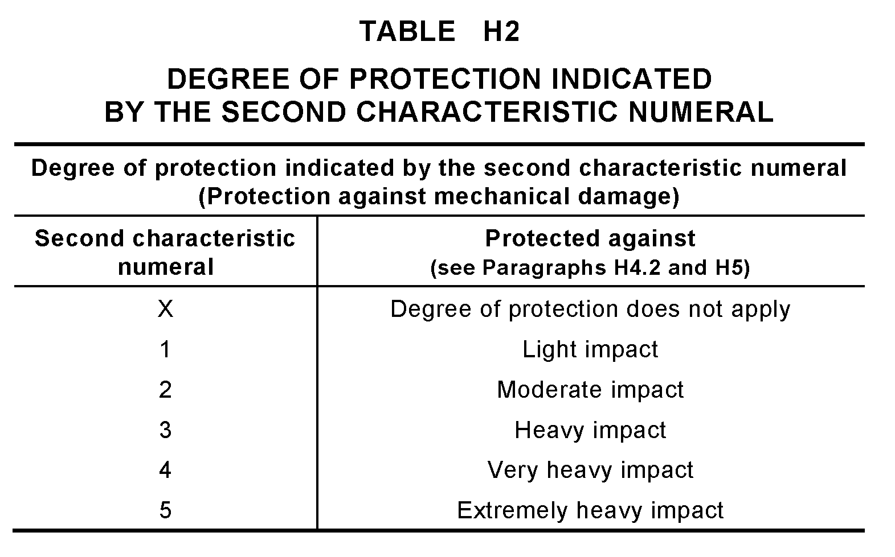
L

Slide 62
WS2X
WS5X
WS4X
L

Slide 63
L

Slide 64
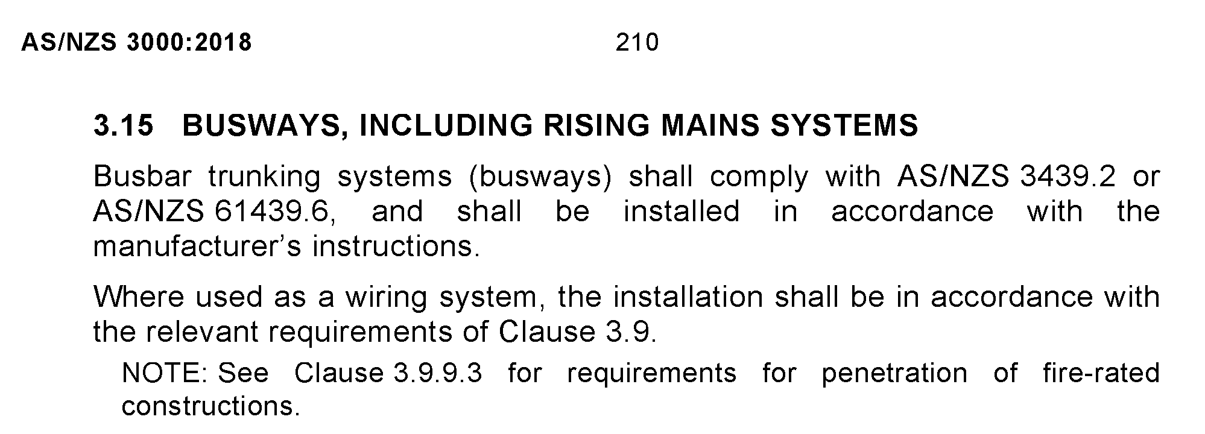
L

Slide 65
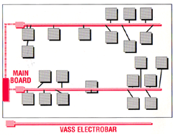
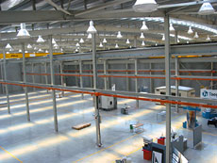
L

Slide 66
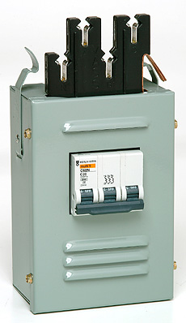
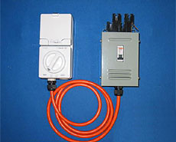
L

Slide 67
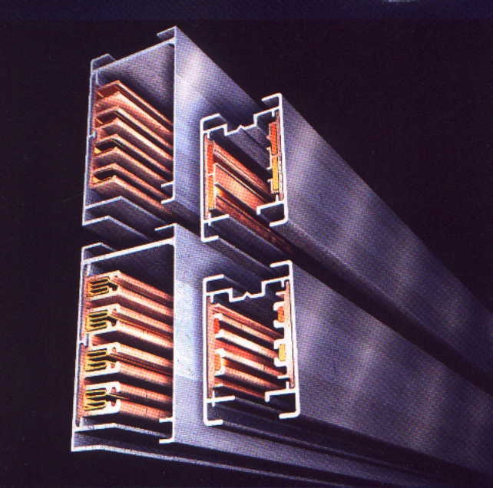
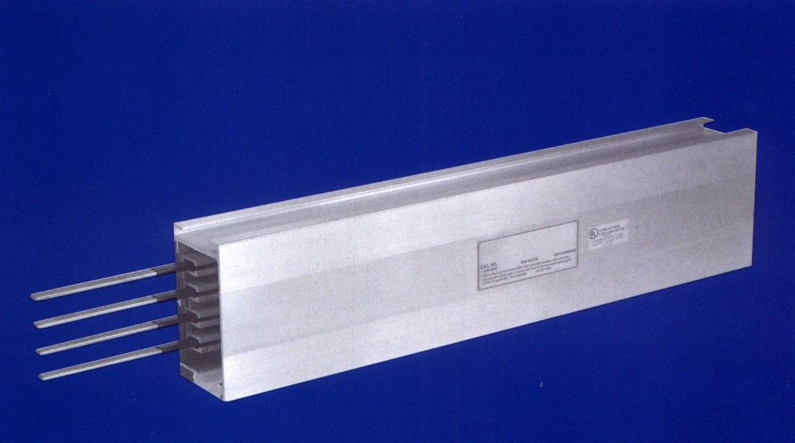
L

Slide 68
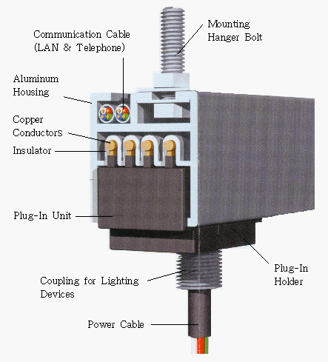
L

Slide 69
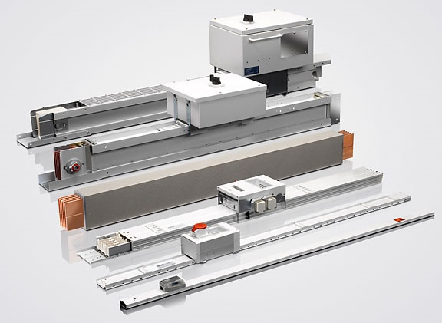
L

Slide 70
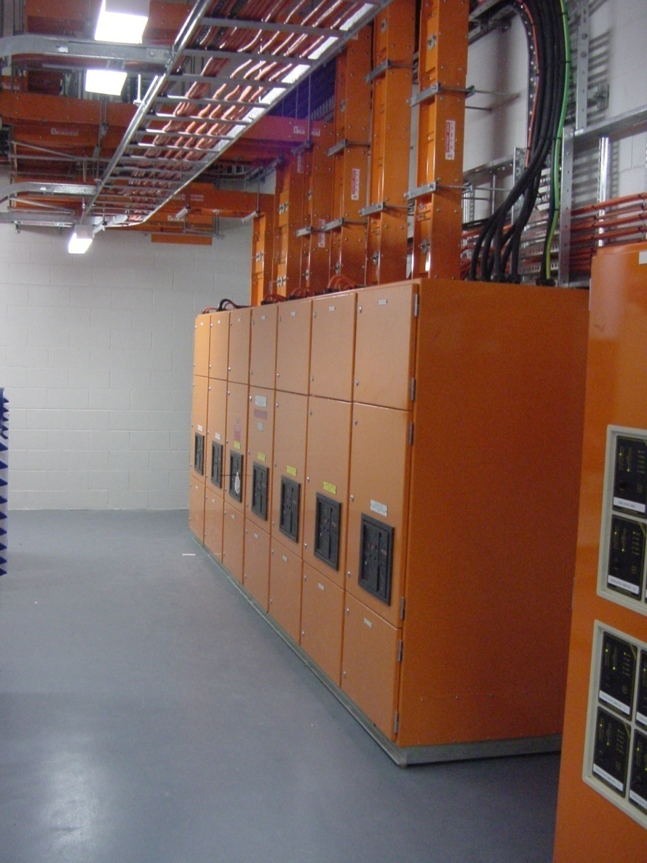
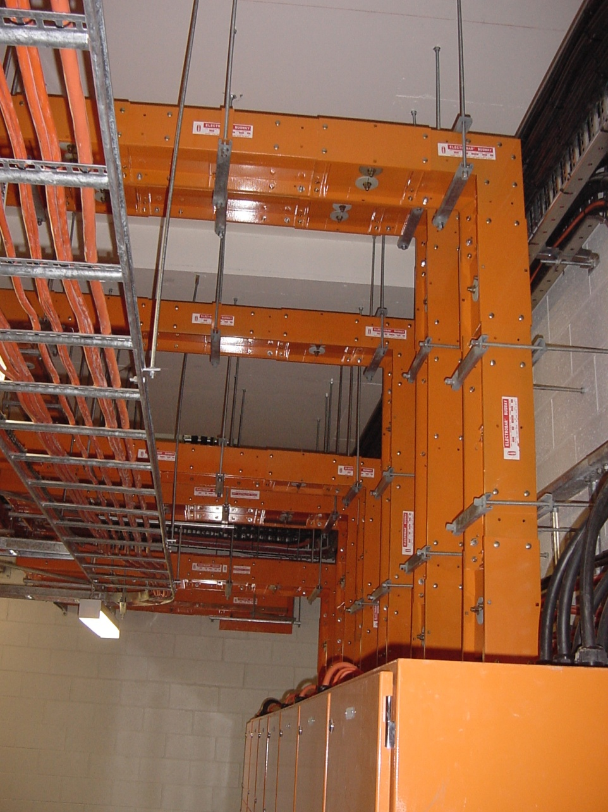
L

Slide 71
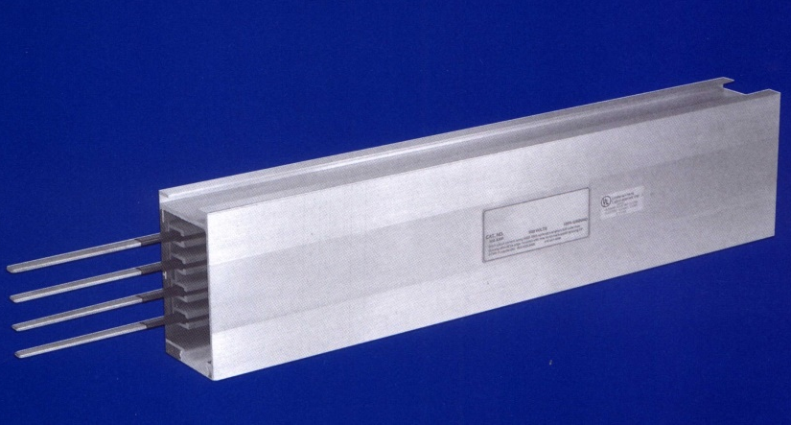
L

Slide 72
L

Slide 73
L

Slide 74
L

Slide 75
Protected Earth Neutral
L

Slide 76
L

Slide 77
Protected Earth Neutral
30 m
Clause 3.9.10.3 (b)
No
No
L

Slide 78
L

Slide 79
L

Slide 80
L

Slide 81
END OF LESSON

