Slide 2
SECTION 4
MAXIMUM DEMAND ON
CONSUMERS MAINS - DOMESTIC

Slide 3
MAXIMUM DEMAND ON CONSUMERS MAINS - DOMESTIC
Topics
Methods used to determine the maximum demand
Determining maximum demand for domestic consumers
mains
Aim
Learners will determine the maximum demand of the consumer’s mains in single and multiple domestic installations.
L

Slide 4
MAXIMUM DEMAND ON CONSUMERS MAINS - DOMESTIC
Learning objectives:
Learners should be able to meet the following learning objectives:
Describe the acceptable methods for determining the maximum demand on an installation’s consumer’s mains.
Calculate the maximum demand for the consumer's mains for given installations up to 400 A per phase.
L

Slide 5
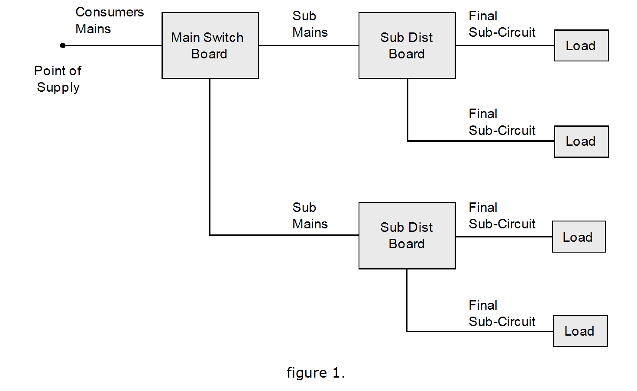
This submain will only carry the load current of f.s.’c connected to DB1
The Consumers Mains will carry the total load current of circuits in the installation.
This submain will only carry the load current of f.s.’c connected to DB2
L

Slide 6
L

Slide 7
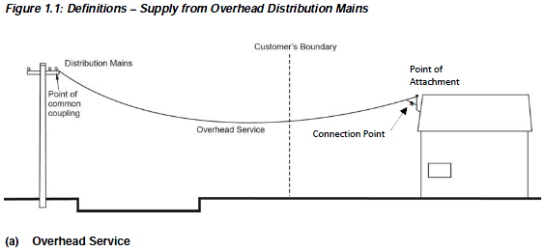
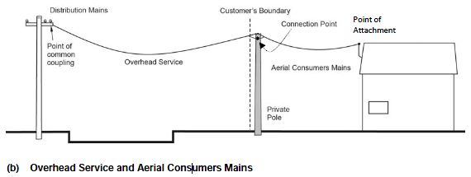
Service Mains
(prior to the connection point)
Consumers Mains always begin AFTER the connection point, regardless whether it be an overhead or underground connection.
L

Slide 8
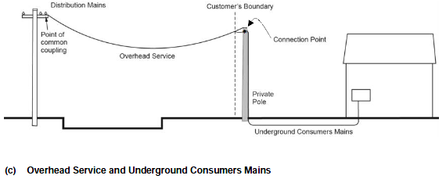
Important Note:
The ‘Connection Point’ used to be referred to as the ‘Point of Supply’ in previous editions of The Service and Installation Rules of NSW.
AS/NZS3000:2007 still uses the terminology ‘Point of Supply’ throughout, therefore so does your class workbook.
The terms ‘Connection Point’ and ‘Point of Supply’ are interchangable throughout this unit as they both refer to the same thing, which by definition is ‘the junction where the Distribution System is connected to the Customers Installation’.
L

Slide 9
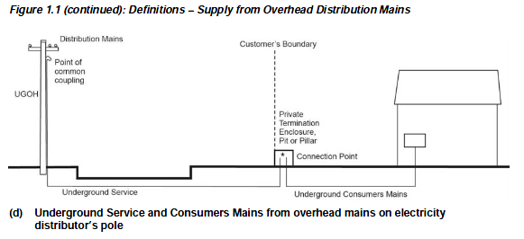
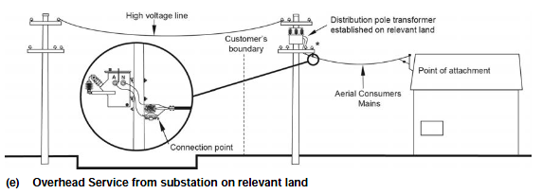
L

Slide 10
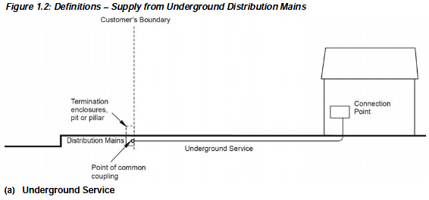
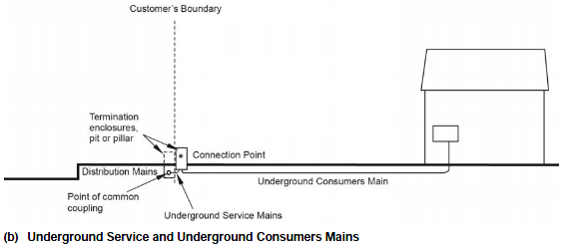
This arrangement is typical in new sub-divisions / housing estates.
This arrangement is used for long mains runs (service mains cannot exceed 50m, but consumers mains are unlimited).
L

Slide 11
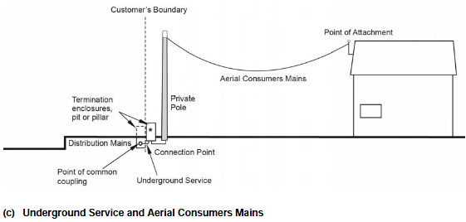
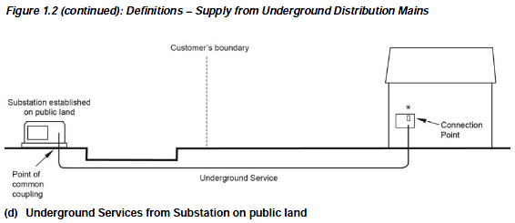
L

Slide 12
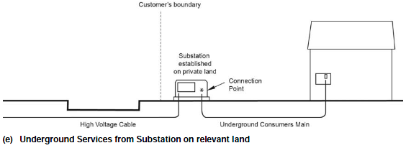
L

Slide 13
Connection Point
(previously known as the point of supply)
L

Slide 14
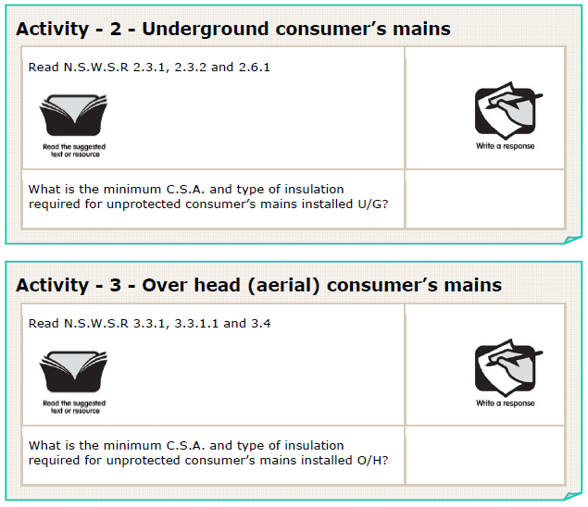
L

Slide 15
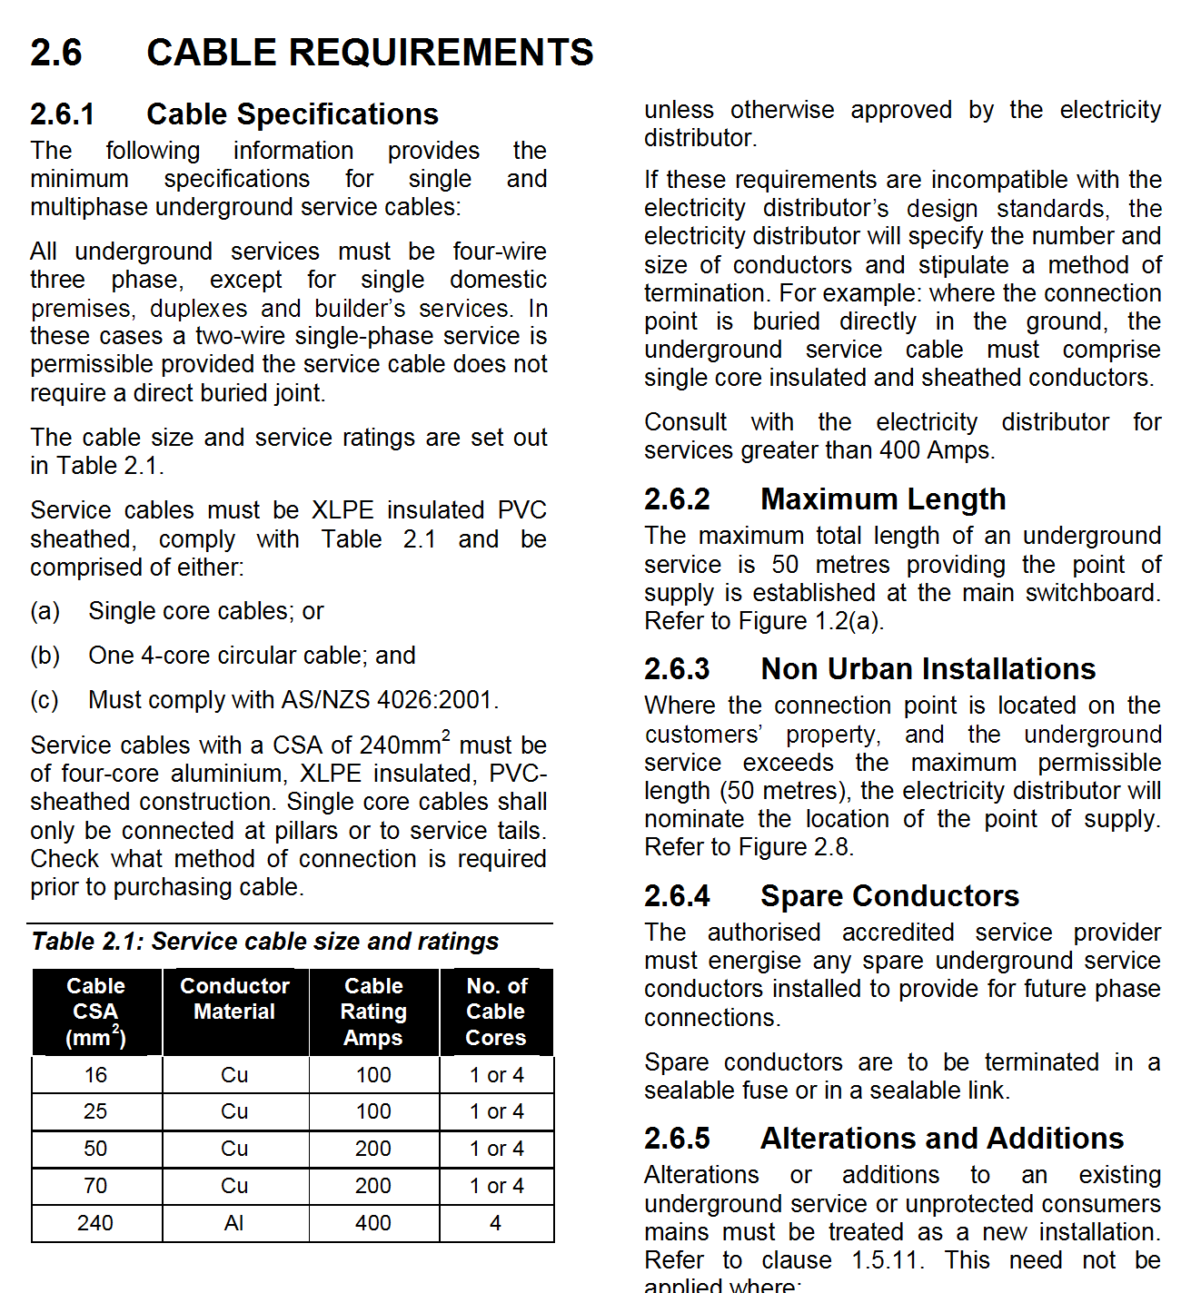
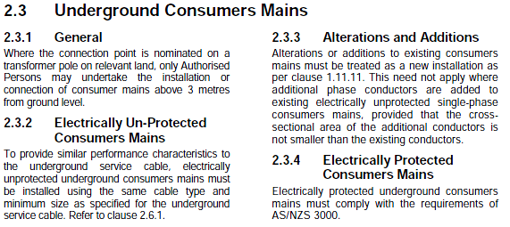
L

Slide 16
16 mm²
XLPE Cu
L

Slide 17
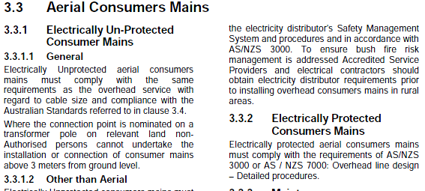
L

Slide 18
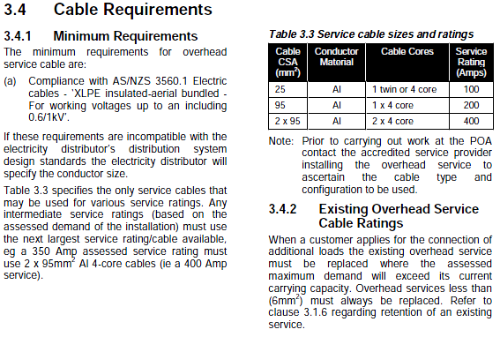
L

Slide 19
16 mm²
XLPE Cu
25 mm²
XLPE Al
L

Slide 20
c
L

Slide 21
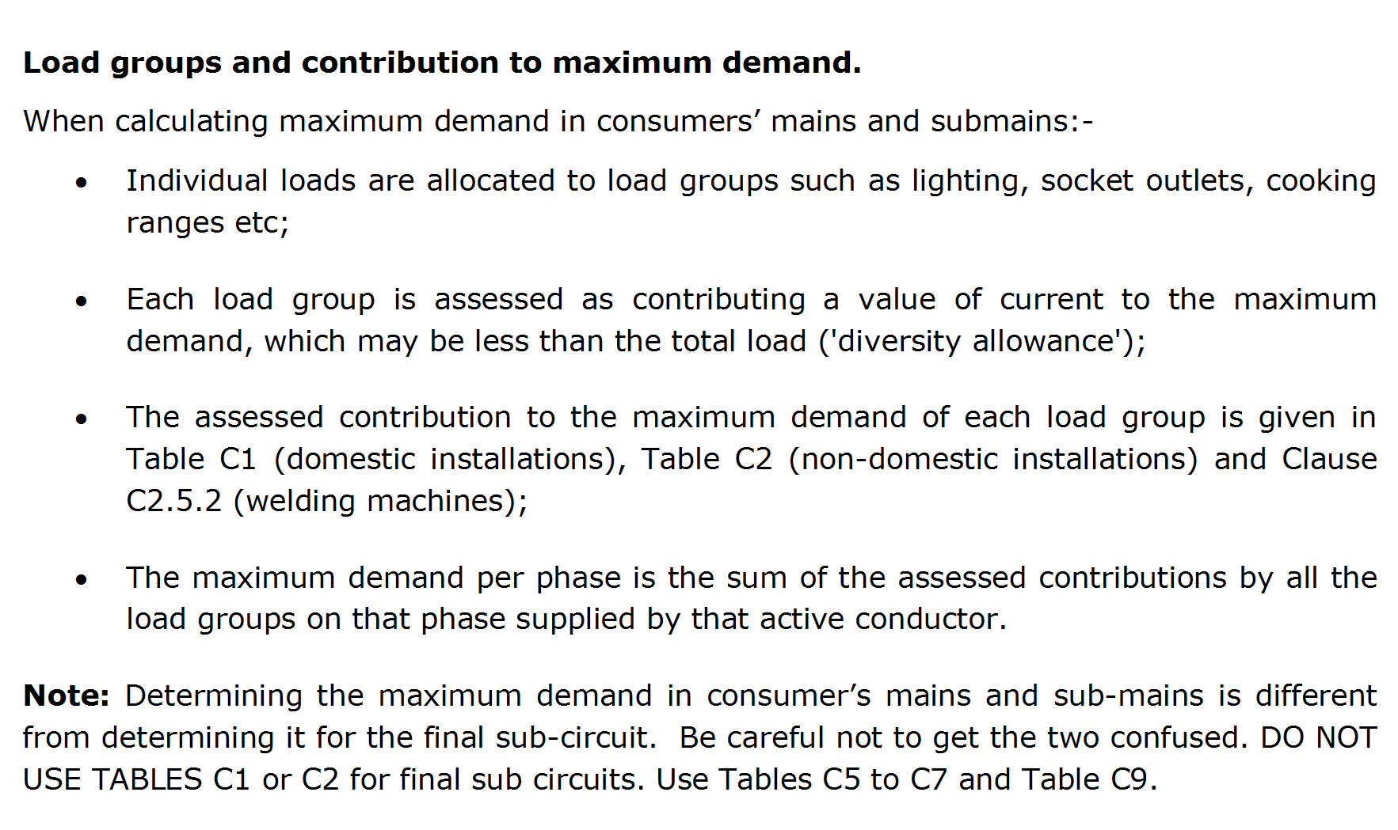
L

Slide 22
L

Slide 23
L

Slide 24
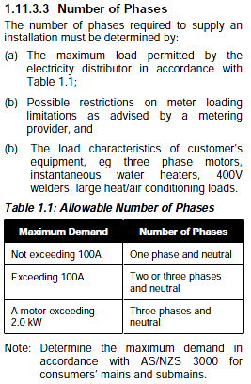
L

Slide 25
2.0 kW
L

Slide 26
L

Slide 27
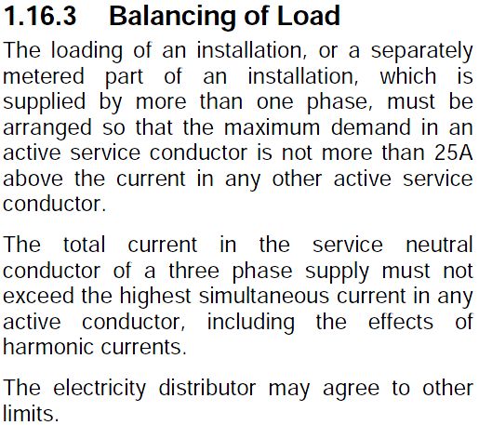
25A
L

Slide 28
L

Slide 29
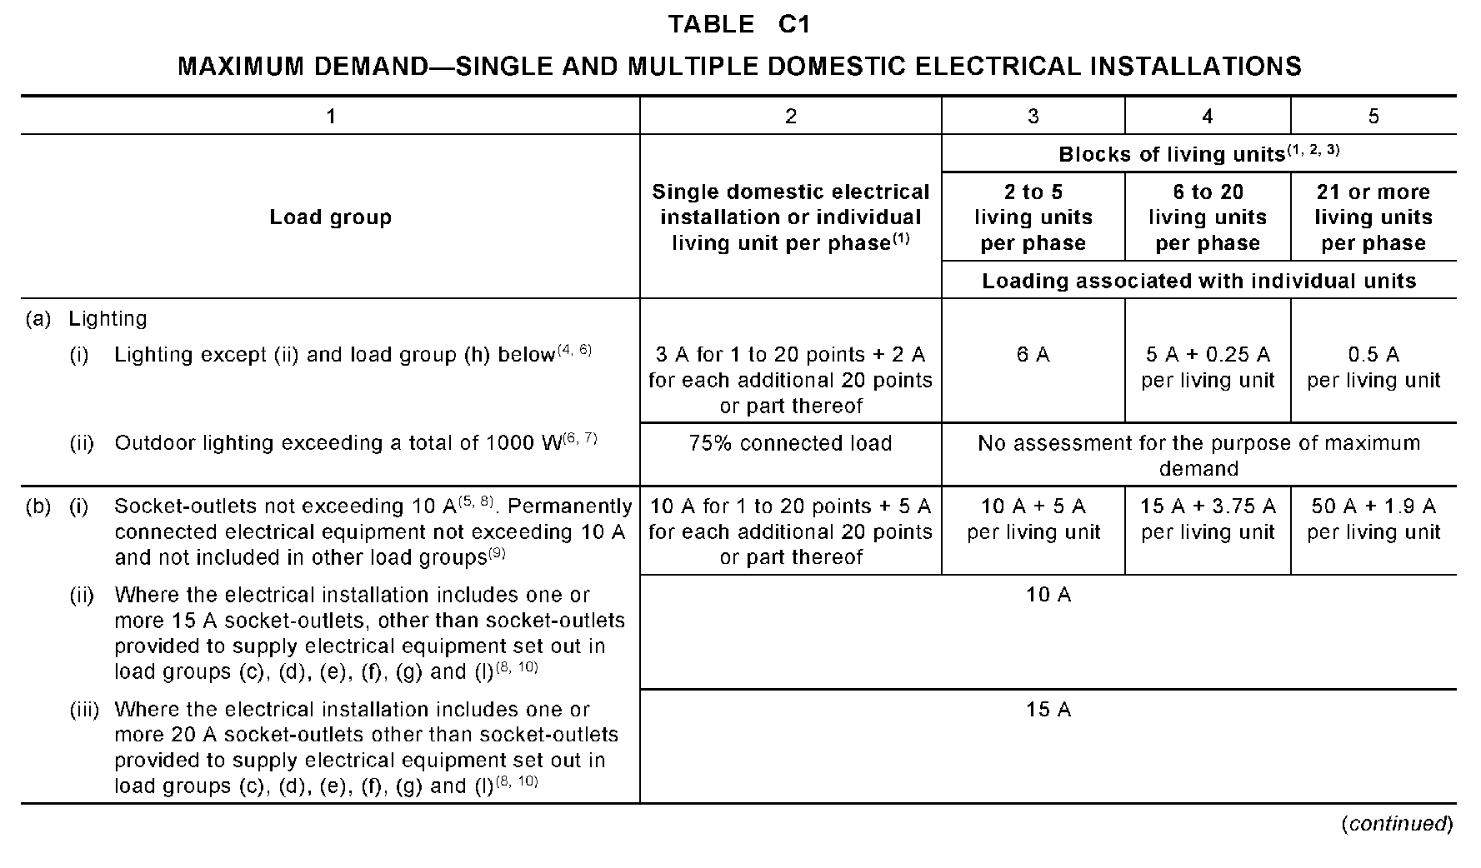
L

Slide 30
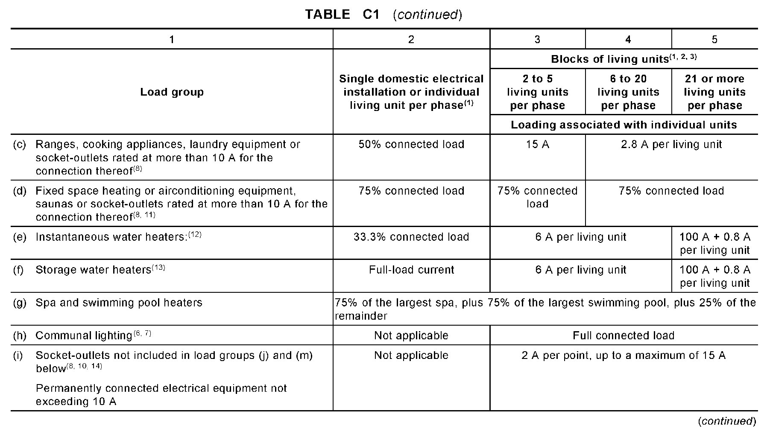
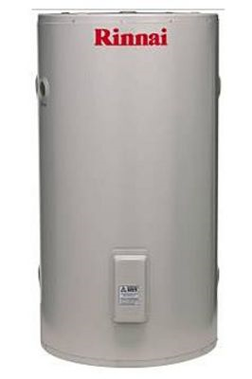
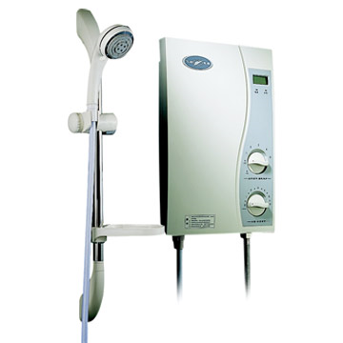
L

Slide 31
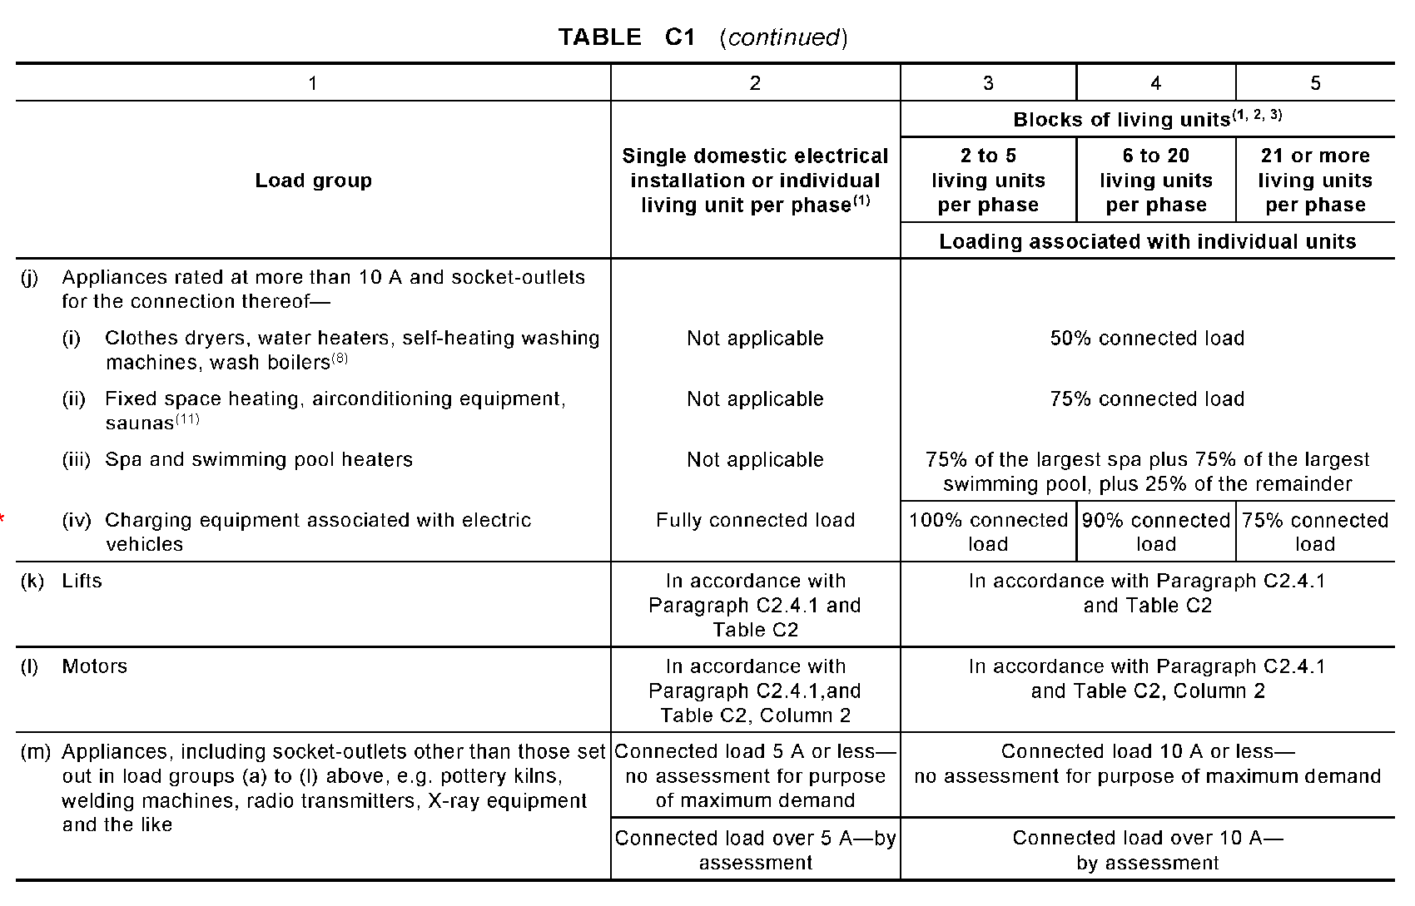
L

Slide 32
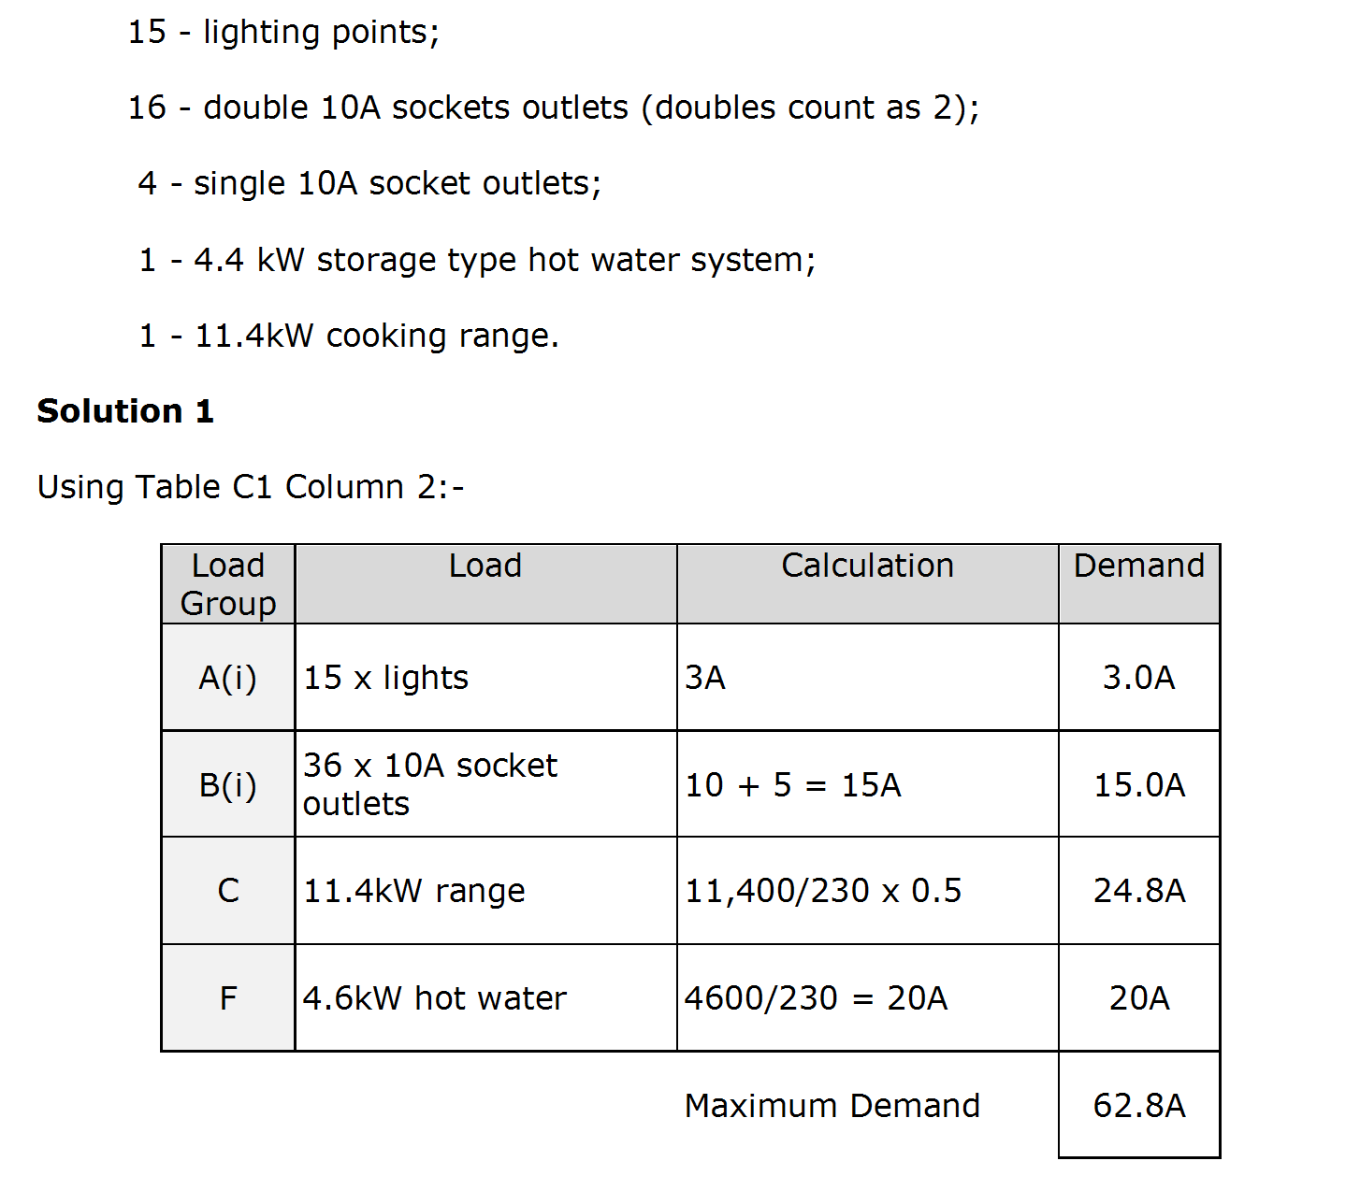
L

Slide 33
L

Slide 34
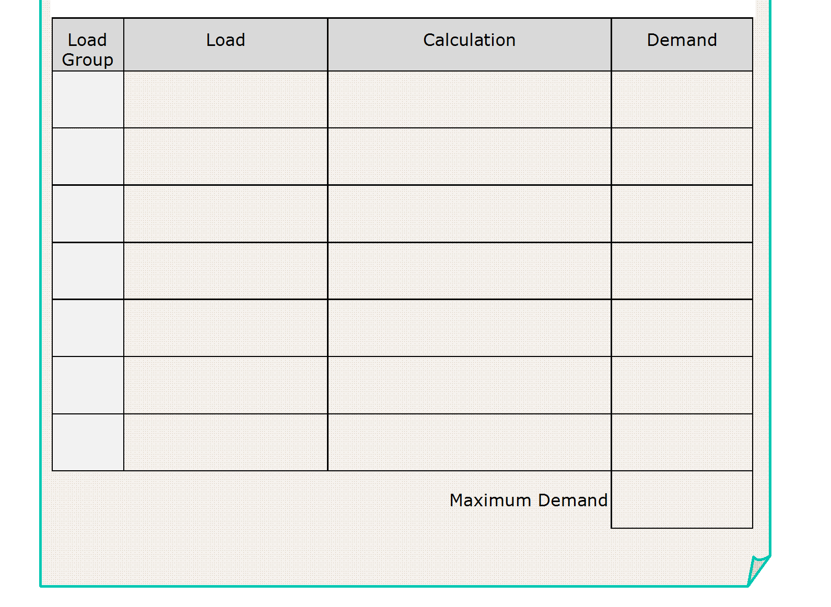
Ai
22 lights
3 + 2 =
5A
Bi
48 10A S/o
10 + 5 + 5 =
20A
Bii
15A S/o
10A
10A
6000 X 0.5 =
C
Cook top
13.1A
230
C
Oven
3900 X 0.5 =
8.5A
230
F
H.W.S.
4400 =
19.2A
230
75.8A
L

Slide 35
L

Slide 36
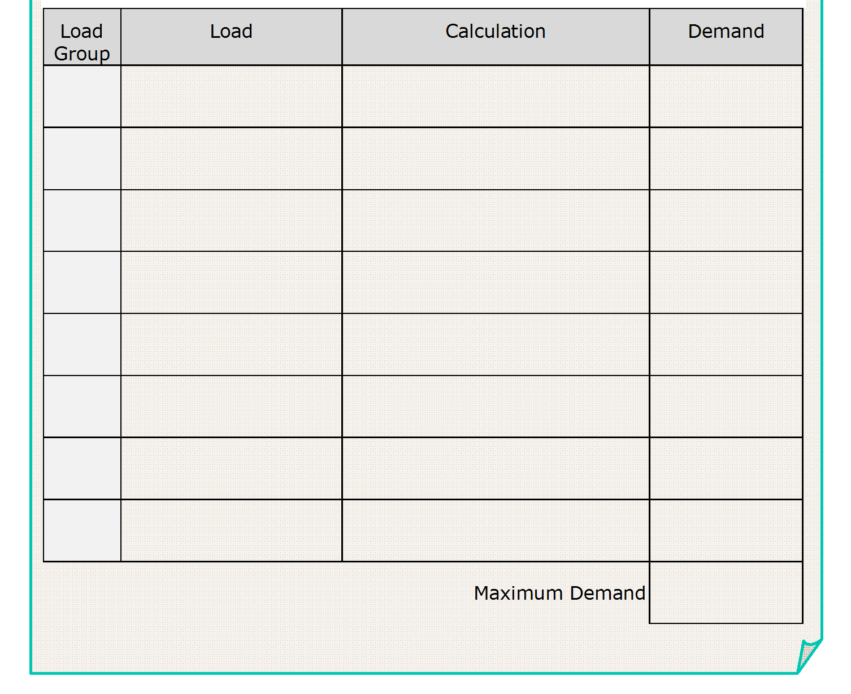
Ai
16 lights
3
3A
Bi
32x10A S.O.
10 + 5 =
15A
F
HWS
4400 =
19.2A
230
C
Oven
6000 X 0.5 =
13.1A
230
50.3A
L

Slide 37
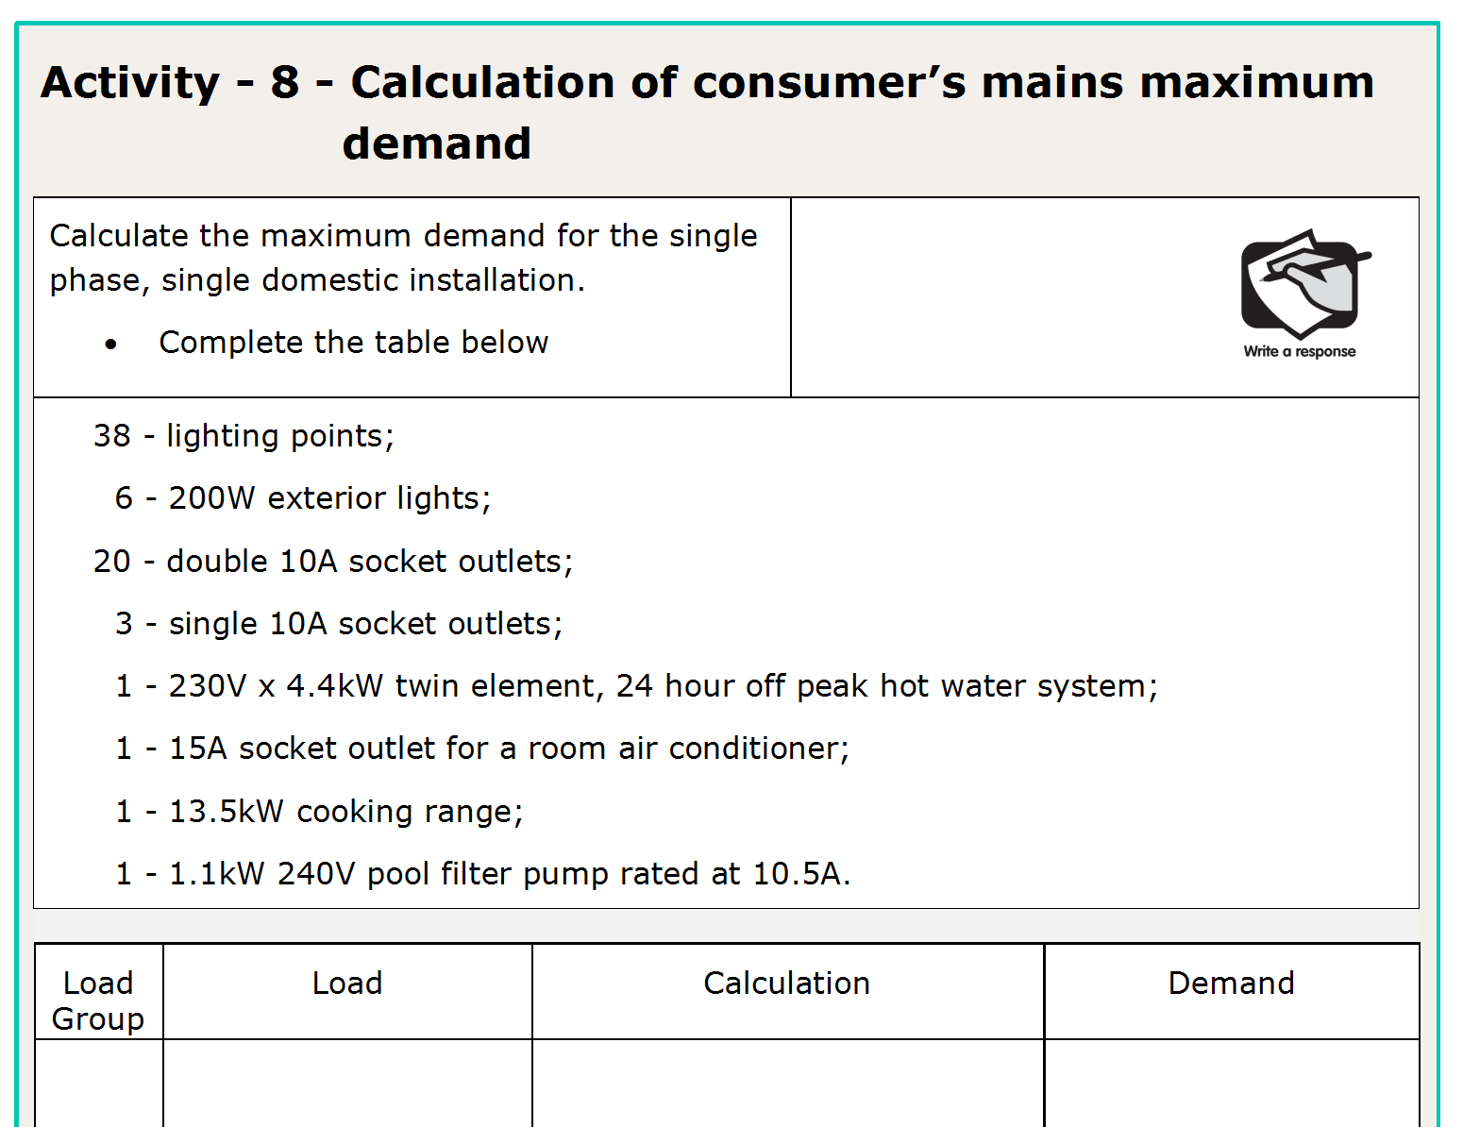
L

Slide 38
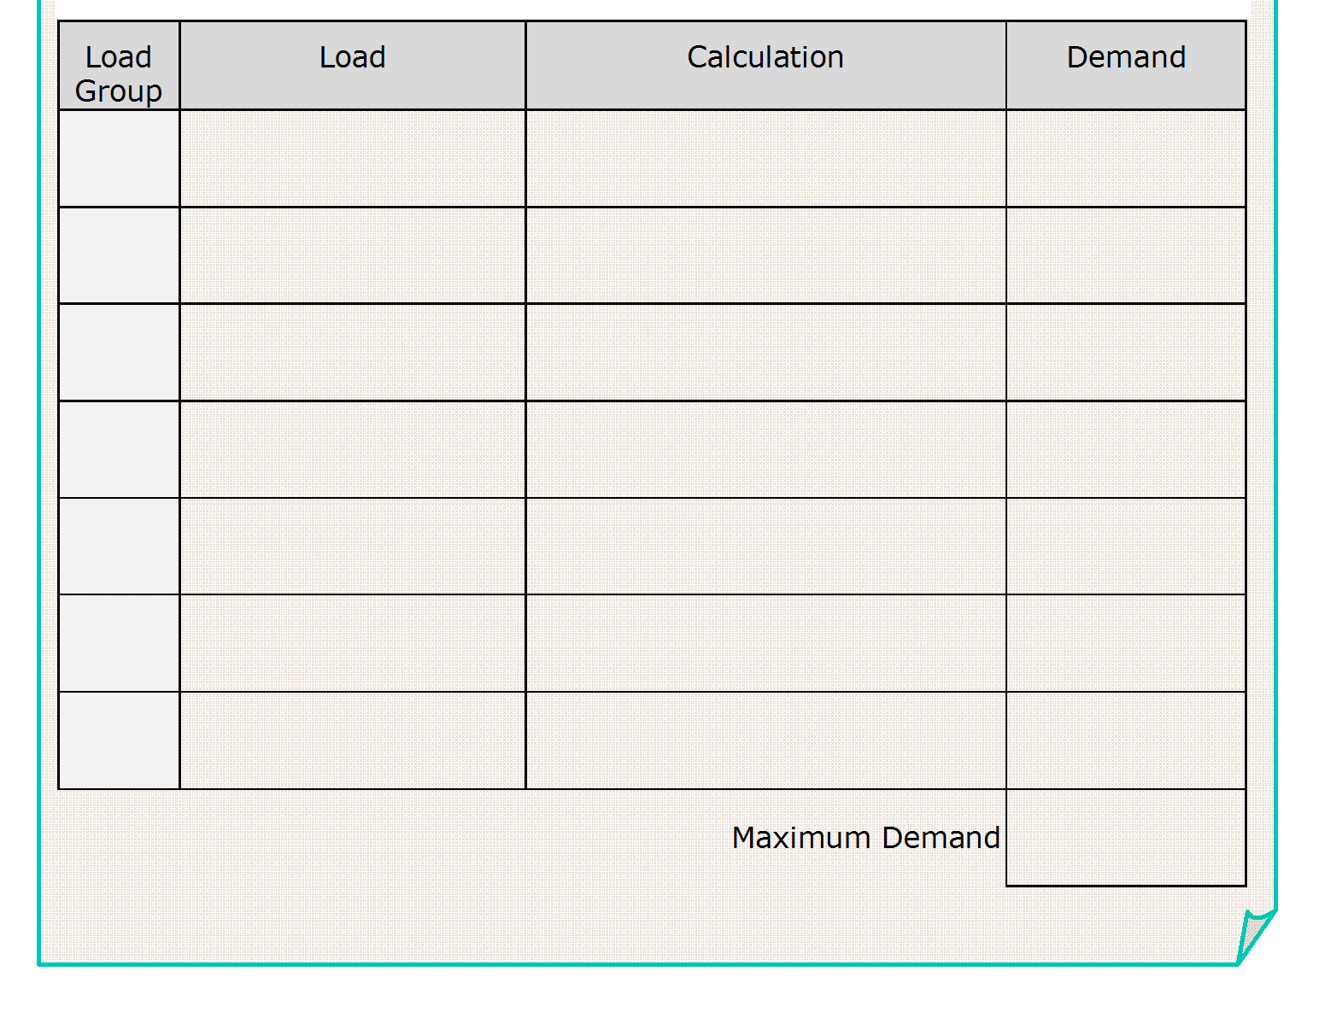
Ai
38 lights
3 + 2
5A
Aii
6 ext Lights
1200 x 0.75 =
3.92A
230
Bi
43 x 10A s/o
10 + 5 + 5 =
20A
F
HWS
4400 =
19.2A
230
D
A/C
15 x 0.75 =
11.25A
C
Range
13500 x 0.5 =
29.4A
230
L

Slide 39
L

Slide 40
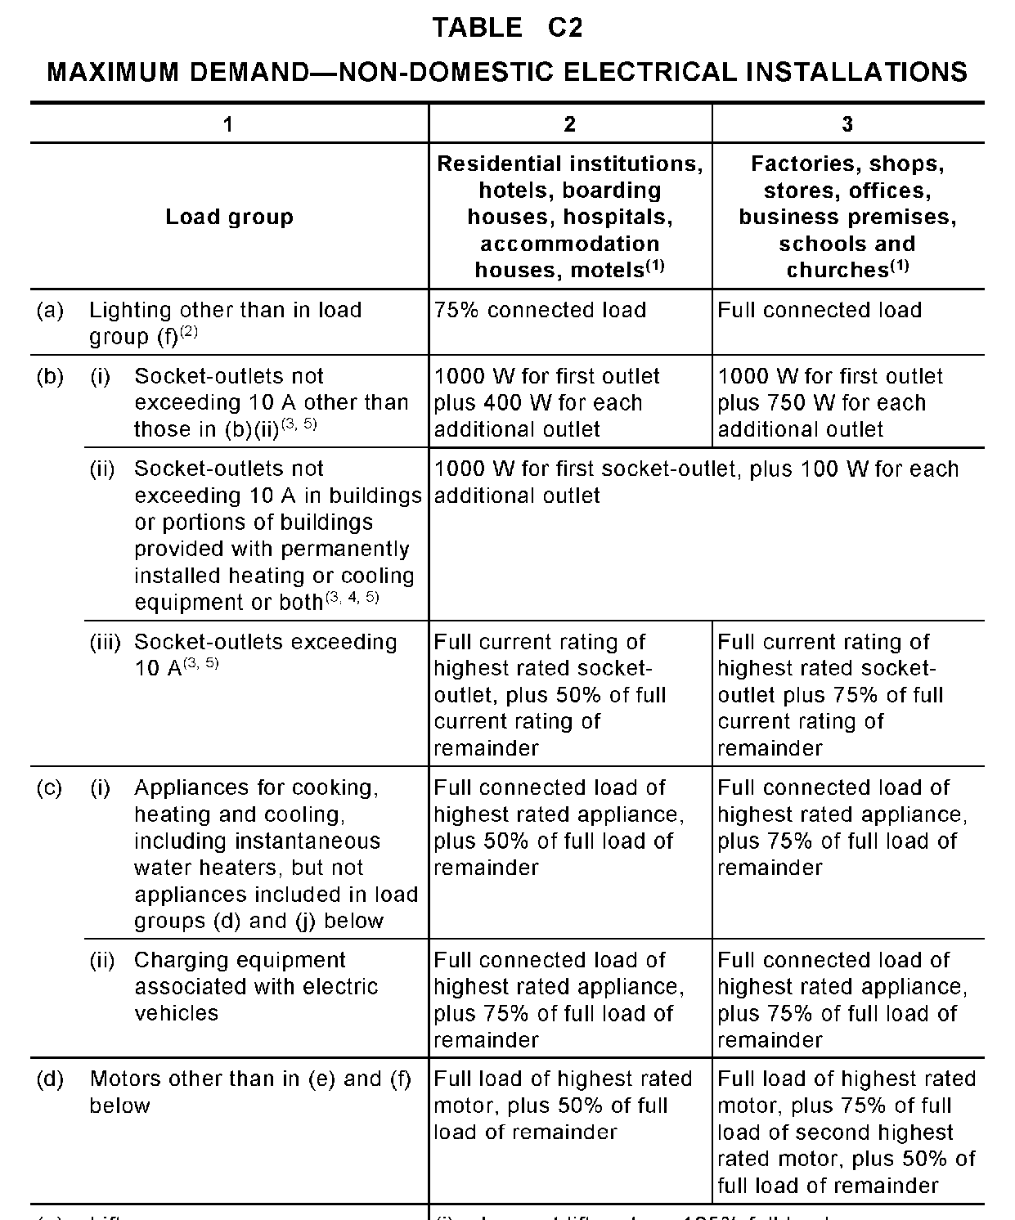
L

Slide 41
Ai
38 lights
3 + 2
5A
Aii
6 ext Lights
1200 x 0.75 =
3.92A
230
Bi
43 10 s/o
10 + 5 + 5 =
20A
F
HWS
4400 =
19.2A
230
D
A/C
15 x 0.75 =
11.25A
C
Range
13500 x 0.5 =
29.4A
230
L
Motor (pump)
FLC
10.5A
99.27A
L

Slide 42
L

Slide 43
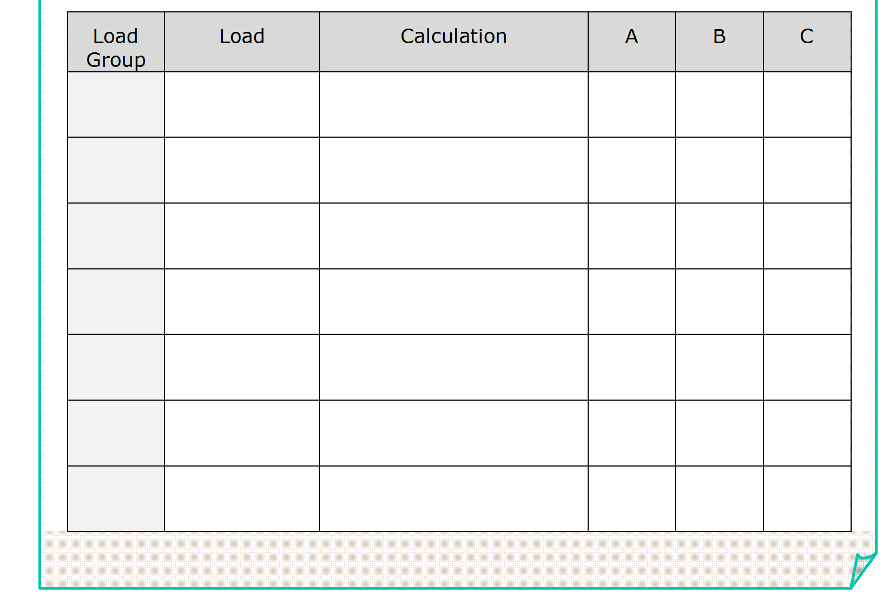
Ai
24 lights (cct 1)
3 + 2
5
Ai
24 lights (cct 2)
3 + 2
5
2 x fan heats
What load group do combination
Fan / Heat / Lamps belong to?
L

Slide 44
L

Slide 45
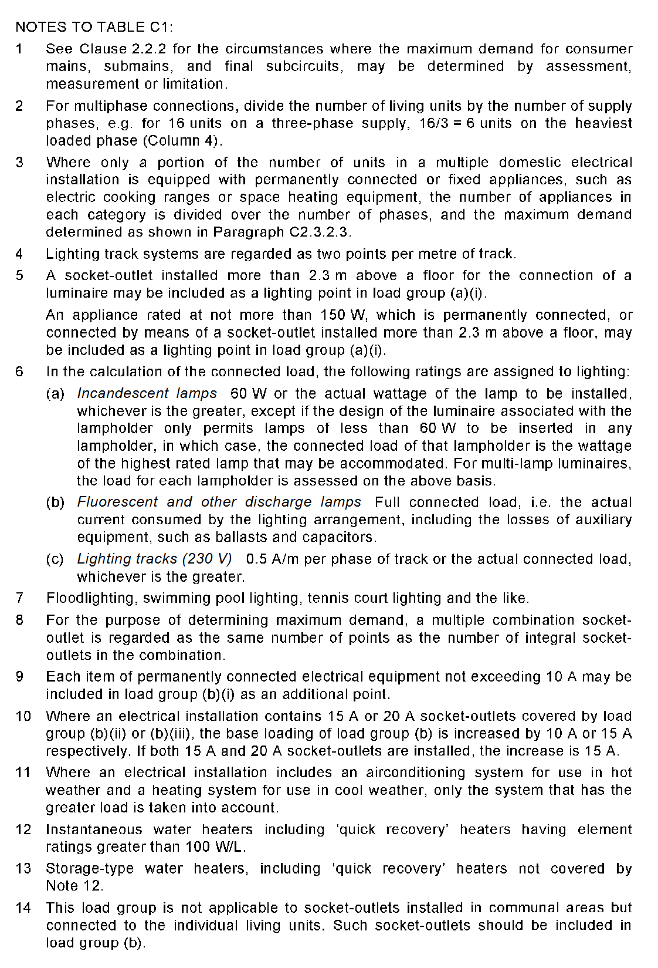
L

Slide 46
Ai
24 lights (cct 1)
3 + 2
5
Ai
24 lights (cct 2)
3 + 2
5
Bi
2 x fan heats
(same as 2 s/o points)
Bi
20 s/o (cct 1) + 2 Points from above
10+5
15
Bi
20 s/o (cct 2)
10
10
Bi
20 s/o (cct 3)
10
10
D
A/C 3Ø
18 x 0.75 =
13.5
13.5
13.5
7800 x 0.5 =
17
C
Range
230
G
Spa 3Ø
22000 x 0.75 =
23.9
23.9
23.9
(√3 x 400)
D
Sauna
3600 x 0.75 =
11.8
230
F
HWS
4400 =
19.2
230
69.4A
71.6A
64.2A
L

Slide 47
L

Slide 48
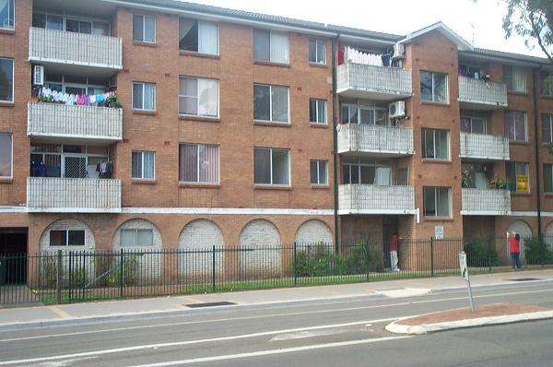
Multiple Domestic
L

Slide 49
Communal Loads
L

Slide 50
L

Slide 51
L

Slide 52
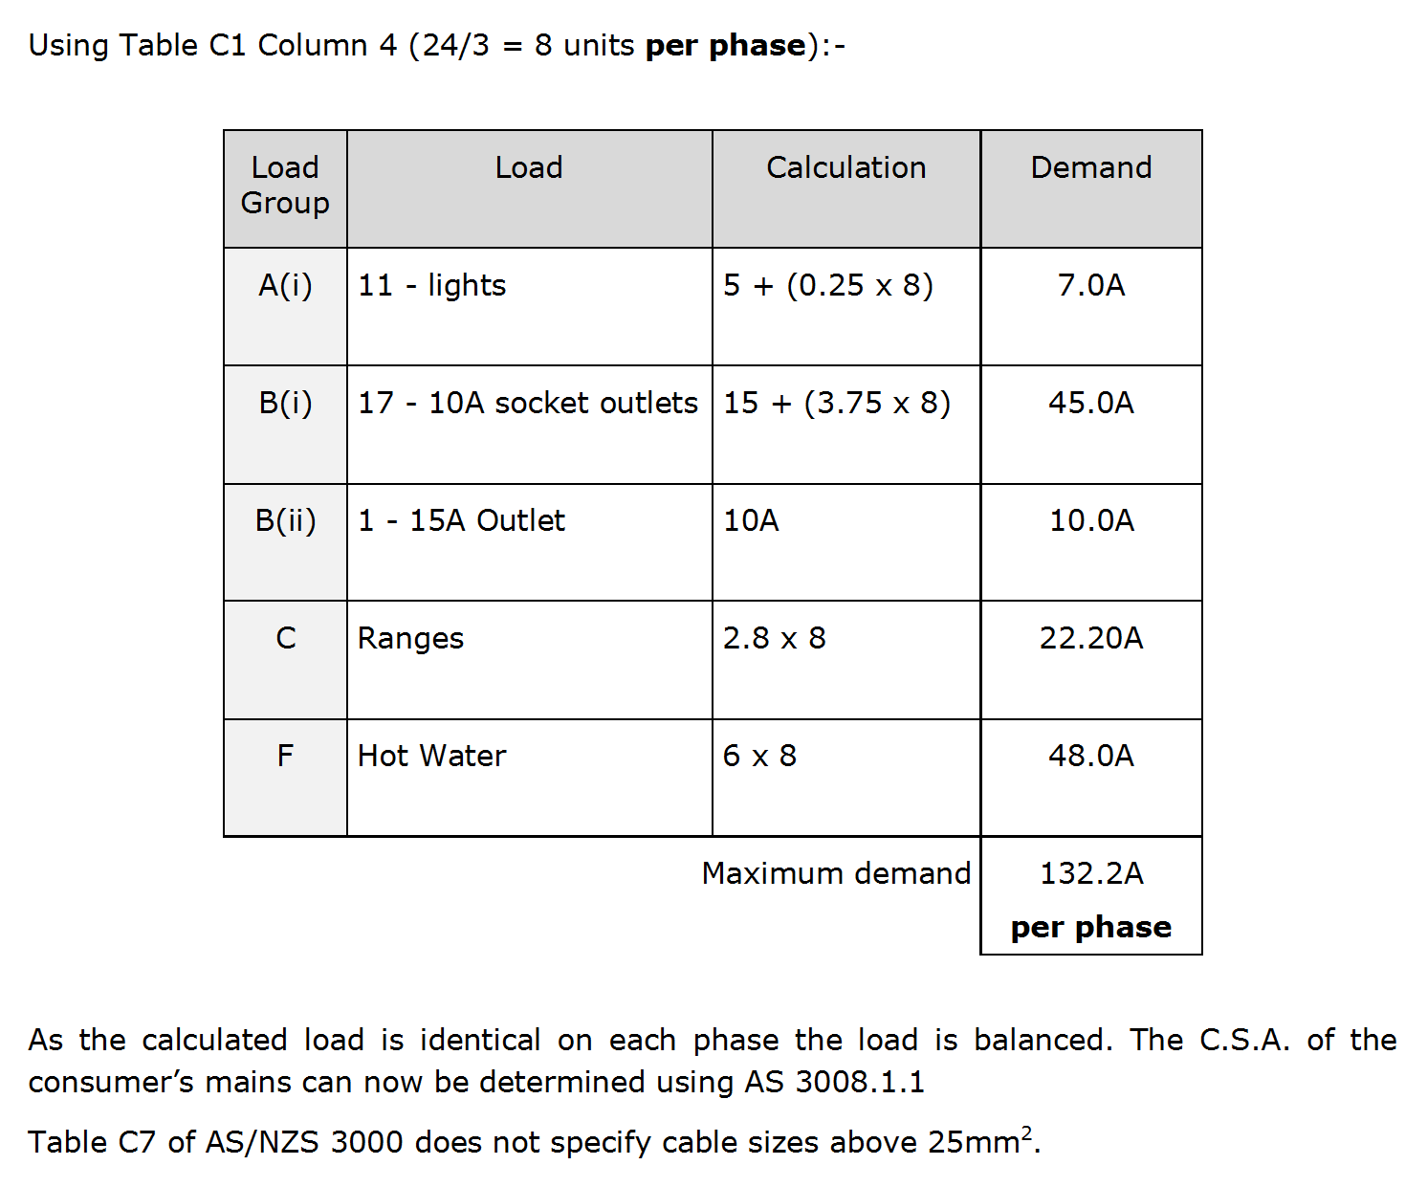
L

Slide 53
L

Slide 54
9 Units on A phase
Main
Switch
Board
6 Units + House Load (communal load) on C phase
9 Units on
B phase
L

Slide 55
L

Slide 56
L

Slide 57
L

Slide 58
L

Slide 59
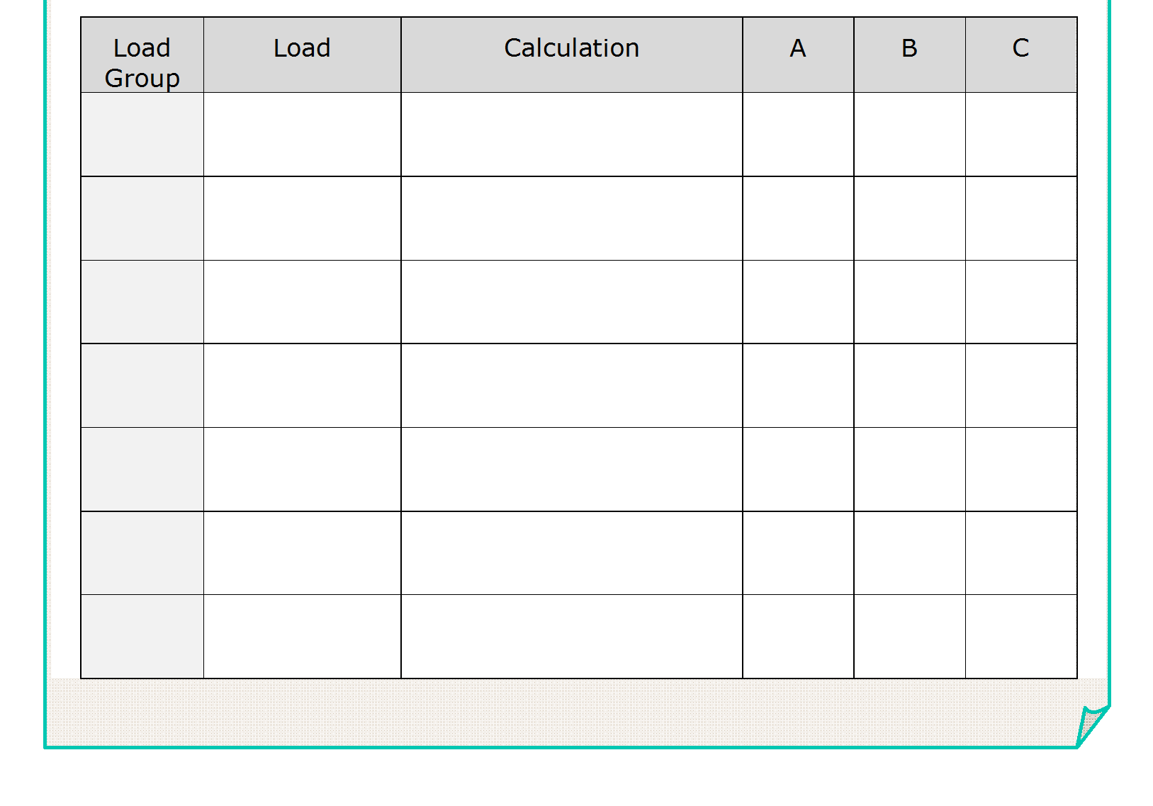
Ai
lights
6
6
Bi
10A s/o
10+ (5 x 2) =
20
20
C
Range
15
15
C
Dryer s/o
Inc above
-
-
F
H.W.S.
6 x 2 =
12
12
53A
53A
L

Slide 60
8
8
6 + com
L

Slide 61
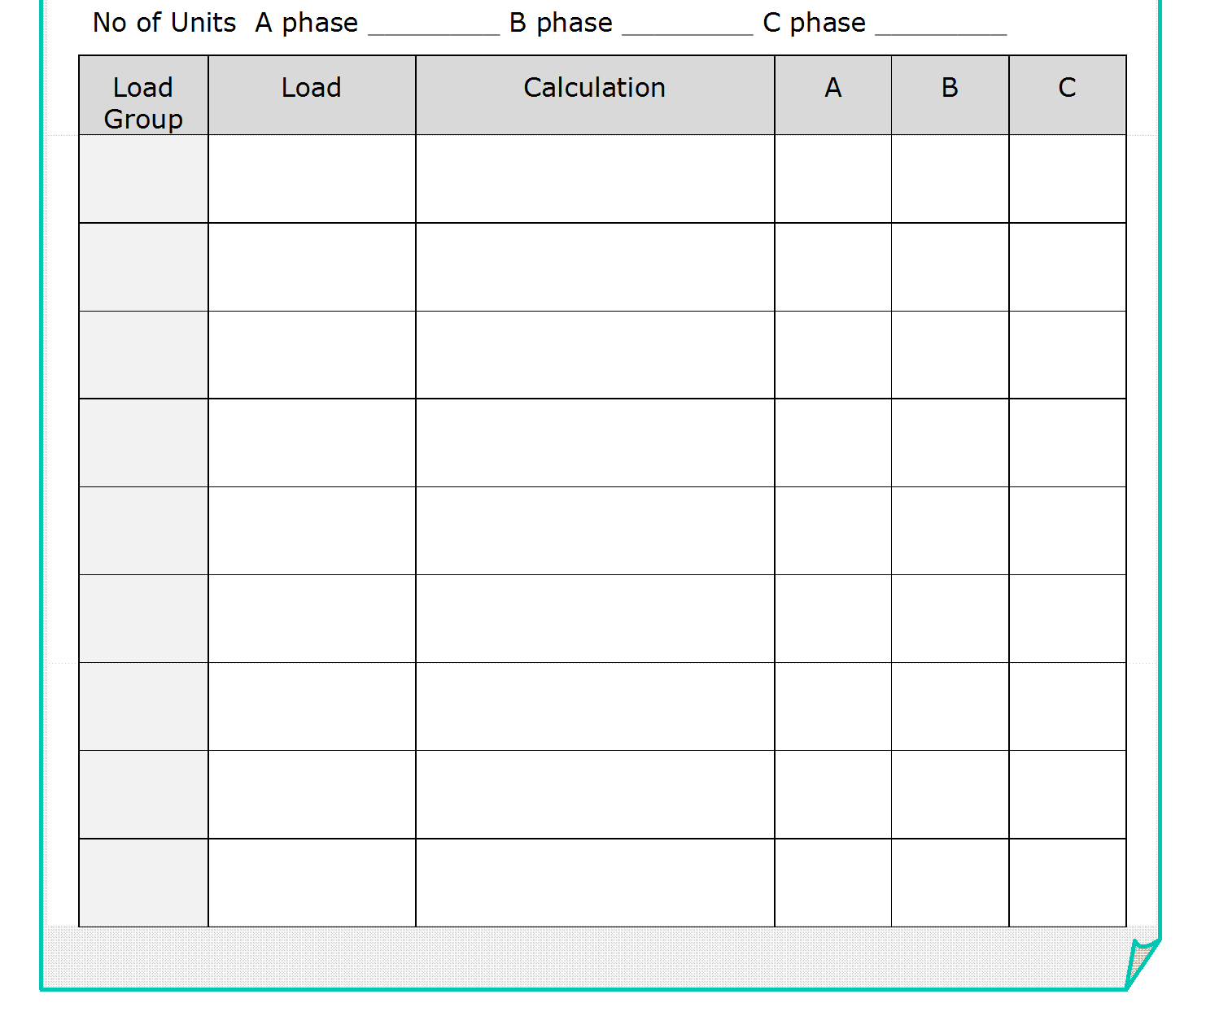
8
8
6 + com
5 + (0.25 x 8) =
Ai
Lights
7
7
6.5
5 + (0.25 x 6) =
Bi
10A s/o
15 + (3.75 x 8) =
45
45
37.5
15 + (3.75 x 6) =
C
Cook top
& oven
2.8 x 8 =
22.4
22.4
16.8
2.8 x 6 =
F
HWS
6 x 8 =
48
48
36
6 x 6 =
H
Com lights
20 x 0.33 +
19.65
(50 x 60 / 230) =
I
Com power
15 x 2 = 30A
15
15A max
J
Dryers
2 x 15 x 0.5 = 15
15
122A
122A
146A
L

Slide 62
END OF LESSON

