Slide 1
SECTION 5
MAXIMUM DEMAND ON
CONSUMERS MAINS & SUBMAINS

Slide 2
MAXIMUM DEMAND ON CONSUMERS MAINS and submains
Learning objectives:
Learners should be able to meet the following learning objectives:
Describe the acceptable methods for determining the maximum demand on an installation’s consumer’s mains.
Calculate the maximum demand for the consumer's mains for given installations up to 400 A per phase.
Describe the acceptable methods for determining the maximum demand on sub mains.
Calculate the maximum demand for given sub mains
L

Slide 3
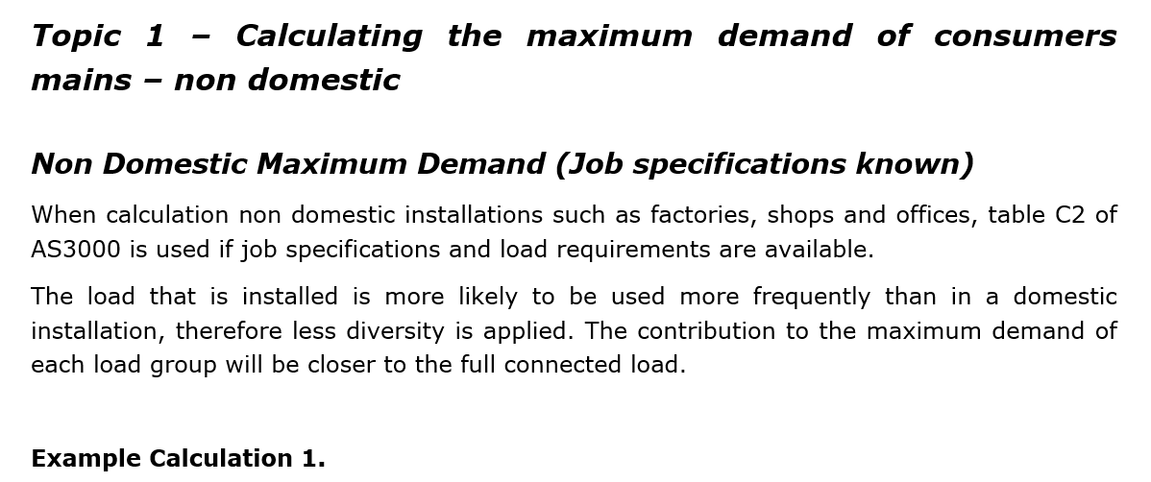
L

Slide 4
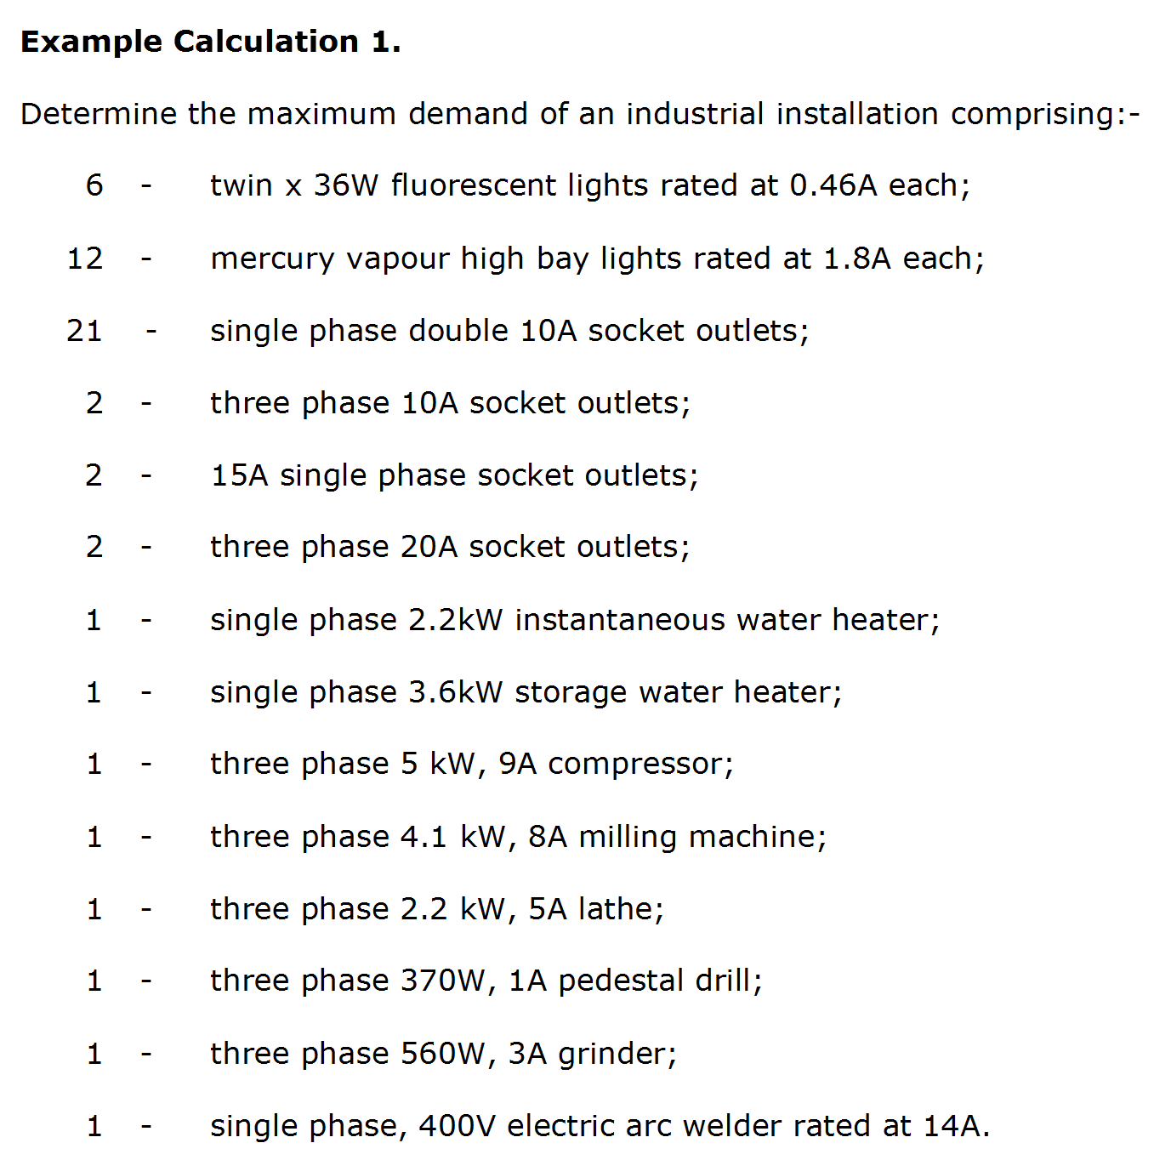
L

Slide 5
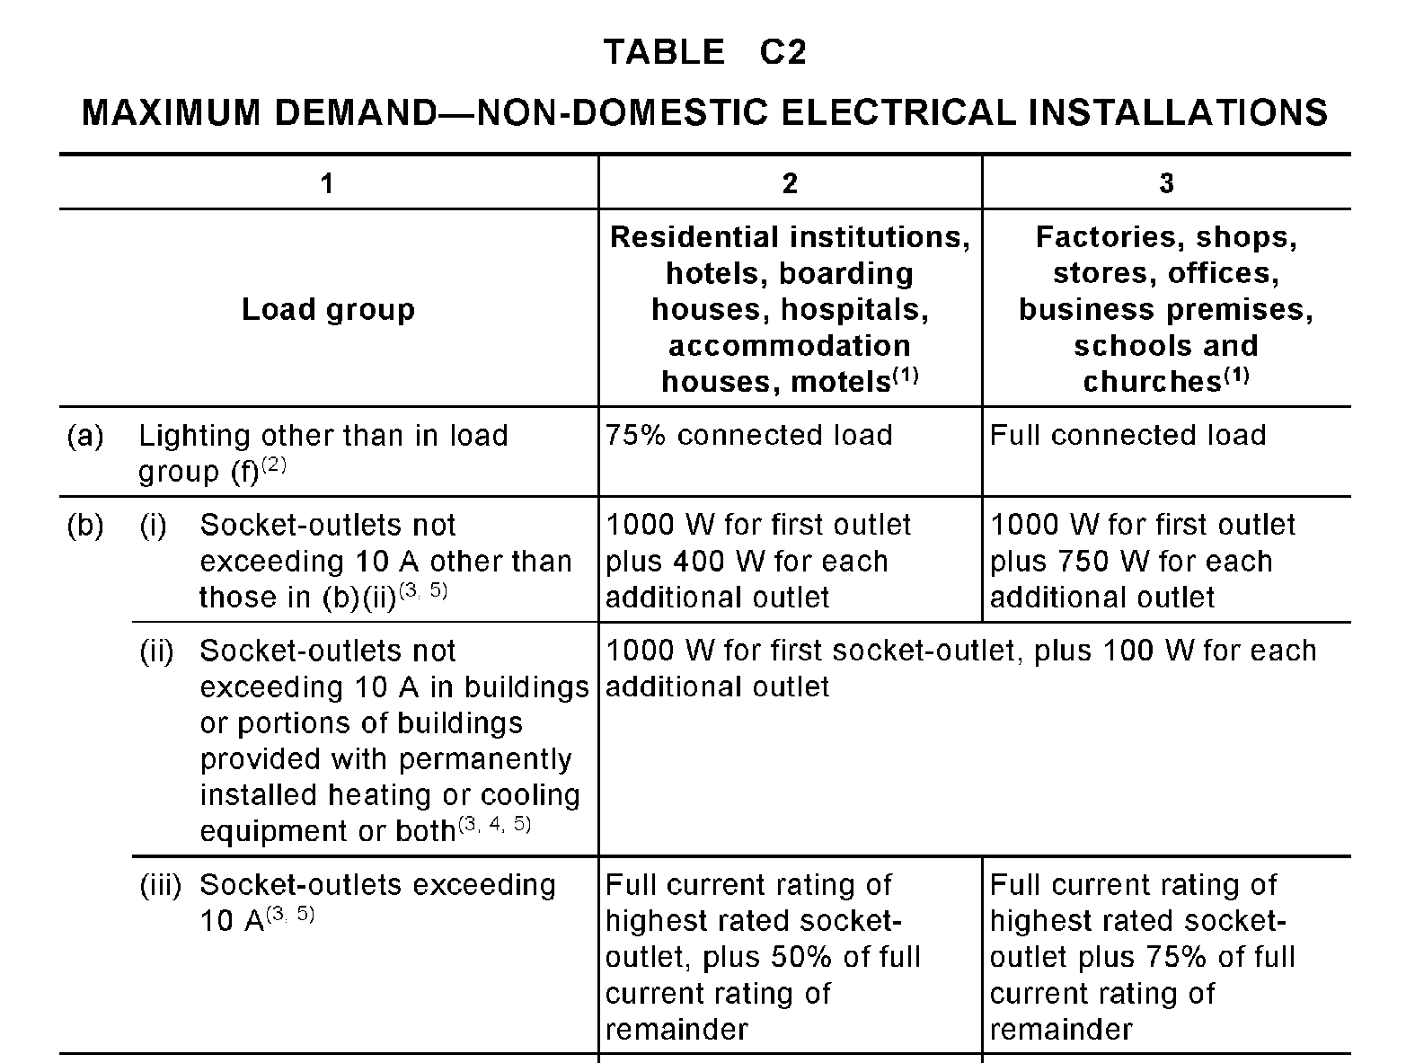
L

Slide 6
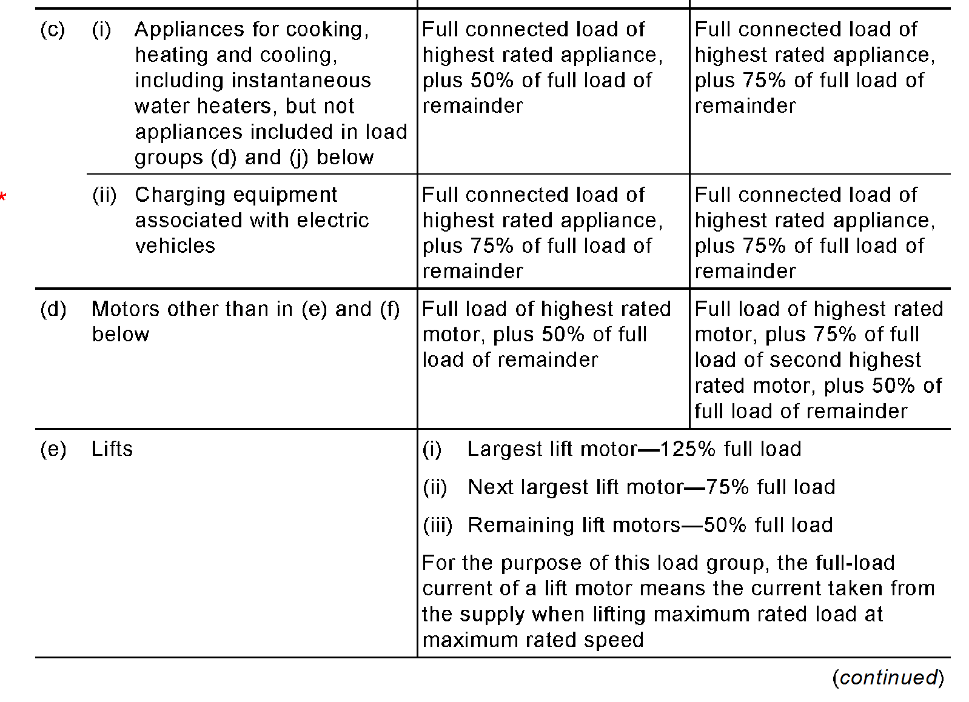
L

Slide 7
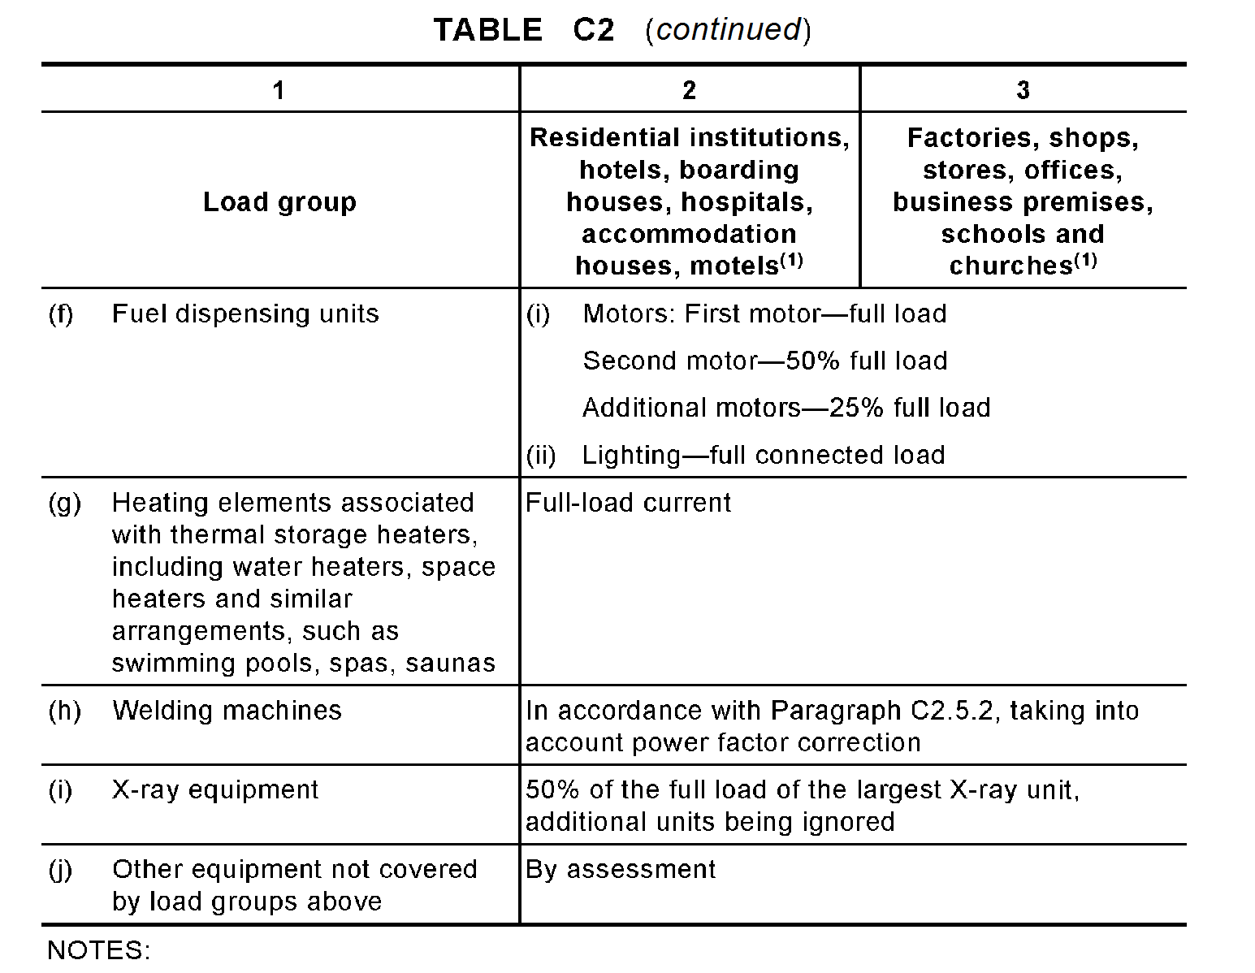
L

Slide 8
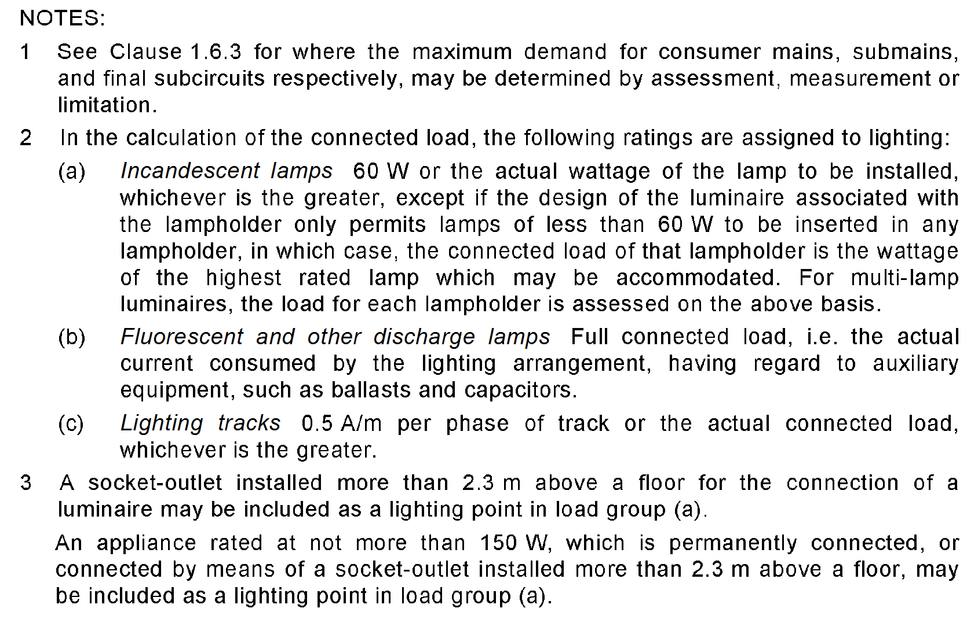
L

Slide 9
L

Slide 10
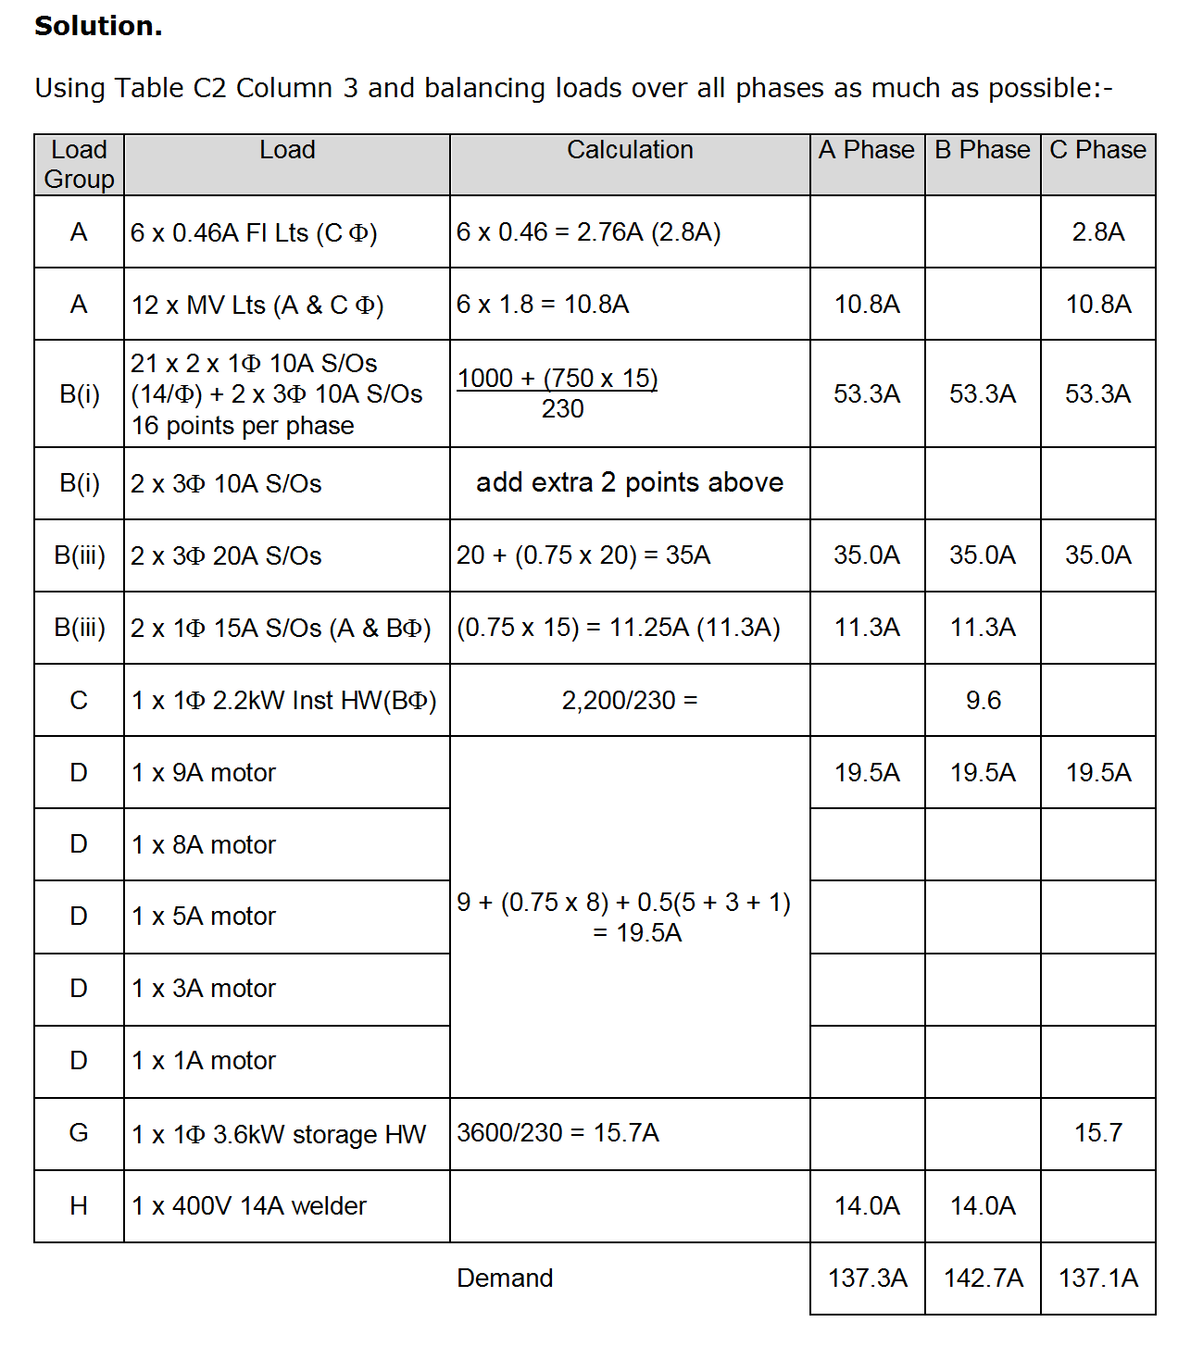
L

Slide 11
NOTE: Change to welder
1
30A
L

Slide 12
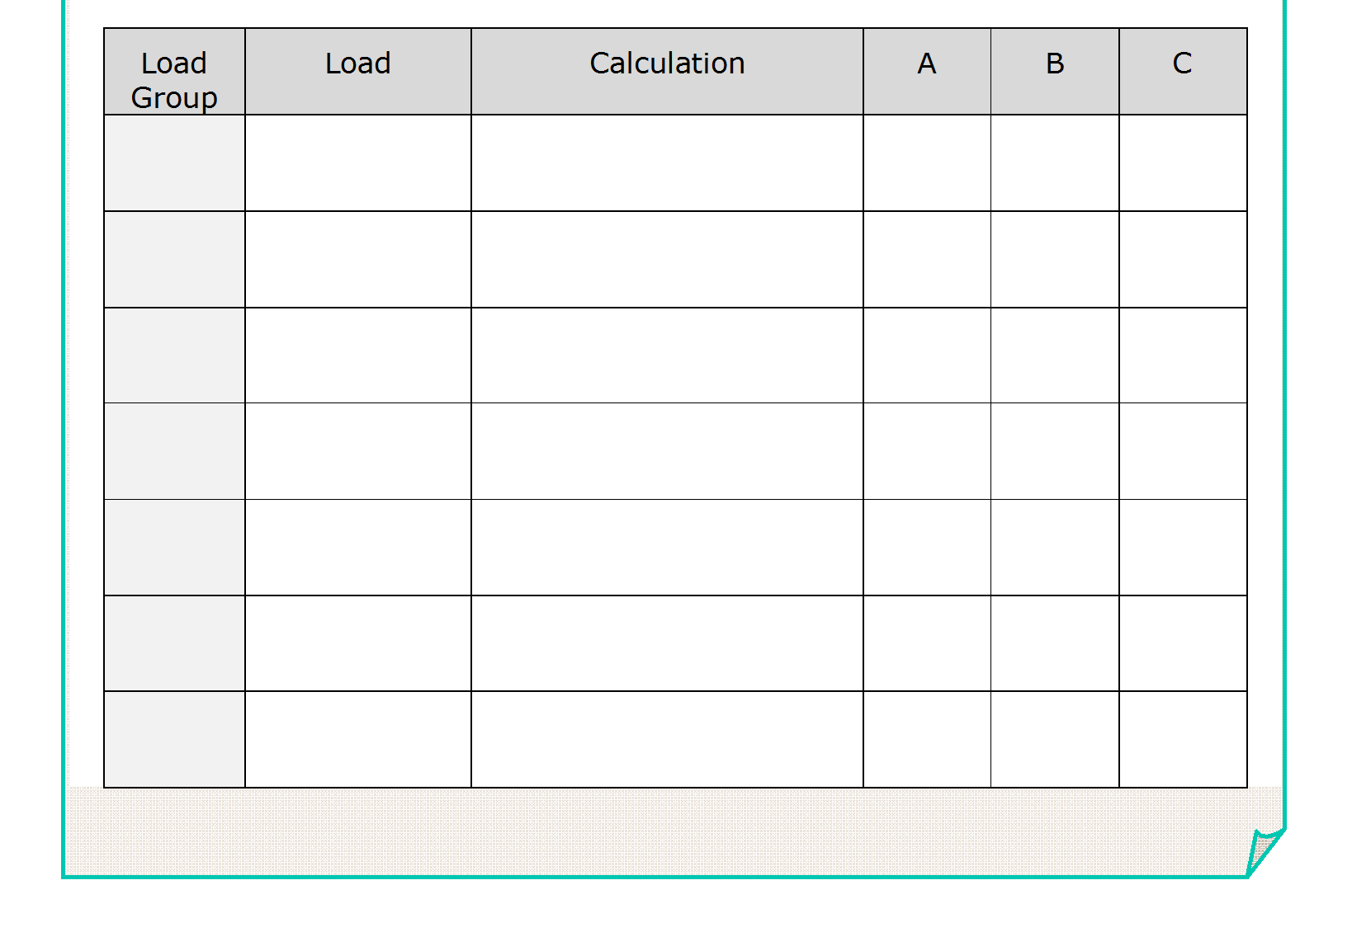
A
Lights
12 x 2.6 =
31.2
31.2
31.2
B
10A s/o
1000+(13 x 750)
46.7
46.7
46.7
230
Biii
20A s/o
20+(0.75 x 20 x 3)
65
65
65
D
Motors
28 +(0.75 x 28)
49
49
49
H
Welders
L

Slide 13
L
L

Slide 14
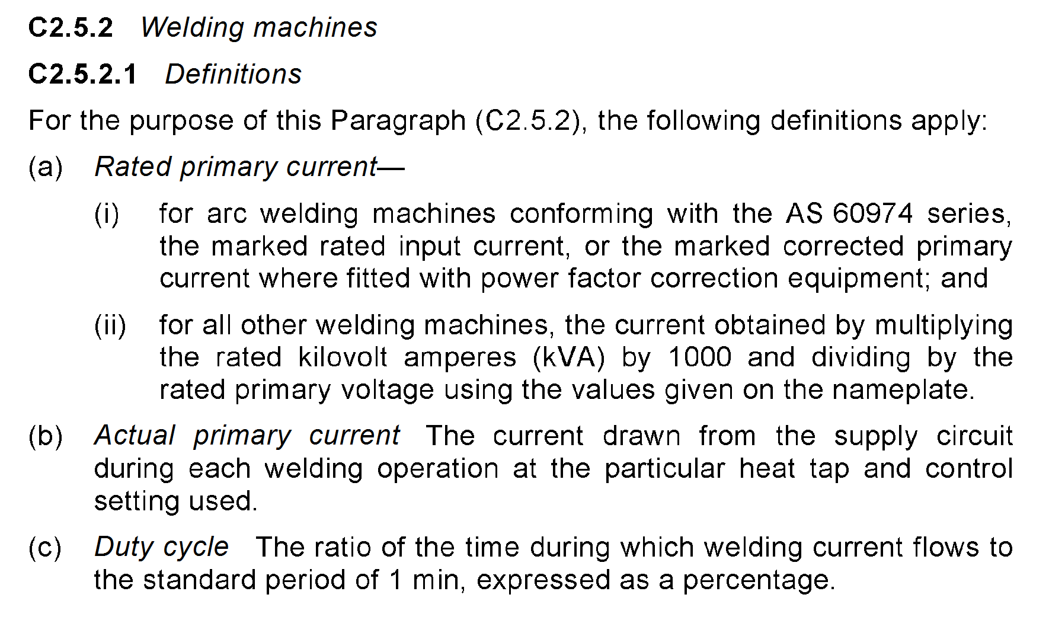
L

Slide 15
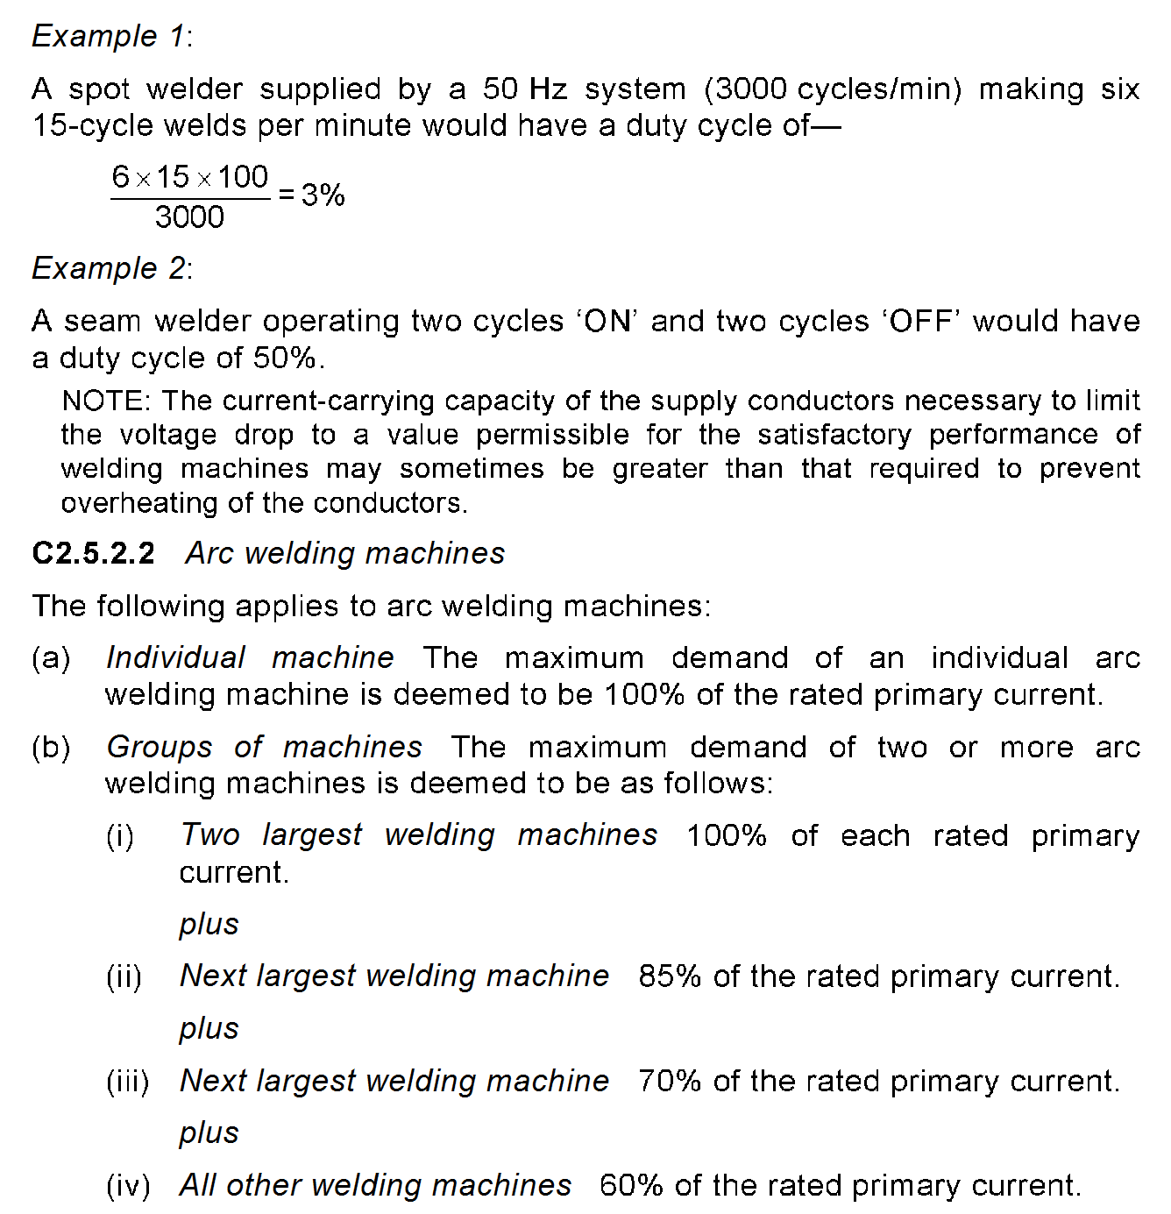
L

Slide 16
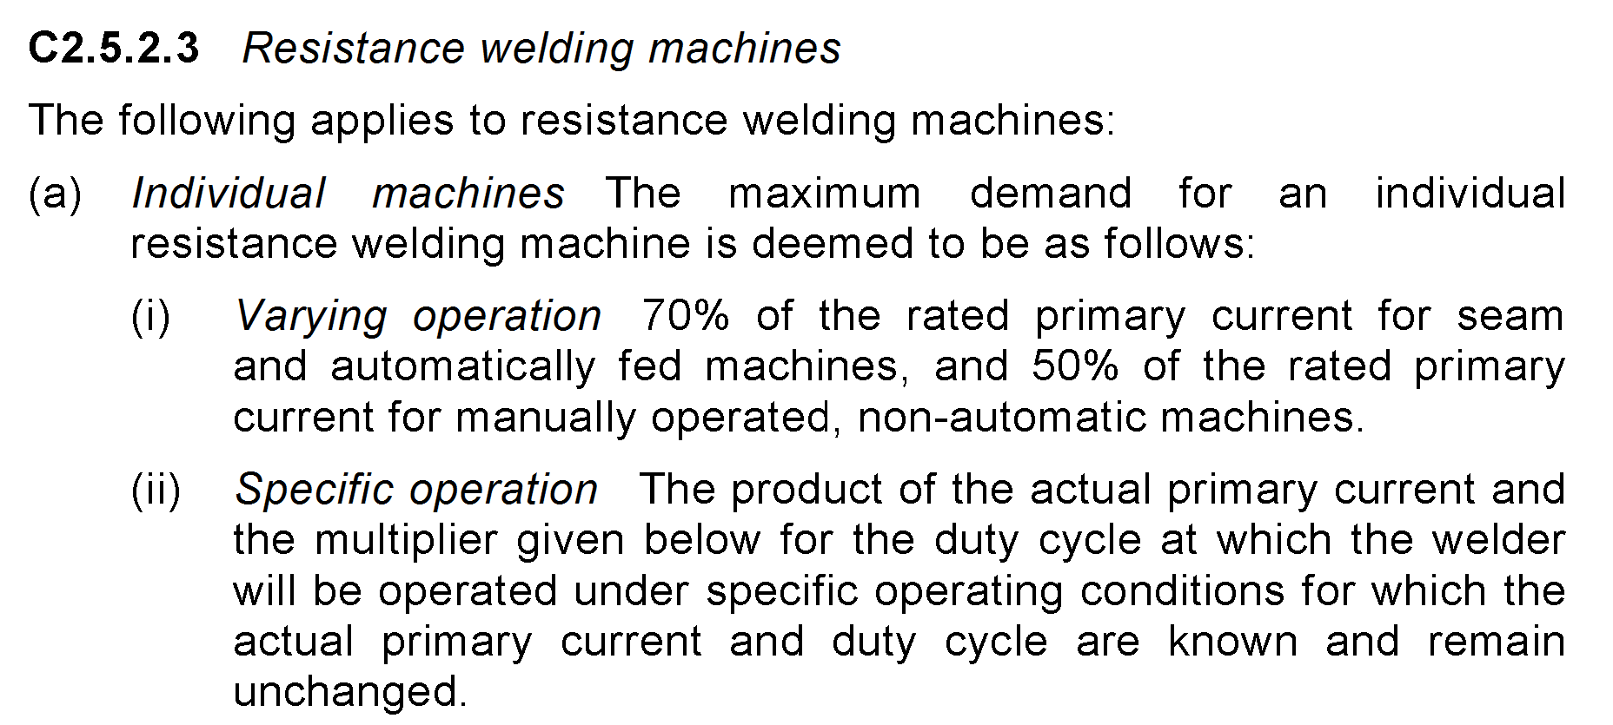
spot welders
L

Slide 17
A
Lights
12 x 2.6 =
31.2
31.2
31.2
Bi
10A s/o
1000+(13 x 750)
46.8
46.8
46.8
230
Biii
20A s/o
20+(0.75 x 20 x 3)
65
65
65
D
Motors
28 +(0.75 x 28)
49
49
49
H
Welder
30 x 0.63 =
19
19
211A
211A
192A
L

Slide 18
L

Slide 19
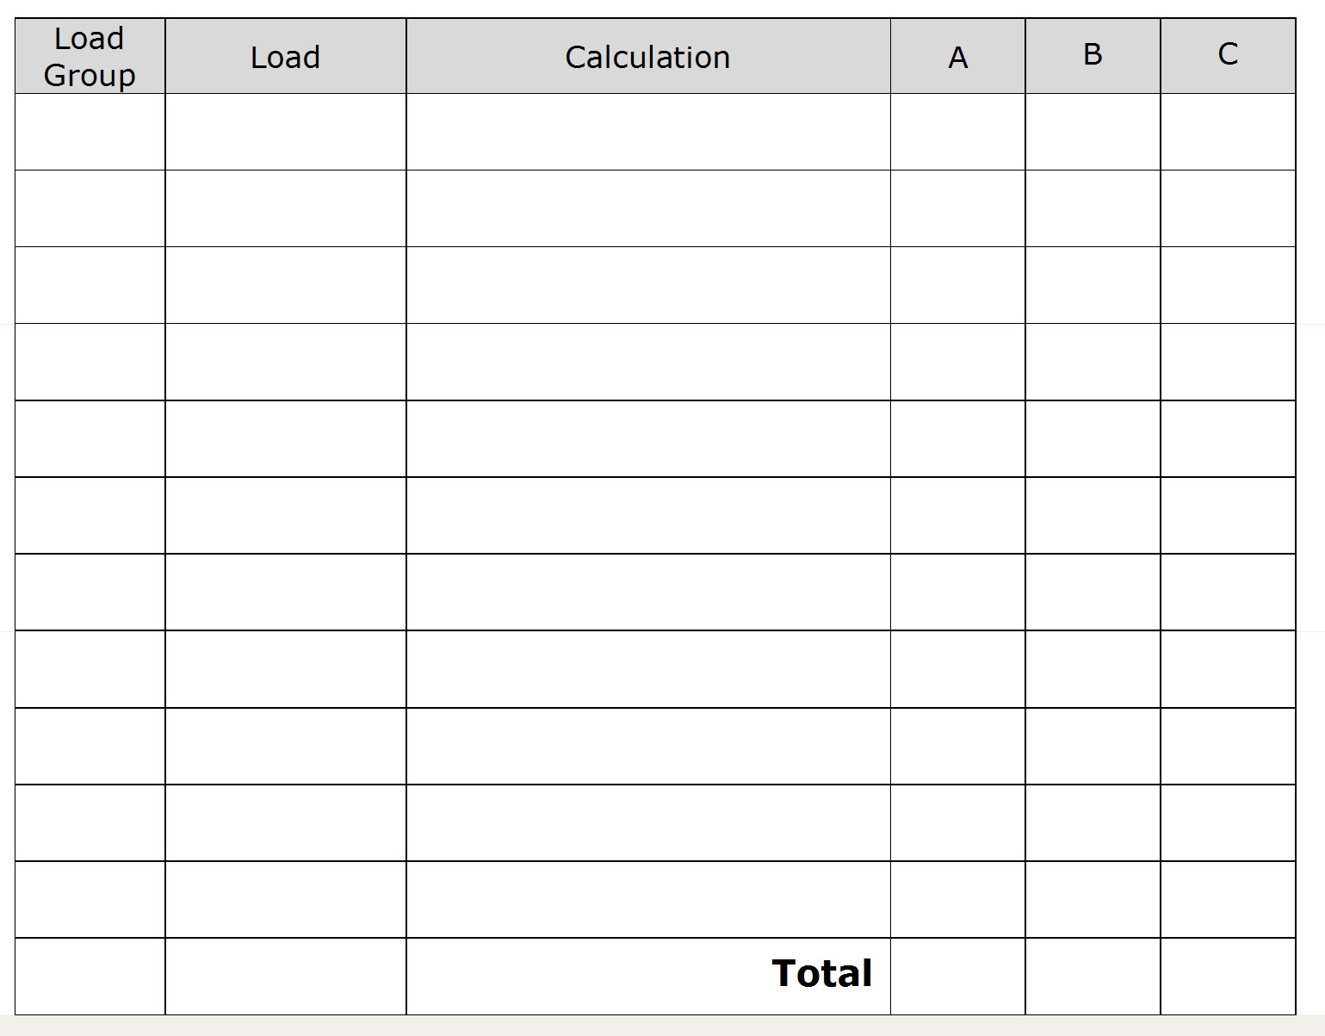
A
Lights
Twins=15 x 0.5
7.5
7.5
Floods=
3 x 500
230
6.6
Incandescents =
6 x 100
2.7
230
Bi
10A s/o (6/ph)
1000+(750 x 5)
20.7
20.7
20.7
230
Biii
15A s/o
15+(5 x 15 x 0.75)
71.3
71.3
71.3
2300
G
H.W.S.
10
230
D
Motors
42+(42 x 0.75)
73.5
73.5
73.5
3 x 16.8 x 0.5
25.2
25.2
25.2
4 x 2.8 x 0.5
5.6
5.6
5.6
214.1
204.1
205.6
L

Slide 20
Hint - Rectifier is assessed at full load
Hint - Double s/o can’t have an odd number of points
L

Slide 21
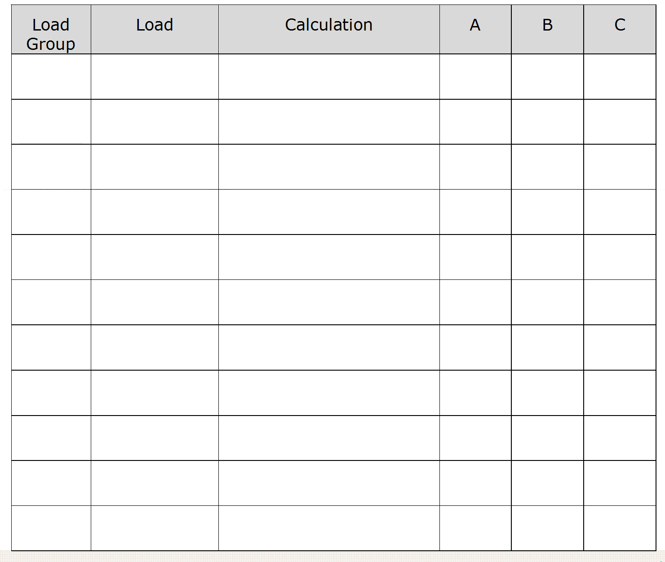
A
Lights
14 x 0.25
3.5
3.5
J
Rectifier
FCL
72
72
72
1000 + (13 x 750)
Bi
14/Ø
230
46.8
46.8
10A s/o
1000+(11 x 750)
12/Ø
230
40.3
Biii
20A s/o
20 + (6 x 20 x 0.75)
110
110
110
D
6.3 + (6.3 x 0.75) +(6.3 x 0.5)
14.2
14.2
14.2
Motors
2 x 5.2 x 0.5
5.2
5.2
5.2
251.6
245.1
248.1
L
Notes:
Split 10A socket outlets 7 + 7 + 6 single points therefore 14 + 14 + 12 = 40 points as you can not have an odd number of double 10A s/o ie don’t do 13 +13 +14 = 40

Slide 22
Hint split 10A s/o’s over 2 phases to balance range
L

Slide 23
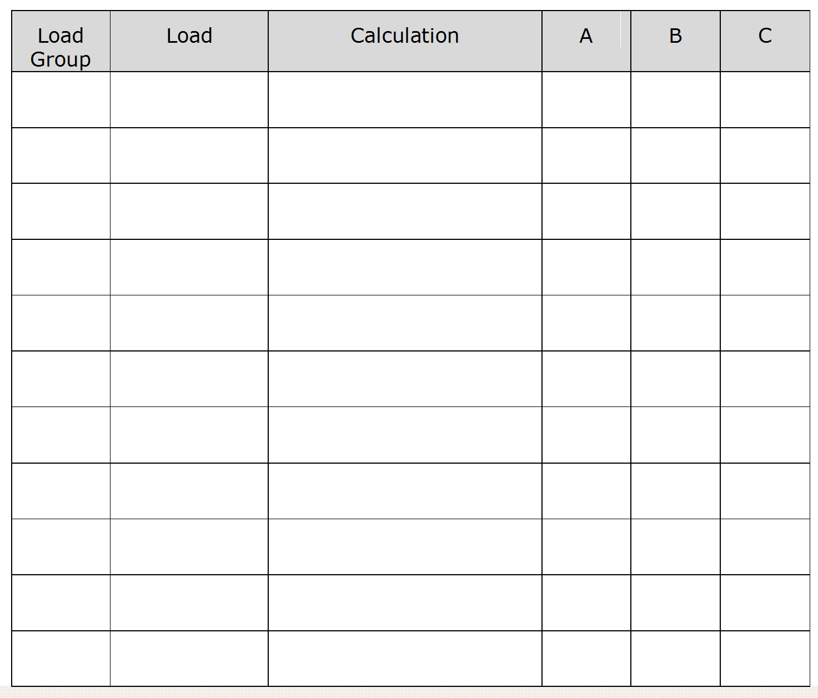
Ai
Lights
18 x 0.25
4.5
4.5
1000 + (21 x 750)
72.9
72.9
Bi
10A s/o
230
Biii
15A s/o
15
4400
G
H.W.S.
230
19.2
10500
45.7
C
Range
230
77.4
77.4
79.9
L

Slide 24
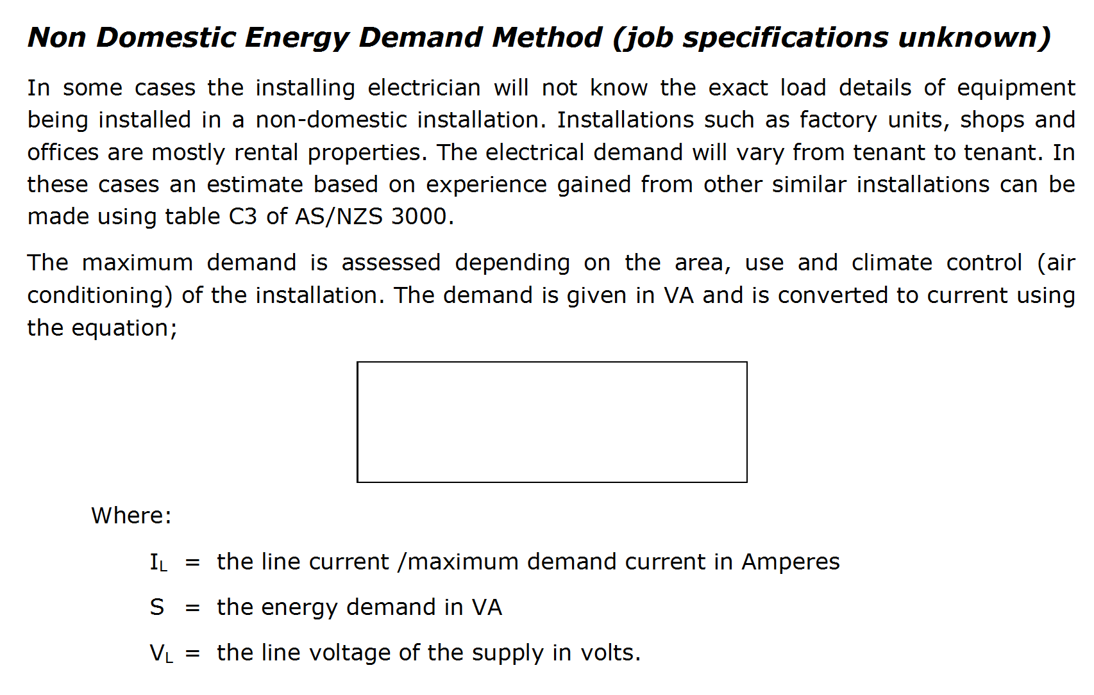
I_{L} = S
√3 x V_{L}
L

Slide 25
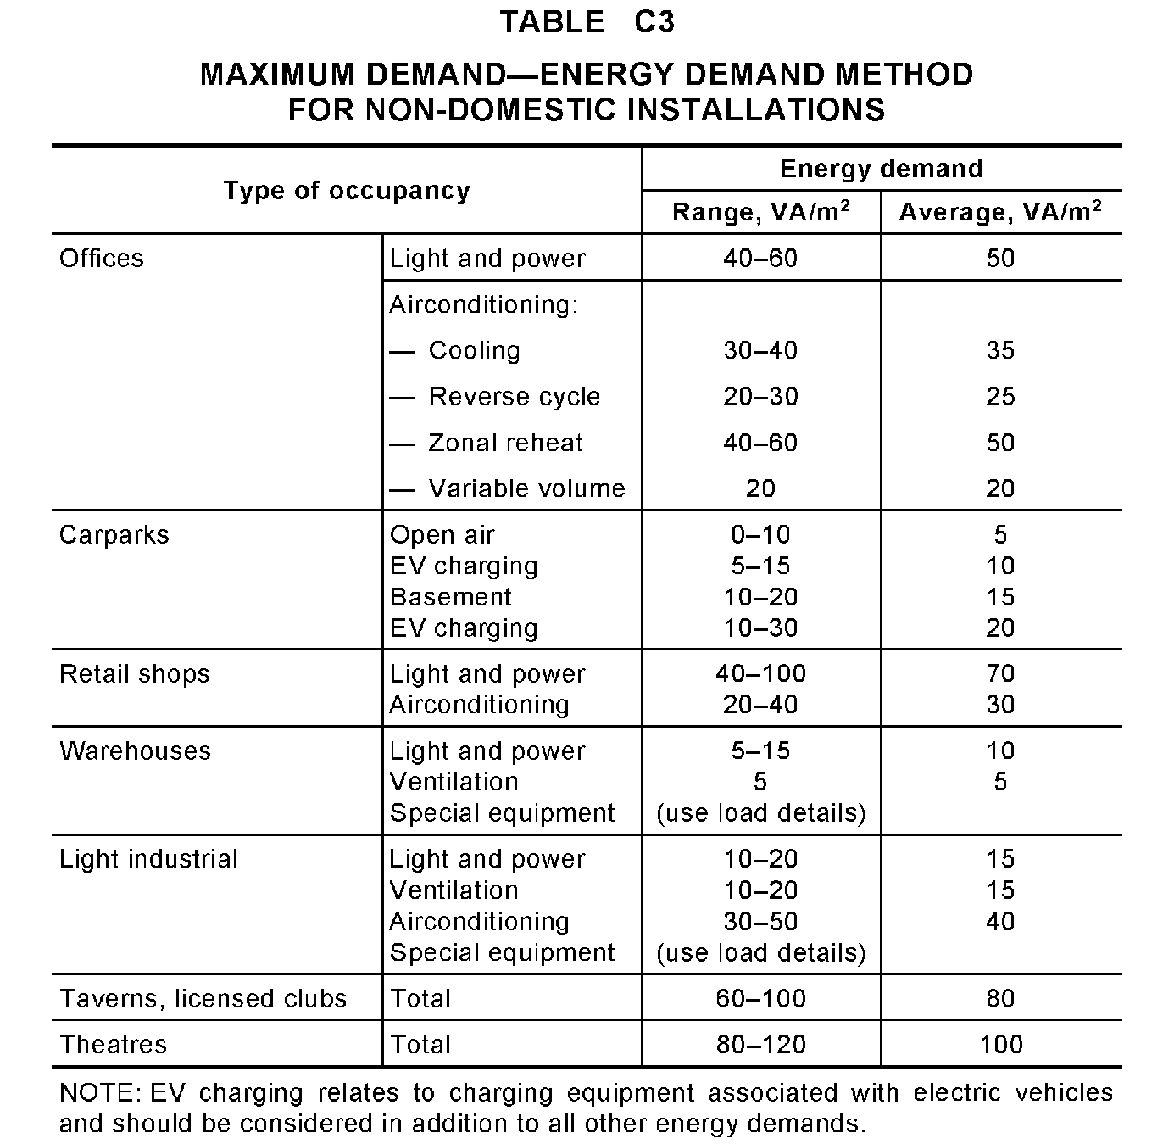
L

Slide 26
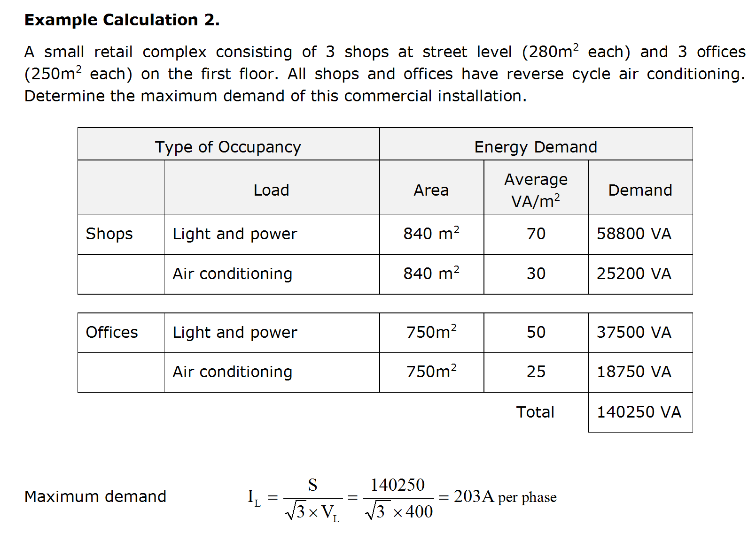
L

Slide 27
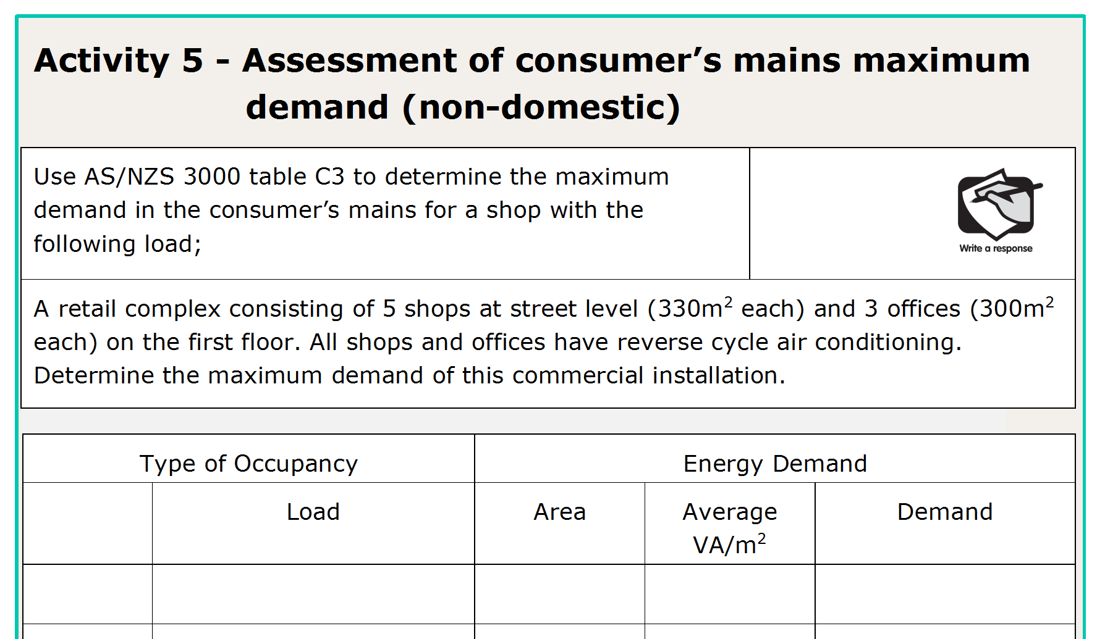
L

Slide 28
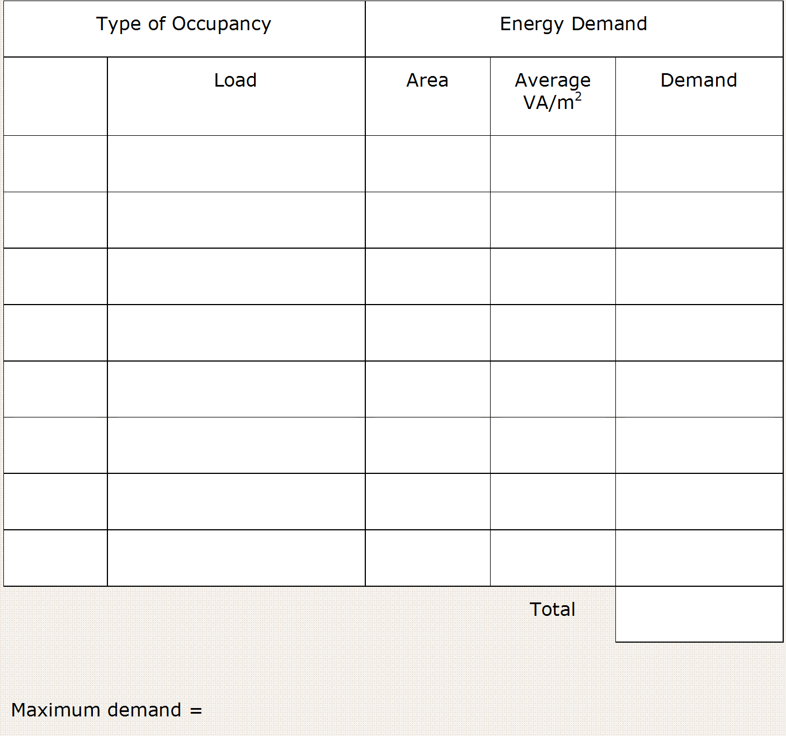
shops
L + P
1650
x
70
=
115500
A/C
1650
30
49500
offices
L + P
900
50
45000
A/C
900
25
22500
232500VA
S
= 232500
= 336A/Ø
√3 x V_{L}
√3 x 400
L

Slide 29
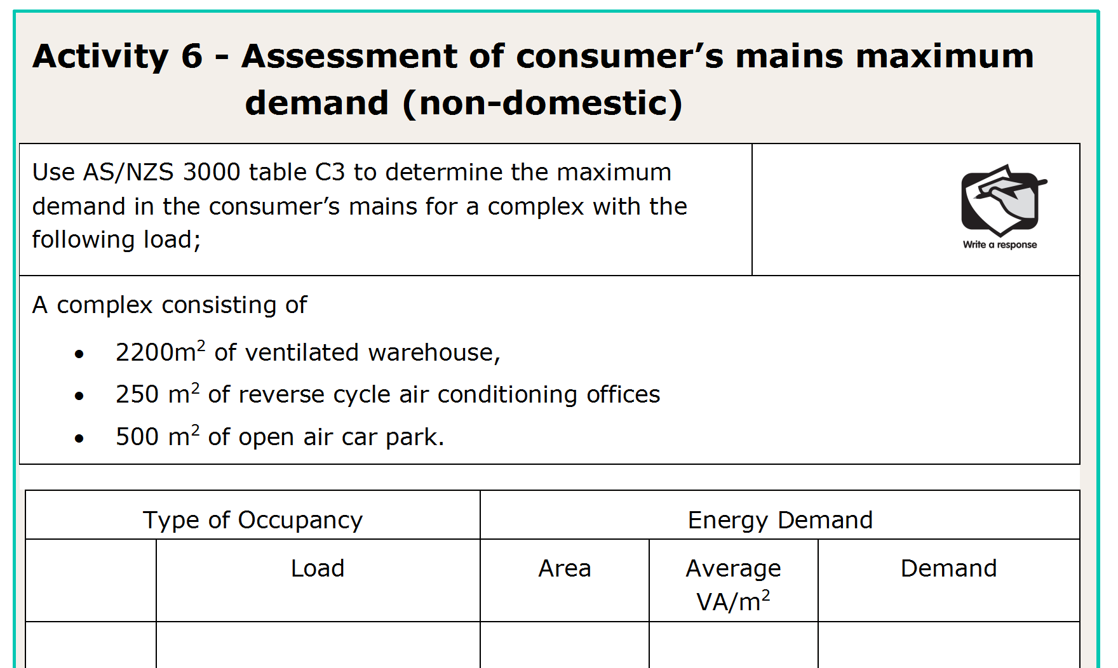
L

Slide 30
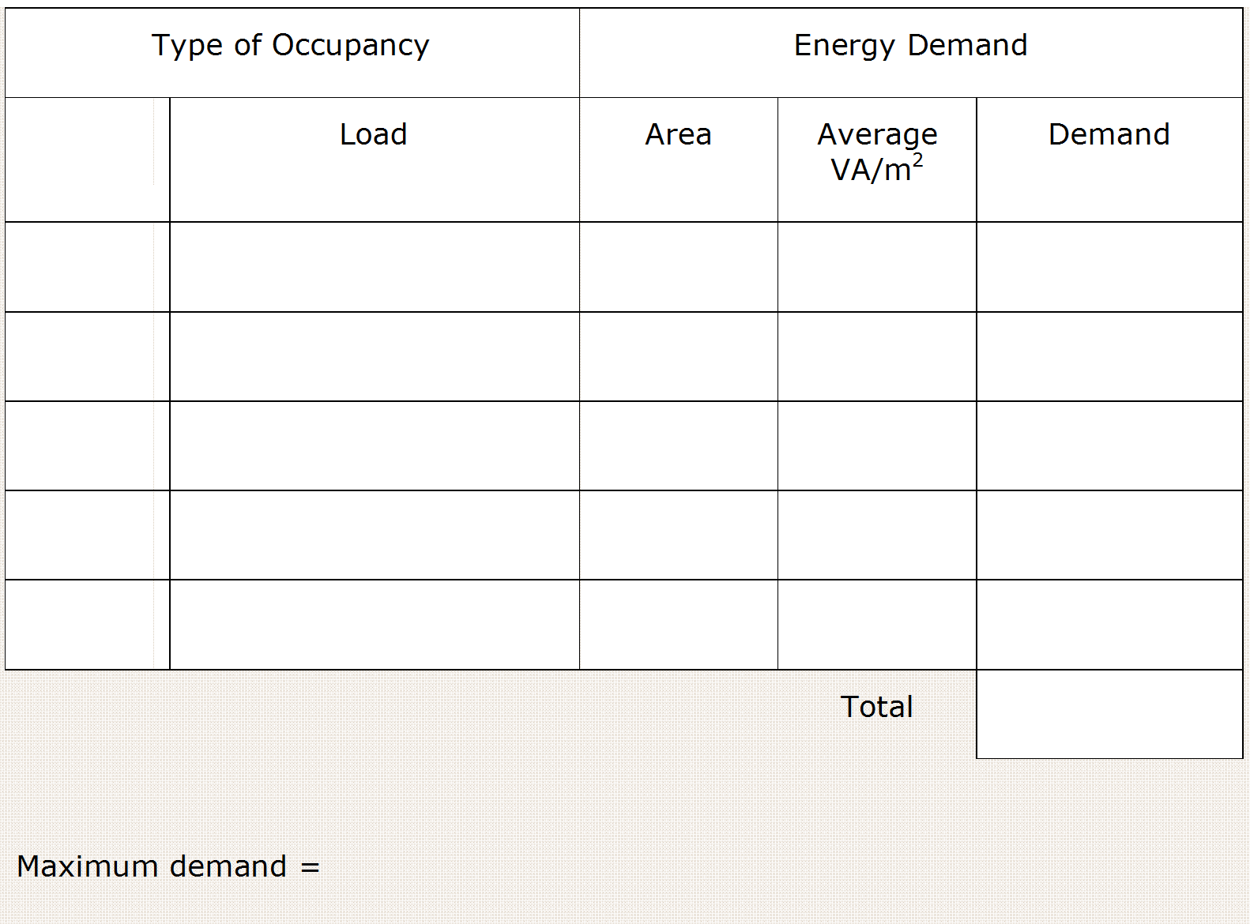
Ware H
L + P
2200
10
22000
ventilation
2200
5
11000
offices
L + P
250
50
12500
A/C
250
25
6250
Car park
Open air
500
5
2500
54250VA
S
= 54250
= 78.3A/Ø
√3 x V_{L}
√3 x 400
L

Slide 31
L

Slide 32
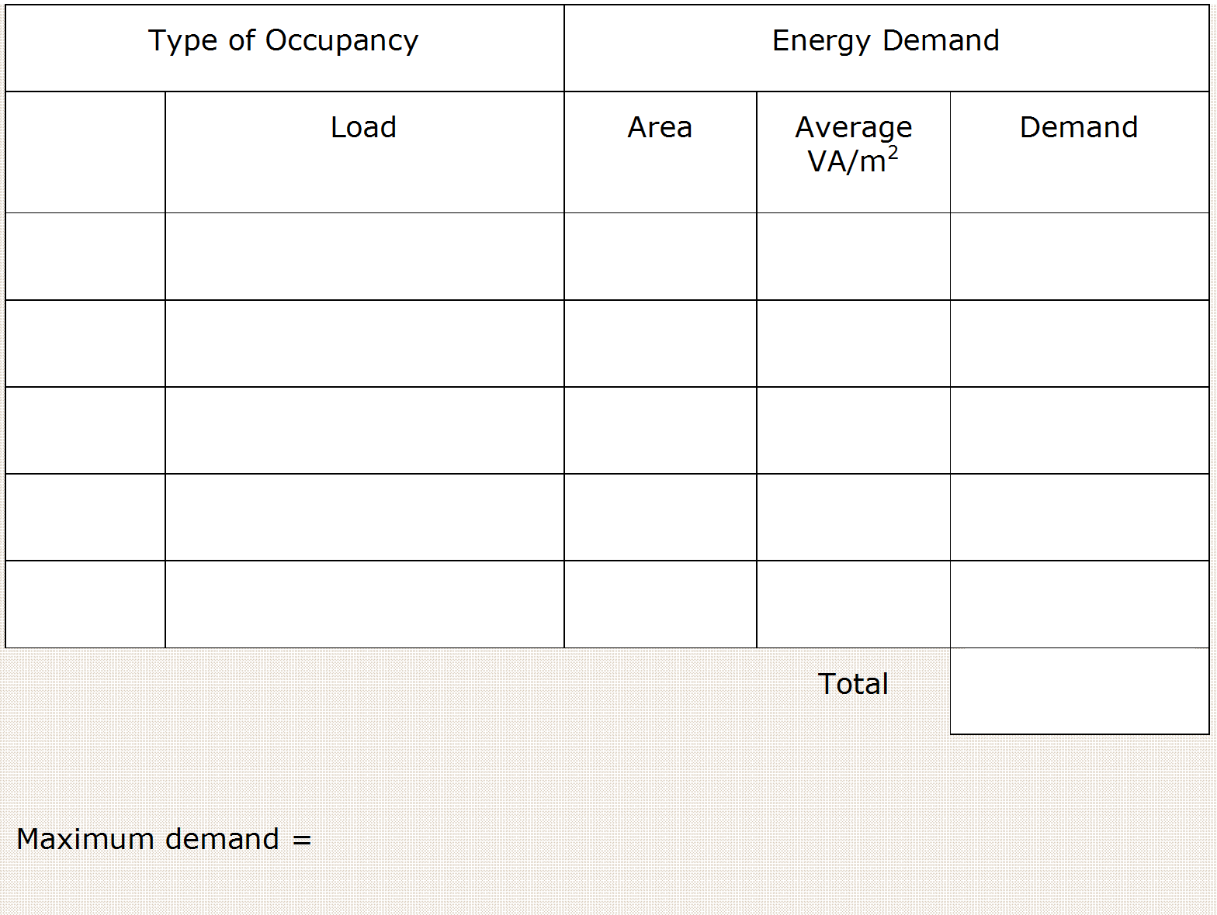
L Ind
L + P
1200
15
18000
ventilation
1200
15
18000
offices
L + P
850
50
42500
A/C
850
25
21250
Car park
open air
500
5
2500
102250VA
S
= 102250
= 147.6A/Ø
√3 x V_{L}
√3 x 400
L

Slide 33
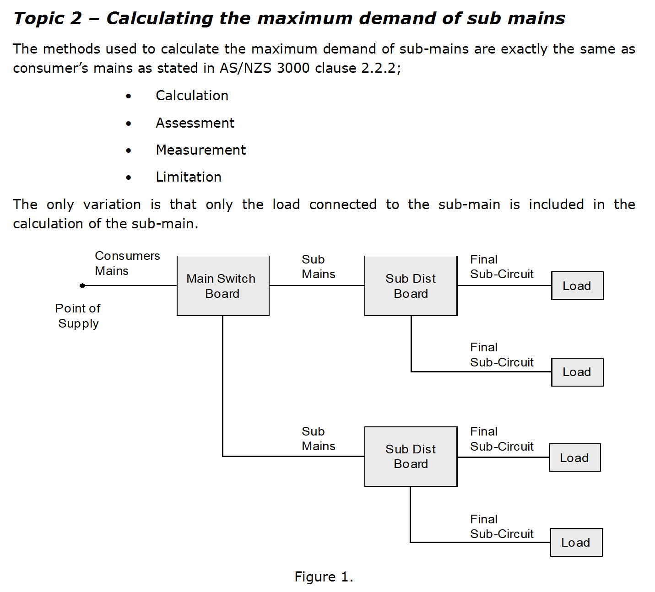
This submain will only carry the load current of f.s.’c connected to DB1
This submain will only carry the load current of f.s.’c connected to DB2
L

Slide 34
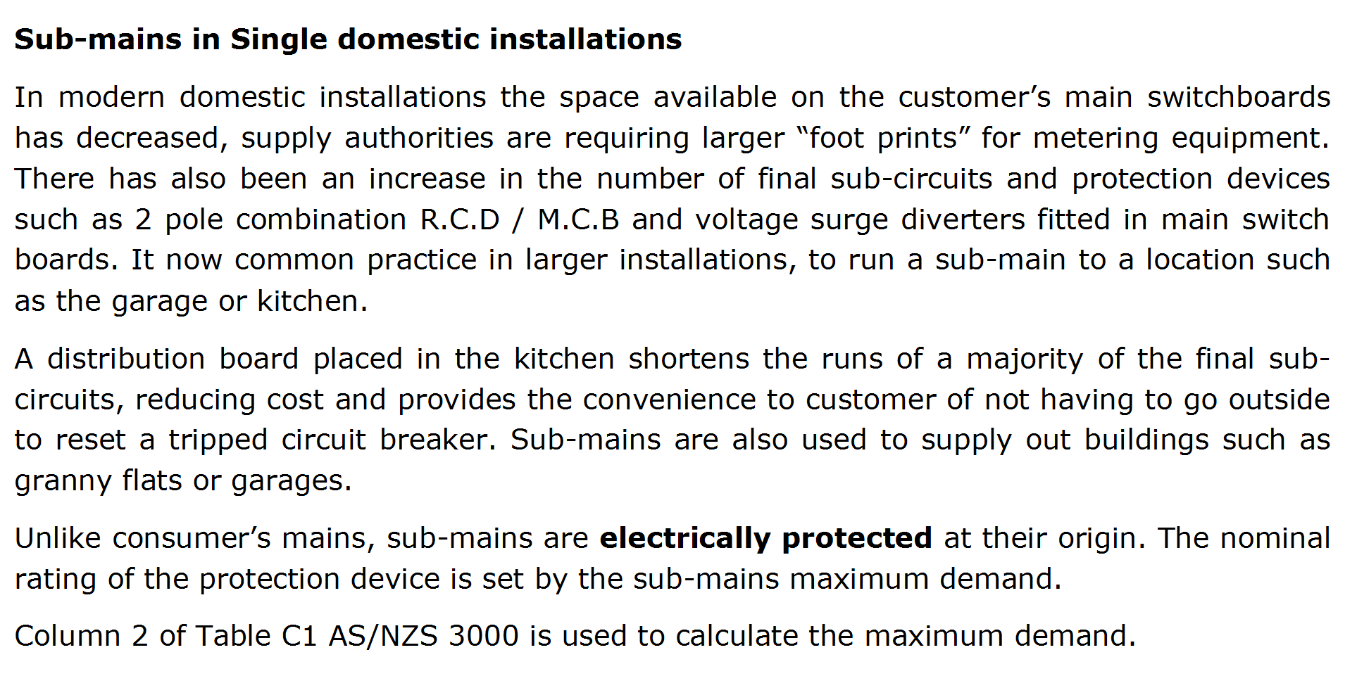
L

Slide 35
L

Slide 36
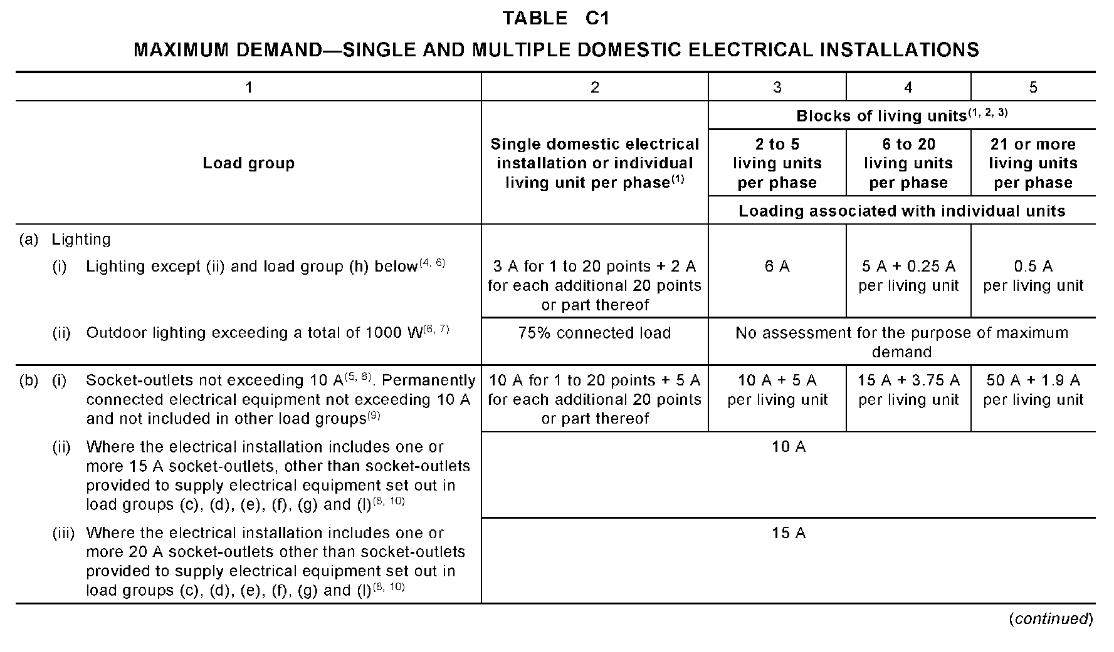
L

Slide 37
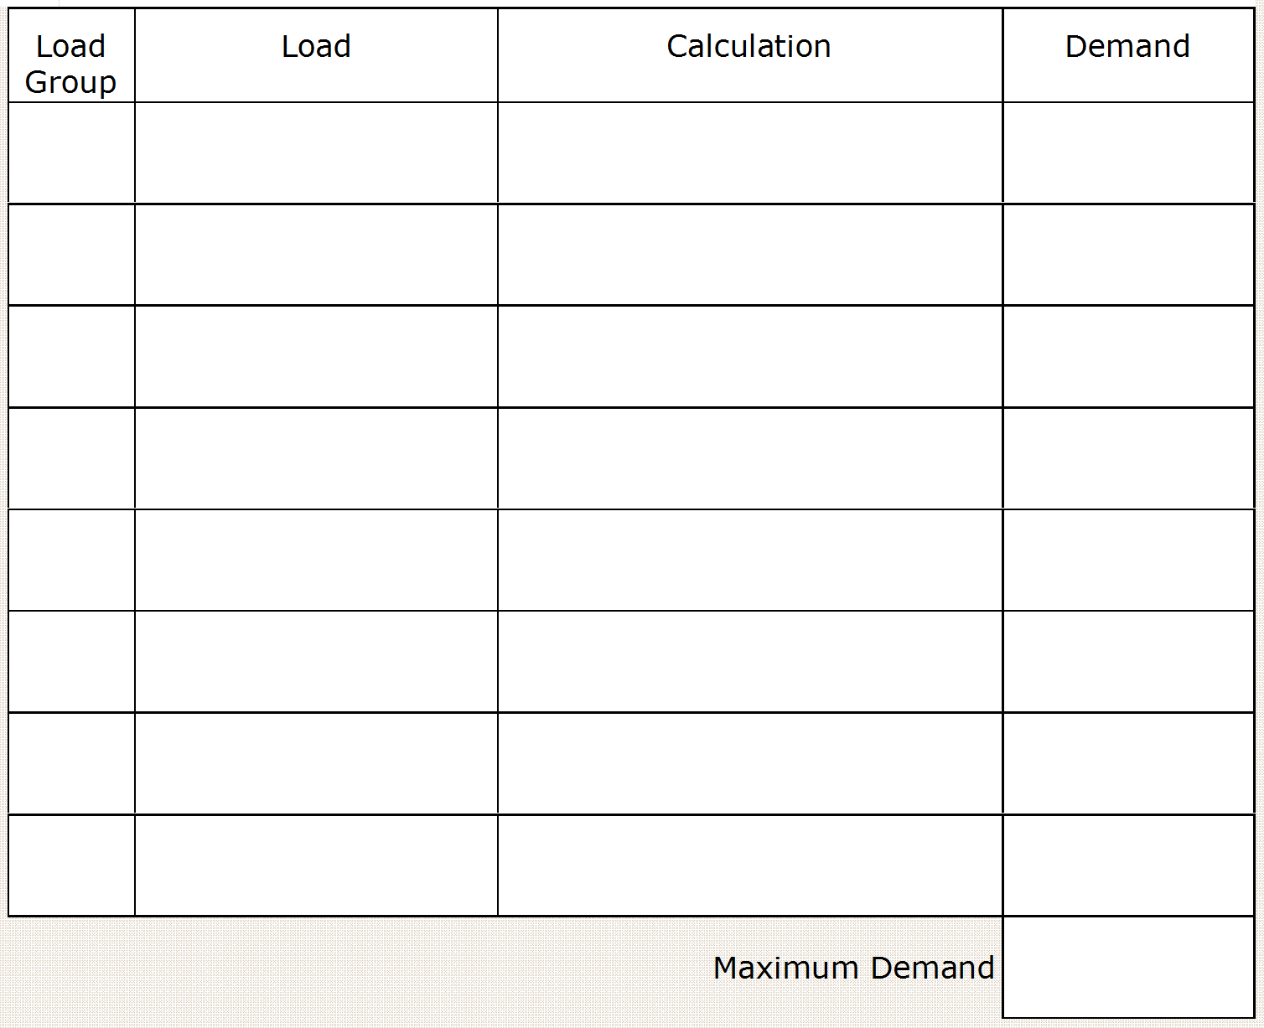
Ai
Lights (8)
3
Bi
10A s/o (11)
10
3300
F
H.W.S.
14.4
230
4400 x 0.5
C
Range
9.6
230
D
A/C
15 x 0.75
11.3
48.3A
L

Slide 38
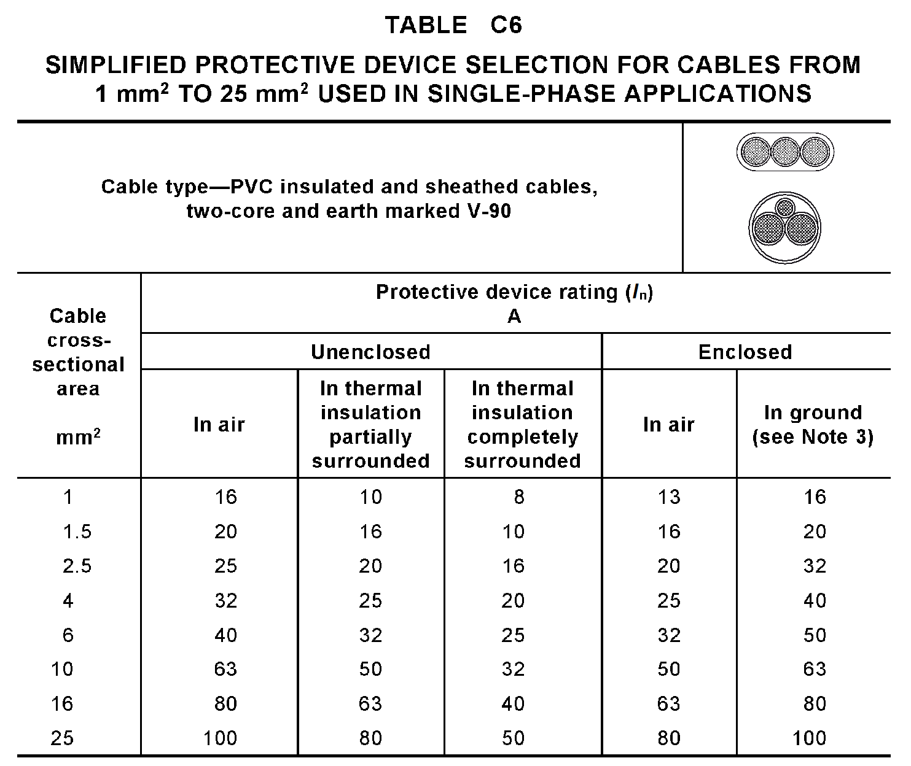
L

Slide 39
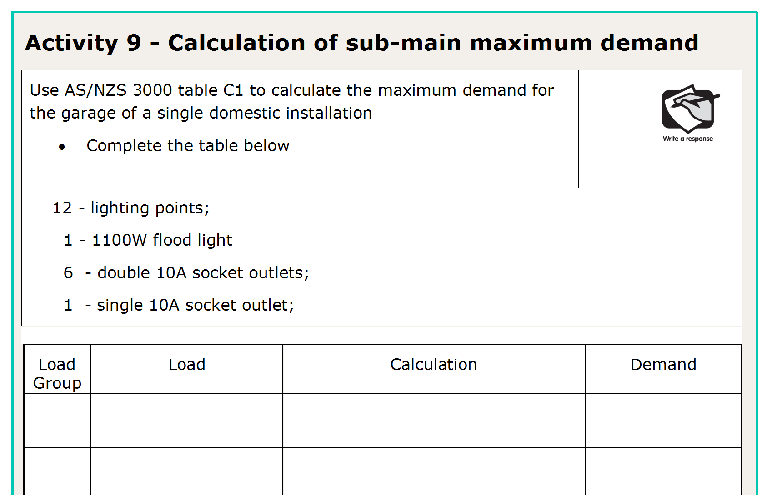
L

Slide 40
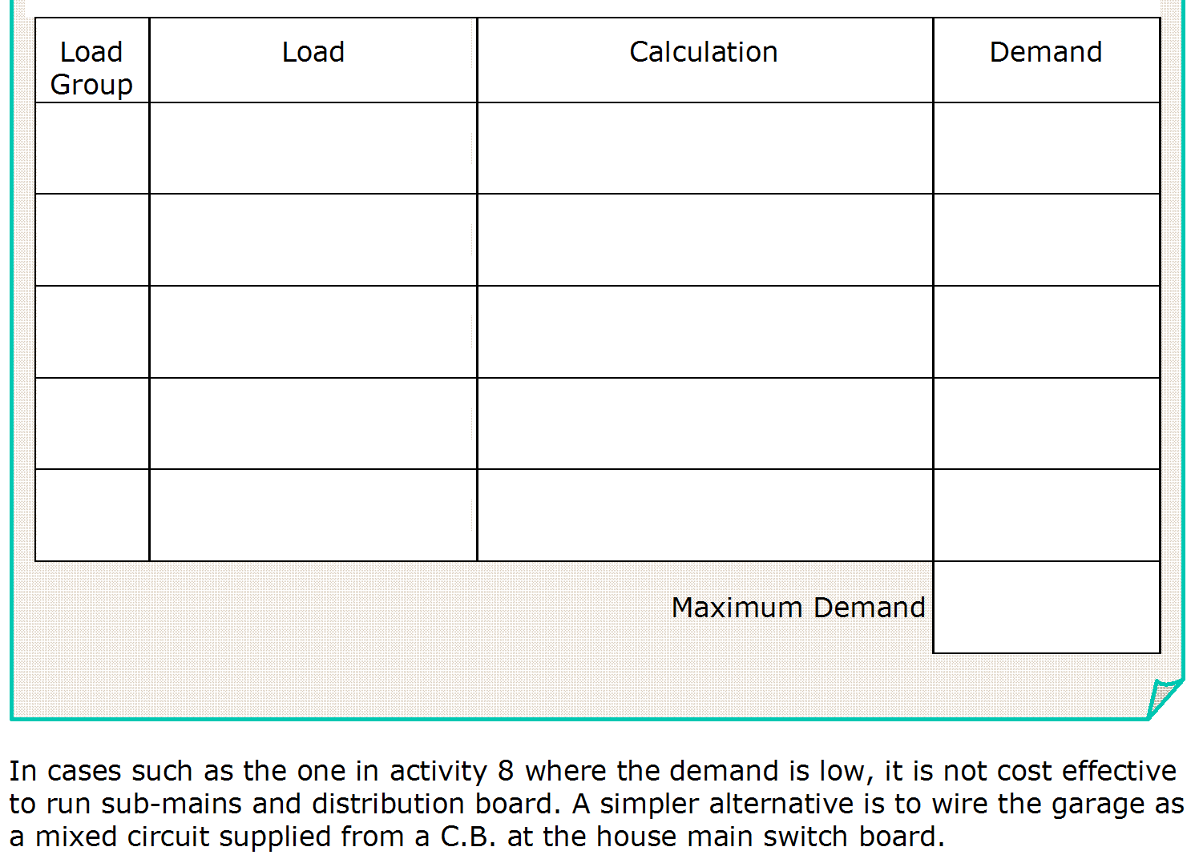
Ai
Lights (12)
3
1100 x 0.75
3.5
Aii
O/D Lights (1)
230
Bi
10A s/o (13)
10
16.5A
L

Slide 41
L

Slide 42
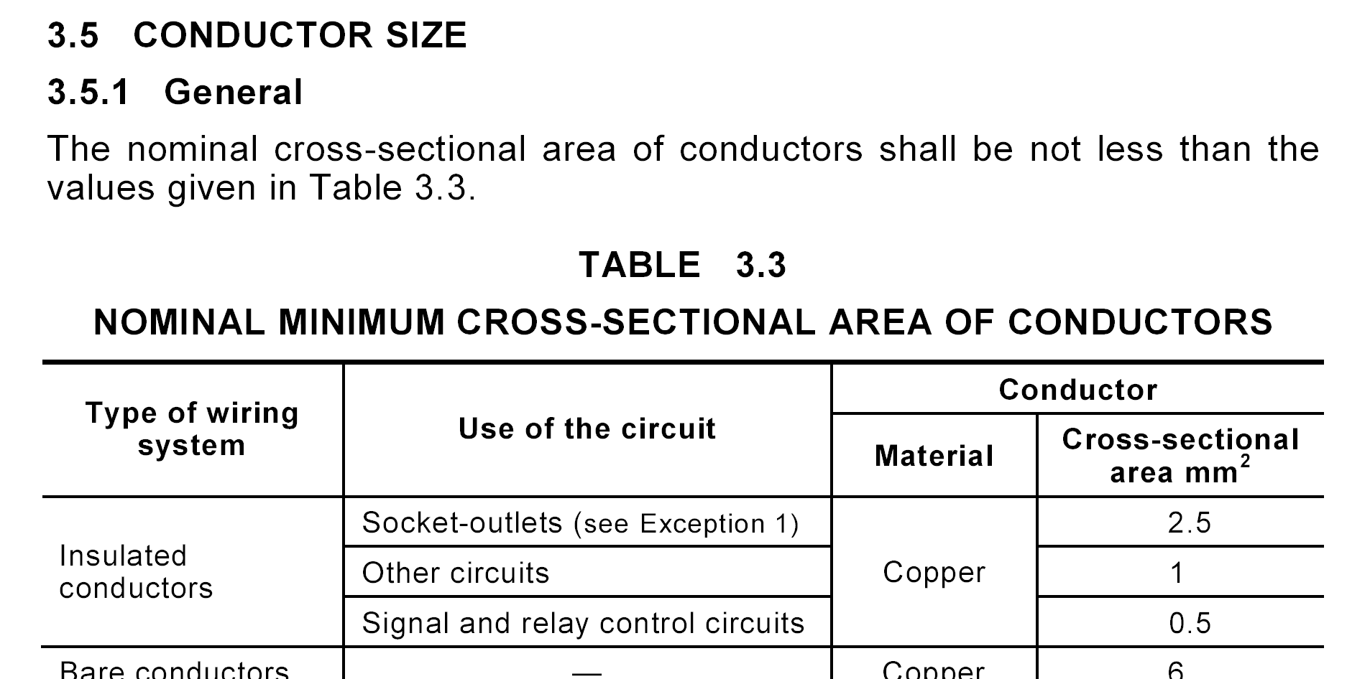
Volt drop limitations and Fault Loop Impedance tripping times more often than not make conductors smaller than 2.5mm² impractical for socket outlets
L

Slide 43
30 points total
2 points per m = 6 x 2 = 12 points (Ai footnote 4)
L

Slide 44
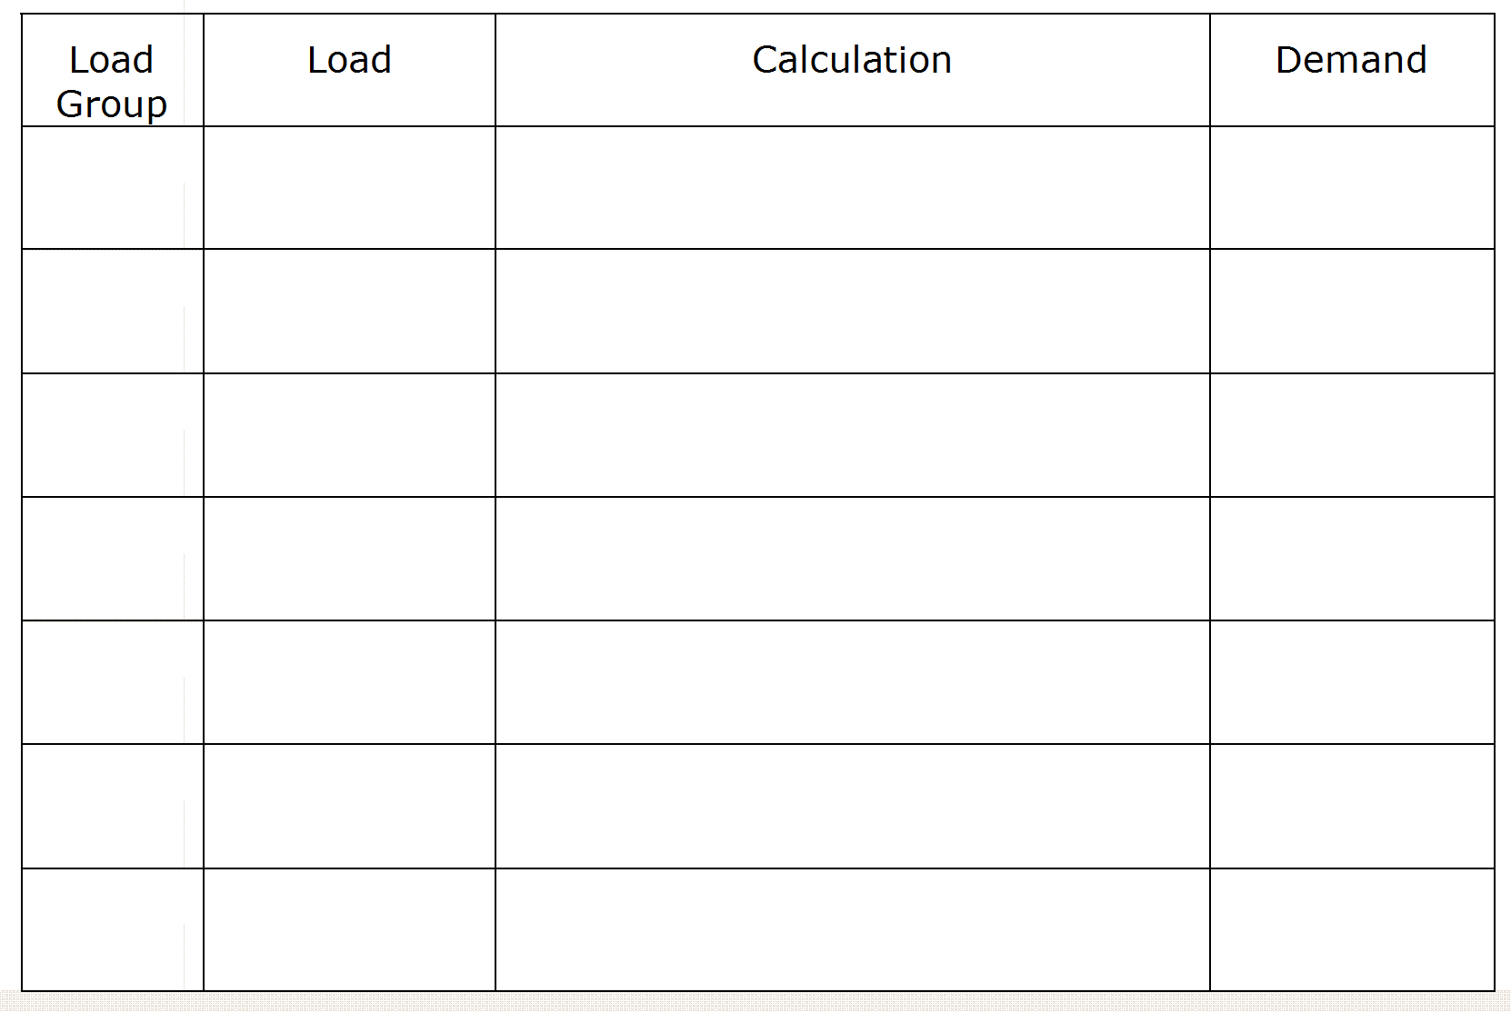
Ai
Lights (30)
3 + 2
5
Bi
10A s/o (22)
10 + 5
15
6000 x 0.5
C
Range
13.1
230
C
Dryer
15 x 0.5
7.5
F
H.W.S
4400
19.2
230
59.8A
L

Slide 45
L

Slide 46
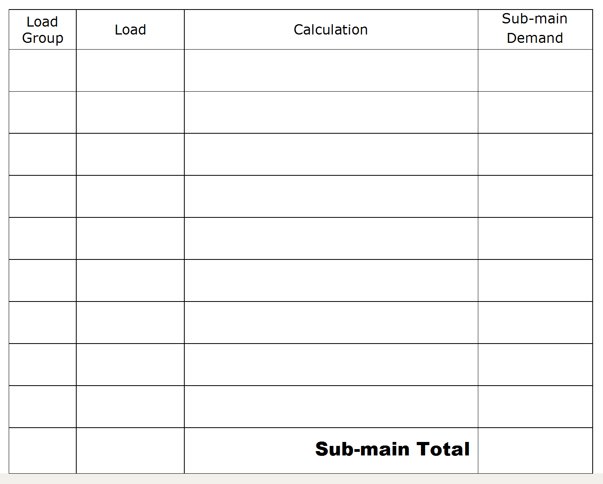
Ai
Lights (16)
3
Bi
10A s/o (32)
10 + 5
15
9000 x 0.5
C
CT / oven
19.6
230
4400
19.2
F
H.W.S
230
56.8A
L

Slide 47
L

Slide 48
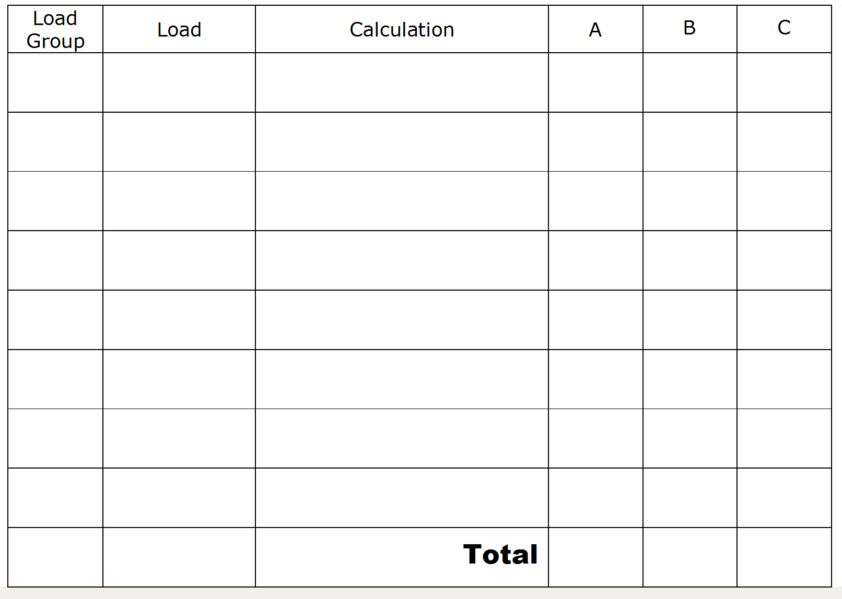
Ai
Lights
6 x 2.6 =
15.6
30 x 0.333 =
10
16/Ø
1000+(750 x 15)
Bi
10A s/o
230
53.3
53.3
8/Ø
1000+(750 x 7)
27.2
230
Biii
20A s/o
20+(3 x 20 x 0.75)
65
65
65
32+(32 x 0.75) +
(32 x 2 x 0.5) =
D
Motors
88
88
88
G
4400
19.2
H.W.S
230
H
Welder
FCL
40
40
235.8
235.5
246.3
L

Slide 49
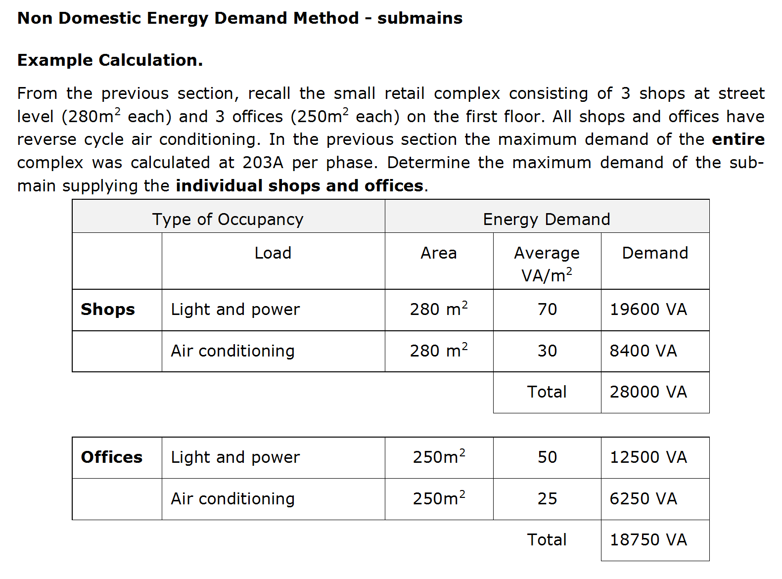
L

Slide 50
L

Slide 51
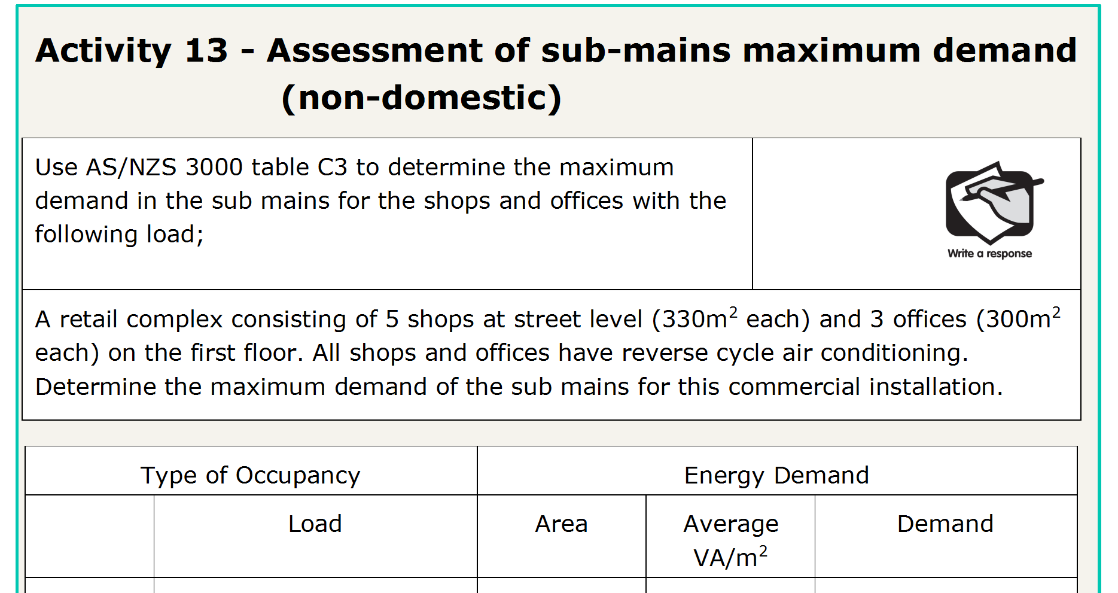
L

Slide 52
L + P
330
70
23100
A/C
330
30
9900
33000
S
= 33000
= 47.7A per phase
√3 x V_{L}
√3 x 400
L

Slide 53
L + P
300
50
15000
A/C
300
25
7500
22500
S
= 22500
= 32.5A per phase
√3 x V_{L}
√3 x 400
L

Slide 54
END OF LESSON

