Slide 1
SECTION 6
CABLE SELECTION BASED ON
CURRENT CARRYING CAPACITY

Slide 2
CABLE SELECTION BASED ON CURRENT CARRYING CAPACITY
Learning objectives:
Learners should be able to meet the following learning objectives:
Describe installation conditions for a range of wiring systems and applications.
Identify external influences that require the use of a de-rating factor.
Describe the AS/NZS 3000 requirements for coordination of cables and protection devices.
Use AS/NZS 3008.1.1 to select conductor size based on the maximum current requirement for a given installation condition including any applicable de-rating factors.
L

Slide 3
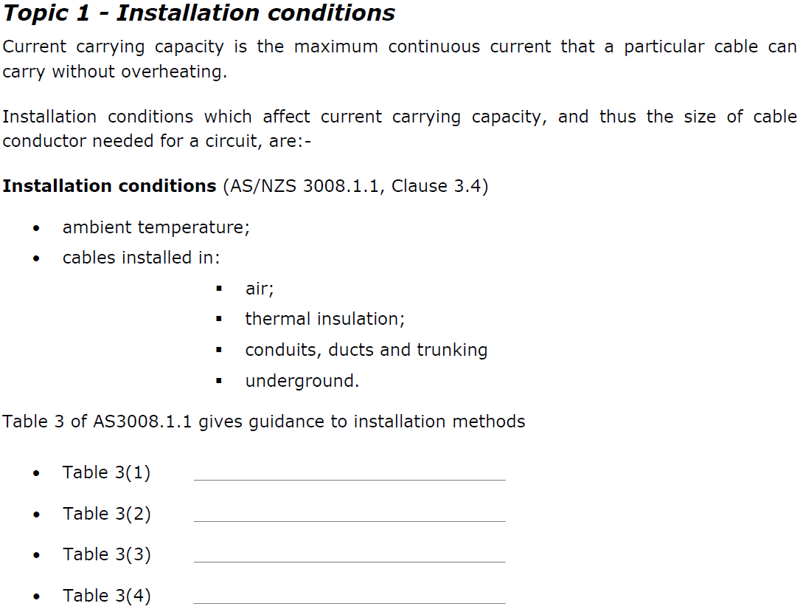
Unenclosed in Air
Enclosed
Buried Direct in ground
Underground wiring Enclosures
L

Slide 4
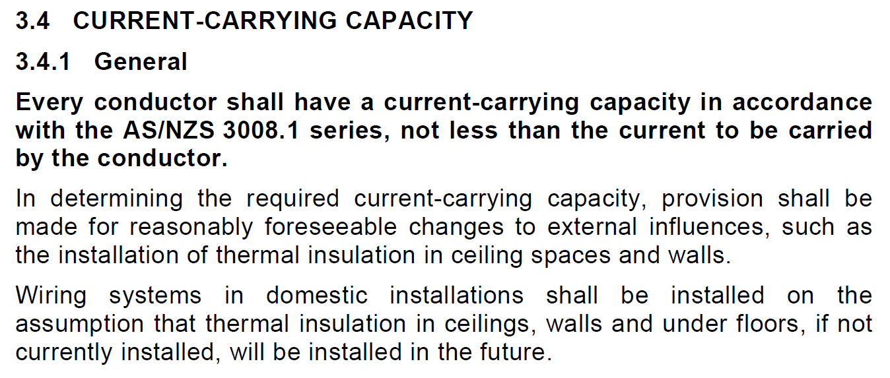
Therefor a cable installed in a domestic ceiling, wall or under a floor would need to be considered as “partially surrounded” or “fully surrounded” even if no insulation exists yet.
So for this situation you would need to use table 3(2)
L

Slide 5
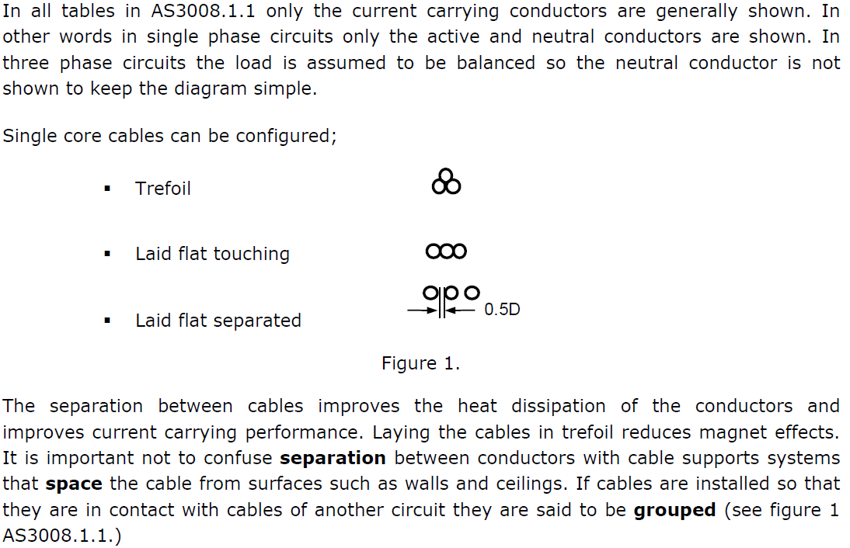
L

Slide 6
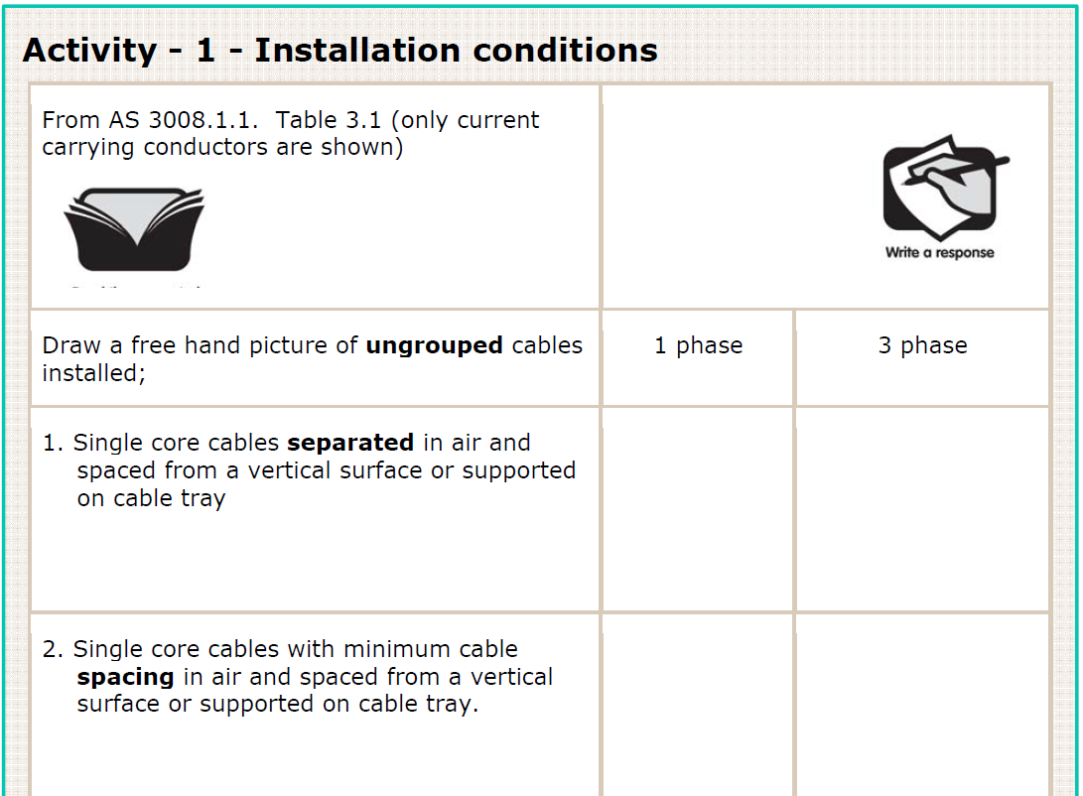
L

Slide 7
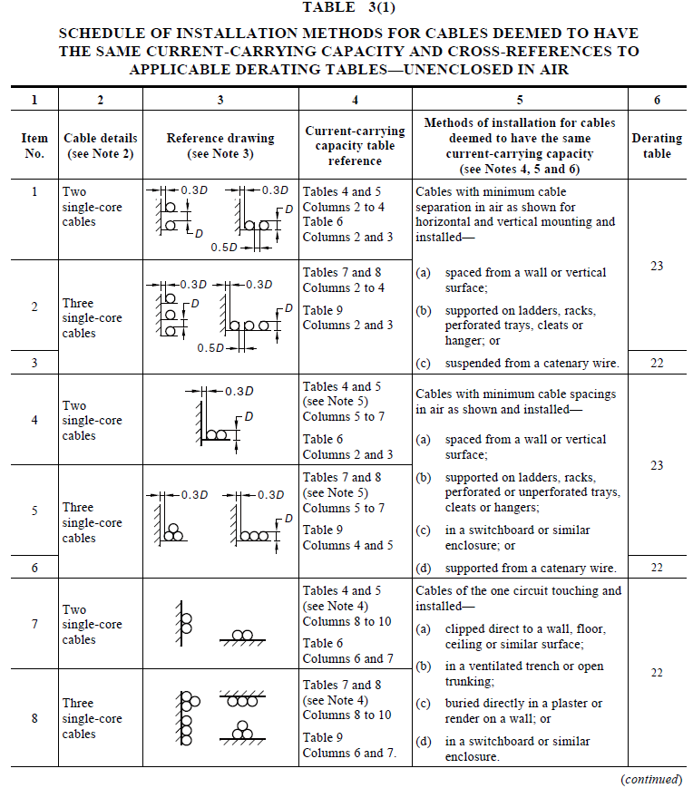
AS/NZS 3008.1.1
L

Slide 8
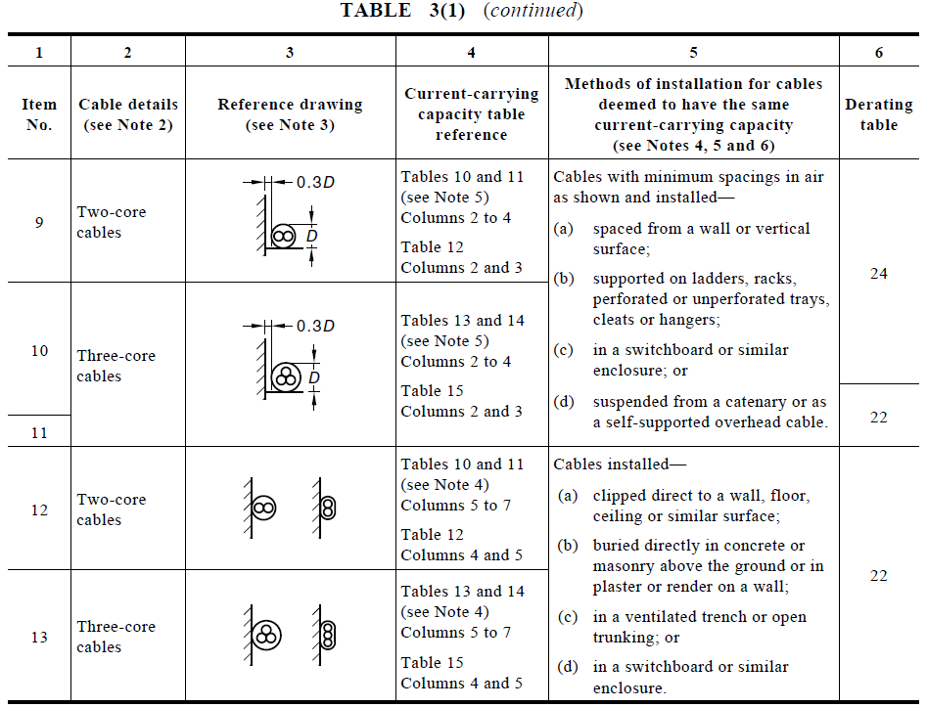
L

Slide 9
0.5D
0.5D
L

Slide 10
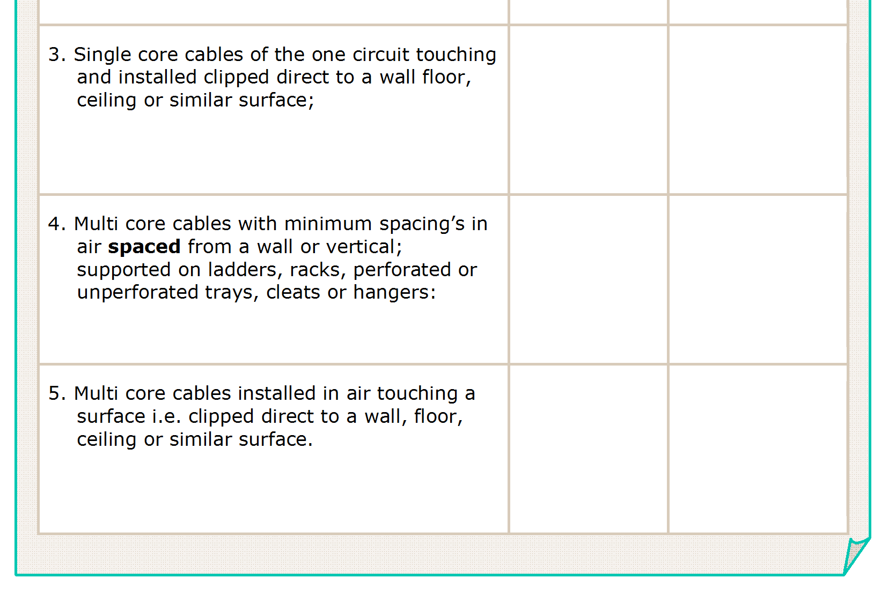
0.3D
0.3D
L

Slide 11
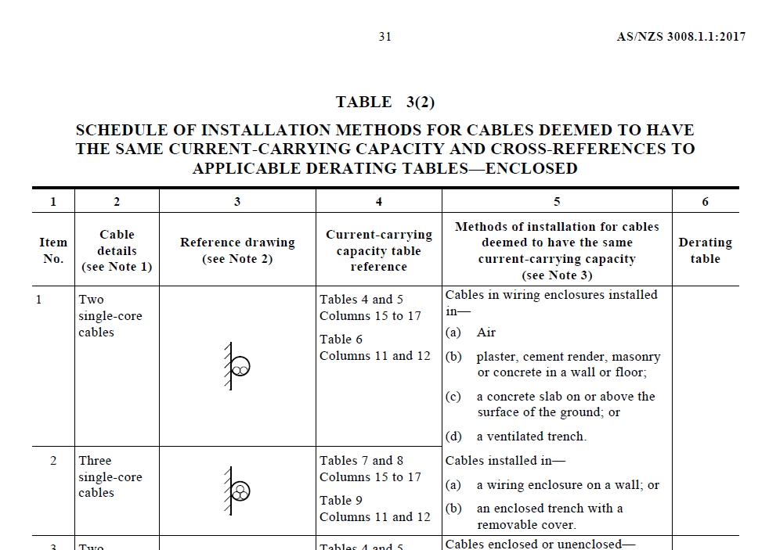
22
INSERT MISSING NUMBER IN AS3008 Table 3(2)
L

Slide 12
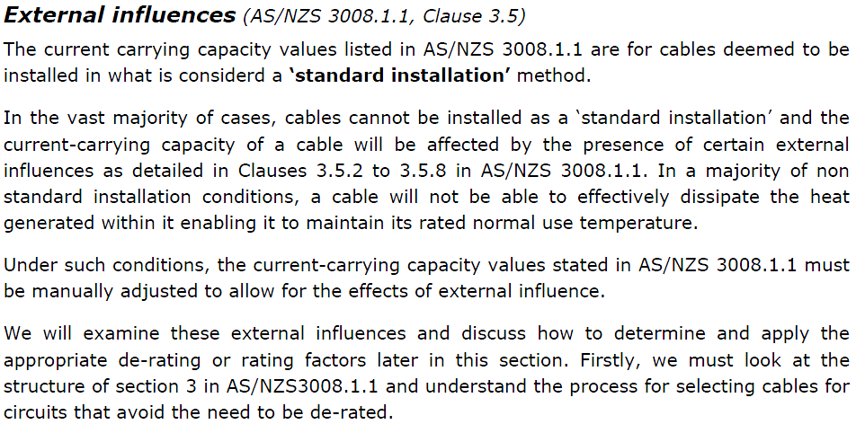
L

Slide 13
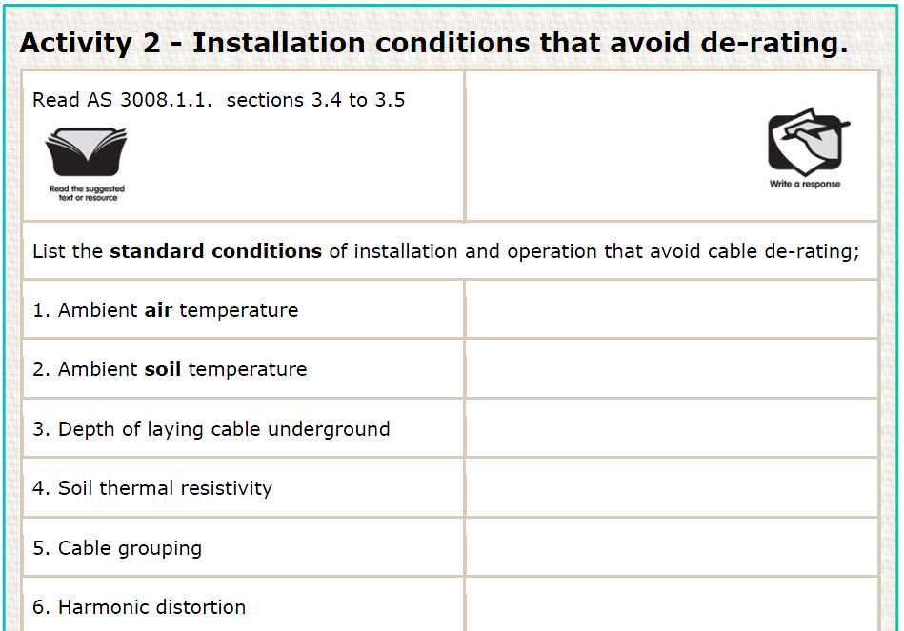
L

Slide 14
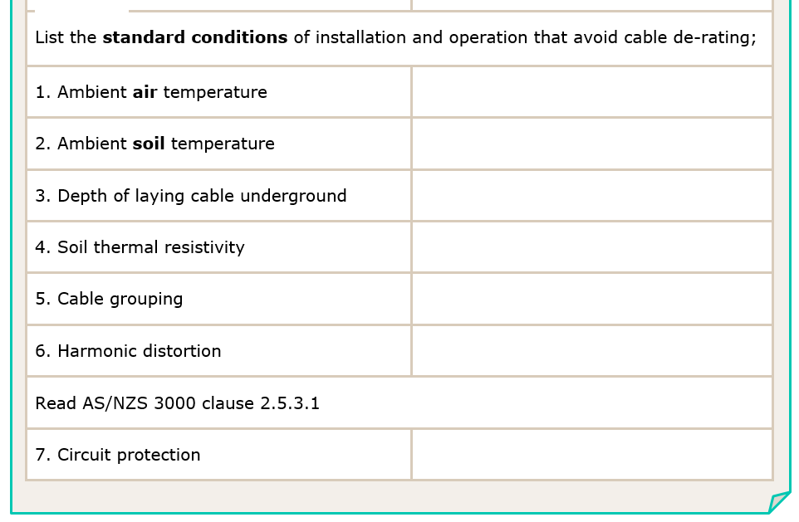
40ºC
25ºC
0.5m
1.2ºC.m/W
Single circuit configuration
(as per table 2)
Less than 15% total harmonic distortion
Circuit Breaker
L

Slide 15
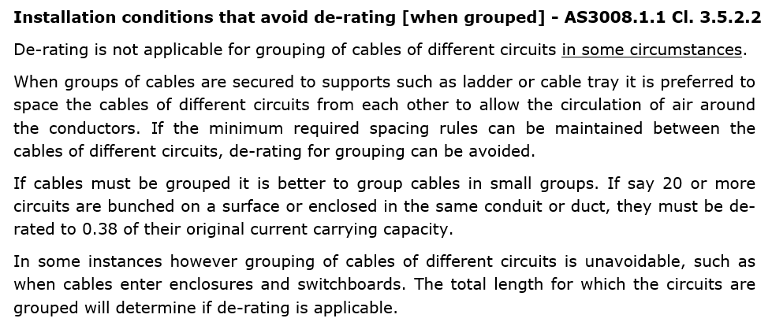
L

Slide 16
No 3.5.2.2(a)
1 metre 3.5.2.2(b)(i)
L

Slide 17
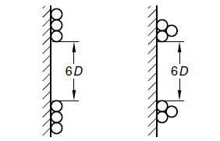
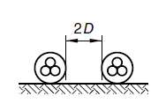
No 3.5.2.2(a)
1 metre 3.5.2.2(b)(i)
6 x D
Figure 1
2 x D
Figure 1
L

Slide 18
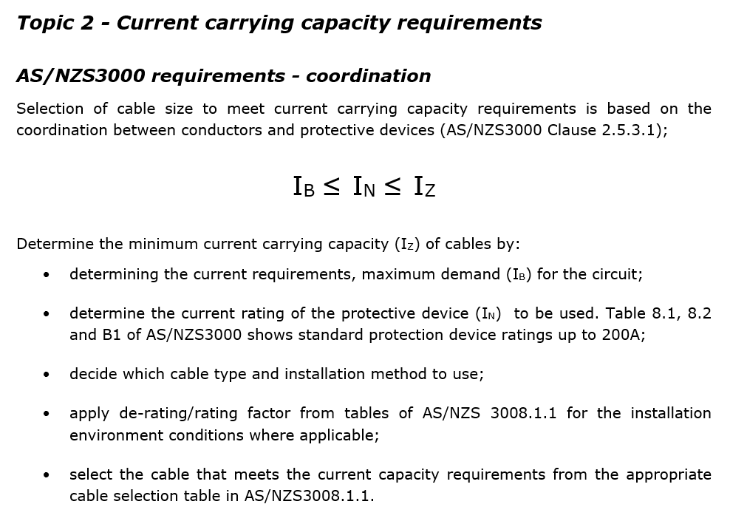
(selecting I_{Z} – the process)
L

Slide 19
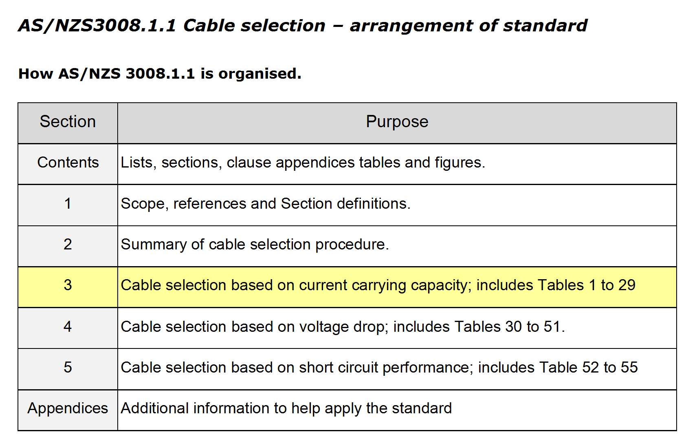
L

Slide 20
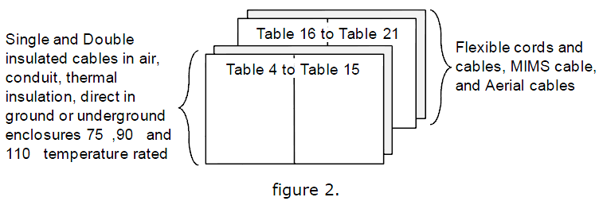
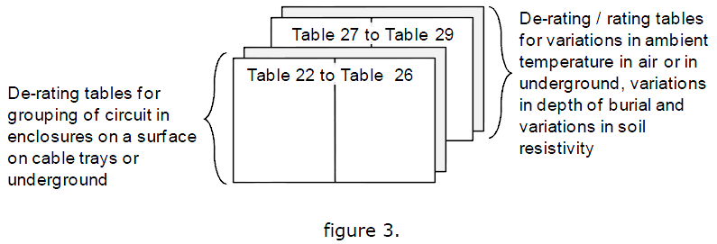
Tables 4 – 21 used to for cable selection
Tables 27 – 29 used to determine de-rating values when cables are in other situations.
Tables 22 – 26 used to determine de-rating values when cables are grouped
L

Slide 21
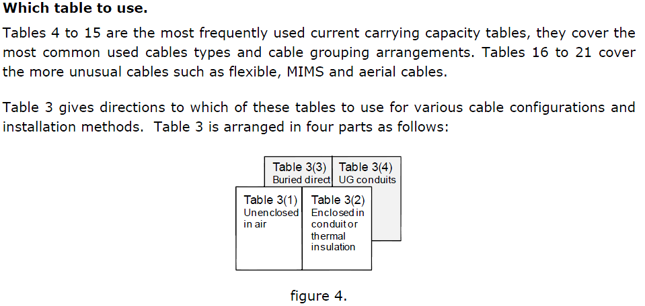
Table 3 is designed to be used as an index. It will direct you to the appropriate cable selection table
These tables are often referred to as “Look up” Tables
L

Slide 22
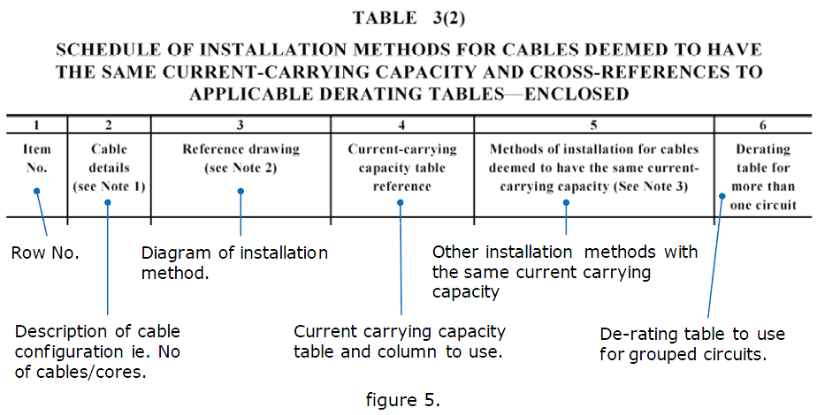
L

Slide 23
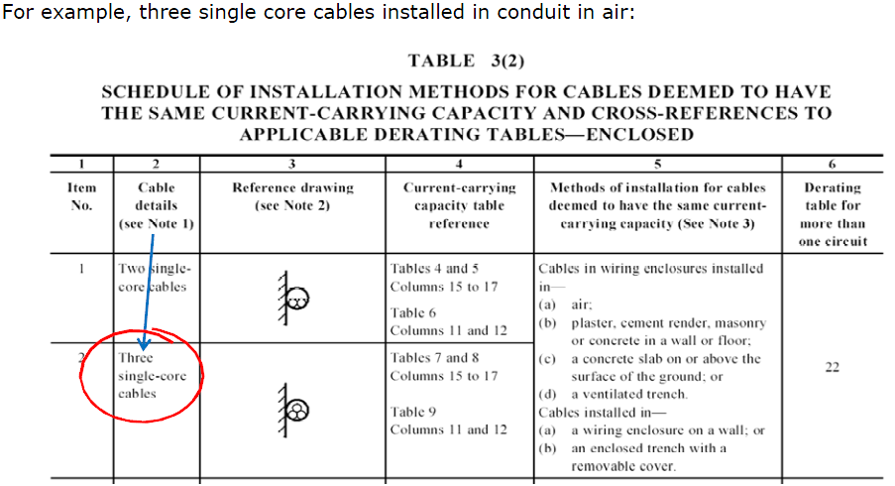
L

Slide 24
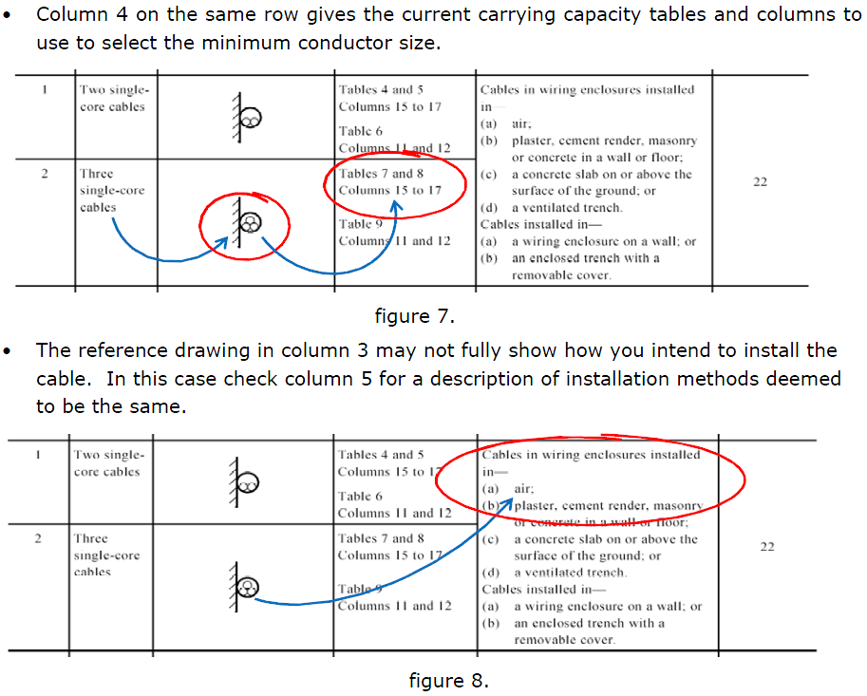
L

Slide 25
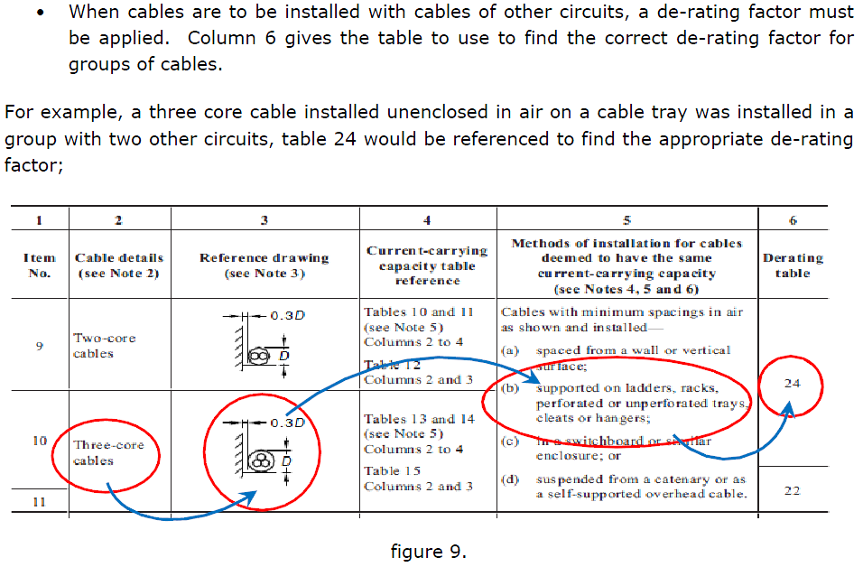
L

Slide 26
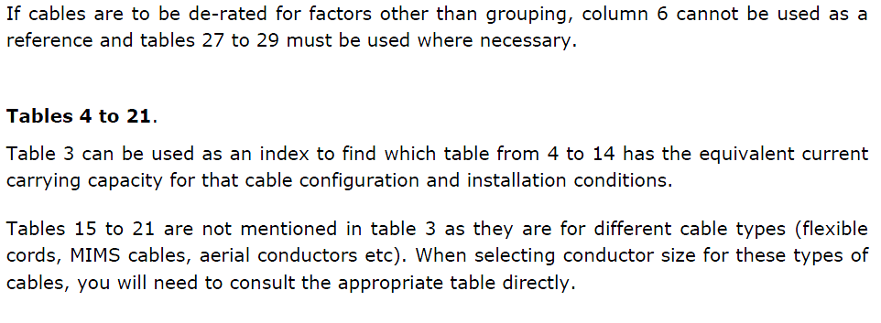
L

Slide 27
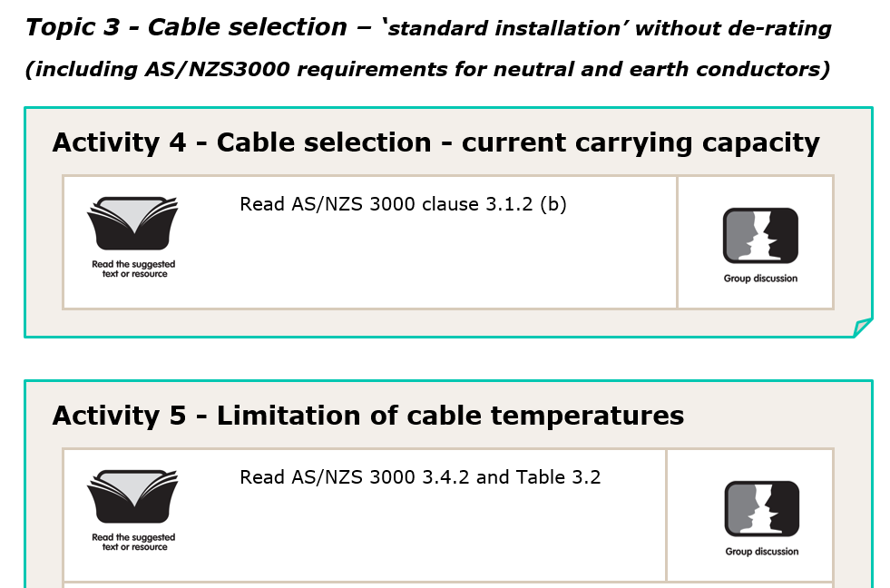
L

Slide 28
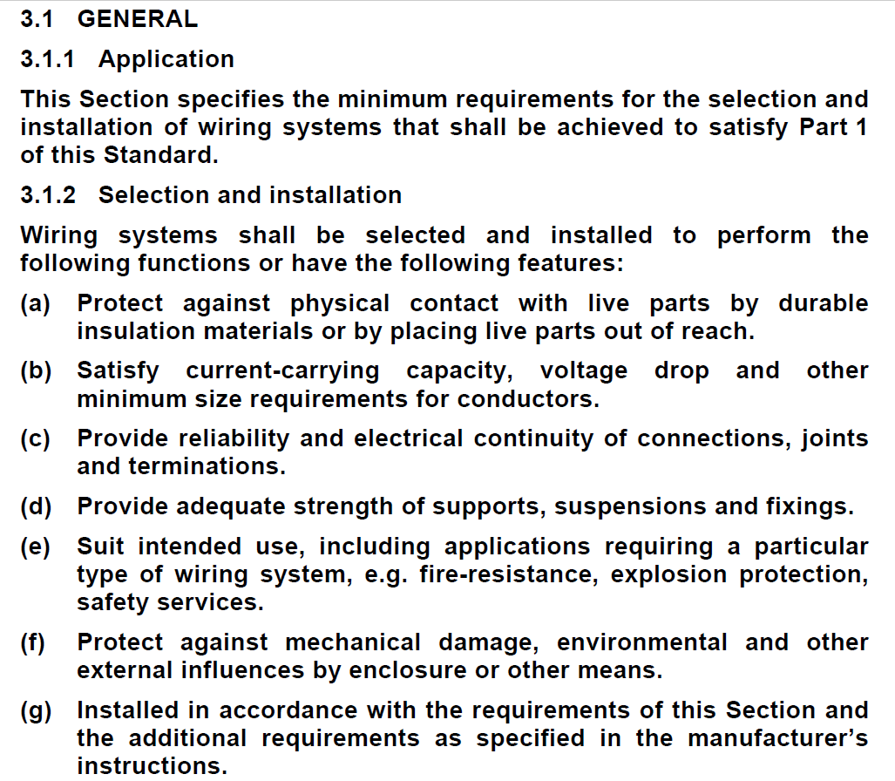
L

Slide 29
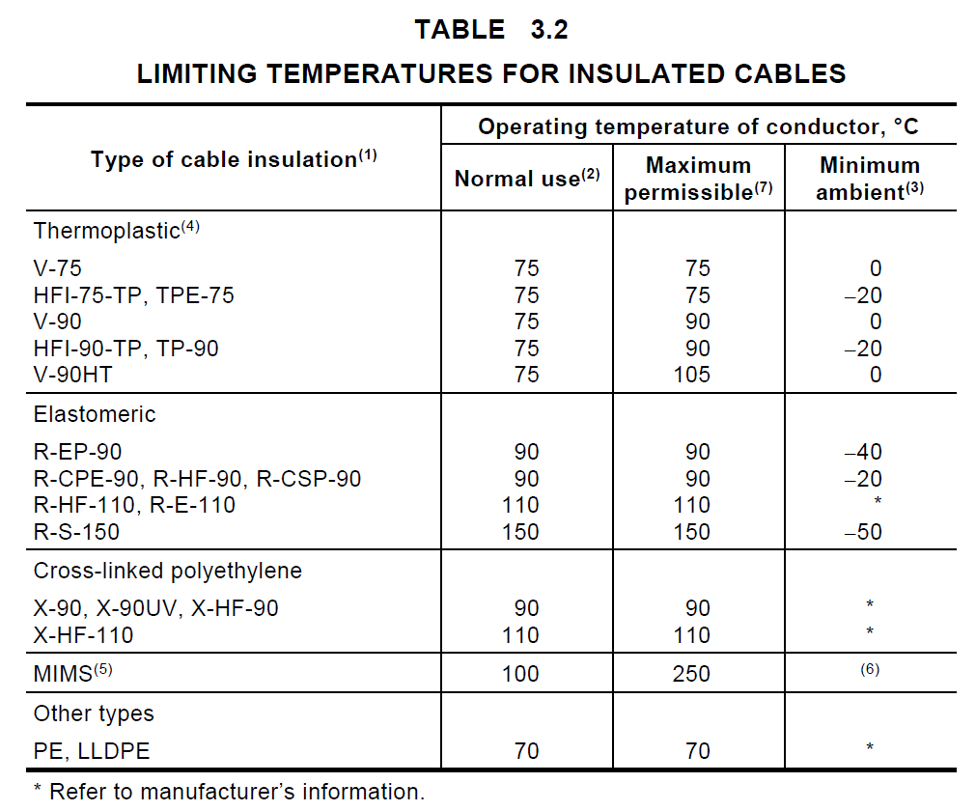
AS/NZS 3000
L

Slide 30
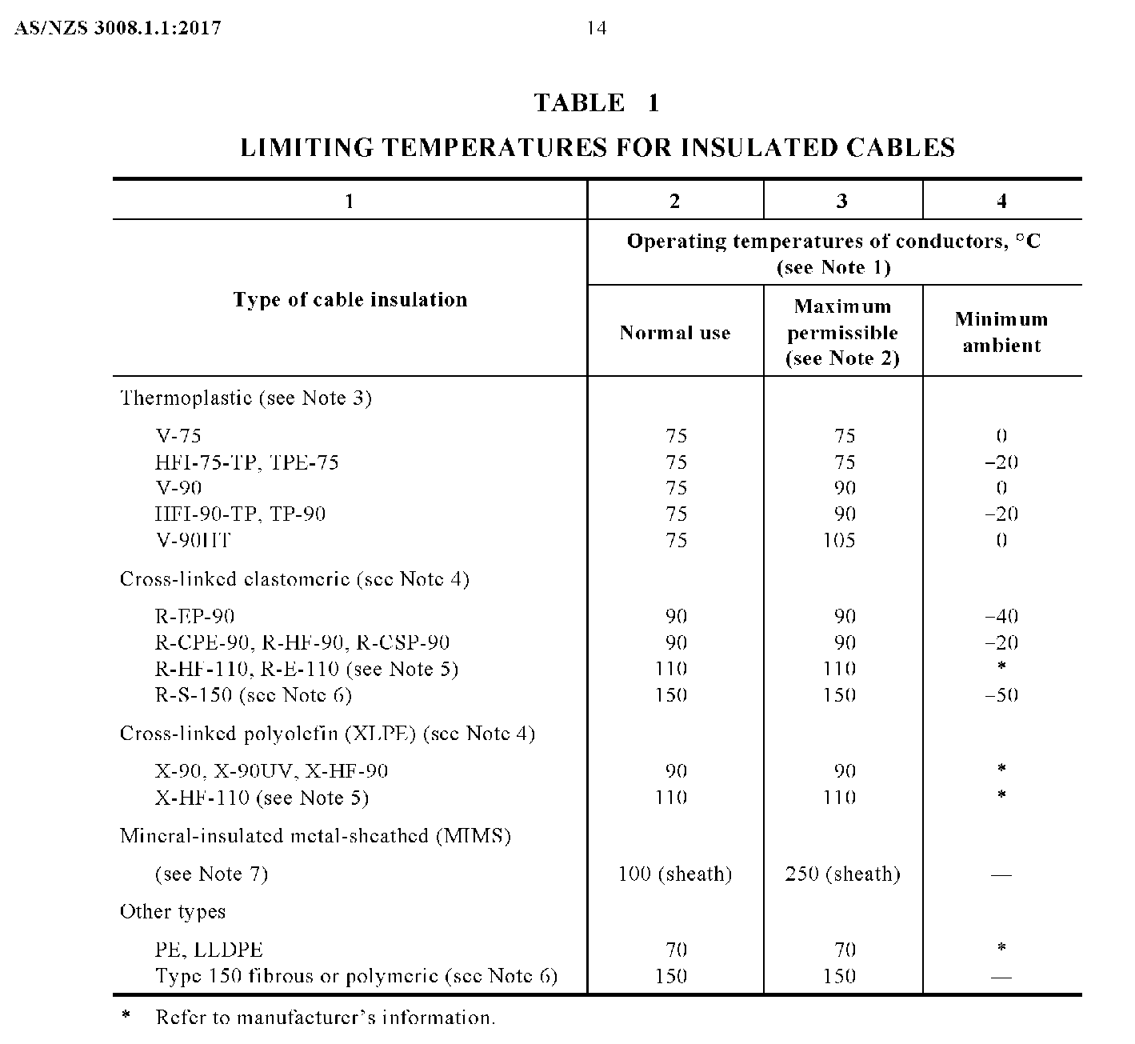
AS/NZS 3008.1.1
L

Slide 31
75ºC
75ºC
90ºC
100ºC
L

Slide 32
L

Slide 33
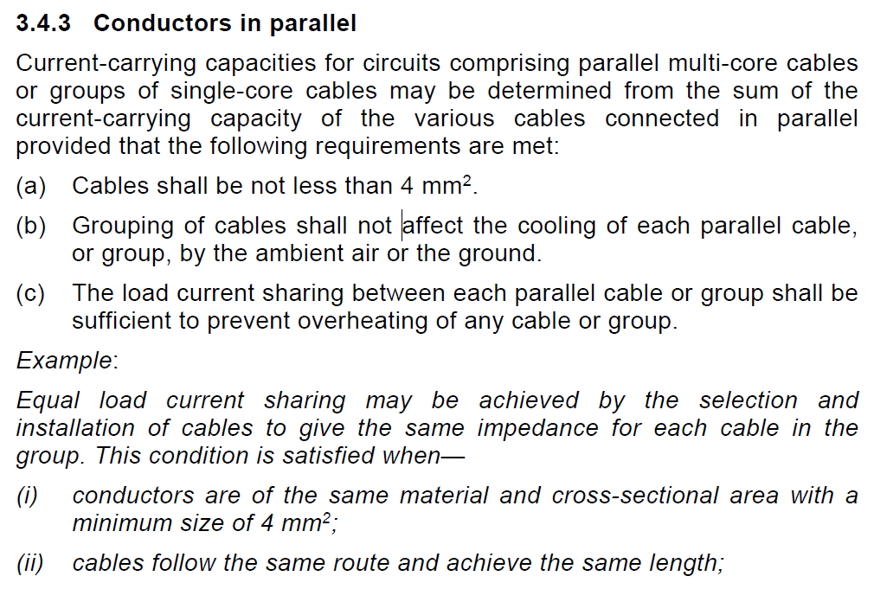
L

Slide 34
L

Slide 35
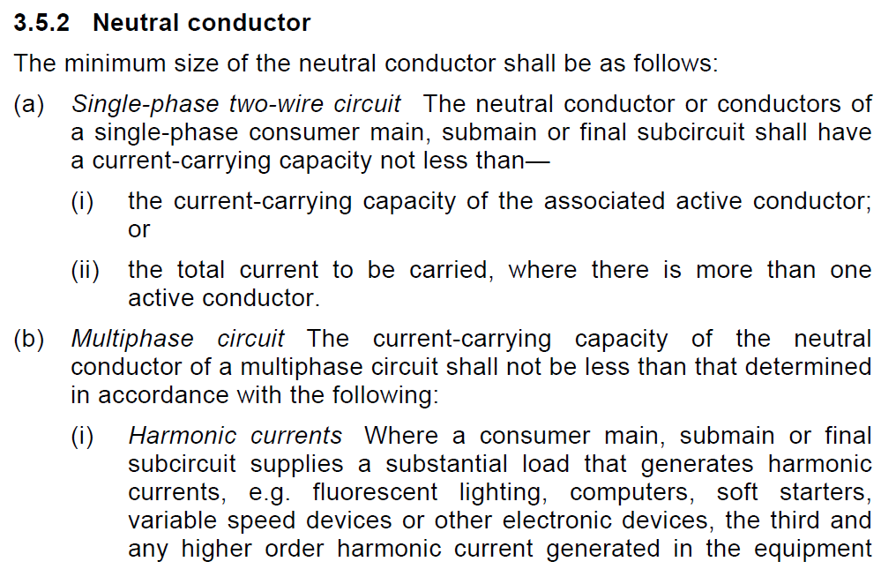
L

Slide 36
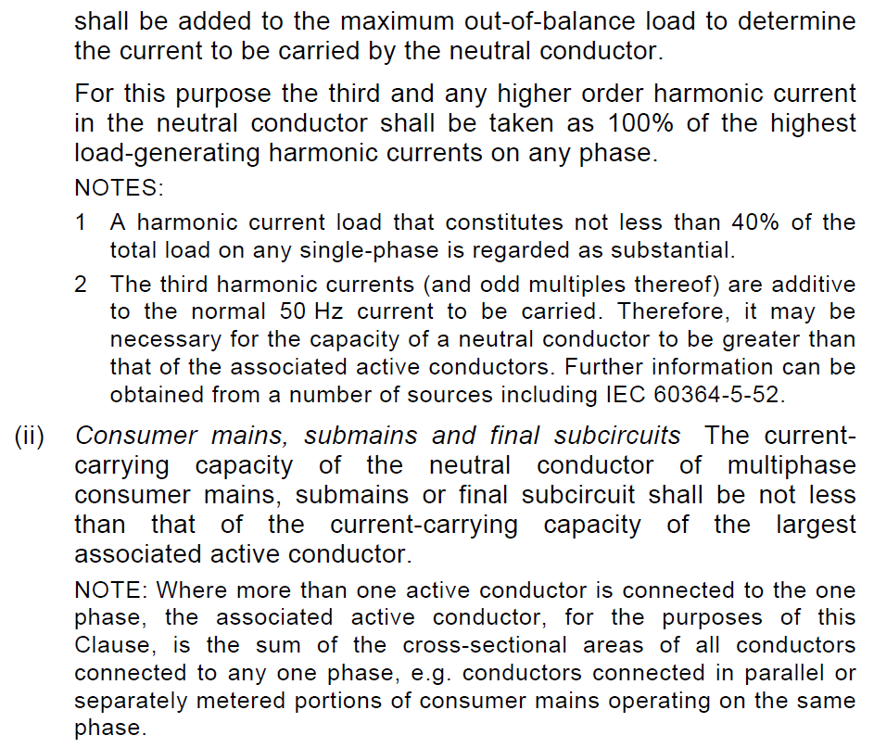
L

Slide 37
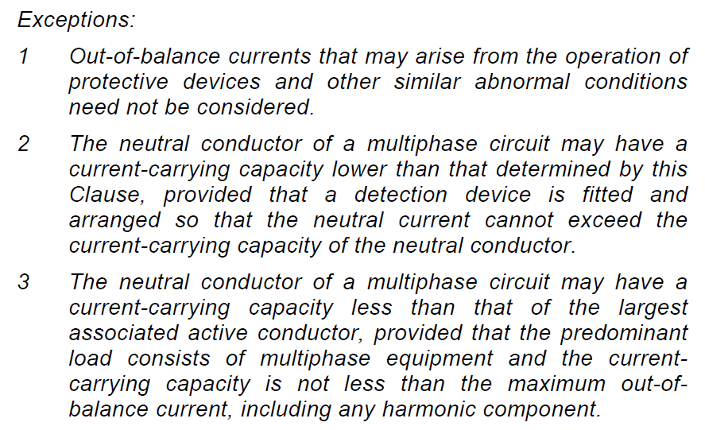
L

Slide 38
The CCC of the associated active or total current to be carried
Not less than the CCC of the largest associated active conductor
L

Slide 39
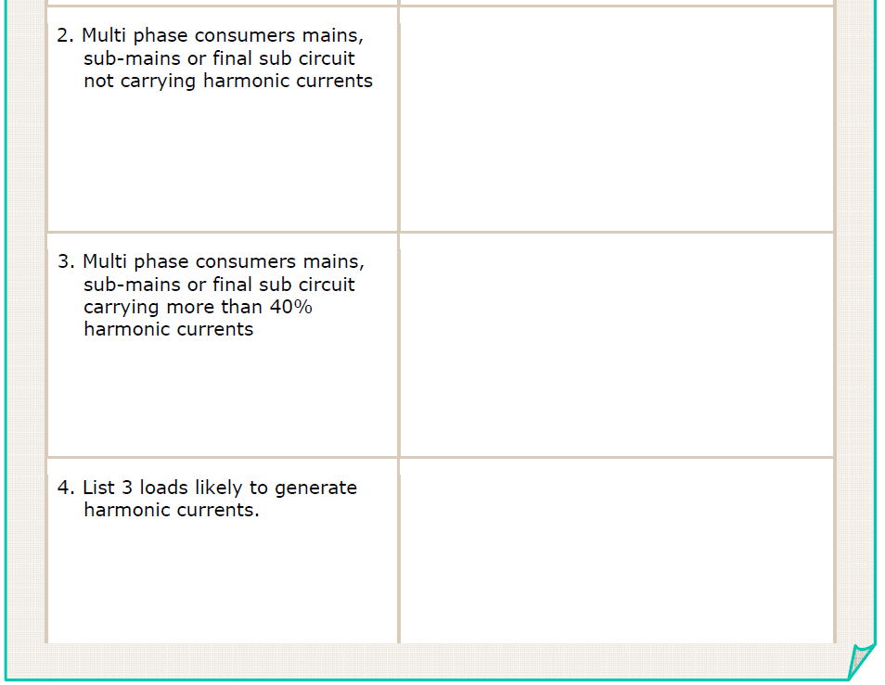
Not less than the CCC of the largest associated active conductor
Not less than the maximum out of balance current plus the harmonic current
Fluorescent lights, computers, Soft starters, VSDs
L

Slide 40
L

Slide 41
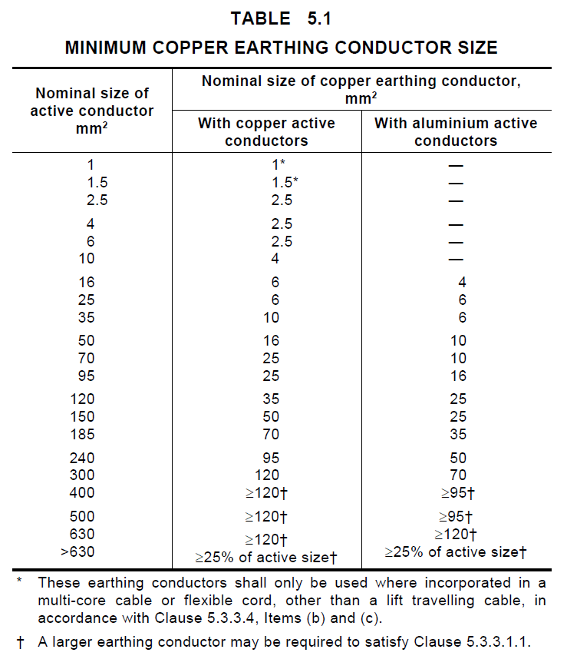
L

Slide 42
2.5mm²
2.5mm²
1.0mm²
L

Slide 43
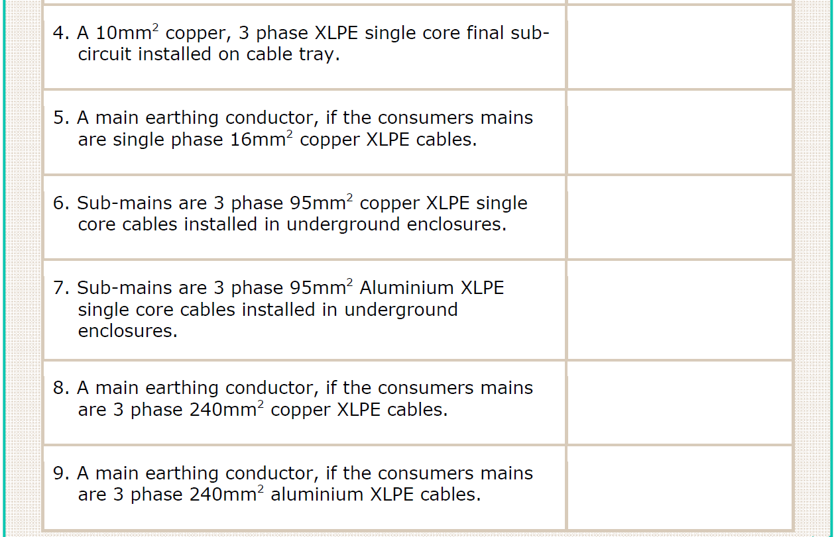
4mm²
6mm²
25mm²
16mm²
95mm²
50mm²
L

Slide 44
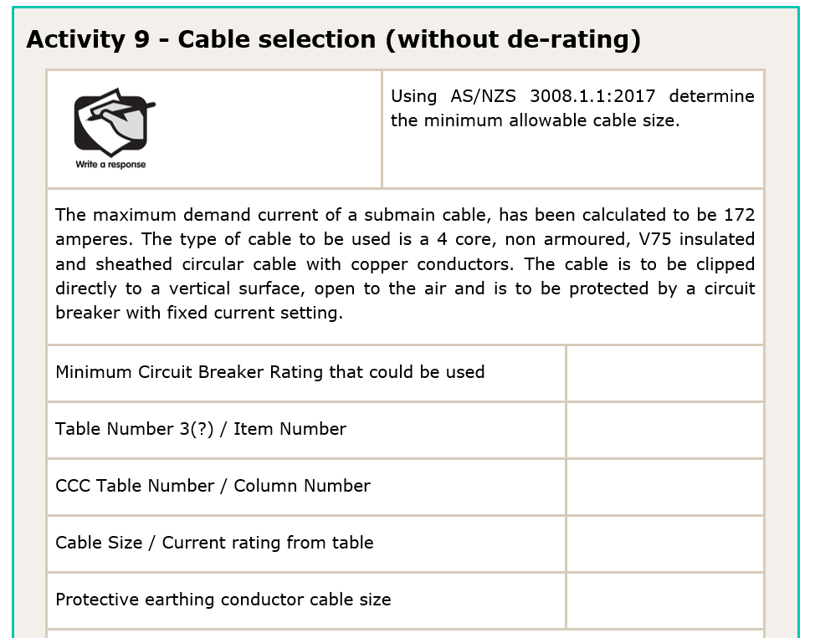
L

Slide 45
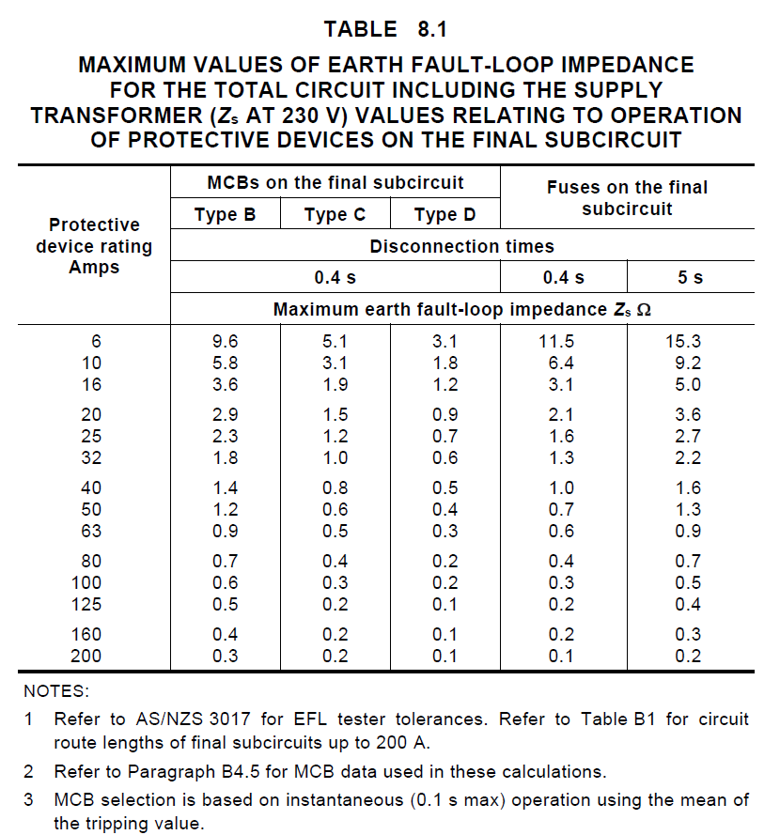
Table 8.1 in AS/NZS3000 can be used as a guide to help you select an appropriate protection device rating (I_{N})
L

Slide 46
200A
L

Slide 47
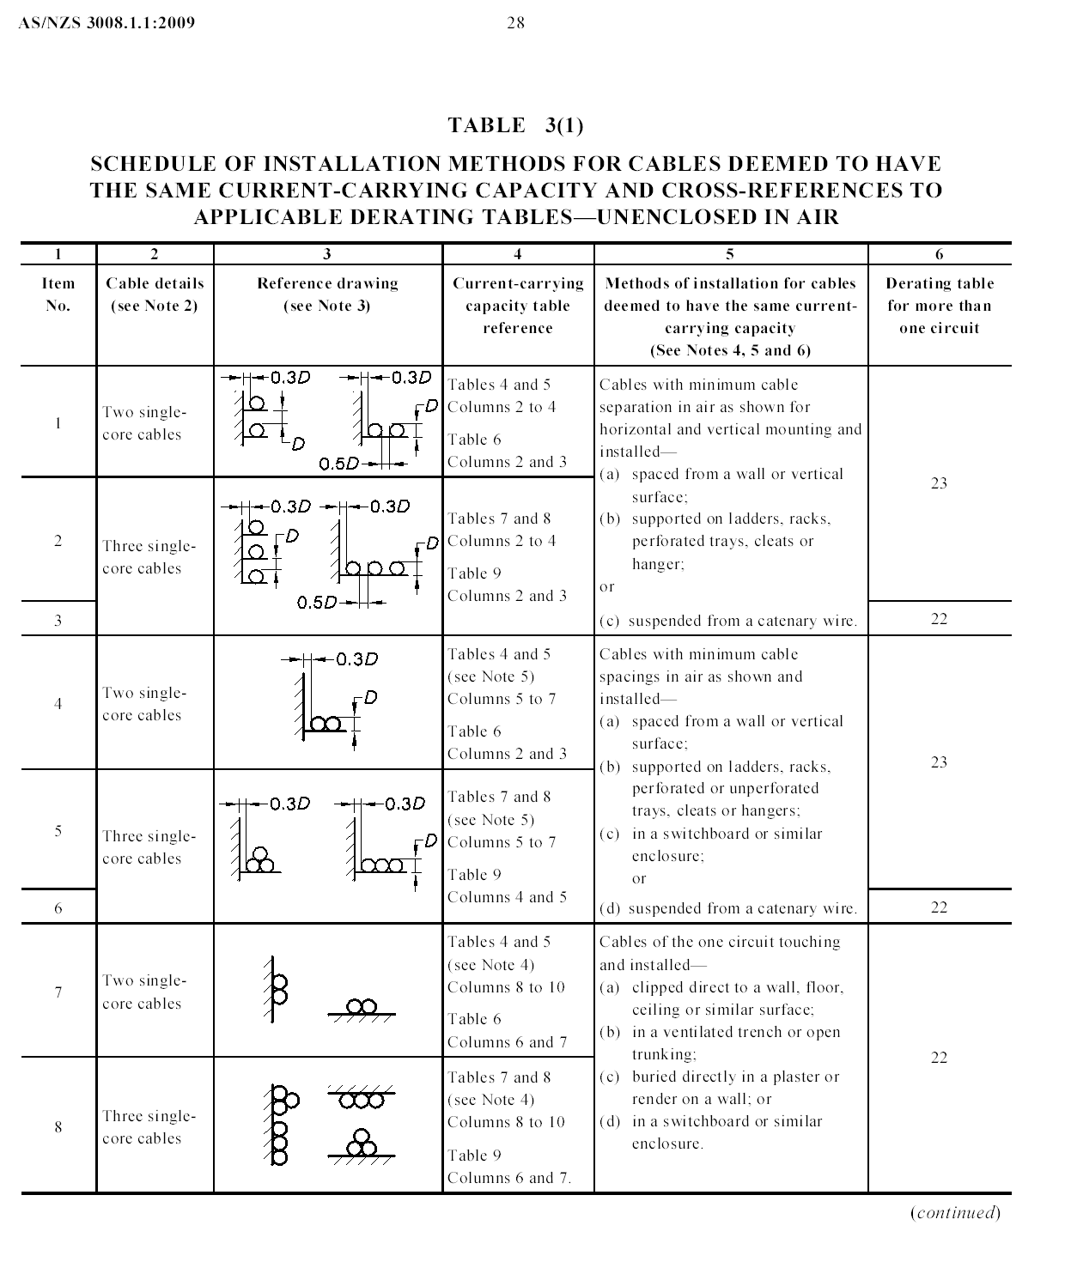
AS/NZS 3008
L

Slide 48
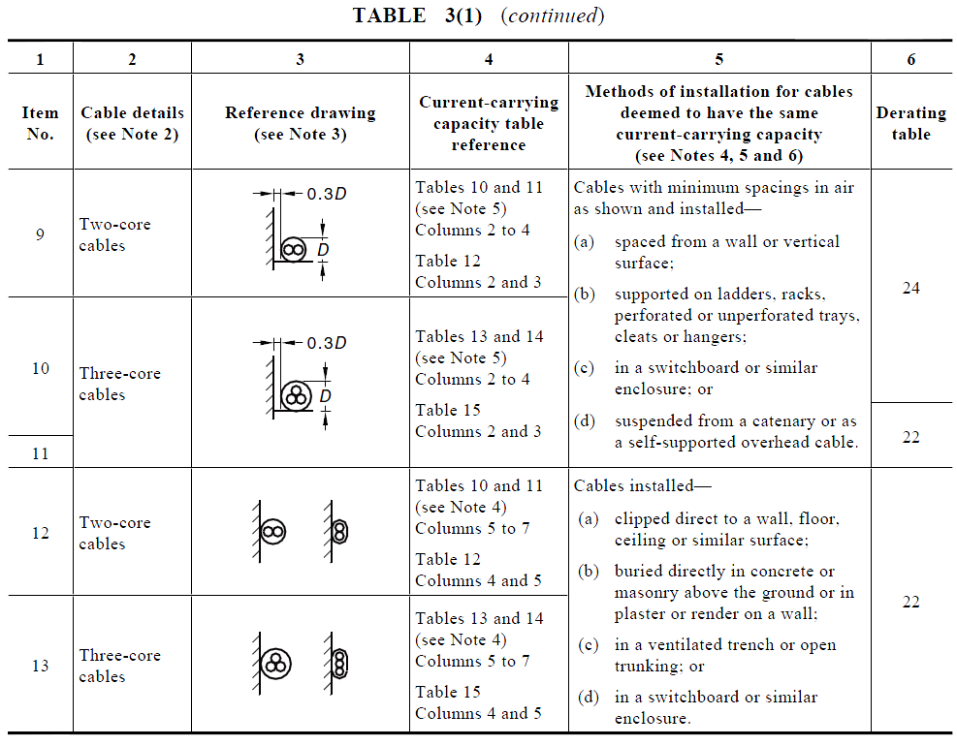
AS/NZS 3008
L

Slide 49
200A
T3(1) Item 13
T13 C5
L

Slide 50
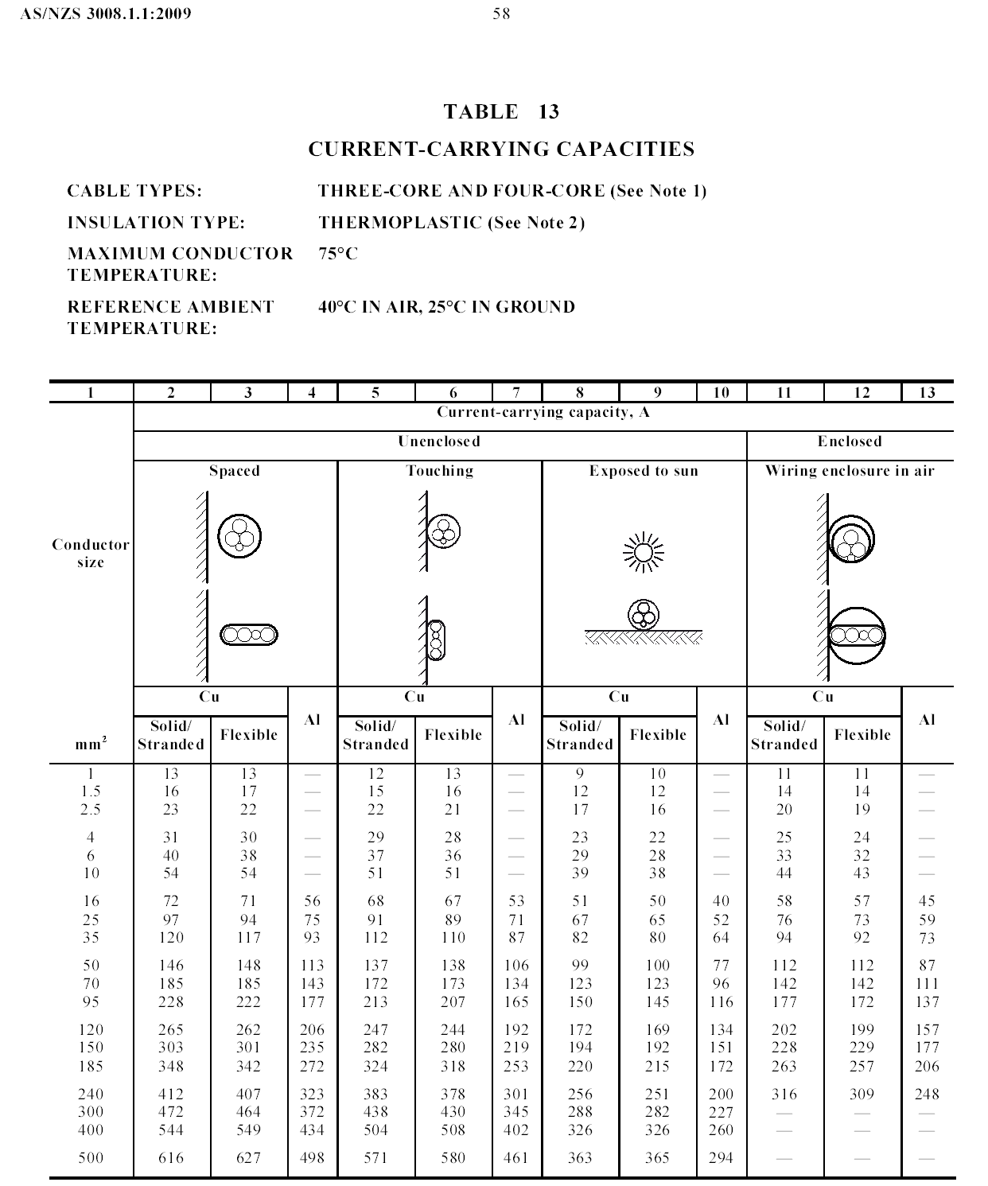
AS/NZS 3008
L

Slide 51
200A
T3(1) Item 13
T13 C5
95mm² (213A)
25mm²
L

Slide 52
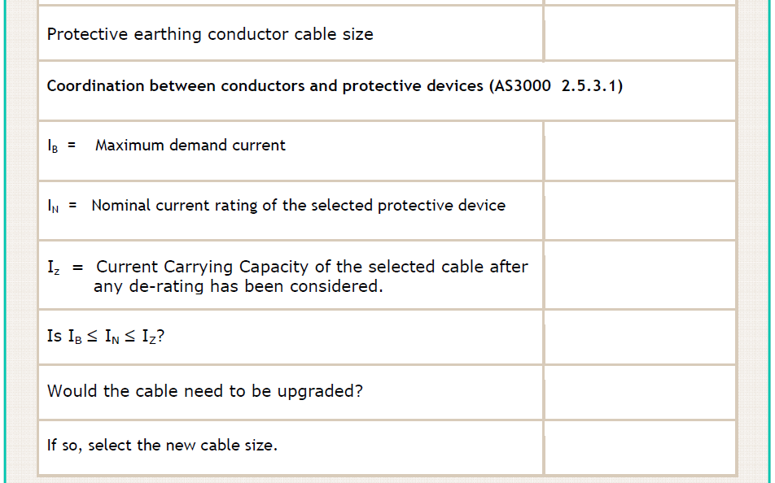
25mm²
172A
200A
213A
Y
N
N/A
L

Slide 53
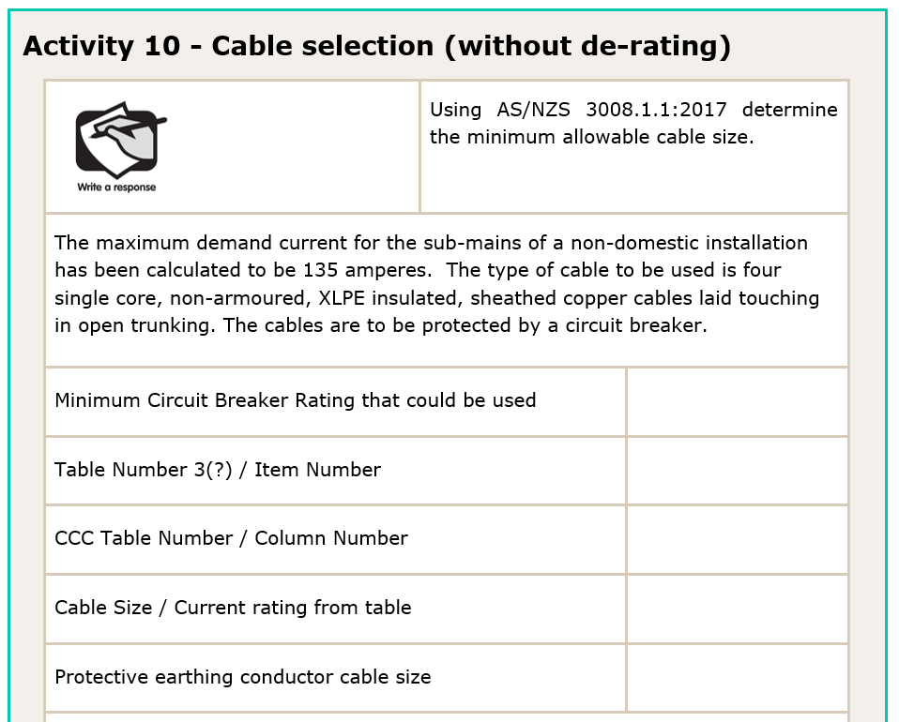
160A
T3(1) Item 8
T8 C8
50mm² (176A)
16mm²
L

Slide 54
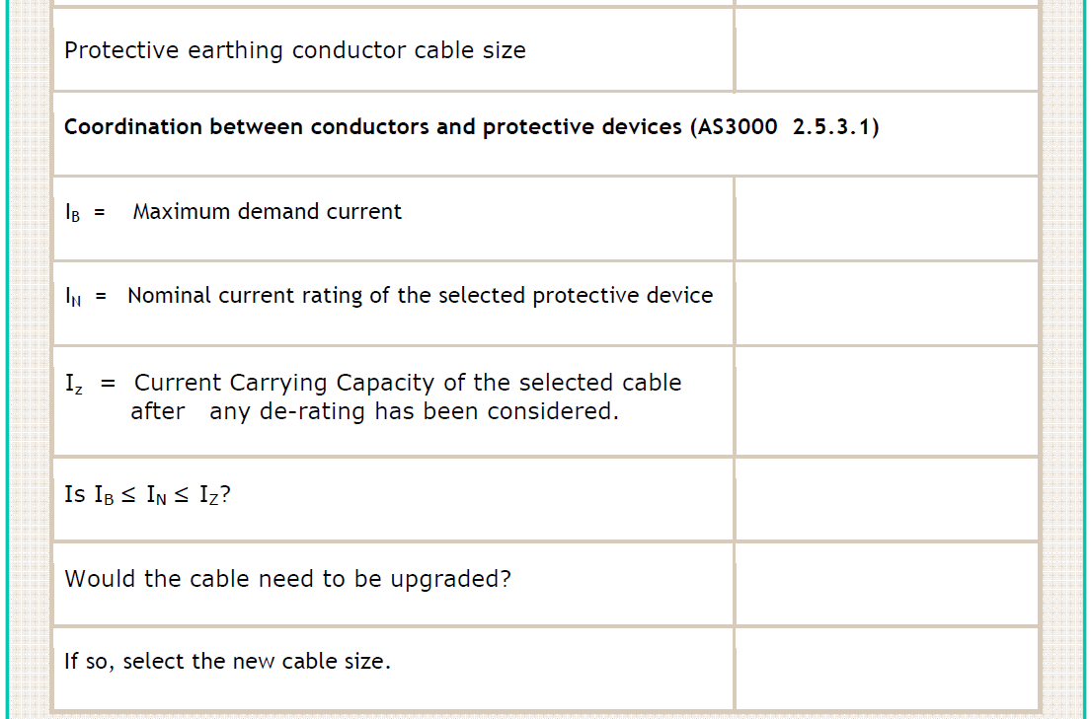
16mm²
135A
160A
176A
Y
N
N/A
L

Slide 55
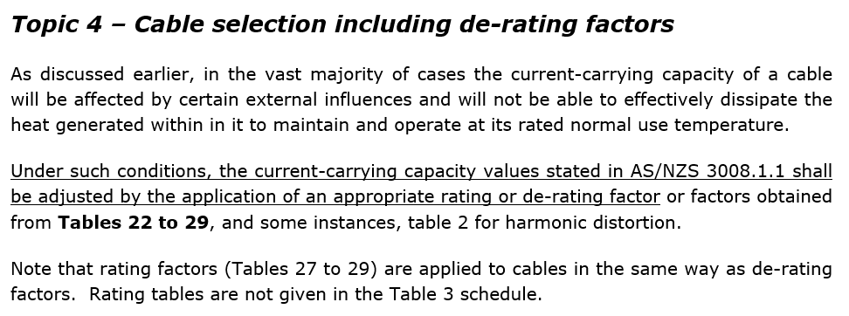
Factors below 1 – when applied, cables will have a lower CCC than that indicated in the current carrying capacity tables
Factors equal to 1 – when applied, cables will have the same CCC as indicated in the current carrying capacity tables
Factors above 1 – when applied, cables will have a higher CCC than that indicated in the current carrying capacity tables
L

Slide 56
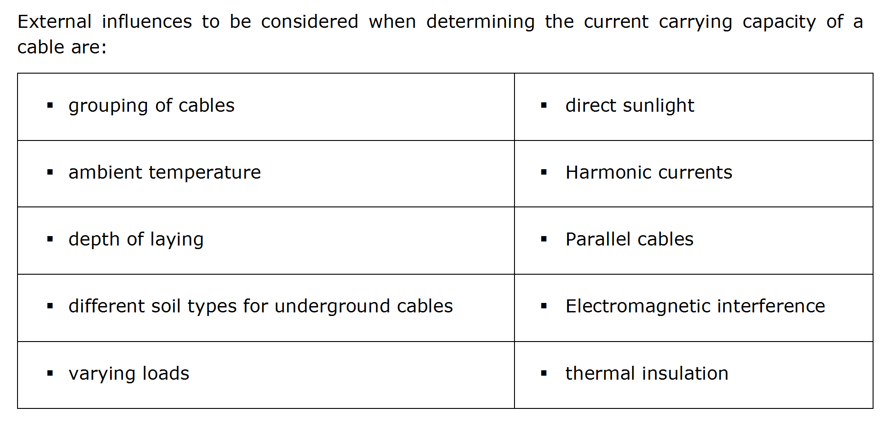
Tables 22 to 26
Allowed for in tables 4 to 15
Tables 27(1) & 27(2)
Table 2
Tables 28(1) & 28(2)
See grouping of cables
Table 29
Tables 3(1) to 3(4)
L

Slide 57
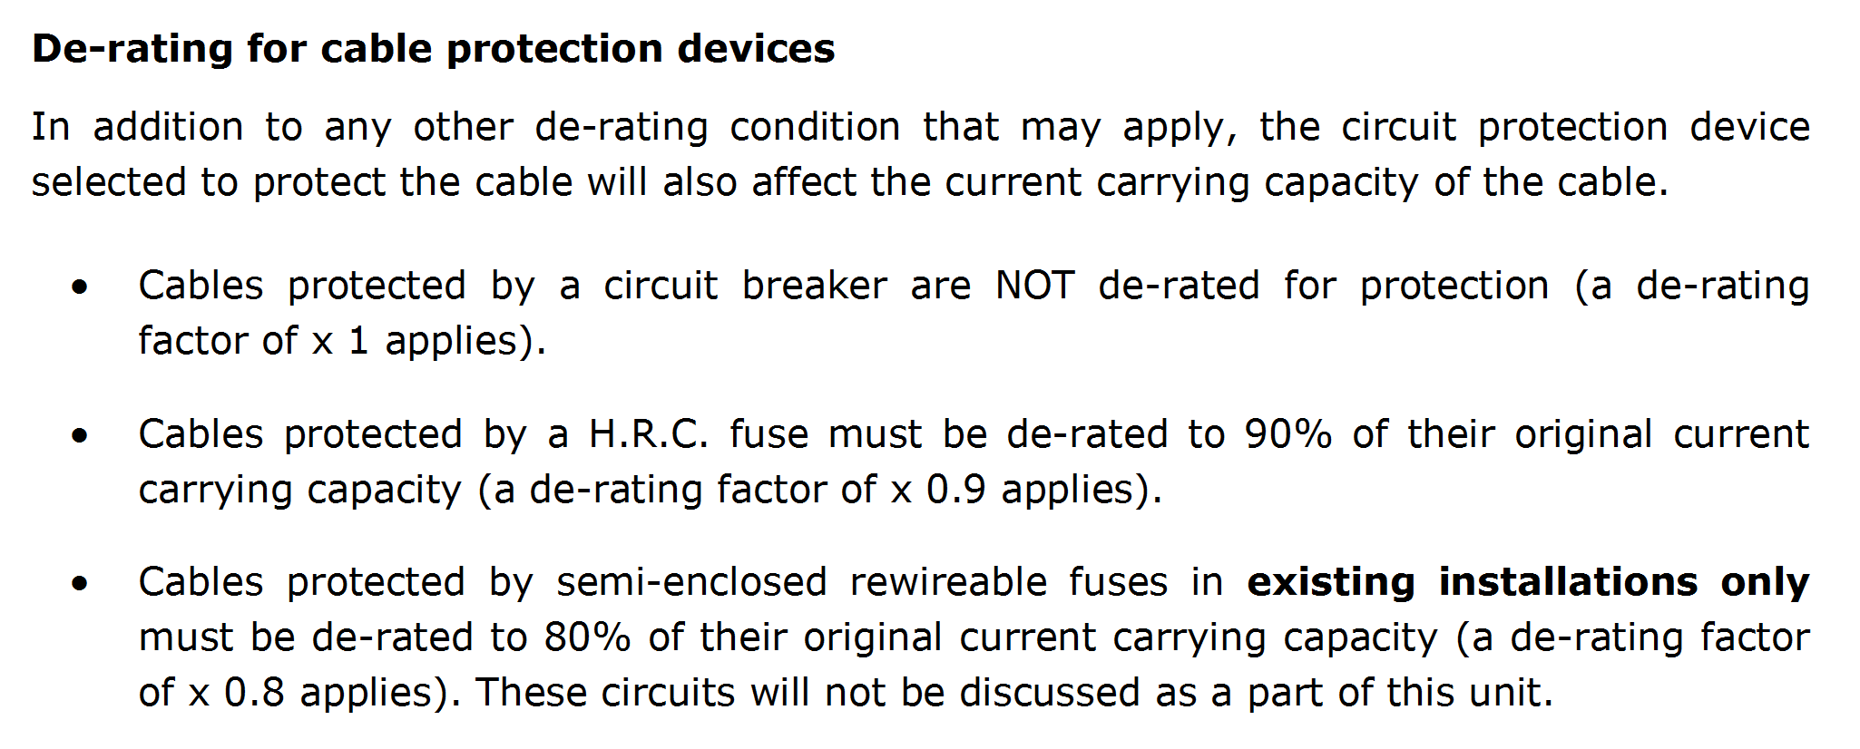
L

Slide 58
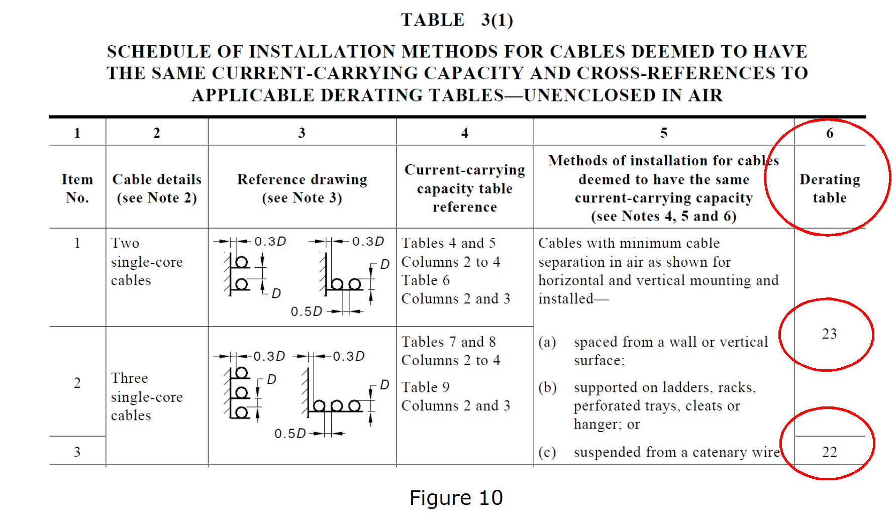
L

Slide 59
L

Slide 60
Table 2 and tables 22 to 29
27(1)
Column 10
0.72
L

Slide 61
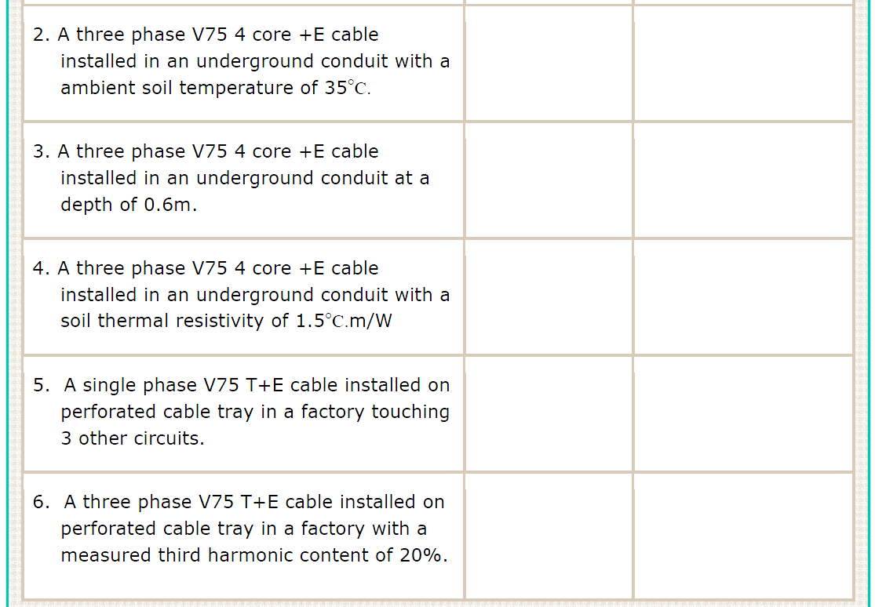
27(2)
Column 7
0.89
28(2)
Column 3
0.99
29
Column 4
0.95
24
Column 8
0.78
2
Column 2
0.86
L

Slide 62
L

Slide 63
L

Slide 64
I_{Z} = I_{N} = 100 = 139A
D.R 0.72
100 ≤ 100 ≤ 139x0.72
Yes
L

Slide 65
I_{Z} = I_{N} = 200 = 223A
D.R 0.9
180 ≤ 200 ≤ 223x0.9
Yes
L

Slide 66
160A
T3(4) Item 2
T7, column 24
T28 (2)
0.88
L

Slide 67
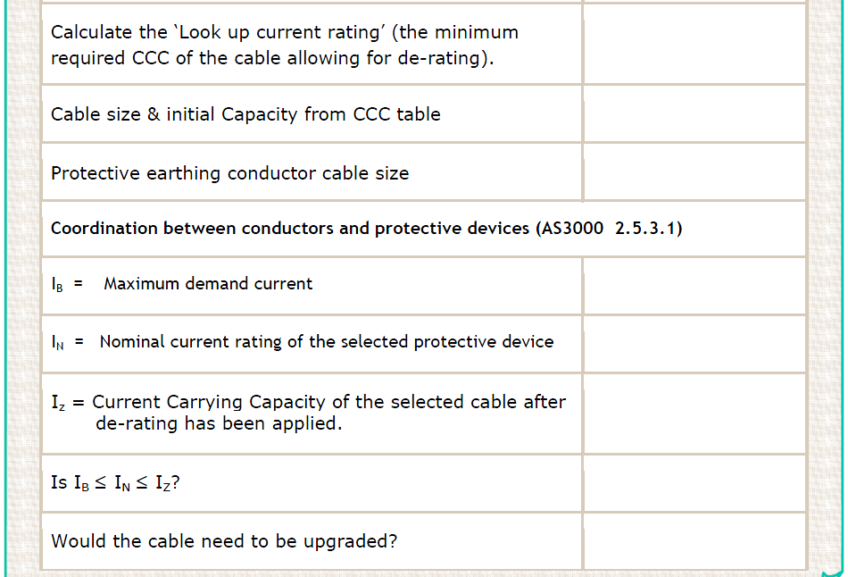
I_{Z} = 160 =
182A
0.88
95mm² (217A)
25mm²
155A
160A
217 x 0.88 = 190A
155 ≤ 160 ≤ 190
Y
N
L

Slide 68
100A
T3(1) Item 5
T7, column 5
T27 (1)
0.91
L

Slide 69
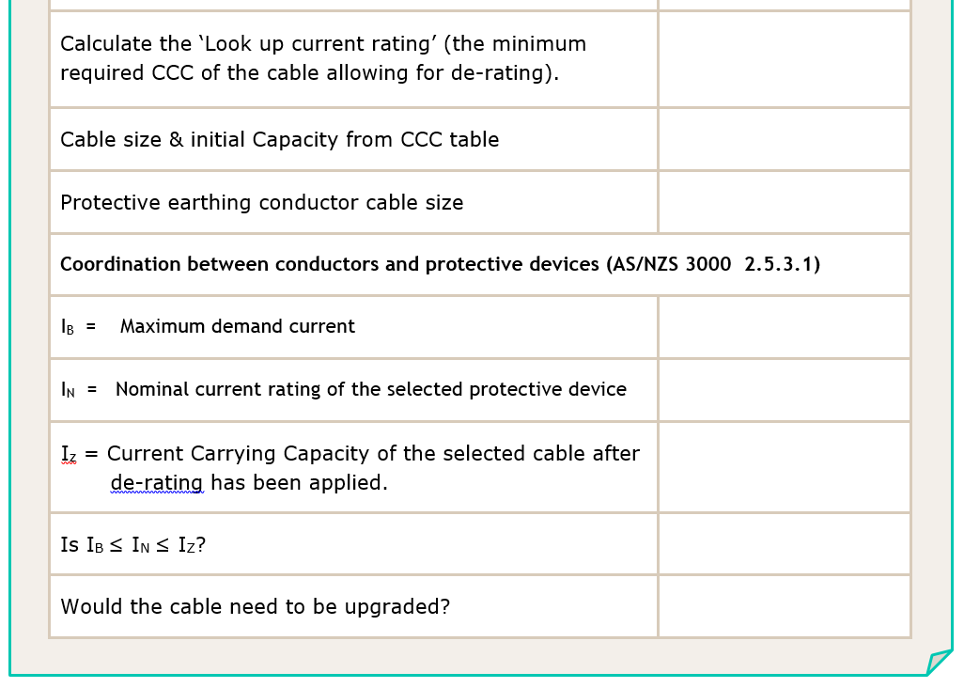
I_{Z} = 100 =
110A
0.91
35mm² (127A)
10mm²
85A
100A
127 x 0.91 = 115A
85 ≤ 100 ≤ 115
Y
N
L

Slide 70
T3(1) Item 10
T14 C4
68A
T24 C6
0.88
= 68 x 0.88 x 0.9
= 53.85A
50A
L

Slide 71
= 68 x 0.88 x 0.9
= 53.85A
50A
N/A (up to 50A)
50A
53A
50 ≤ 50 ≤ 53
Y
L

Slide 72
T3(2) Item 1
T4 C15
32A
T22 C7
0.65
32 x 0.65 = 20.8A
20A
L

Slide 73
32 x 0.65 = 20.8A
20A
N/A (up to 20A)
20A
20.8A
20 ≤ 20 ≤ 20.8
Y
L

Slide 74
T3(3) Item 2
T8 C23
277A
T25(1) C5
0.88
277 x 0.88 = 243A
200A
L

Slide 75
277 x 0.88 = 243A
200A
N/A (up to 200A)
200A
243A
200 ≤ 200 ≤ 243
Y
L

Slide 76
T3(4) Item 1
T4 C24
89A
T26(2) C2
0.83
89 x 0.83 = 73A
63A
L

Slide 77
89 x 0.83 = 73A
63A
N/A (up to 63A)
63A
73A
63 ≤ 63 ≤ 73
Y
L

Slide 78
Once set, the adjusted value becomes the fixed value of nominal current (I_{N})
L

Slide 79
L

Slide 80
T3(1) Item 5
T8 C5
349A
T23 C7
0.95
349 x 0.95 = 331A
L

Slide 81
349 x 0.95 = 331A
400A
331/400 x 100 = 0.828
Use 0.8
N/A (up to 320A)
400 x 0.8 = 320A
331A
320 ≤ 320 ≤ 331
Y
L

Slide 82
L

Slide 83
L

Slide 84
4mm²
L

Slide 85
Final CCC value
de-rating HRC fuse
de-rating for group of 2
2 x the single cable listed value
L

Slide 86
AS/NZS 3008
L

Slide 87
T3(4) Item 2
T8 C24
163 x 2 =
326A
26(2) C4
0.95
326 x 0.95 = 309A
L

Slide 88
326 x 0.95 = 309A
50 + 50 = 100
Next up = 120mm²
35mm²
400A
309/400 x 100 = 0.774
0.63
N/A (up to 252A)
400 x 0.63 = 252A
309A
252 ≤ 252 ≤ 309
Y
L

Slide 89
END OF LESSON

Slide 90
T3(1) Item 10
T13 C2
54A
L

Slide 91
L

Slide 92
L

Slide 93
T3(1) Item 10
T13 C2
54A
T24 C7
0.82
= 54 x 0.82
= 44.28A
40A
L

Slide 94
= 54 x 0.82
= 44.28A
40A
N/A (up to 40A)
40A
44A
40 ≤ 40 ≤ 44
Y
L

