Slide 1
SECTION 7
CABLE SELECTION BASED ON
VOLTAGE DROP REQUIREMENTS

Slide 2
CABLE SELECTION BASED ON VOLTAGE DROP REQUIREMENTS
Topics
AS/NZS3000 requirements
Voltage drop tables in AS/NZS3008.1.1
Voltage drop calculations
Cable selection
Maximum length of cables
L

Slide 3
L

Slide 4
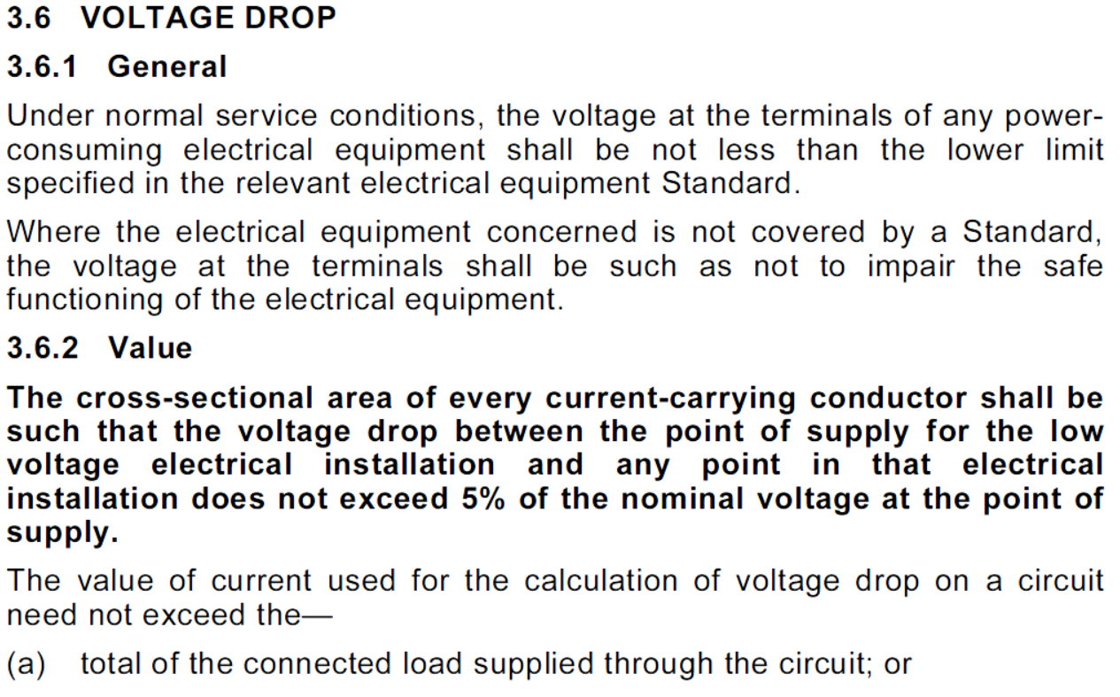
L

Slide 5
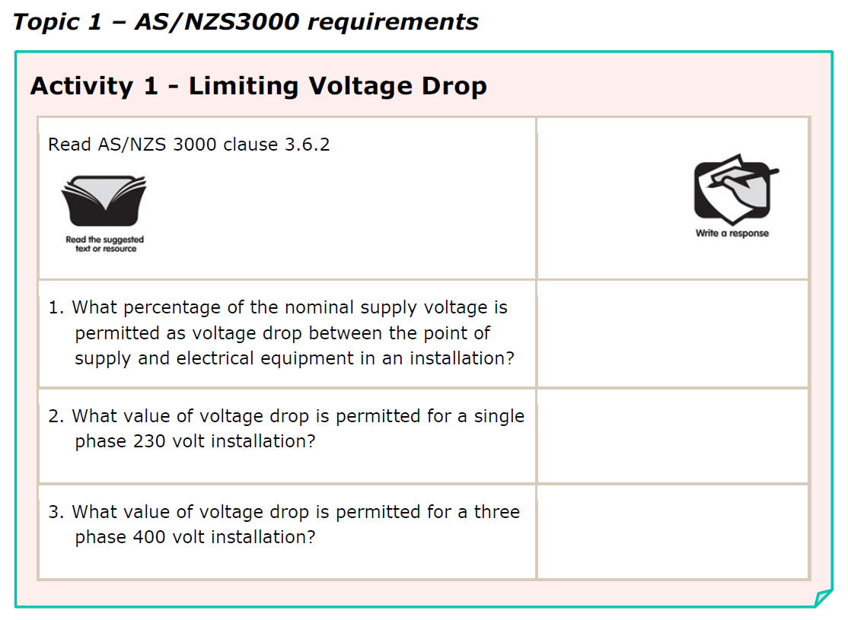
5%
11.5V
20V
L

Slide 6
L

Slide 7
L

Slide 8
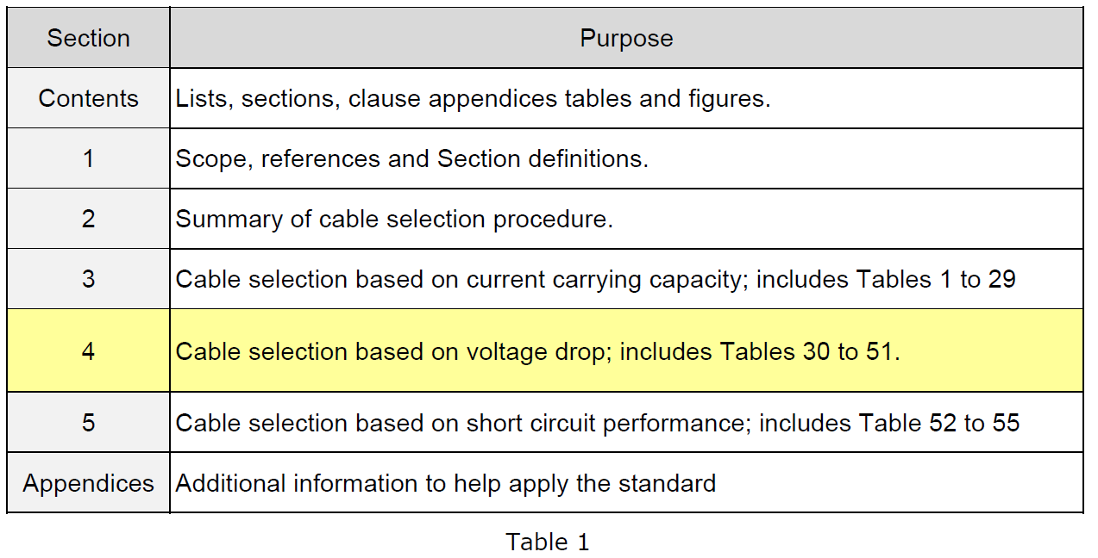
L

Slide 9
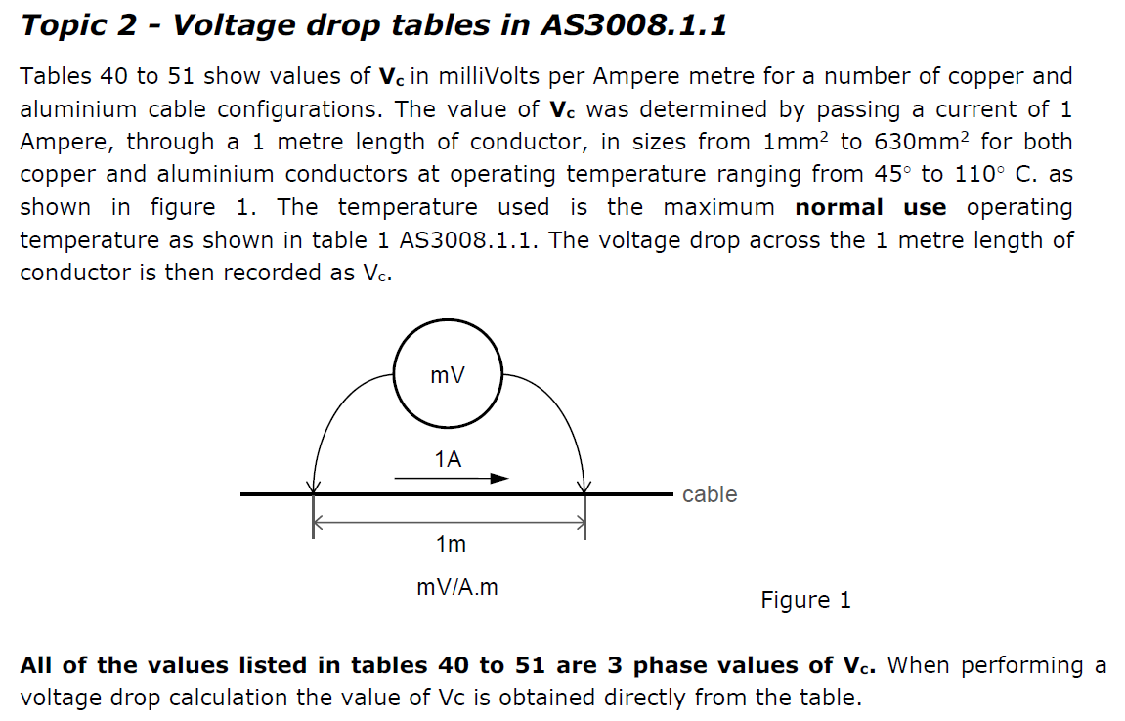
L

Slide 10
x 1.155
x 0.866
L

Slide 11
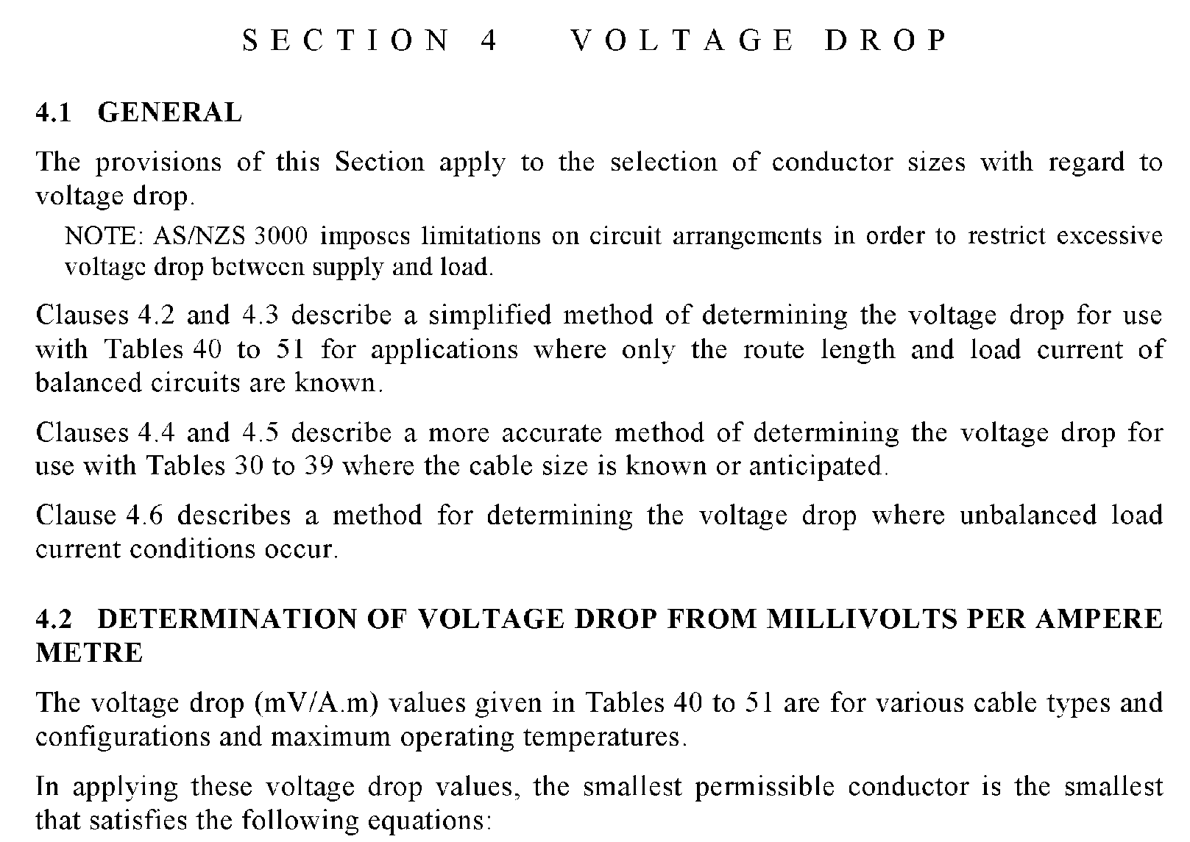
Page 91
L

Slide 12
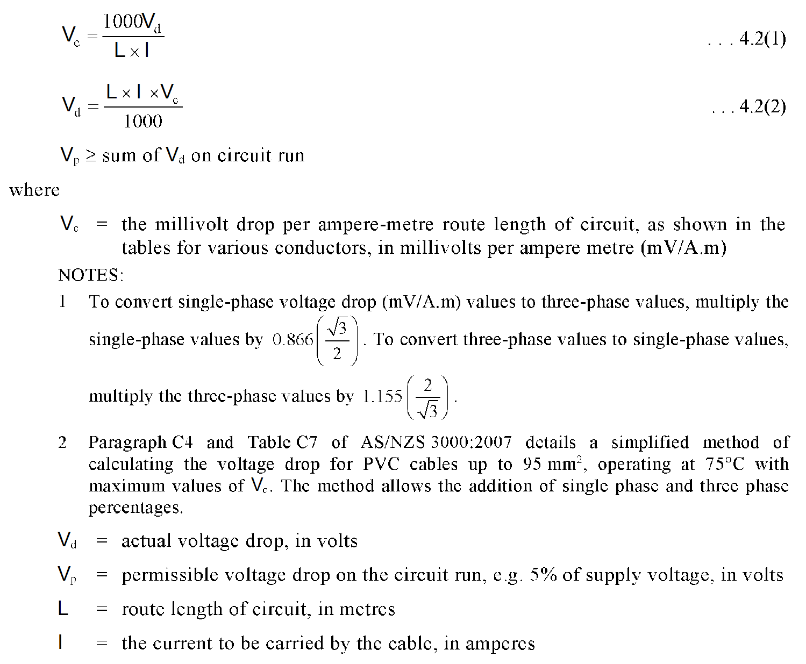
Use to find cable C.S.A
Use to find actual voltage drop
L

Slide 13
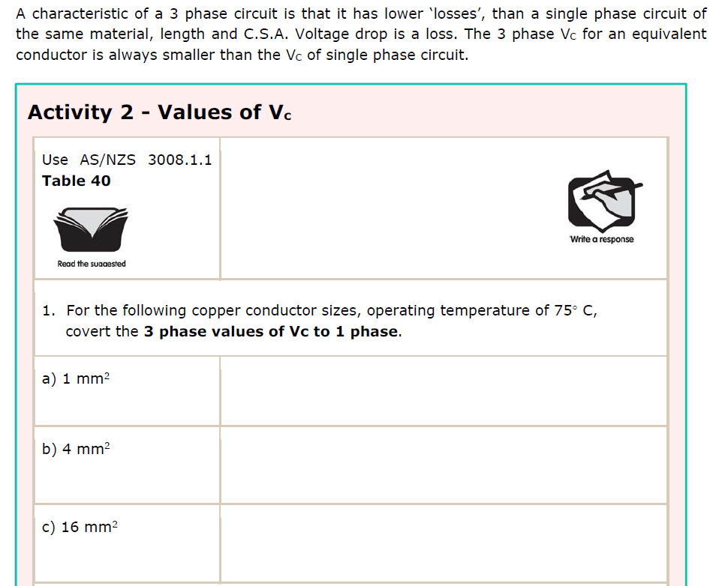
L

Slide 14
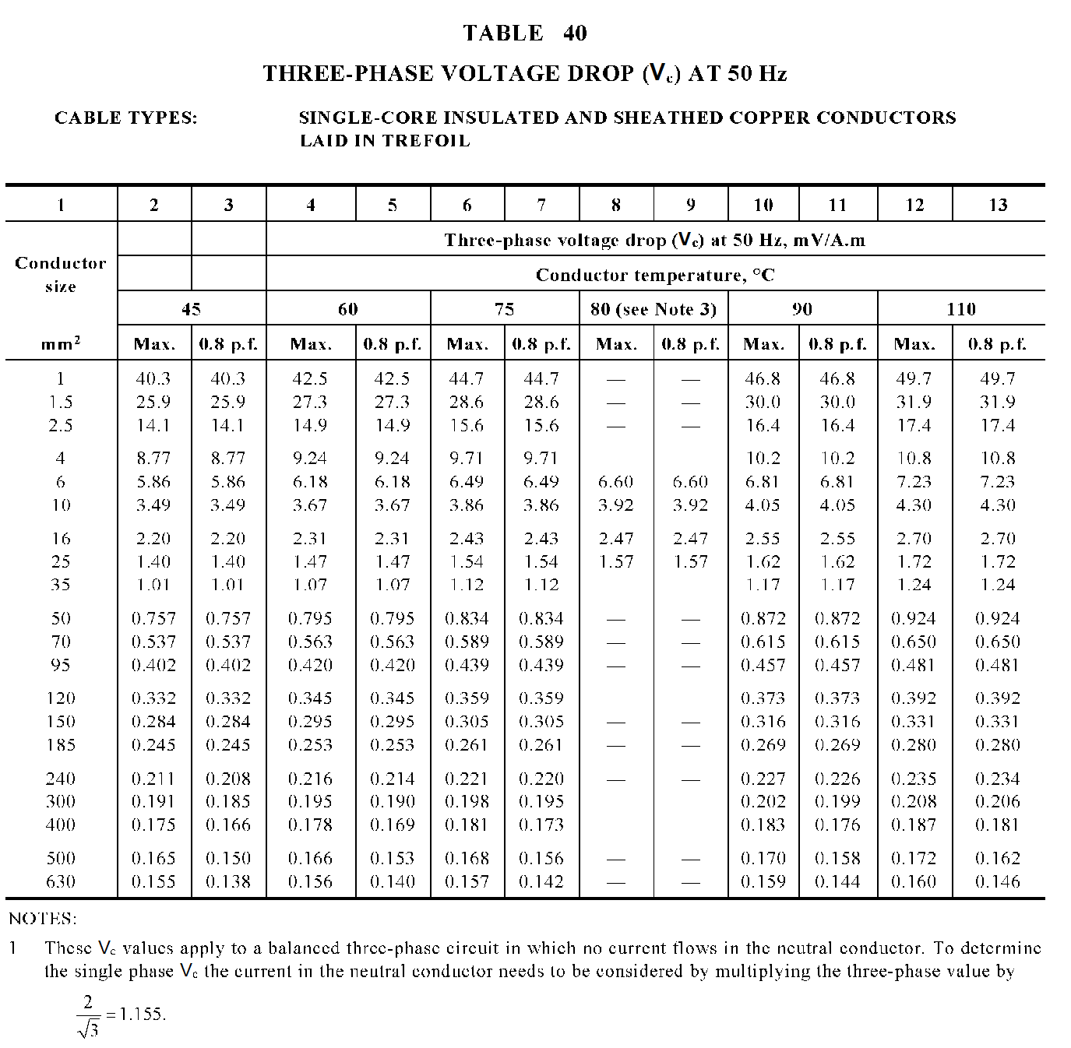
Page 108
L

Slide 15
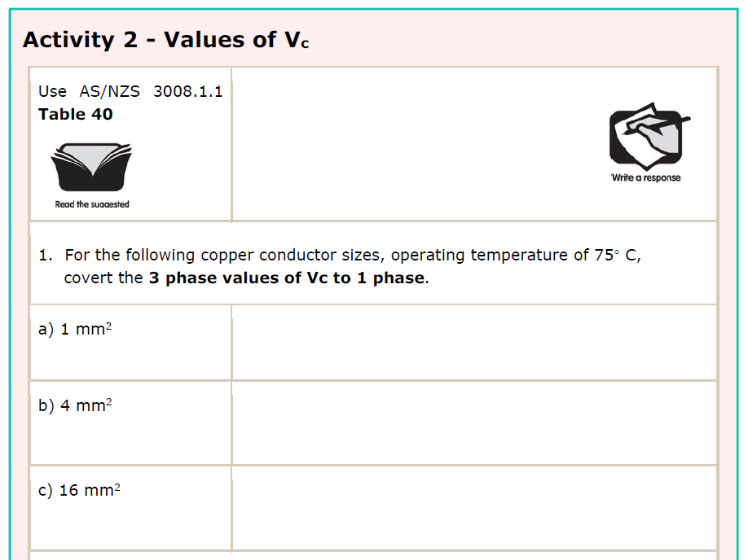
44.7 x 1.155 = 51.63 mV/A.m
9.71 x 1.155 = 11.22 mV/A.m
2.43 x 1.155 = 2.81 mV/A.m
L

Slide 16
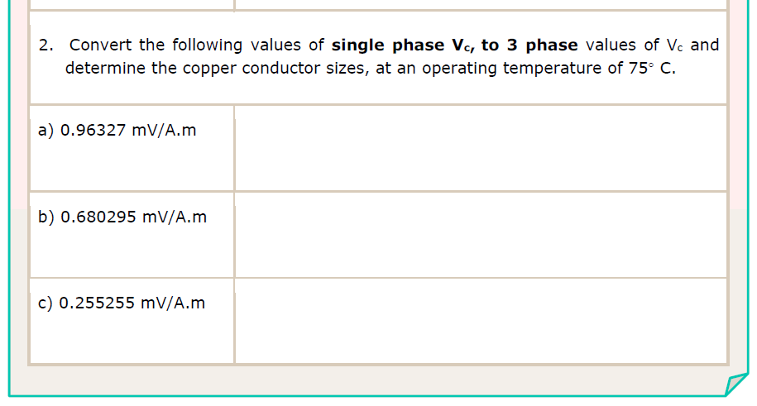
x 0.866 = 0.834 mV/A.m
x 0.866 = 0.589 mV/A.m
x 0.866 = 0.221 mV/A.m
L

Slide 17
Page 108
L

Slide 18
x 0.866 = 0.834 mV/A.m
(50mm²)
x 0.866 = 0.589 mV/A.m
(70mm²)
x 0.866 = 0.221 mV/A.m
(240mm²)
L

Slide 19
Page 108
For table 40, highlight the following info and add the trefoil drawing for easy visual reference
Also take note at the bottom of each Vc table. To convert a 3 phase Vc to a single phase equivalent, you must use the multiplier x 1.155
L

Slide 20
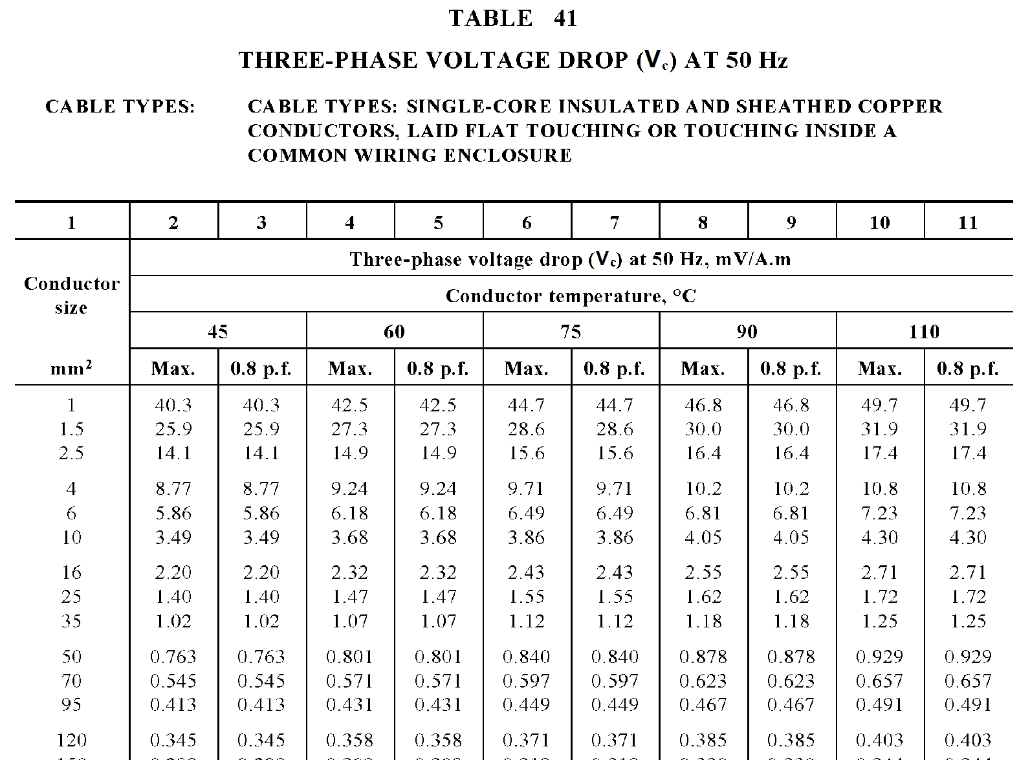
Page 109
or in conduit
For table 41, highlight the following info and add the laid flat drawing for easy visual reference.
This table is also used for cables in a wiring enclosure
L

Slide 21
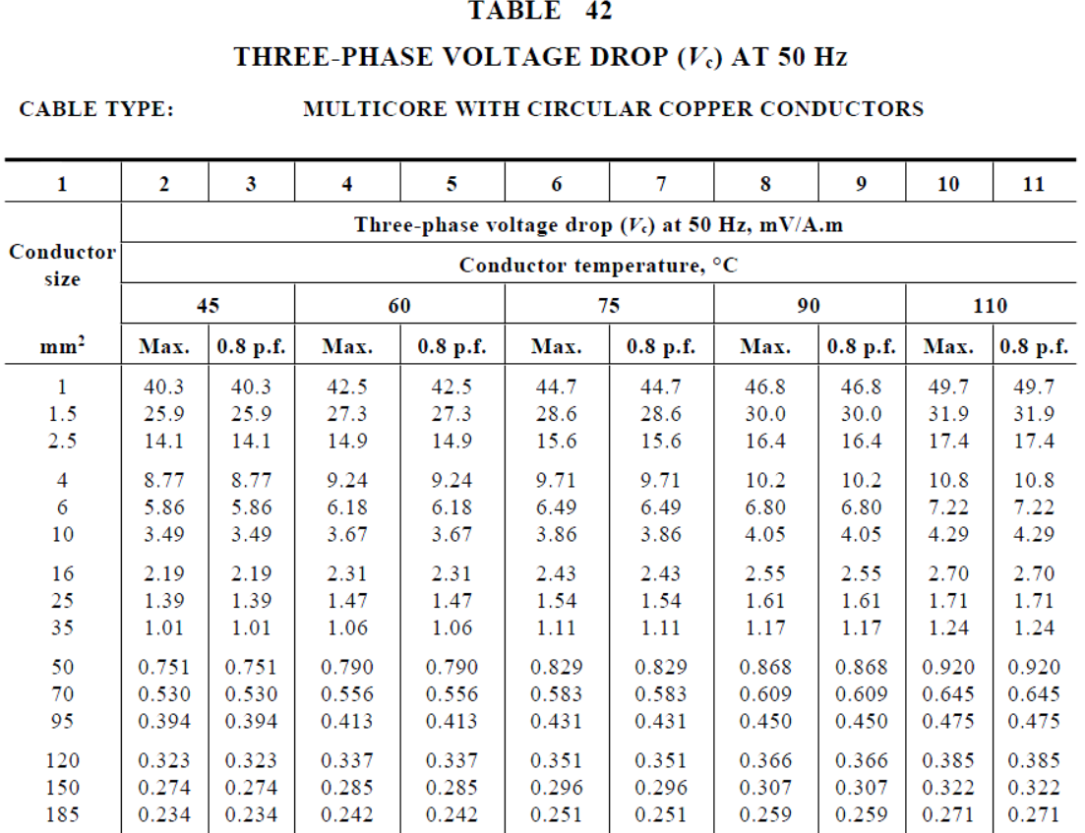
Page 110
For table 42, highlight the following info for multicore copper cables.
Note that Vc tables 43 to 45 are set out the same way but for ALUMINIUM conductors
L

Slide 22
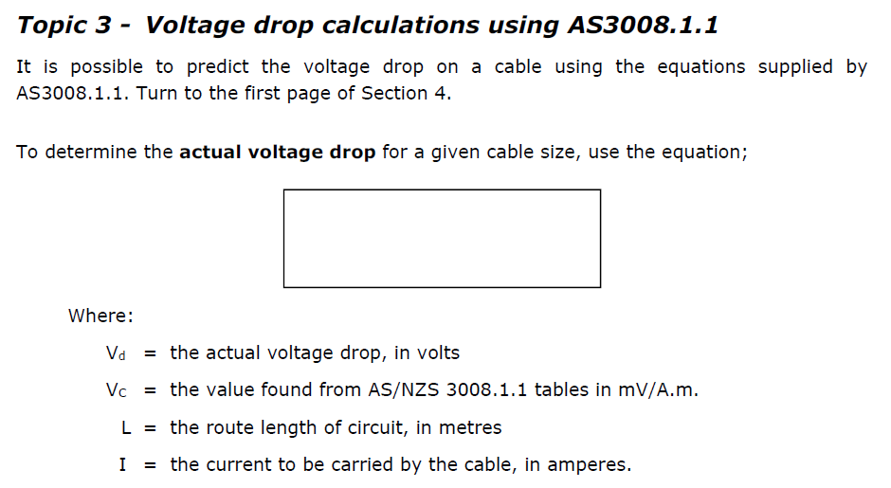
Vd = L x I x Vc
1000
L

Slide 23
Use to find cable C.S.A
Use to find actual voltage drop
L

Slide 24
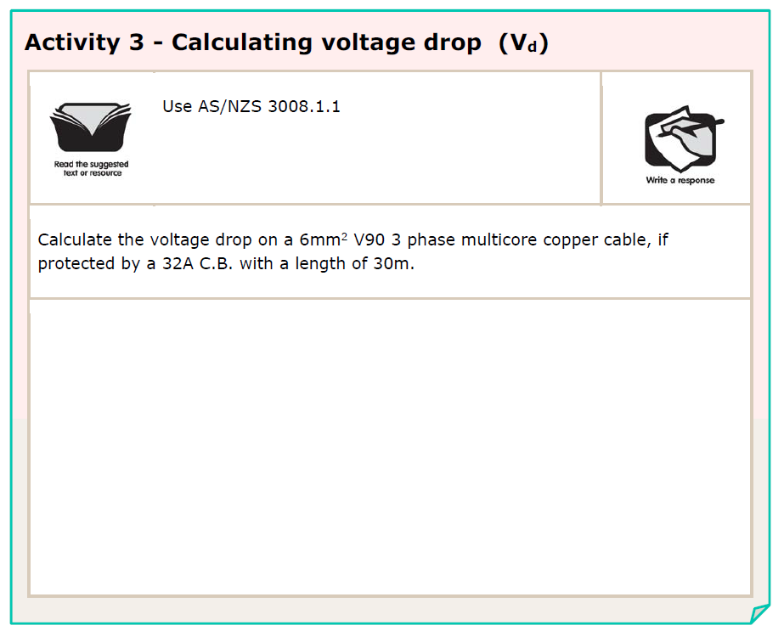
L

Slide 25
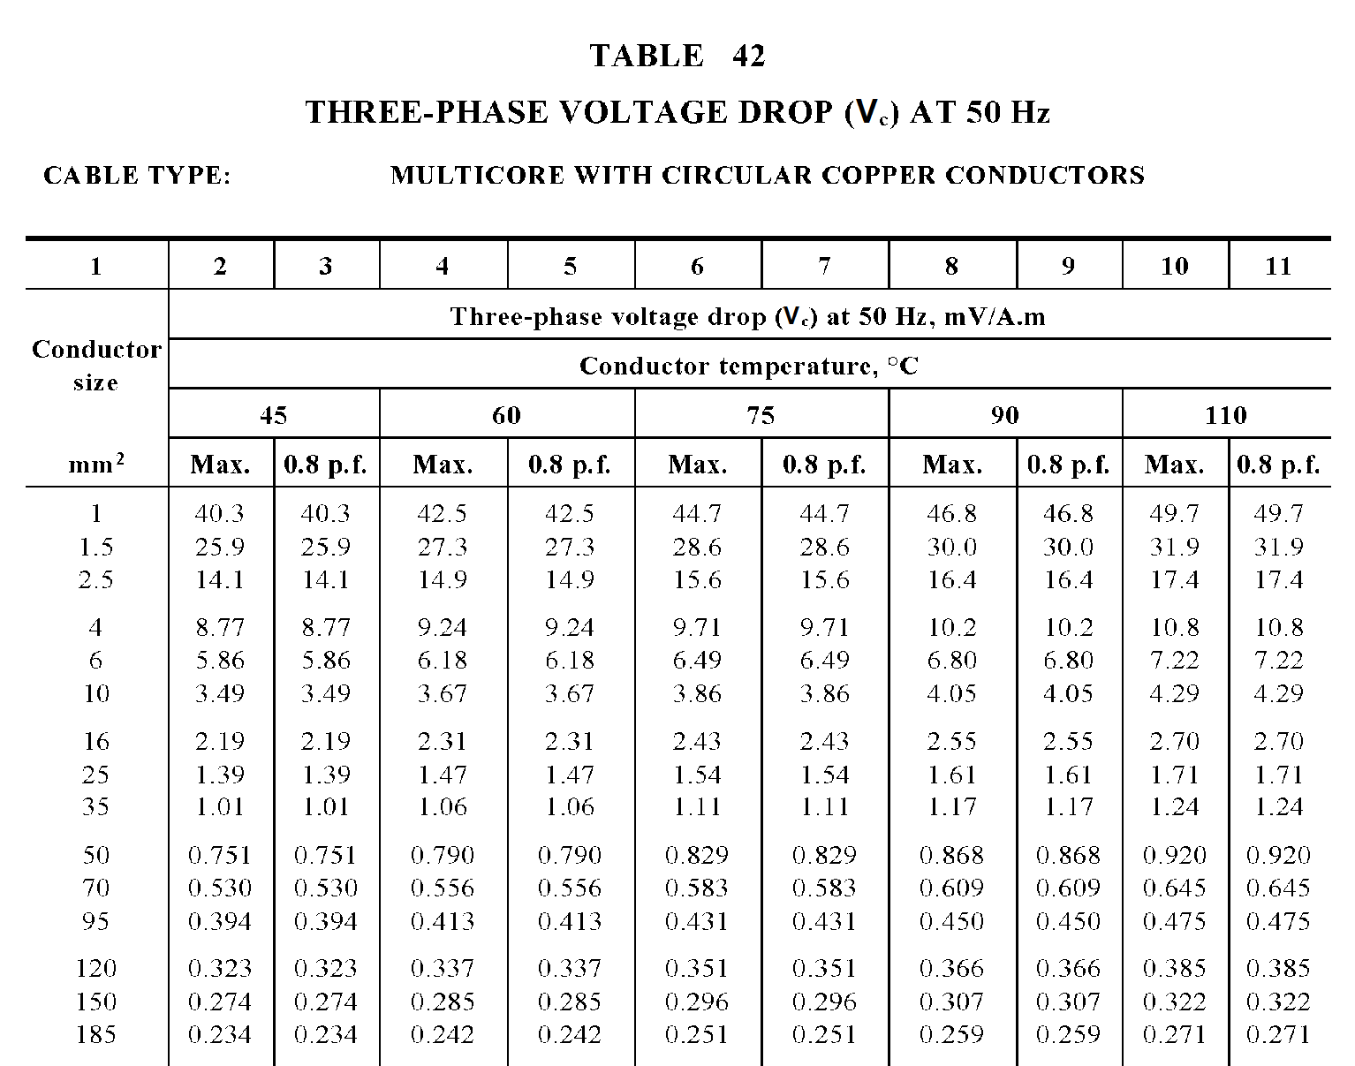
L

Slide 26
Vc = 6.49 mV/A.m (T42C6)
Vd = L x I x Vc
= 30 x 32 x 6.49
= 6.23V
1000
1000
L

Slide 27
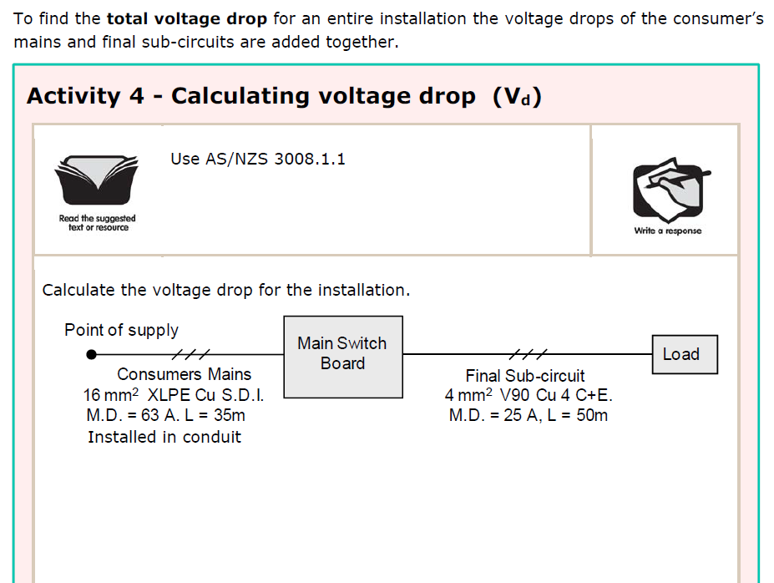
L

Slide 28
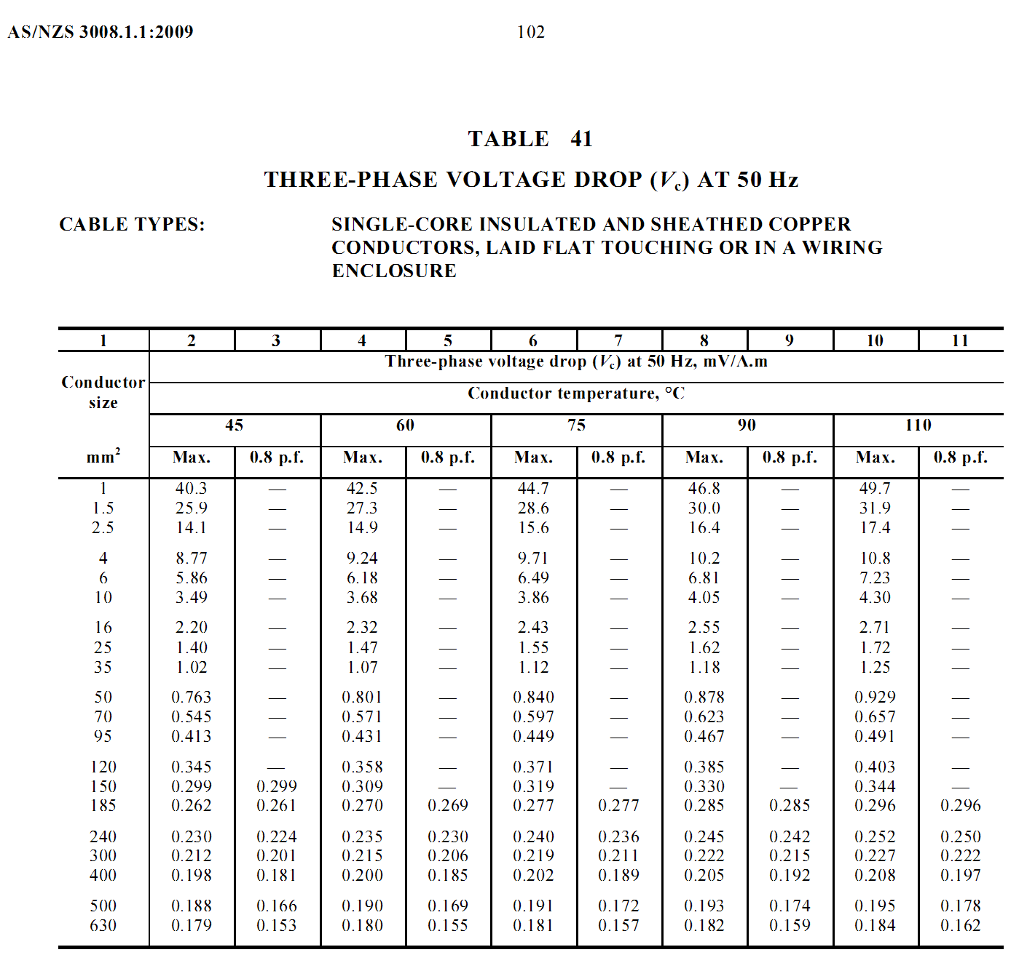
L

Slide 29
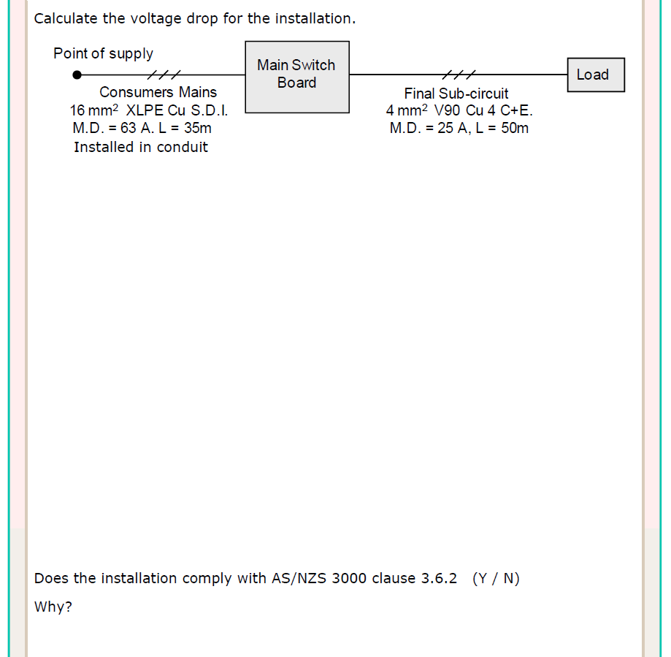
Vc = 2.55 mV/A.m (T41C8)
Vd = L x I x Vc
1000
= 35 x 63 x 2.55
1000
= 5.622V
L

Slide 30
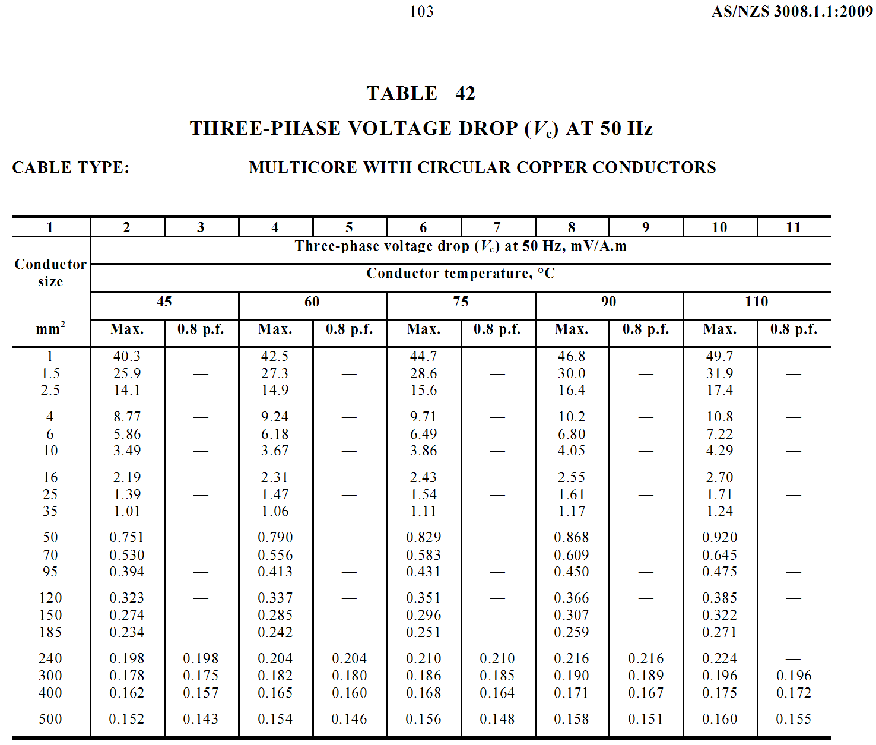
L

Slide 31
Vc = 2.55 mV/A.m (T41C8)
Vc = 9.71 mV/A.m (T42C6)
Vd = L x I x Vc
Vd = L x I x Vc
1000
1000
= 35 x 63 x 2.55
= 50 x 25 x 9.71
1000
1000
= 5.622V
= 12.138V
Vd total = 5.622 + 12.138
= 17.76V
Yes
Vd < 20V
L

Slide 32
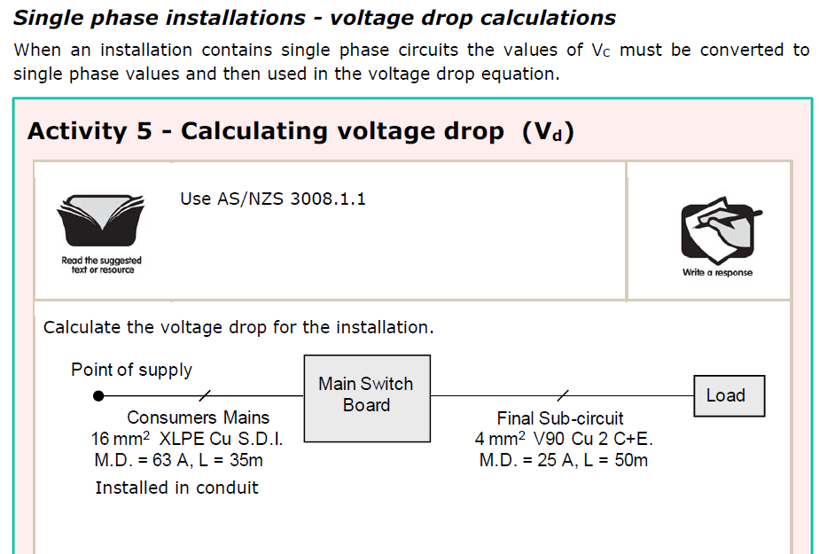
L

Slide 33
L

Slide 34
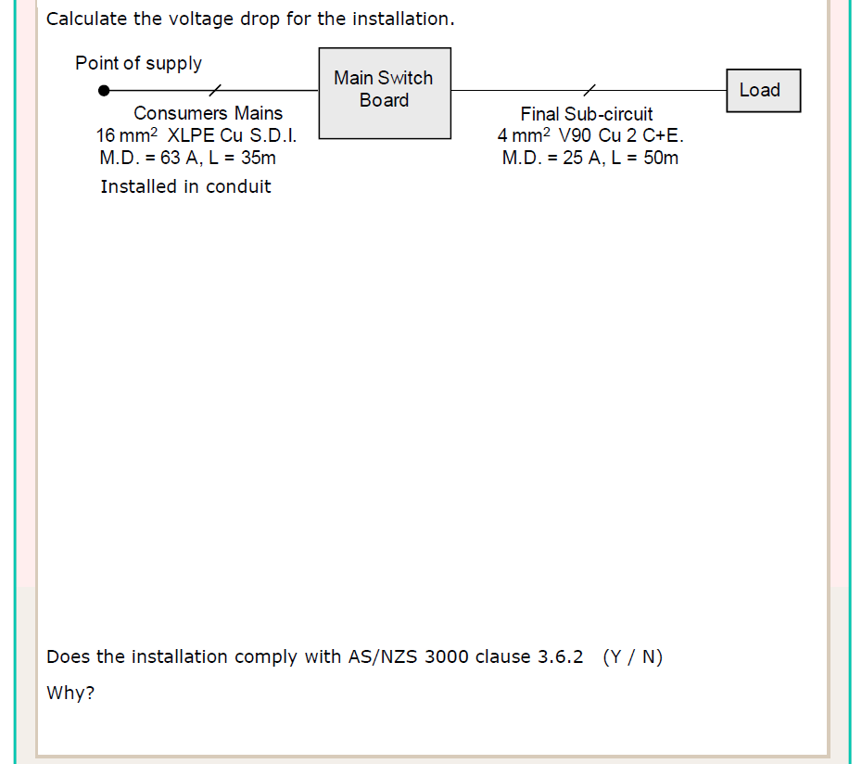
Vc = 2.55 x 1.155
= 2.94 mV/A.m (T41C8)
Vd = L x I x Vc
1000
= 35 x 63 x 2.94
1000
= 6.5V
L

Slide 35
L

Slide 36
Vc = 2.55 x 1.155
= 2.94 mV/A.m (T41C8)
Vc = 9.71 x 1.155
= 11.2 mV/A.m (T42C6)
Vd = L x I x Vc
Vd = L x I x Vc
1000
1000
= 35 x 63 x 2.94
= 50 x 25 x 11.2
1000
1000
= 6.5V
= 14V
Vd total = 6.5 + 14
= 20.5V (1φ)
No
Vd > 11.5V
L

Slide 37
Example from previous activity:
Converting the Vc first:
Converting Vc in the equation:
Vc = 2.55 x 1.155
= 2.94 mV/A.m (single phase)
Vd = L x I x Vc
Vd = L x I x Vc x 1.155
1000
1000
= 35 x 63 x 2.94
= 35 x 63 x 2.55 x 1.155
1000
1000
= 6.5V
= 6.5V
L

Slide 38
L

Slide 39
L

Slide 40
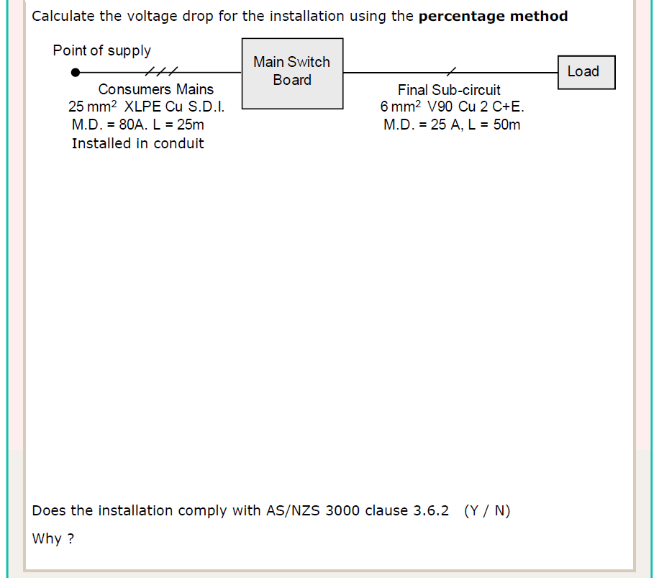
Vc = 1.62 mV/A.m (T41C8)
Vd = L x I x Vc
1000
= 25 x 80 x 1.62
1000
= 3.24V
V% = 3.24 x 100
= 0.81%
400
L

Slide 41
L

Slide 42
Vc = 6.49 x 1.155
= 7.49mV/A.m (T42C6)
Vc = 1.62 mV/A.m (T41C8)
Vd = L x I x Vc
Vd = L x I x Vc
1000
1000
= 25 x 80 x 1.62
= 50 x 25 x 7.49
1000
1000
= 3.24V (3φ)
= 9.36V (1φ)
V% = 3.24 x 100
= 0.81%
V% = 9.36 x 100
= 4.07%
400
230
V%T = V%CM + V%fsc
= 0.81 + 4.07
= 4.88%
Yes
V%T < 5%
L

Slide 43
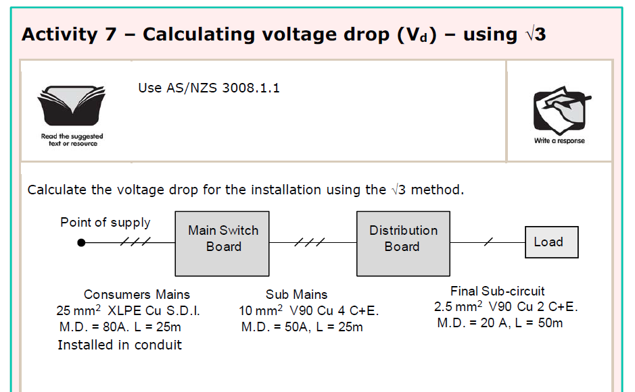
L

Slide 44
L

Slide 45
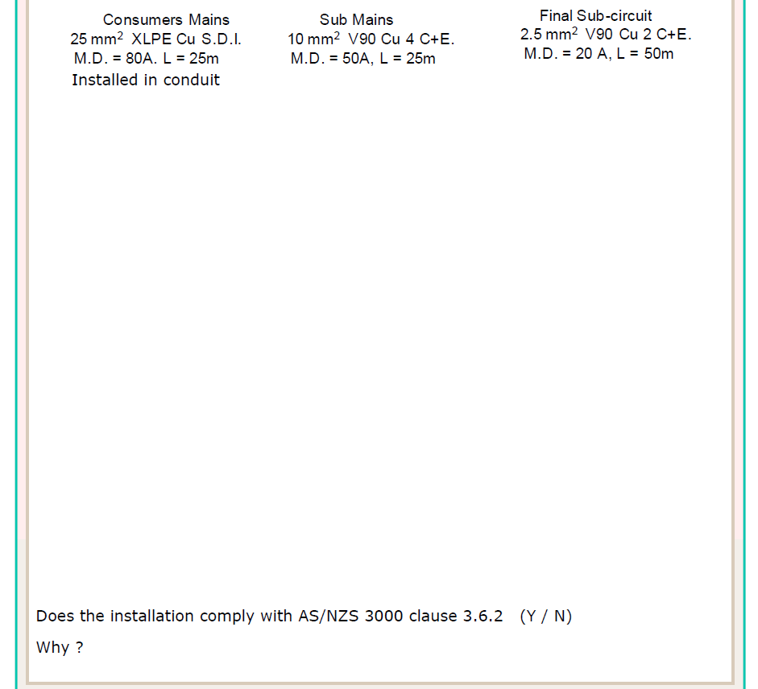
Vc = 1.62 mV/A.m
(T41C8)
Vd = L x I x Vc
1000
= 25 x 80 x 1.62
1000
= 3.24V (3φ)
L

Slide 46
L

Slide 47
Vc = 1.62 mV/A.m
(T41C8)
Vc = 3.86 mV/A.m
(T42C6)
Vd = L x I x Vc
Vd = L x I x Vc
1000
1000
= 25 x 80 x 1.62
= 25 x 50 x 3.86
1000
1000
= 3.24V (3φ)
= 4.825V (3φ)
L

Slide 48
L

Slide 49
Vc = 15.6 x 1.155
= 18.018 mV/A.m
(T42C6)
Vc = 1.62 mV/A.m
(T41C8)
Vc = 3.86 mV/A.m
(T42C6)
Vd = L x I x Vc
Vd = L x I x Vc
Vd = L x I x Vc
1000
1000
1000
= 25 x 80 x 1.62
= 25 x 50 x 3.86
= 50 x 20 x 18.018
1000
1000
1000
= 3.24V (3φ)
= 4.825V (3φ)
= 18.018V (1φ)
Vd = 3.24
Vd = 4.825
√3
√3
+
+
=
22.7V
1.87 V (1φ)
2.786 V (1φ)
18.018V (1φ)
No
22.7 > 11.5V
L

Slide 50
Vc = 1000 x Vp
(L x I)
L

Slide 51
Vc = 1000 x Vp
= 1000 x 14
= 12.44mV/A.m.
(L x I)
(45 x 25)
L

Slide 52
≤ 12.44mV/A.m.
L

Slide 53
Vc = 1000 x Vp
= 1000 x 14
= 12.44mV/A.m.
(L x I)
(45 x 25)
C.S.A = 4mm² (9.71mV/A.m) T42C6
L

Slide 54
12V
8V
Vp = 20 - 12
= 8V
L

Slide 55
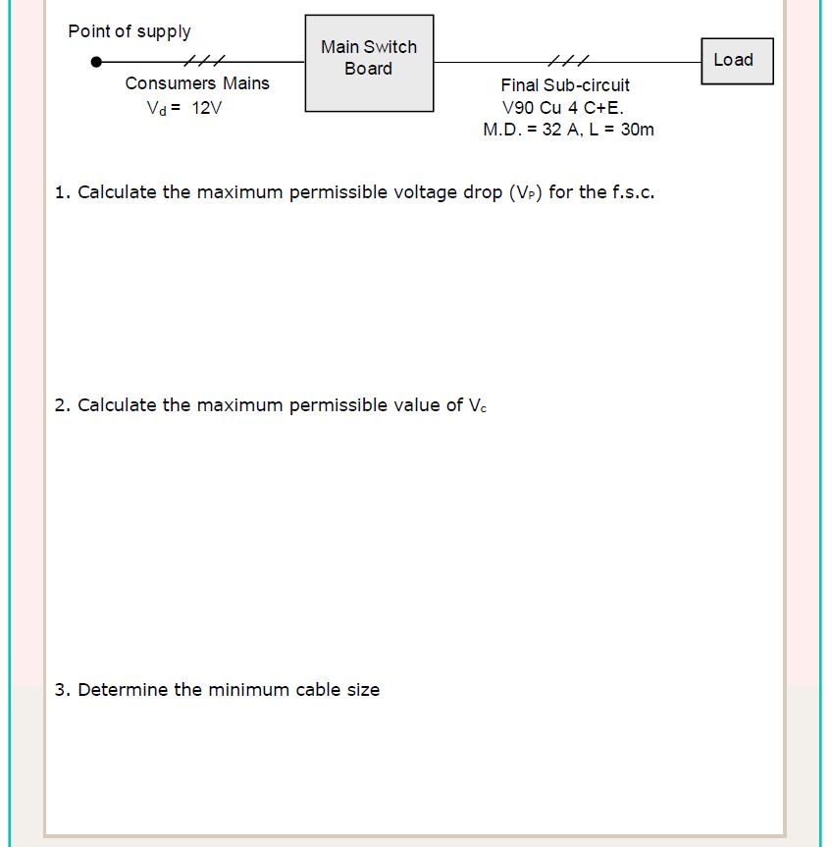
12V
8V
Vp = 20 - 12
= 8V
Vc = 1000 x Vp
= 1000 x 8
= 8.33mV/A.m.
(L x I)
(30 x 32)
L

Slide 56
≤ 8.33mV/A.m.
L

Slide 57
12V
8V
Vp = 20 - 12
= 8V
Vc = 1000 x Vp
= 1000 x 8
= 8.33mV/A.m.
(L x I)
(30 x 32)
C.S.A = 6mm² (6.49mV/A.m) T42C6
L

Slide 58
L

Slide 59
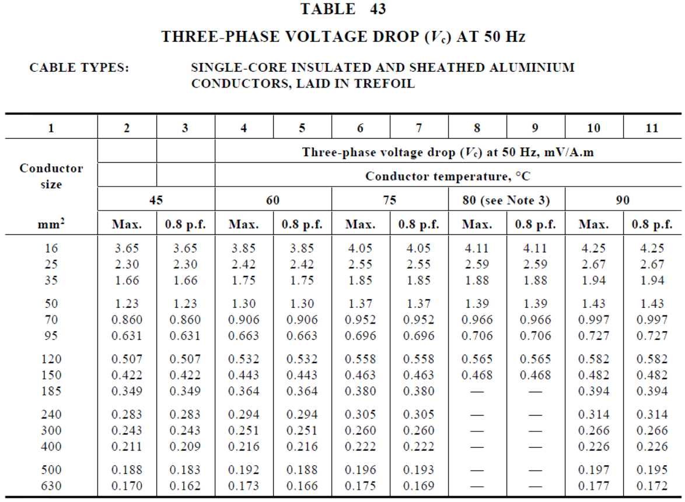
L

Slide 60
Vc = 0.997 mV/A.m (T43C8)
Vd = L x I x Vc
= 55 x 150 x 0.997
= 8.23V
1000
1000
L

Slide 61
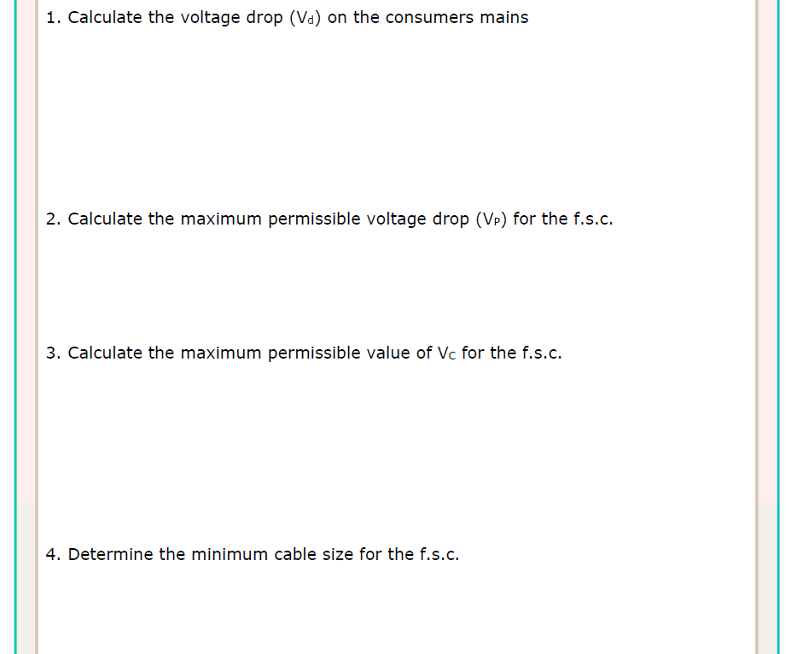
Vc = 0.997 mV/A.m (T43C8)
Vd = L x I x Vc
= 55 x 150 x 0.997
= 8.23V
1000
1000
Vp = 20 - 8.23
= 11.77V
Vc = 1000 x Vp
= 1000 x 11.77
= 12.26mV/A.m.
(L x I)
(60 x 16)
L

Slide 62
≤12.26mV/A.m.
L

Slide 63
Vc = 0.997 mV/A.m (T43C8)
Vd = L x I x Vc
= 55 x 150 x 0.997
= 8.23V
1000
1000
Vp = 20 - 8.23
= 11.77V
Vc = 1000 x Vp
= 1000 x 11.77
= 12.26mV/A.m.
(L x I)
(60 x 16)
C.S.A. = 4mm² (9.71mV/A.m) T42 C6
L

Slide 64
L

Slide 65
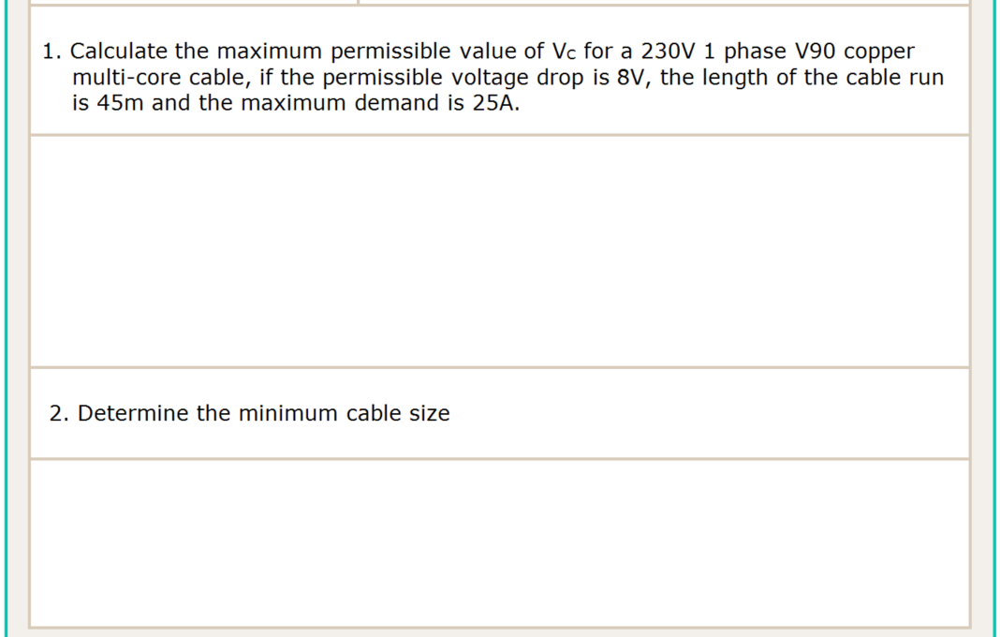
Vc = 1000 x Vp
= 1000 x 8
= 7.11mV/A.m. (1 φ)
(L x I)
(45 x 25)
3 φ Vc= 7.11 x 0.866
= 6.15mV/A.m.
L

Slide 66
≤ 6.15mV/A.m.
L

Slide 67
Vc = 1000 x Vp
= 1000 x 8
= 7.11mV/A.m. (1 φ)
(L x I)
(45 x 25)
3 φ Vc= 7.11 x 0.866
= 6.15mV/A.m.
C.S.A. = 10mm² (3.86mV/A.m) T42 C6
L

Slide 68
Example from previous activity:
In activity 11, the 3 phase Vc after conversion was 6.15mV/A.m.
Vc = 1000 x Vp x 0.866
= 1000 x 8 x 0.866
= 6.15 mV/A.m.
(3 phase value)
(L x I)
(45 x 25)
L

Slide 69
6.9 V
4.6 V
Vp = 11.5 - 6.9
= 4.6V
L

Slide 70
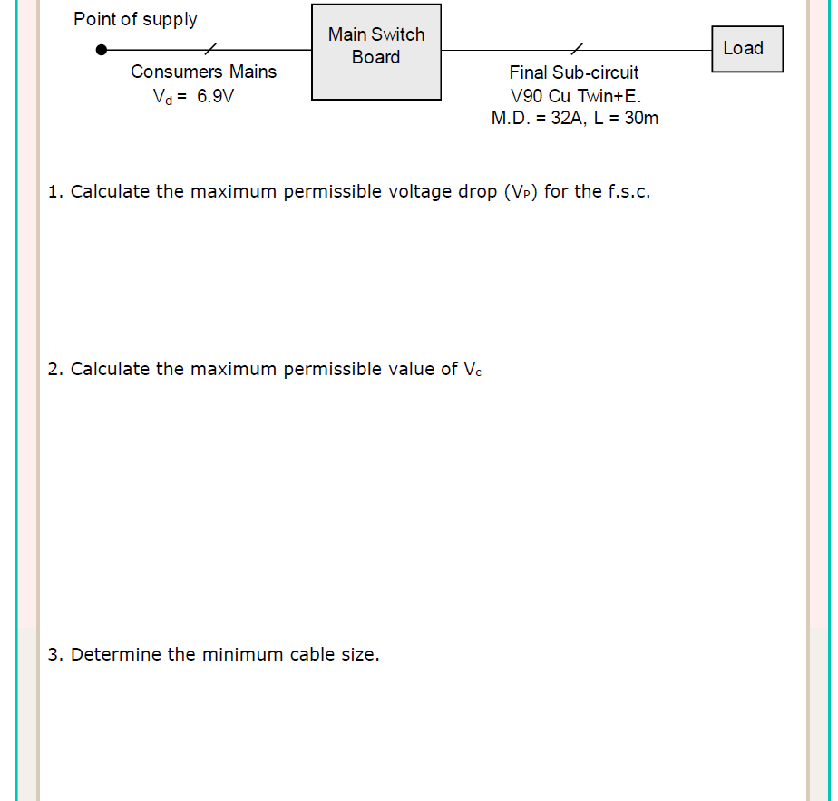
6.9 V
4.6 V
Vp = 11.5 - 6.9
= 4.6V
Vc = 1000 x Vp
= 1000 x 4.6
= 4.79mV/A.m. (1 φ)
(L x I)
(30 x 32)
3 φ Vc= 4.79 x 0.866
= 4.14mV/A.m.
L

Slide 71
≤ 4.14mV/A.m.
L

Slide 72
6.9 V
4.6 V
Vp = 11.5 - 6.9
= 4.6V
Vc = 1000 x Vp
= 1000 x 4.6
= 4.79mV/A.m. (1 φ)
(L x I)
(30 x 32)
3 φ Vc= 4.79 x 0.866
= 4.14mV/A.m.
C.S.A. = 10mm² (3.86mV/A.m) T42 C6
L

Slide 73
L

Slide 74
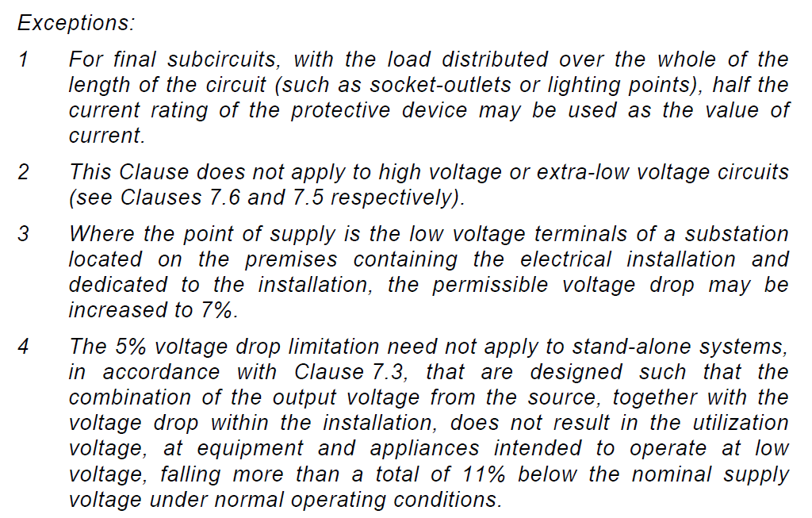
L

Slide 75
Vc = 2.55 x 1.155 = 2.95mV/A.m (T41C8)
Vd = L x I x Vc
= 15 x 80 x 2.95
= 3.54V (1φ)
1000
1000
Vp = 11.5 - 3.54
= 7.96V
Vc = 1000 x Vp
= 1000 x 7.96
= 19.9mV/A.m. (1φ)
(L x I)
(40x(0.5x20))
3φ Vc= 19.9 x 0.866
= 17.23mV/A.m.
L

Slide 76
≤ 17.23mV/A.m.
L

Slide 77
Vc = 2.55 x 1.155 = 2.95mV/A.m (T41C8)
Vd = L x I x Vc
= 15 x 80 x 2.95
= 3.54V (1φ)
1000
1000
Vp = 11.5 - 3.54
= 7.96V
Vc = 1000 x Vp
= 1000 x 7.96
= 19.9mV/A.m. (1φ)
(L x I)
(40x(0.5x20))
3φ Vc= 19.9 x 0.866
= 17.23mV/A.m.
C.S.A. = 2.5mm² (15.6mV/A.m) T42 C6
L

Slide 78
L

Slide 79
L

Slide 80
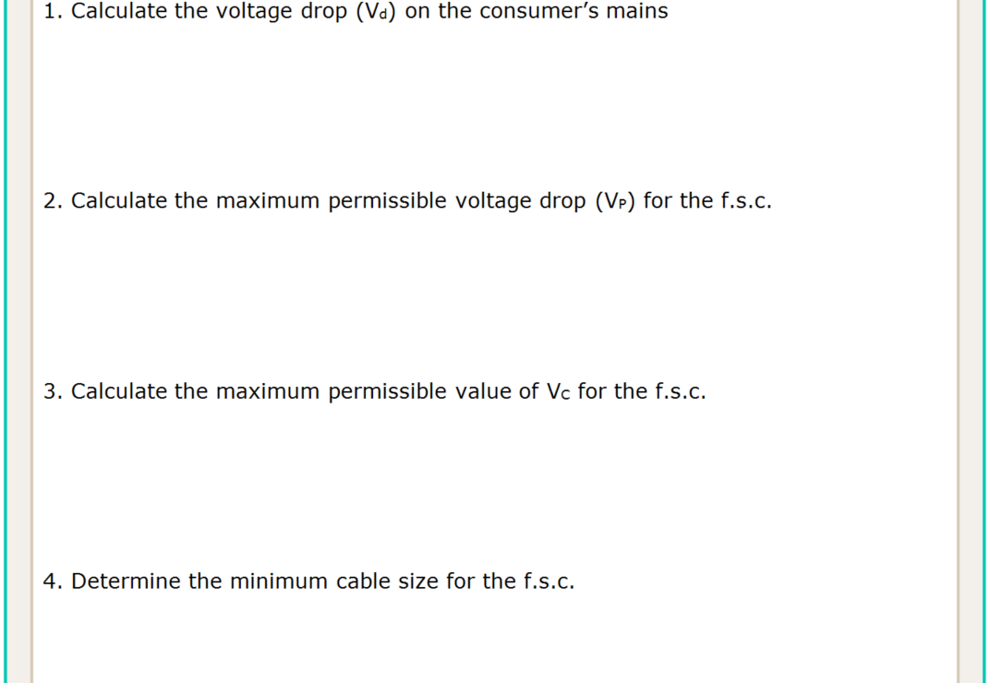
Vc = 2.55mV/A.m (T41C8)
Vd = L x I x Vc
= 20 x 63 x 2.55
= 3.22V (3φ)
1000
1000
V% = 3.22 x 100
= 0.805%
%p = 5% - 0.805%
= 4.195%
400
Vp = 230 x 4.195 %
= 9.65V
Vc = 1000 x Vp
= 1000 x 9.65
= 7.98mV/A.m. (1φ)
(L x I)
(55 x 22)
3 φ Vc= 7.98 x 0.866
= 6.91mV/A.m.
L

Slide 81
≤ 6.91mV/A.m.
L

Slide 82
Vc = 2.55mV/A.m (T41C8)
Vd = L x I x Vc
= 20 x 63 x 2.55
= 3.22V (3φ)
1000
1000
V% = 3.22 x 100
= 0.805%
%p = 5% - 0.805%
= 4.195%
400
Vp = 230 x 4.195 %
= 9.65V
Vc = 1000 x Vp
= 1000 x 9.65
= 7.98mV/A.m. (1φ)
(L x I)
(55 x 22)
3 φ Vc= 7.98 x 0.866
= 6.91mV/A.m.
C.S.A. = 6mm² (6.49mV/A.m) T41 C6
L

Slide 83
L

Slide 84
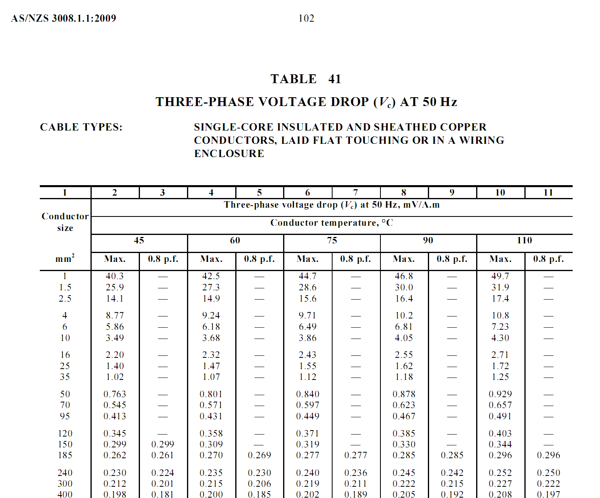
VC = 1.62 mV/A.m.
L

Slide 85
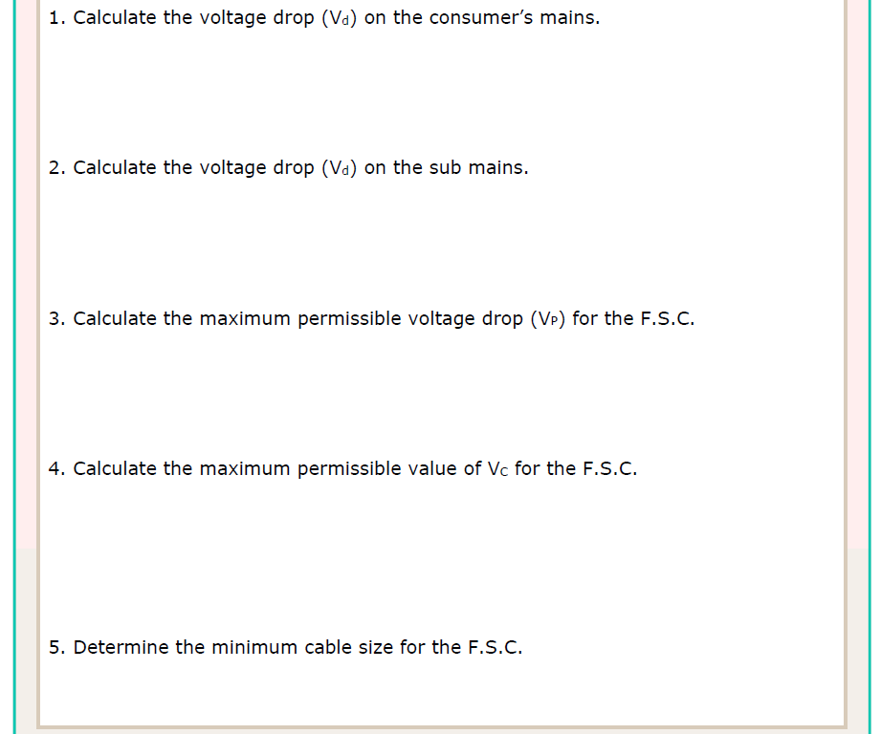
Vc = 1.62mV/A.m (T41C8)
Vd = L x I x Vc
= 25 x 100 x 1.62
= 4.05V (3φ)
1000
1000
L

Slide 86
Vc = 2.43 mV/A.m.
L

Slide 87
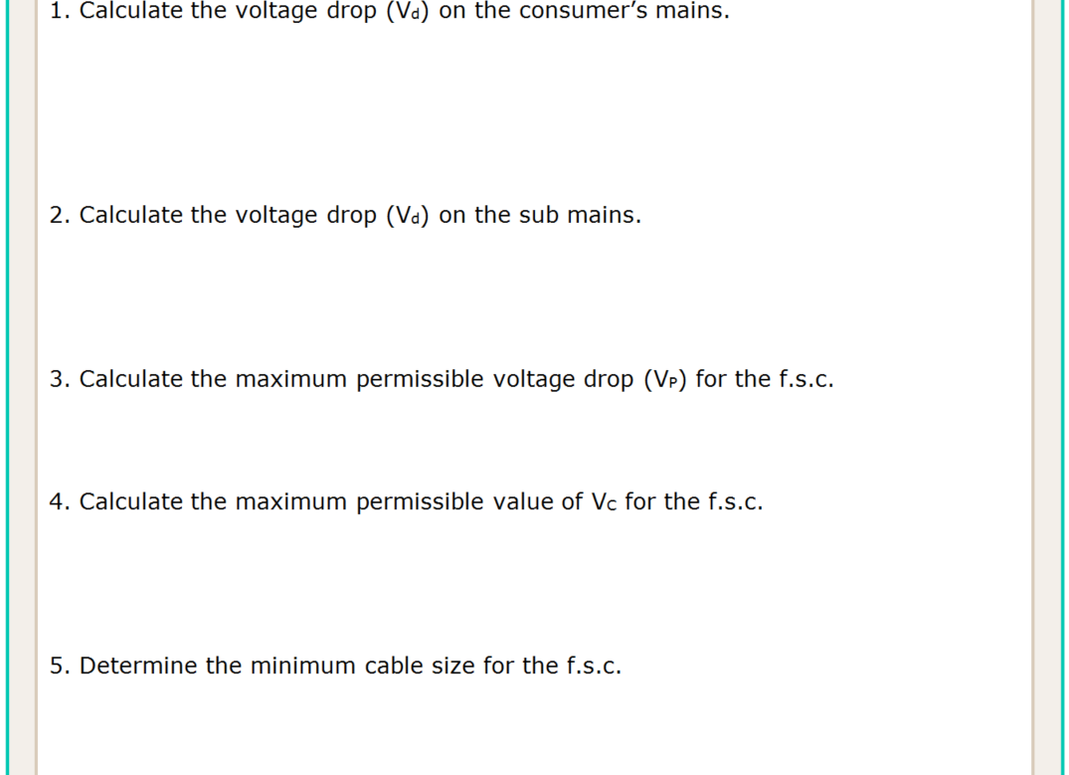
Vc = 1.62mV/A.m (T41C8)
Vd = L x I x Vc
= 25 x 100 x 1.62
= 4.05V (3φ)
1000
1000
Vc = 2.43 mV/A.m (T42C6)
Vd = L x I x Vc
= 45 x 63 x 2.43
= 6.89V (3φ)
1000
1000
V% = 4.05+6.89 x 100
= 2.735%
%p = 5% - 2.735%
Vp = 230 x 2.265 %
400
= 2.265%
= 5.2V
Vc = 1000 x Vp
= 1000 x 5.2
= 10.4 mV/A.m. (1φ)
(L x I)
(50 x 10)
3φ Vc= 10.4 x 0.866
= 9.01 mV/A.m.
L

Slide 88
≤ 9.01mV/A.m.
L

Slide 89
Vc = 1.62mV/A.m (T41C8)
Vd = L x I x Vc
= 25 x 100 x 1.62
= 4.05V (3φ)
1000
1000
Vc = 2.43 mV/A.m (T42C6)
Vd = L x I x Vc
= 45 x 63 x 2.43
= 6.89V (3φ)
1000
1000
V% = 10.94 x 100
= 2.735%
%p = 5% - 2.735%
Vp = 230 x 2.265 %
400
= 2.265%
= 5.2V
Vc = 1000 x Vp
= 1000 x 5.2
= 10.4 mV/A.m. (1φ)
(L x I)
(50 x 10)
3φ Vc= 10.4 x 0.866
= 9.01 mV/A.m.
C.S.A. = 6.0 mm² (6.49 mV/A.m) T42 C6
L

Slide 90
L

Slide 91
Vc = 2.55 mV/A.m.
L

Slide 92
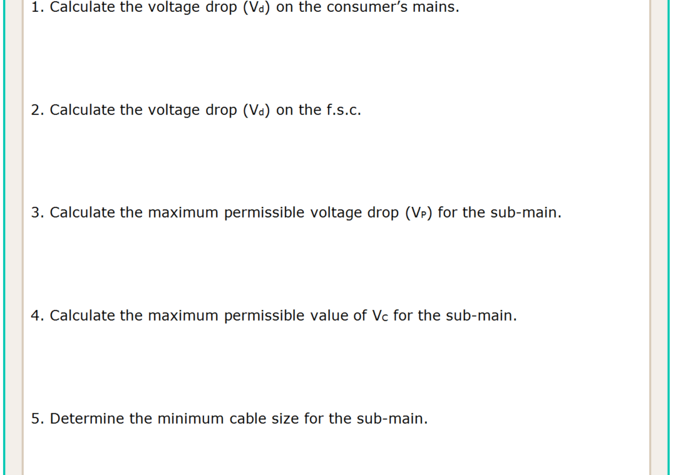
Vc = 2.55 mV/A.m (T42C8)
Vd = L x I x Vc
= 15 x 63 x 2.55
= 2.4 V (3φ)
1000
1000
L

Slide 93
Vc = 9.71 mV/A.m.
L

Slide 94
Vc = 2.55 mV/A.m (T42C8)
Vd = L x I x Vc
= 15 x 63 x 2.55
= 2.4 V (3φ)
1000
1000
Vc = 9.71 x 1.155 = 11.2mV/A.m (T42C6)
Vd = L x I x Vc
= 15 x 25 x 11.2
= 4.21 V (1φ)
1000
1000
VCM% = 2.4 x 100
= 0.6%
VSM%= 5-(0.6+1.83) = 2.57%
400
Vfsc%= 4.21 x 100
=1.83%
VSM 230 x 2.57% = 5.91 V
230
Vc = 1000 x Vp
= 1000 x 5.91
= 2.955 mV/A.m. (1φ)
(L x I)
(50 x 40)
3φ Vc= 2.995 x 0.866 = 2.55 mV/A.m.
L

Slide 95
≤ 2.55 mV/A.m.
L

Slide 96
Vc = 2.55 mV/A.m (T42C8)
Vd = L x I x Vc
= 15 x 63 x 2.55
= 2.4 V (3φ)
1000
1000
Vc = 9.71 x 1.155 = 11.2mV/A.m (T42C6)
Vd = L x I x Vc
= 15 x 25 x 11.2
= 4.21 V (1φ)
1000
1000
VCM% = 2.4 x 100
= 0.6%
VSM= 5-(0.6+1.83) = 2.57%
400
Vfsc%= 4.21 x 100
=1.83%
230 x 2.57% = 5.91 V
230
Vc = 1000 x Vp
= 1000 x 5.91
= 2.955 mV/A.m. (1φ)
(L x I)
(50 x 40)
3φ Vc= 2.995 x 0.866 = 2.55 mV/A.m.
C.S.A. = 16.0 mm² (2.43mV/A.m) T42 C6
L

Slide 97
L = 1000 x Vp
(Vc x I)
L

Slide 98
L

Slide 99
L

Slide 100
Vc = 15.6 mV/A.m (T42C6)
L = 1000 x Vp
= 1000 x 12
= 38.46m
(Vc x I)
(15.6 x 20)
L

Slide 101
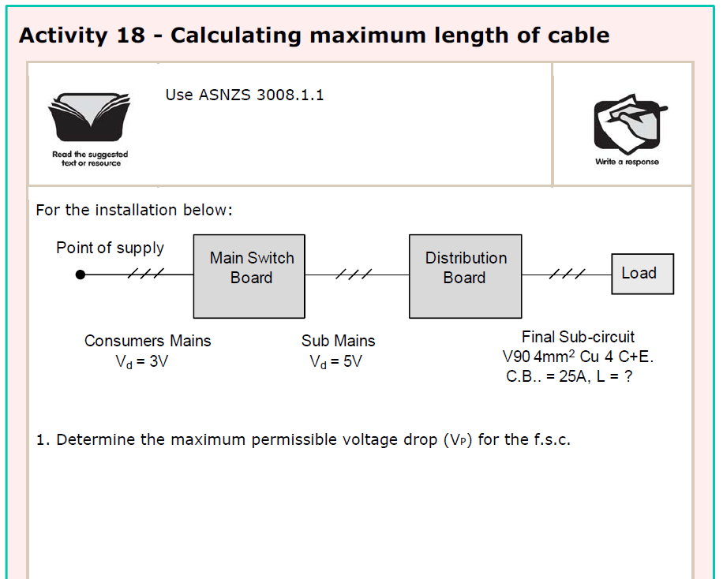
Vp = 20 – (3 + 5)
= 12V
L

Slide 102
L

Slide 103
Vp = 20 – (3 + 5)
= 12V
Vc = 9.71 mV/A.m (T42C6)
L = 1000 x Vp
= 1000 x 12
= 49.43m
(Vc x I)
(9.71 x 25)
L

Slide 104
Vp = 11.5 – (2 + 3)
= 6.5 V
L

Slide 105
L

Slide 106
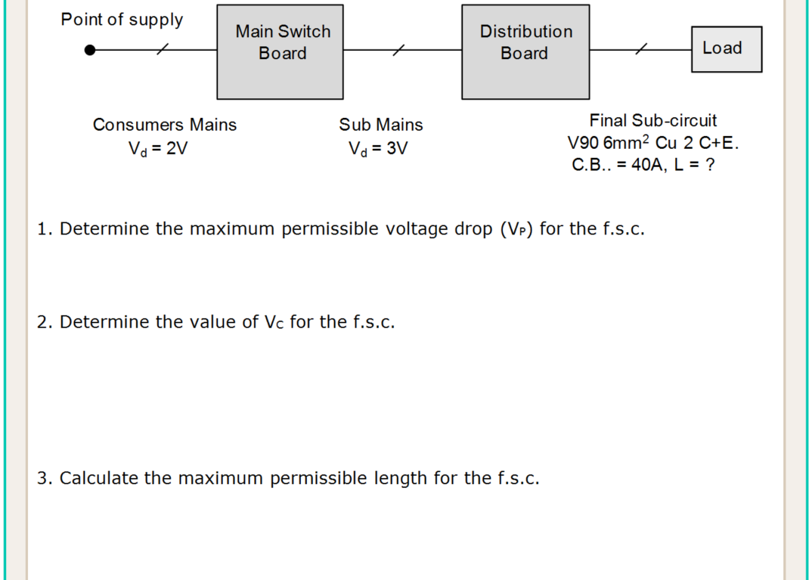
Vp = 11.5 – (2 + 3)
= 6.5 V
3φ Vc = 6.49 mV/A.m (T42C6)
1φ Vc = 6.49 x 1.155
= 7.5 mV/A.m
L = 1000 x Vp
= 1000 x 6.5
= 21.67m
(Vc x I)
(7.5 x 40)
L

Slide 107
L

Slide 108
L

Slide 109
Vc = 0.623mV/A.m (T41C8)
Vd = L x I x Vc
= 40 x 200 x 0.632
= 4.98V
1000
1000
VP = (20 – 4.98)
= 8.67V (1φ)
√3
L

Slide 110
L

Slide 111
Vc = 0.623mV/A.m (T41C8)
Vd = L x I x Vc
= 40 x 200 x 0.632
= 4.98V
1000
1000
VP = (20 – 4.98)
= 8.67V (1φ)
√3
3φ Vc = 28.6 mV/A.m (T41C6)
1φ Vc = 28.6 x 1.155
= 33.03 mV/A.m
L = 1000 x Vp
= 1000 x 8.67
= 16.41m
(Vc x I)
(33.03 x 16)
L

Slide 112
END OF LESSON

