Slide 1
Section 9 – Selecting protection devices
Topics
• Selecting overload protection devices
• Short-circuit hazards
• Selecting short-circuit protection devices
• Protection against indirect contact
• AS 3000 Requirements

Slide 2
Lesson Objectives
Explain how the coordination between conductors and protection devices ensures the protection of cables from overheating due to over current.
Apply AS/NZS 3000 requirements for selecting devices to protect against overload current for a range of circuits and loads.
Describe the possible injuries to persons and livestock from hazards due to a short circuit.
Apply AS/NZS 3000 requirements for selecting devices to protect against short-circuit current for a range of installation conditions.
Outline acceptable methods of protection against indirect contact.
Apply the AS/NZS 3000 requirements for selecting methods and devices to protect against indirect contact for a range of installation types and conditions.

Slide 3
3 types of electrical faults that must be protected against;
Overload: when simply too much load is applied to another wise undamaged circuit, causing a larger current to flow than under normal operation.
Short Circuit: when a fault of negligible impedance occurs between live conductors, usually due to damage to insulation or failure of equipment. Known as the ‘Prospective Short Circuit Current’ this is the largest of all electrical faults. Current will only be limited by the impedance of the cables and will be of an extremely high value.
Earth Fault: when a live conductor comes in contact with conductive parts which are ‘earthed’. Usually due to insulation failure. The current that flows will be of a lower value than the ‘Prospective Short Circuit Current’ as the earth fault loop impedance will be higher than the cable impedance of a phase to phase fault.

Slide 4
Normal operation

Slide 5
Activity – 1 – Normal operation
1. Calculate the Line current (I_{L}) for the circuit shown in figure 1.
2. Calculate the multiple of the C32A C.B. rating.
3. Is I_{B} ≤ I_{N} ≤ I_{Z} (32 ≤ 32 ≤ 34)
4. Draw on figure 2 a line to show the multiple of rated current. Will the circuit breaker operate (trip), if so in what time? | Max ______ Min ______
32 A
1
Y
No
Assume the cable is 4 mm² x 60 m V90 T&E in air; I_{Z} = 34 A (T10C5)

Slide 6
If the following equations are true the circuit will operate correctly under normal conditions and the circuit protection will operate in the required time if the circuit is overloaded.
I_{B} ≤ I_{N} ≤ I_{Z}
where
I_{B} = the maximum demand of the circuit in Amperes
I_{N} = the current rating of the circuit protection device (fuse or C.B.) in Amperes.
I_{Z} = the current rating of the conductor after all applicable de- ratings have been applied.
and
I₂ ≤ 1.45 x I_{Z}
where
I₂ = the current ensuring effective operation of the protective device (causes protection device to operate in 1 hour (3600 seconds)
= 1.45 x I_{N} for Circuit Breakers.
= 1.6 x I_{N} for H.R.C. fuses.
I_{Z} = the current rating of the conductor after all applicable de- ratings have been applied.

Slide 7
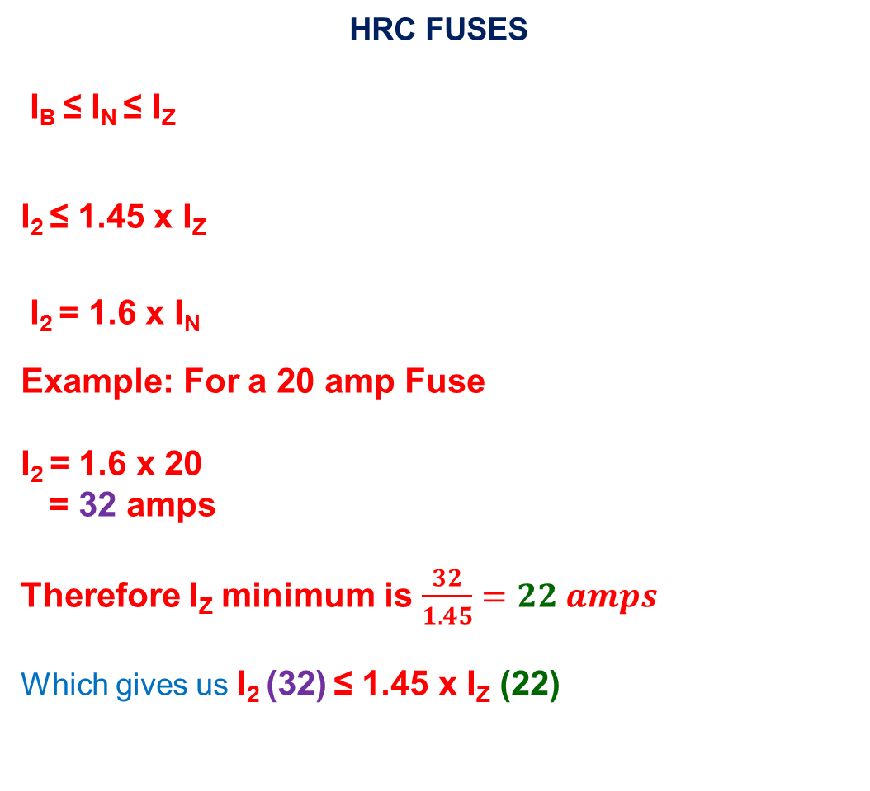
HRC FUSES
I_{B} ≤ I_{N} ≤ I_{Z}
I₂ ≤ 1.45 x I_{Z}
I₂ = 1.6 x I_{N}
Example: For a 20 amp Fuse
I₂ = 1.6 x 20
= 32 amps
Therefore I_{Z} minimum is $\frac{32}{1.45}=22 amps$
Which gives us I₂ (32) ≤ 1.45 x I_{Z} (22)

Slide 8
Overload condition
I_{line} = I_{phase} = V_{phase =} 230 = 64 A
Z_{phase} 3.6

Slide 9
The figure below shows how a small increase in current above the maximum current carrying capacity will cause a large increase in the operating temperature of the conductor. The increased operating temperature over time will damage the insulation of the conductor. It will take several hours at these over loads for the temperature to reach those shown if figure 4.

Slide 10
If the following equations are true the circuit will operate correctly under normal conditions and the circuit protection will operate in the required time if the circuit is overloaded.
I_{B} ≤ I_{N} ≤ I_{Z}
where
I_{B} = the maximum demand of the circuit
I_{N} = the current rating of the circuit protection device (fuse or C.B.) i
I_{Z} = the current rating of the conductor after all applicable de- ratings have been applied.
and
I₂ ≤ 1.45 x I_{Z}
where
I₂ = the current ensuring effective operation of the protective device (causes protection device to operate in 1 hour (3600 seconds))
= 1.45 x I_{N} for Circuit Breakers.
= 1.6 x I_{N} for H.R.C. fuses.
I_{Z} = the current rating of the conductor after all applicable de-ratings have been applied.

Slide 11
As the thermal trip mechanism of a circuit breaker has a similar heating characteristic to that of the cable it protects, 100% of the cables current rating can be used. The statement I₂ ≤ 1.45 x IZ will always be true if IB ≤ IN ≤ IZ is true.
If a cable is protected by a H.R.C. fuse the cable must be de-rated by a factor of 0.9. The statement I₂ ≤ 1.45 x IZ will always be true if;
IB ≤ IN ≤ IZ x 0.9

Slide 12
Activity – 3 – Overload operation
1. Calculate the Line current (I_{L}) for the circuit shown in figure 3.
2. Calculate the multiple of the C32A C.B. rating.
3. Is I_{B} ≤ I_{N} ≤ I_{Z} (64 ≤ 32 ≤ 34)
4. Draw on figure 2 a line to show the multiple of rated current. Will the circuit breaker operate (trip), if so in what time? | Max Min
64 A
2
N
120
(seconds)
Yes
30
(seconds)
Assume the cable is 4 mm² x 60 m V90 T&E in air; I_{Z} = 34 A (T10C5)

Slide 13
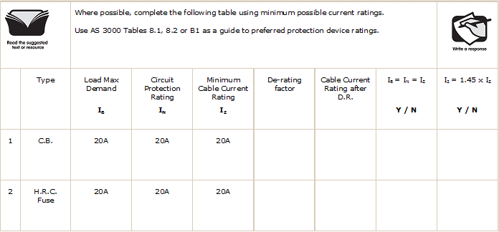
Activity 4 – Overload protection
Nil
20 A
Yes
Yes
0.9
18 A
No
No

Slide 14
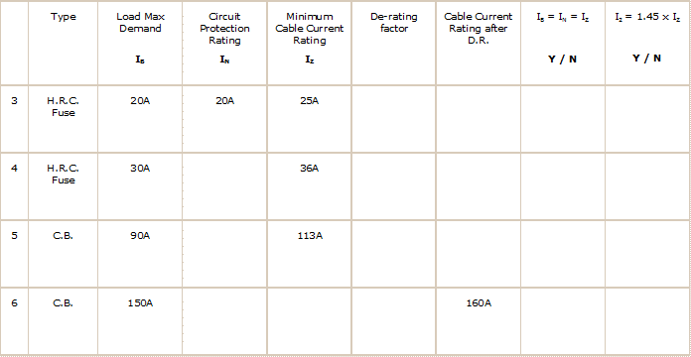
Activity 4 – Overload protection (con’t)
0.9
22.5 A
Yes
Yes
32 A
0.9
32.4 A
Yes
Yes
100 A
113 A
Yes
Yes
160 A
160 A
Yes
Yes

Slide 15
Activity 4 – Overload protection (con’t)
 | Type | Load Max Demand I_{B} | Circuit Protection Rating I_{N} | Minimum Cable Current Rating I_{Z} | De-rating factor | Cable Current Rating after D.R. | I_{B} ≤ I_{N} ≤ I_{Z} Y / N | I₂ ≤ 1.45 x I_{Z} Y / N
7 | C.B. | 250A |  |  |  | 250A
8 | H.R.C. Fuse | 250A | 250A |  |  | 250A
9 | C.B. | 375A | 400A
10 | H.R.C. Fuse | 375A | 400A
250 A
250 A
Yes
Yes
278 A
0.9
Yes
Yes
400 A
Yes
Yes
444 A
0.9
400 A
Yes
Yes

Slide 16
Short Circuit Hazards
The figure shows a circuit condition known as a bolted symmetrical
fault.
The impedance of the fault is considered to be negligible. The only
impedance remaining to limit the circuit current is the impedance
of the cable.
The circuit protection device either circuit breaker or H.R.C. fuse
must be capable of breaking this prospective short circuit current
without damage to either the cables or the protection device itself.

Slide 17
Effects of Prospective Short Circuit Current
An un-interrupted prospective short circuit current will result in catastrophic failure and destruction of the installation, usually resulting in fire. Hazards associated with short circuit conditions include:
extremely large currents
cables reaching very high temperatures
insulation failure
destruction of protection devices
ionisation of enclosures
severe magnetic stresses on conductors and supports
fatal injury to persons and livestock
fire and explosion (Arc blasts).

Slide 18
Activity 5 – Short circuit condition
1. Calculate the Line current (I_{L}) for the circuit shown in figure 6.
2. Calculate the multiple of the C32A C.B. rating.
3. Is I_{B} ≤ I_{N} ≤ I_{Z}
4. Draw on figure 7 a line to show the multiple of rated current. Will the circuit breaker operate (trip), if so in what time? Y / N | Max ______ Min ______
470 A
15
No
0.014 s
0.0025 s

Slide 19
Calculation of Prospective Short Circuit Current
The supply authority will give you information required to calculate the prospective short circuit current at the point of supply (their end of your consumer’s mains).
This information will either be:-
as a prospective short circuit current, in kA or
as an impedance per phase, in ohms or
as a fault level, in MVA (mega volt amperes) or
as an impedance percent (Z%), (similar to voltage regulation percent in a transformer) normally at the secondary of a transformer where the installation is fed from its own substation.

Slide 20

Activity – 6 – NSW Service rules requirements
Read N.S.W.S.R. clause 1.17.4
1. List the nominal prospective short circuit current at the point of supply for services up to 400A in the following locations.
a) Suburban residential areas
b) Commercial and industrial areas
c) Installations on railway land supplied by RailCorp
10 kA
25 kA
6 kA

Slide 21
Once the prospective short circuit current is known ohms law is used
to calculate the impedance per phase of the supply;
where
Z_{p} = the phase impedance in ohms (Ω)
V_{p} = the phase voltage in volts (V)
I_{p} = the phase current in amperes (A)

Slide 22
Activity – 7 – Supply impedance
1. Calculate nominal impedance per phase of the supply system at the point of supply for services up to 400A in the following locations.
a) Suburban residential areas
b) Commercial and industrial areas
c) Installations on railway land supplied by RailCorp
0.023 Ω
0.0092 Ω
0.0383 Ω

Slide 23
Activity 8 – line current under normal conditions
1. Calculate maximum rated line current (I_{L}) for a 500kVA 400V supply authority distribution transformer.

Slide 24
Activity 8 – line current under normal conditions
1. Calculate maximum rated line current (I_{L}) for a 500kVA 400V supply authority distribution transformer.
= 500 000 √3 x 400 = 722 A

Slide 25
where
MVA = the Fault Level (Apparent power) in Mega Volt Amps (MVA)
V_{L} = the line voltage in volts (V)
I_{S/C} =the prospective short circuit current (line current)
in amperes (A)

Slide 26
Activity 9 – Prospective short circuit current
1. Calculate the prospective short circuit current for a 500kVA 400V supply authority distribution transformer with a fault level of 10MVA.

Slide 27
Activity 9 – Prospective short circuit current
1. Calculate the prospective short circuit current for a 500kVA 400V supply authority distribution transformer with a fault level of 10MVA.
= 10 x 10⁶ √3 x 400 = 14.4 kA

Slide 28
The prospective short circuit current can be calculated
using the equation:
where
I_{S/C} = the prospective short circuit current (line current) in amperes
kVA = the maximum rated output (Apparent) power in kilo Volt Amps
V_{L} = the line voltage in volts (V)

Slide 29
ACTIVITY 10 – Prospective short circuit current
1. Calculate the prospective short circuit current for a 500kVA 400V supply authority distribution transformer with percentage impedance of 5%.

Slide 30
ACTIVITY 10 – Prospective short circuit current
1. Calculate the prospective short circuit current for a 500kVA 400V supply authority distribution transformer with percentage impedance of 5%.
= 100 x 500 x 10³ 5 x √3 x 400 = 14.4 kA

Slide 31
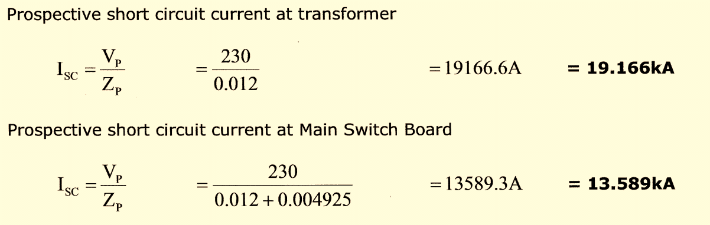
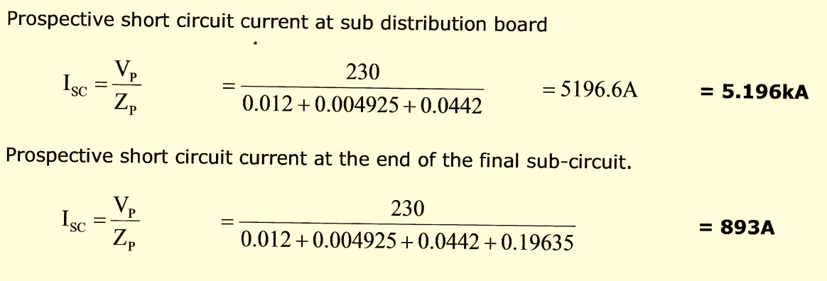

Slide 32
The worked example above shows how as the prospective short circuit (P.S.C.) decreases as the location at which the fault occurs moves away from the supply transformer. The greater the distance from the supply transformer, the higher the impedance of the cable and the lower the prospective short circuit current that can flow at that location.
When selecting short circuit protection devices, the devices breaking capacity or “kA” rating, must be higher than the prospective short circuit current; otherwise the device may not be able to interrupt the fault or may be damaged in the process.

Slide 33
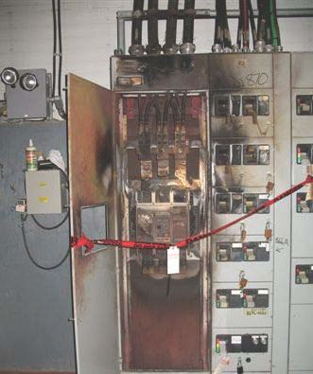
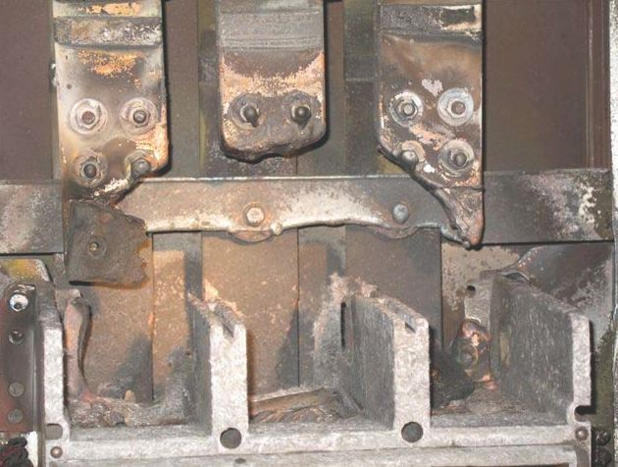
Example of a protective device with a breaking capacity lower than the prospective short circuit current

Slide 34
Activity 11 – Selection of
device
1. Calculate the impedance of the supply at the point of supply shown in figure 10.
2. Calculate the impedance of the active conductor of the consumers mains in figure 10 using table 35 of AS3008.1.1 (use 90⁰C temperature)
3. Calculate the prospective fault current at the Service protection device.
Z_{S} = 230/10 kA
= 0.023 Ω
Z_{ACT} = (1.47 x 20)/1000 (t35)
= 0.0294 Ω
I_{SC} = 230/(0.023 + 0.029)
= 4.4 kA

Slide 35
Fault Current Limiters
A Fault Current Limiter (F.C.L.) is a device which limits the prospective
fault current when a fault occurs. A suitably rated H.R.C. fuse or fault
current limiting circuit breaker is placed “upstream” in series with protection
devices which have a lower fault current breaking capacity than the F.C.L.
This allows the downstream protection devices to be physically smaller and
cheaper.
The fault current limiter protects the downstream protection devices by
operating before the fault current rises above a value that may damage
the downstream device. The fault current that flows until the F.C.L.
operates is known as “let through”, this is shown in figure 11.
The downstream devices must be capable of interrupting the let through
current of the upstream device.

Slide 37

Activity 12 – Selection of devices
 | Use figure 12 to determine;
1. The minimum breaking capacity of a M.C.B protected against a 10kA P.S.C. by a 160A H.R.C. fuse |  | 9kA
2. The minimum breaking capacity of a M.C.B protected against a 25kA P.S.C. by a 160A H.R.C. fuse |  | 12kA

Slide 38
I²t Charts /Curves
Clause 2.5.4.5 of AS3000 states that the energy let through by the circuit protection device must be less than the heat energy required by the cable to raise its insulation temperature to values set by AS3008.1.1 clause 5.5.2. (Table 53).
160⁰C for V75 and V90 insulated cables.
250⁰C for XLPE (X90) insulated cables.
To simplify the equations a series of constants have been assigned to commonly used cable insulation types in table 52 of AS3008.1.1
111 - to raise the insulation from a maximum normal use temperature of 75⁰C to 160⁰C (V75 and V90).
143 - to raise the insulation from a maximum normal use temperature of 90⁰C to 250⁰C (X90).

Slide 39
The time required for the short circuit current to heat the cable to cause the
insulation to rise from maximum normal use temperature to the maximum
permissible is calculated by the equation;
where
t = time duration in seconds
K = the constant value obtained from standards (111 for copper V90)
S = the cross sectional area of the conductor in mm².
I = the short-circuit current in amps (r.m.s)
The circuit protection device must operate in less time than calculated above

Slide 40
Activity 13 - AS3000 requirements- Protection against short circuit current
Read AS 3000 clause 2.5.4.5
Calculate the time required for the short circuit current to heat the cable to cause the insulation to rise from maximum normal use temperature to the maximum permissible for the following copper cables.
1. 1.5 mm² V75 I_{SC} = 1.5kA
2. 2.5 mm² V90 I_{SC} = 1.5kA
3. 16 mm² X90 I_{SC} = 8kA
4. 120 mm² X90 I_{SC} = 35kA
t = 111² x 1.5² = 0.0123 s
1500²
t = 111² x 2.5² = 0.0342 s
1500²
t = 143² x 16² = 0.0818 s
8000²
t = 143² x 120² = 0.24 s
35000²

Slide 41
Protection against indirect contact
The current path flows from the active conductors to the fault,
returning via the protective earthing conductors to the M.E.N. connection,
then along the neutral conductors to the supply. The circuit is no longer
balanced, so the impedances of the serial connected neutral and
protective earth conductors must be included (earth fault loop impedance).
The resulting current flow will be much lower than that of a short circuit
in the same cable. The lower current flow will increase the time the circuit
protection device takes to operate. During the time the circuit protection
takes to operate a touch voltage will be present between the earth
electrode and the exposed conductive parts connected to that protective
earthing conductor.

Slide 42
Activity 14 – Earth fault condition
1. Calculate the short to earth fault current (I_{L}) for the circuit shown in figure 16.
2. Calculate the multiple of the C32A C.B. rating.
3. Is I_{B} ≤ I_{N} ≤ I_{Z}
4. Draw on figure 17 a line to show the multiple of rated current. Will the circuit breaker operate (trip), if so in what time? Y / N | Max Min
I_{S/C} = 230/0.3366 +0.54066+0.153 = 224 A
224/32 = 7
32≤32≤34 T10C5
Y
2 s
0.01 s

Slide 43
Activity 15 - AS3000 requirements - Fault Protection
Read AS 3000 clause 2.4.1
1. List 3 recognized methods of fault methods of fault protection.
Automatic disconnection of supply
Use of Class II equipment
Electrical separation

Slide 44
Activity 16 - AS3000 requirements - Fault Protection
Read AS 3000 clause 2.4.2
1. How is protection by automatic disconnection of supply achieved? | a) b)
Provision of a system of earthing in which exposed conductive parts are connected to the PE
Disconnection of the fault by an overcurrent protective device or RCD

Slide 45
Activity 17 - AS3000 requirements - Fault Protection
Read AS 3000 clause 2.4.3
1. May a device that is capable of automatic reclosing be used as a device to provide automatic disconnection of supply?
2. List 5 devices suitable to provide automatic disconnection of supply. | a) b) c) d) e)
N
HRC fuses
MCB’s
Moulded case C/B’s
RCD’s
Devices with no auto
reclosure

Slide 46
Activity 18 - AS3000 requirements - Protection against over current (over load)
Read AS 3000 clause 2.5.1
1. May a H.R.C. fuse be placed in a neutral conductor to protect against overload?
2. Under what conditions may a circuit breaker be placed in a neutral conductor to protect against overload?
N
The C/B must switch both the active and neutral

Slide 47
Activity 19 - AS3000 requirements - Unprotected consumer’s mains
Read AS 3000 clause 2.5.1.1
1. What is meant by unprotected consumer’s mains?
The mains are not double insulated.
The service fuse is mounted on the main switchboard

Slide 48
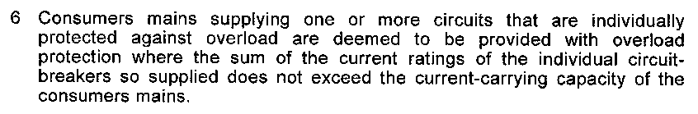
Activity 20 - AS3000 requirements - Unprotected consumer’s mains (over load)
AS 3000 clause 2.5.1.1 (note 6)
Nearly all installations do not satisfy this requirement. The simple solution to provide overload protection of the consumer’s mains is to upgrade the installations main isolation switch to a circuit breaker.

Slide 49
Activity 21 - AS3000 requirements - Protection against over current (over load)
Read AS 3000 clause 2.5.1.2
1. At what point should over current devices be placed to protect sub-mains and final sub-circuits?
At the origin of the circuit and at each point where a reduction in CCC occurs

Slide 50
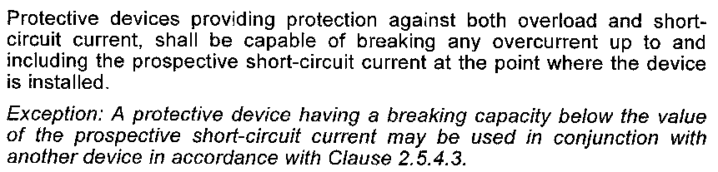
Activity 22 - AS3000 requirements - Protection against over current (over load)
Read AS 3000 clause 2.5.2

Slide 51
Activity 23 - AS3000 requirements - Protection against over current (over load)
Read AS 3000 clause 2.5.3.3
1. In a switchboard the section of cable between the main switch and each circuit protection device is not protected against overload. Why is this permitted?
As long as the cable has a CCC higher
than the sum of the circuit breakers it
supplies

Slide 52
Activity 24 - AS3000 requirements - Protection against short circuit current
Read AS 3000 clause 2.5.4.1
1. List 2 methods of determining the prospective short circuit current in an installation?
Calculation or measurement

Slide 53
Activity 25 - AS3000 requirements - Protection against short circuit current
Read AS 3000 clause 2.5.4.4
1. Under what conditions may consumer’s mains not be provided with short circuit protection?
Clause 3.9.7.1.2
Be constructed in such a manner to reduce the risk of short circuit (double insulated)

